Slide 2
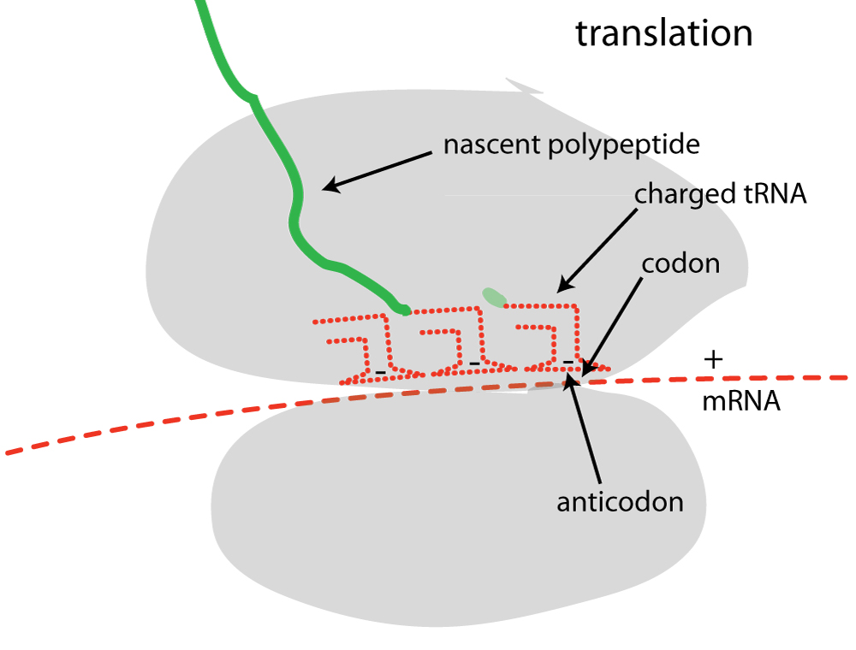

Slide 3
The Translation System
amino acids 20 of them
tRNAs 20 of them
Aminoacyl tRNA synthetases (aaRS’s)
20 of them
covalently link amino
acids to tRNAs
establish the genetic code
Ribosomes - MolWt>10⁶
ribosomal proteins
ribosomal RNA
decode mRNA
peptidyl transfer

Slide 4
Aminoacyl-tRNA Synthetases
Charge tRNAs (link them to amino acids)
Step 1: Activate the Amino Acid.
amino acid + ATP → aminoacyl-AMP + PPi
An activated amino acid = amino-acyl adenylate = aminoacyl-AMP
Step 2: Transfer the activated amino acid to the tRNA
aminoacyl-AMP + tRNA → aminoacyl-tRNA + AMP
Step 1 + 2:
amino acid + tRNA + ATP → aminoacyl-tRNA + AMP + Ppi

Slide 5
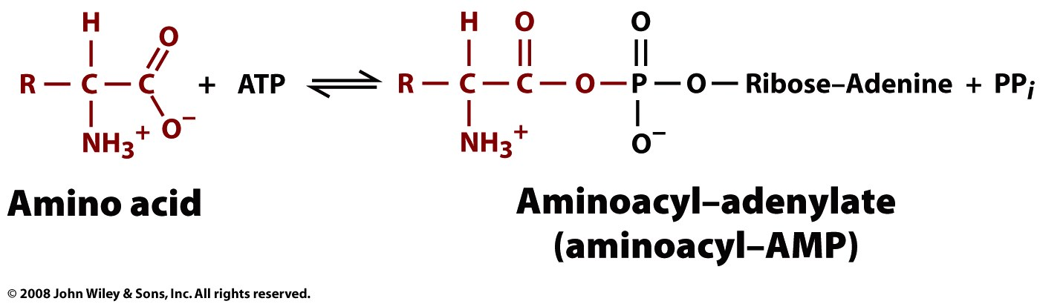
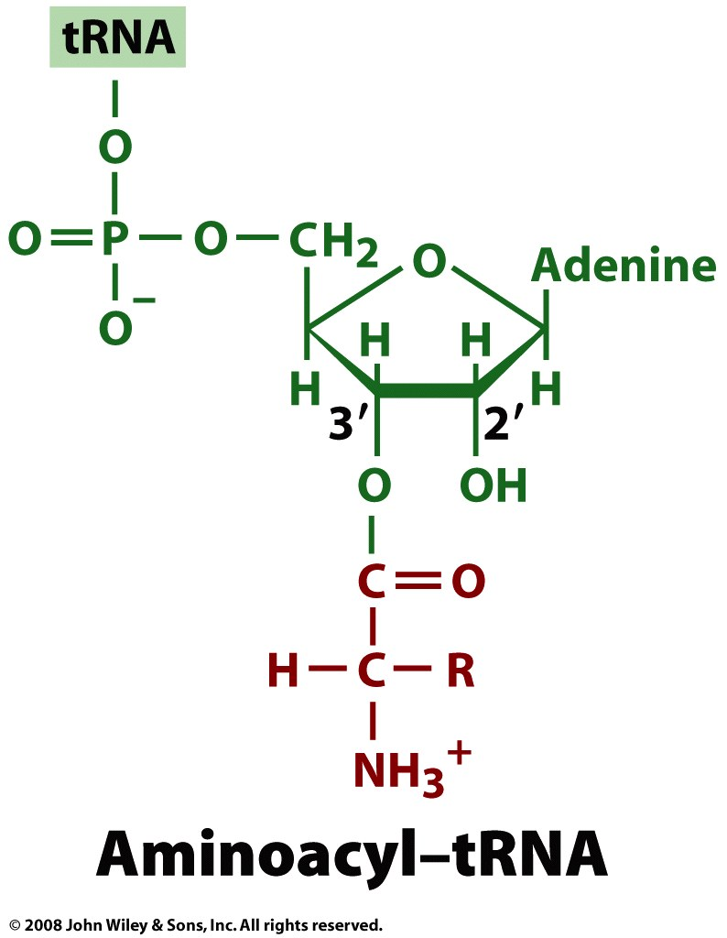
Aminoacyl-tRNA Synthetases
Figure 27-6

Slide 6
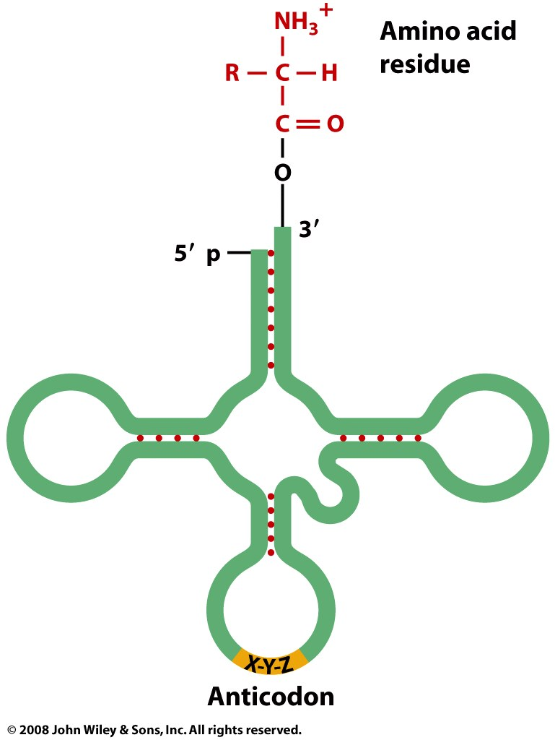
A “charged” tRNA, with an amino acid ester on the 3’ terminus.
Figure 27-1

Slide 7
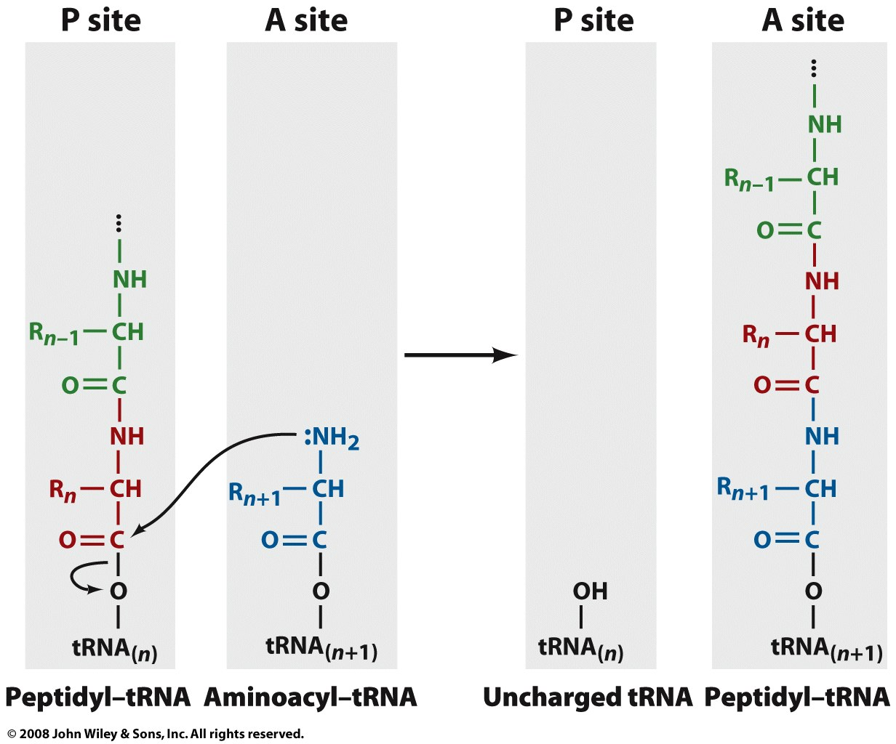
The Ribosome: The peptidyl transfer reaction

Slide 8
“…among the ~60 proteins that are represented by an ortholog in every single cellular life form with a sequenced genome, over 50 are components of the translation machinery”
Wolf YI & Koonin EV (2007) On the Origin of the Translation System and the Genetic Code in the RNA World by Means of Natural Selection, Exaptation, and Subfunctionalization. Biol Direct 2:14.
The translational system is universally conserved and has been essentially invariant since LUCA (3.8 BYA).

Slide 9
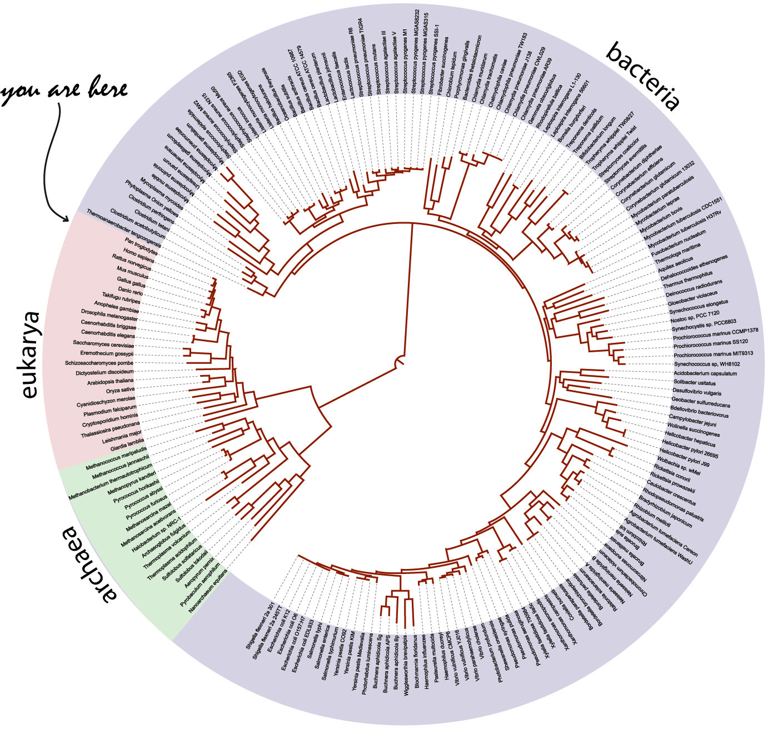

Slide 10
Why is translation so much more complicated that replication and transcription?
Watson & Crick: Direct Templating is simple.

Slide 11
Why is translation so much more complicated that replication and transcription?
Replication and transcription use direct templating. Watson-Crick pairing directs incorporation of G opposite C and U (or T) opposite A (and vice versa).
Translation uses indirect templating [20x(aa+aaRS + tRNA)].
Why? It is not easy to transduce information from polynucleotide to polypeptide. The structures and assembly principles of these two polymers are antithetical.
RNA: anionic backbone, few sidechains of similar structure, assembles by sidechain-sidechain interactions.
Protein: neutral backbone, 20 sidechains of diverse structure, assembles by backbone-backbone interactions.
Antithetical assembly/structure => No Direct Templating.

Slide 12
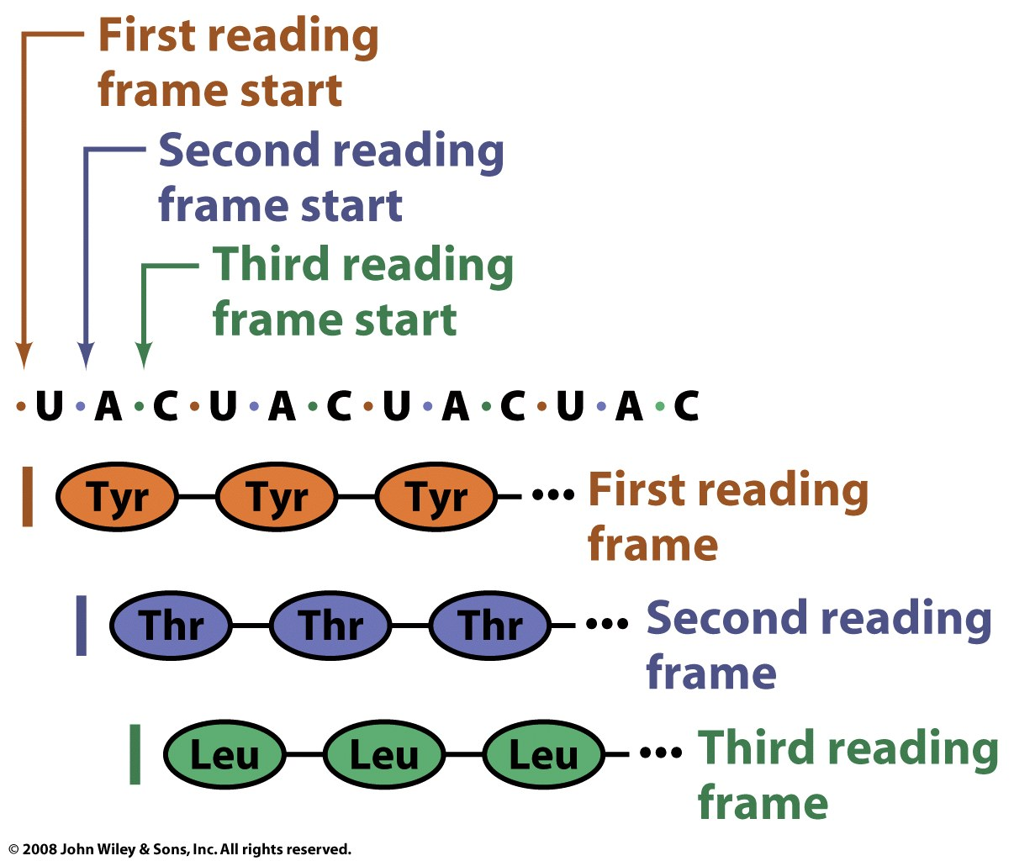
Three possible reading frames
Figure 27-2

Slide 13
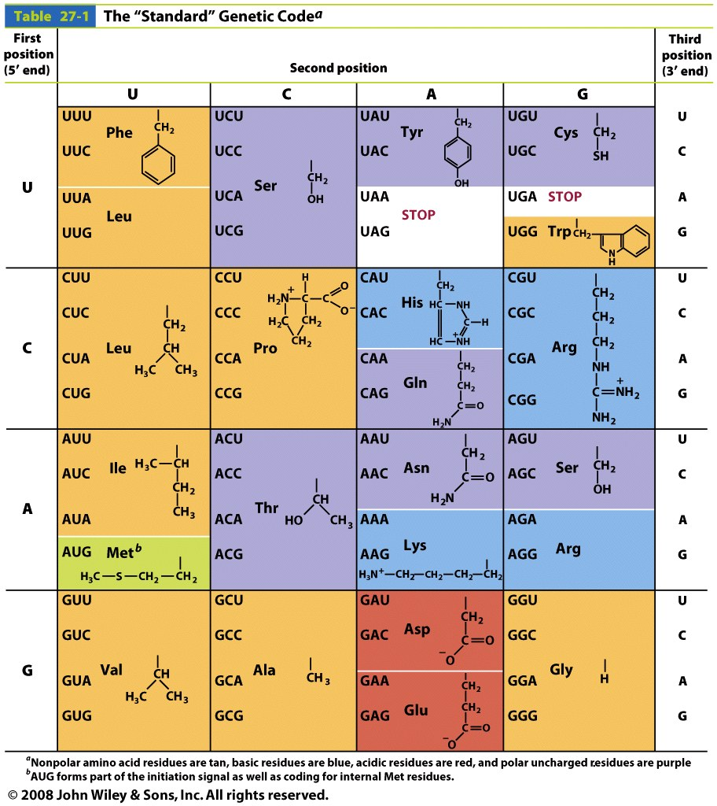
The genetic code is degenerate and non-random
Stop:
UGA UAG UAA

Slide 14
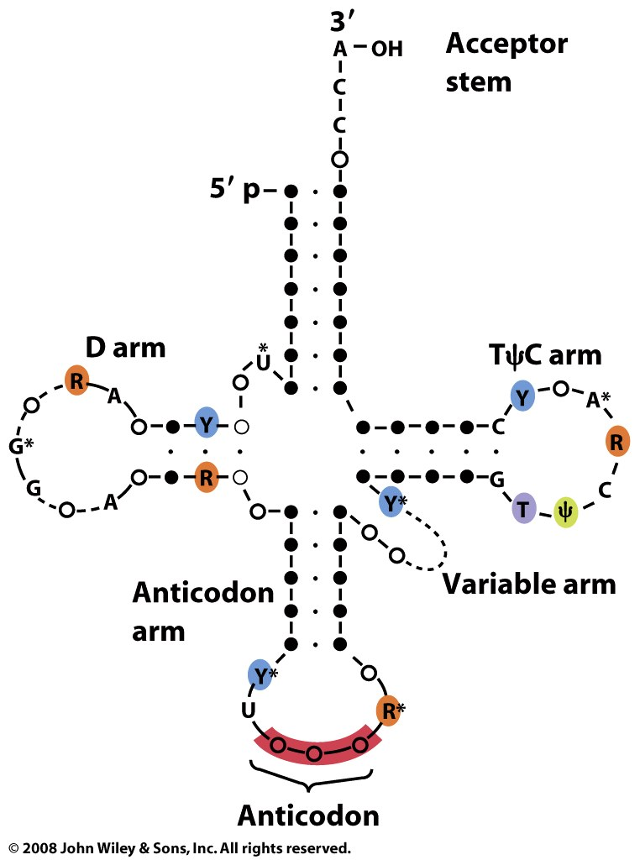
Figure 27-3

Slide 15
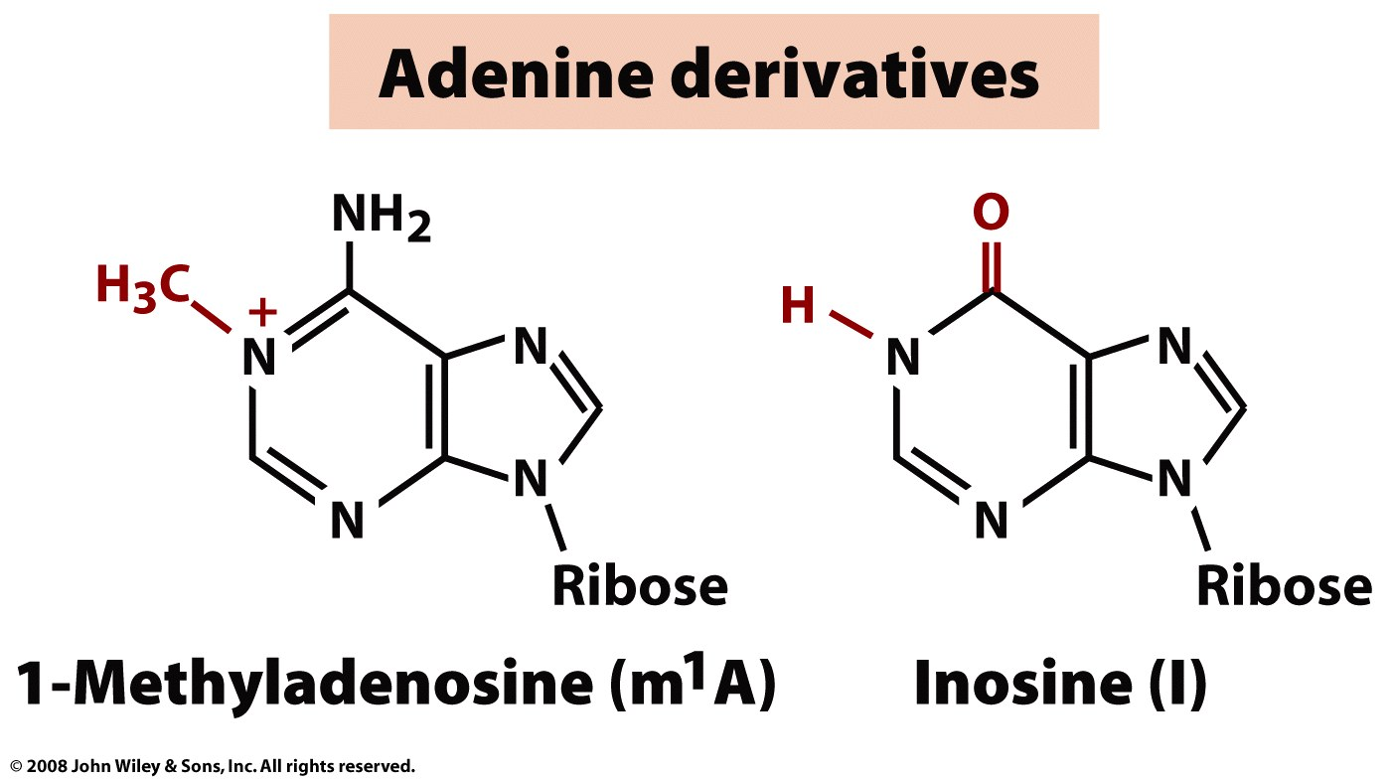
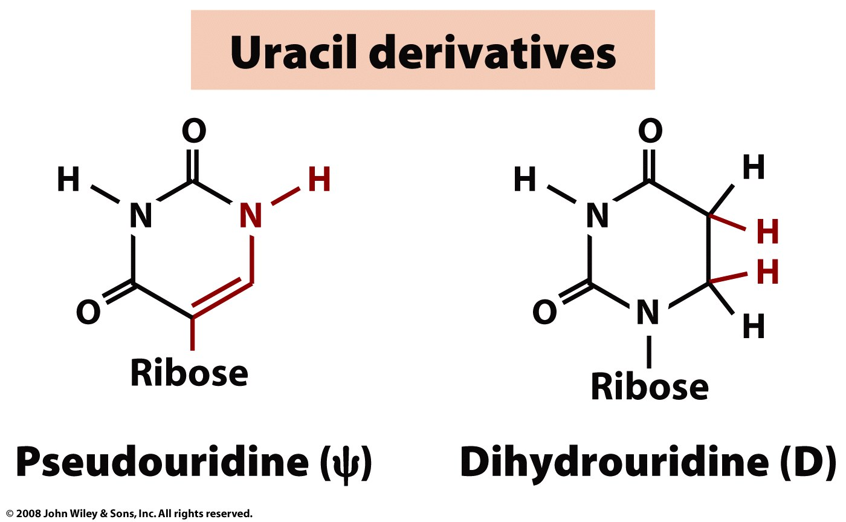
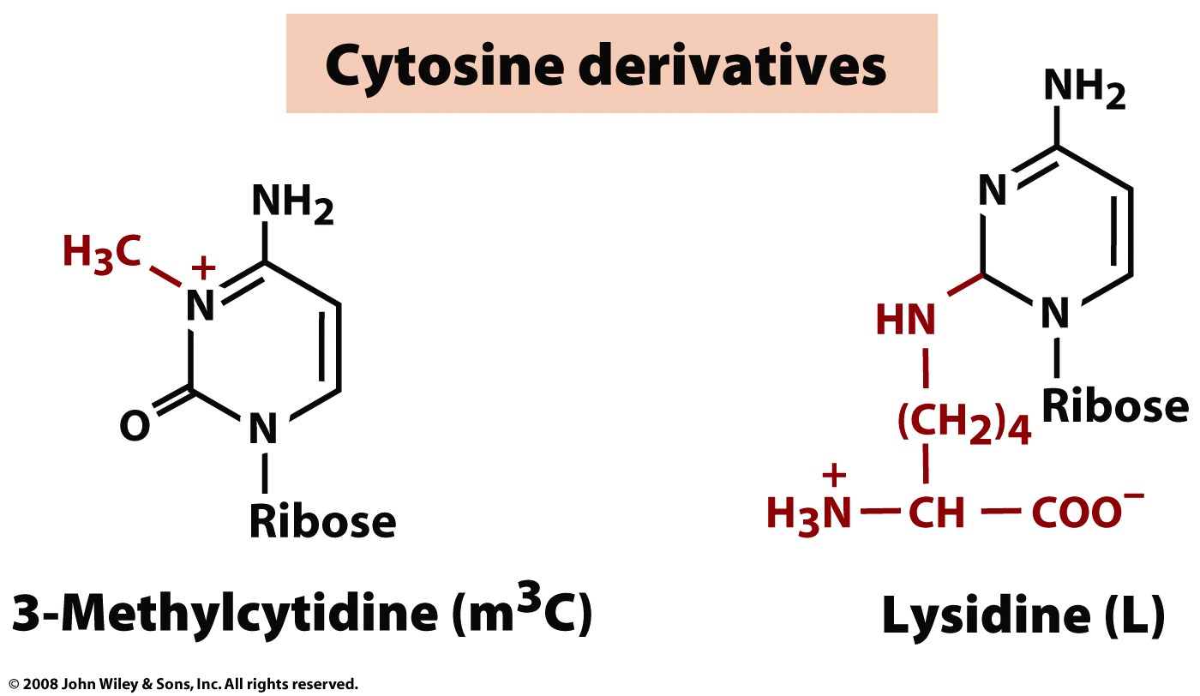
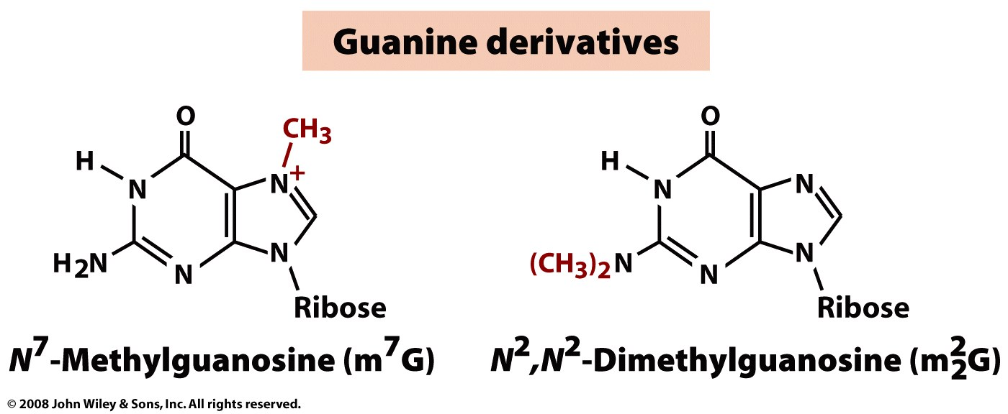
Many bases of tRNA and rRNA are modified

Slide 16
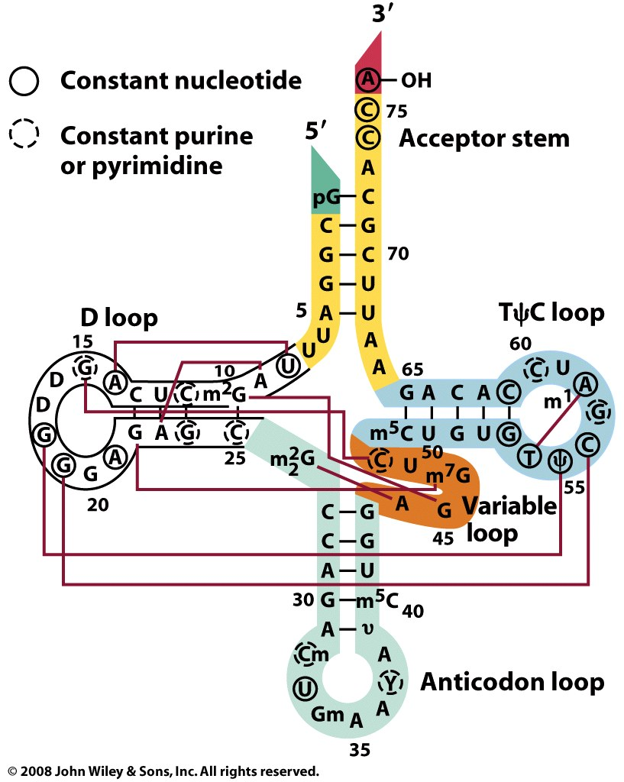
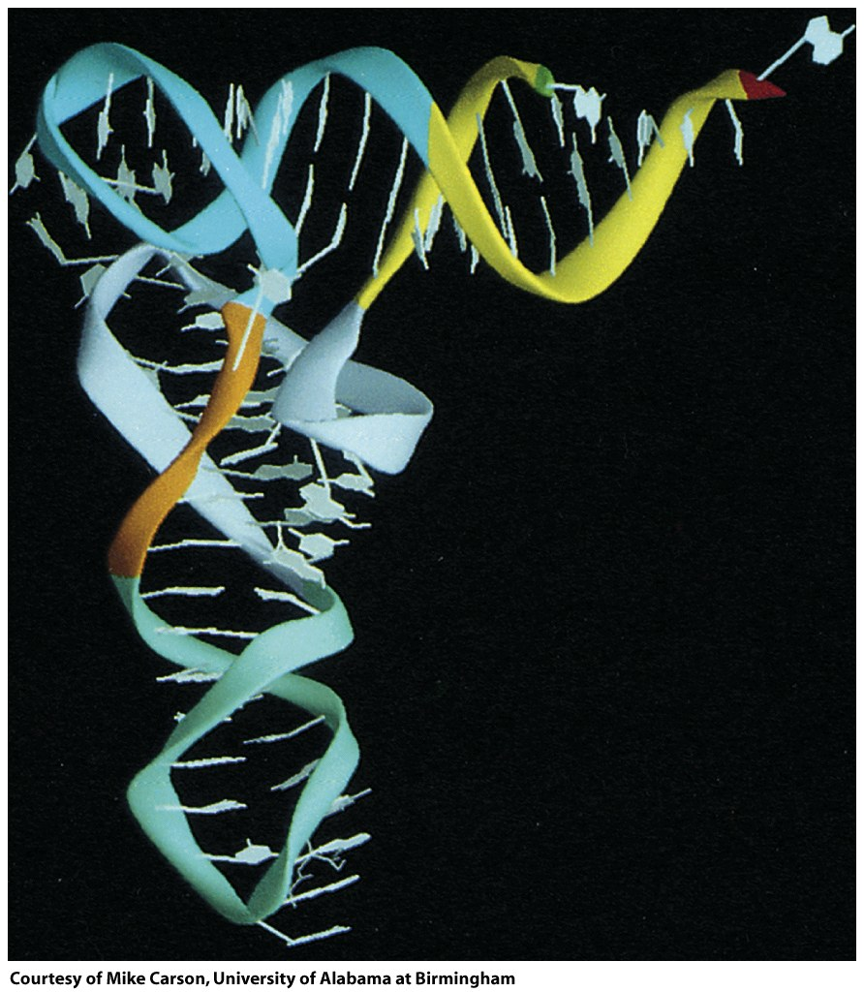

Slide 17
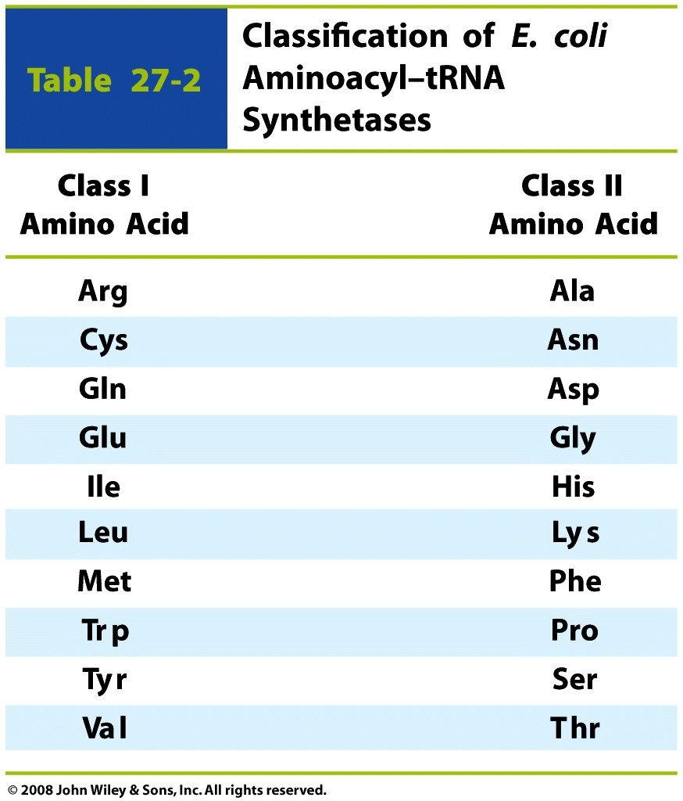
Aminoacyl-tRNA Synthetases
Aminoacyl tRNA synthetases (aaRS's) are enzymes that charge tRNAs. aaRS's catalyze the addition of amino acids to the 3' ends of tRNAs. Each amino acid (except phe) is added to its cognate tRNA (tRNA^{phe}) by the corresponding aaRS (pheRS). For example alaRS adds ala to tRNA^{ala}. The ribosome transfers the correct amino acid from tRNA onto a growing polypeptide according the interaction between the anticodon on the tRNA and codon in the mRNA (the genetic code). There are two classes of aaRS’s

Slide 18
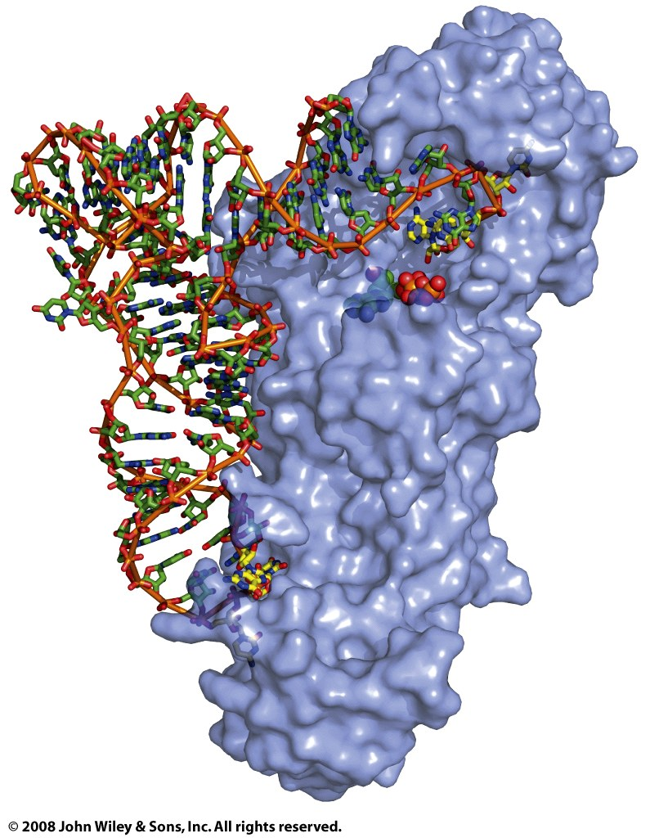
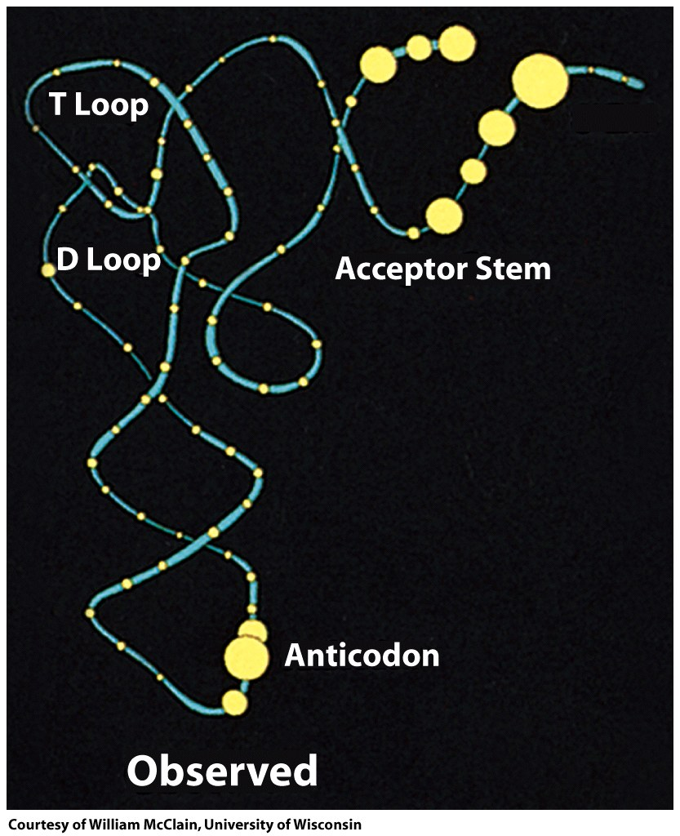
GlnRS bound to tRNA^{Gln} and ATP
In general
Figure 27-7

Slide 19
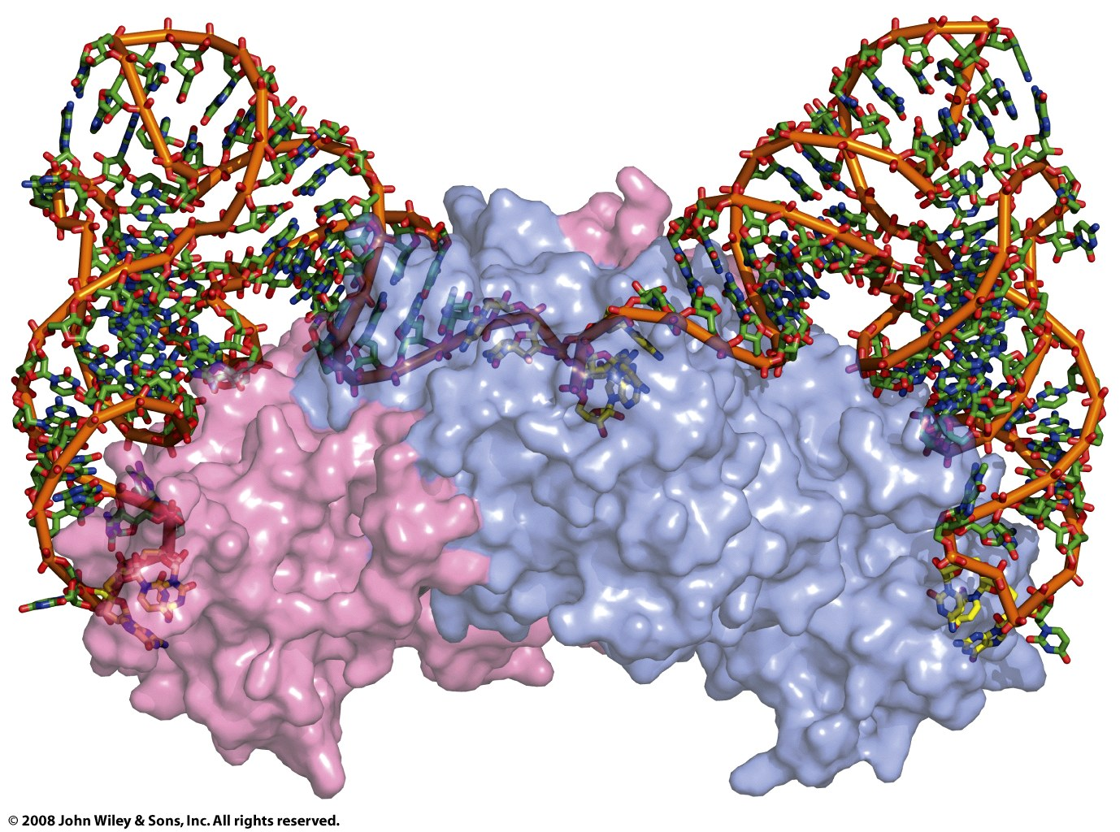
Induced fit
aspRS-tRNA^{asp}
Figure 27-9

Slide 20
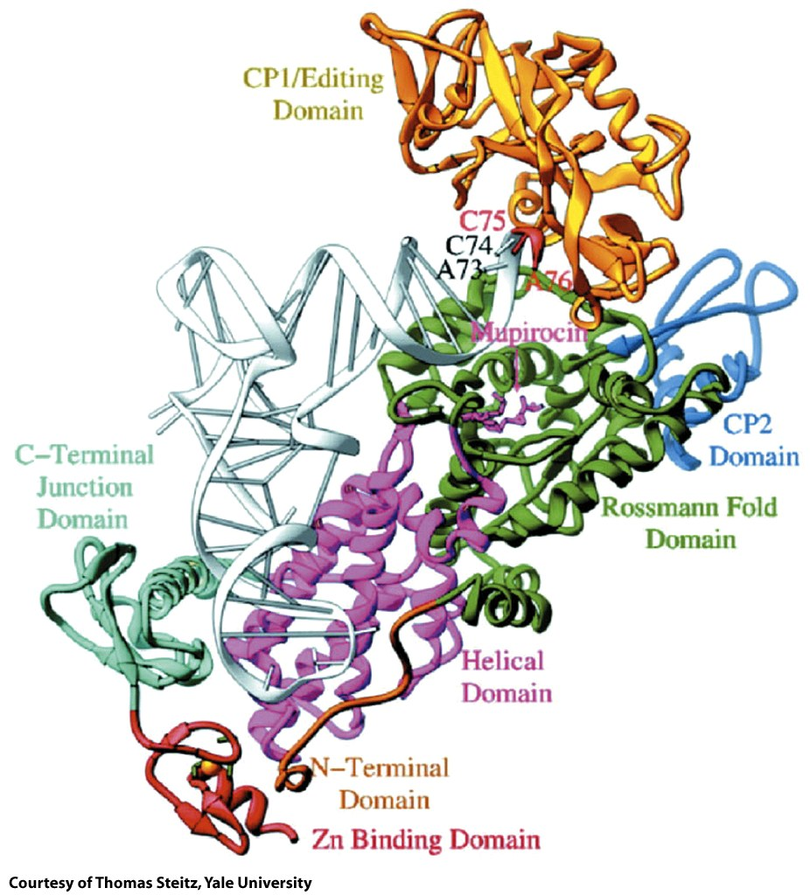
ileRS-tRNA^{ile}
Figure 27-10

Slide 21
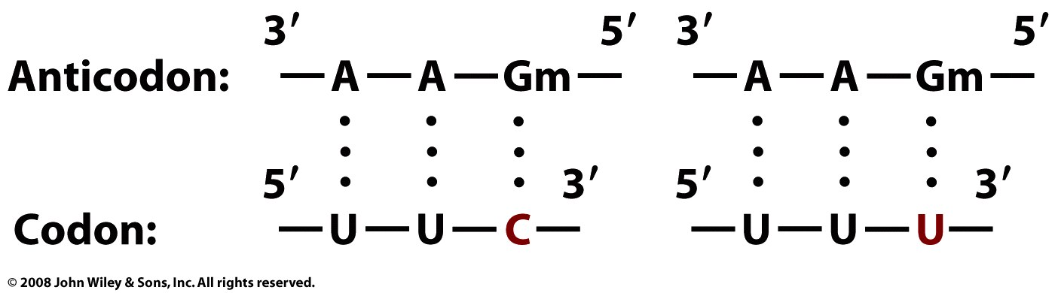
A tRNA can recognize multiple codons (which vary at their 3’ end. The 3rd position of the codon can wobble.
Page 998

Slide 22
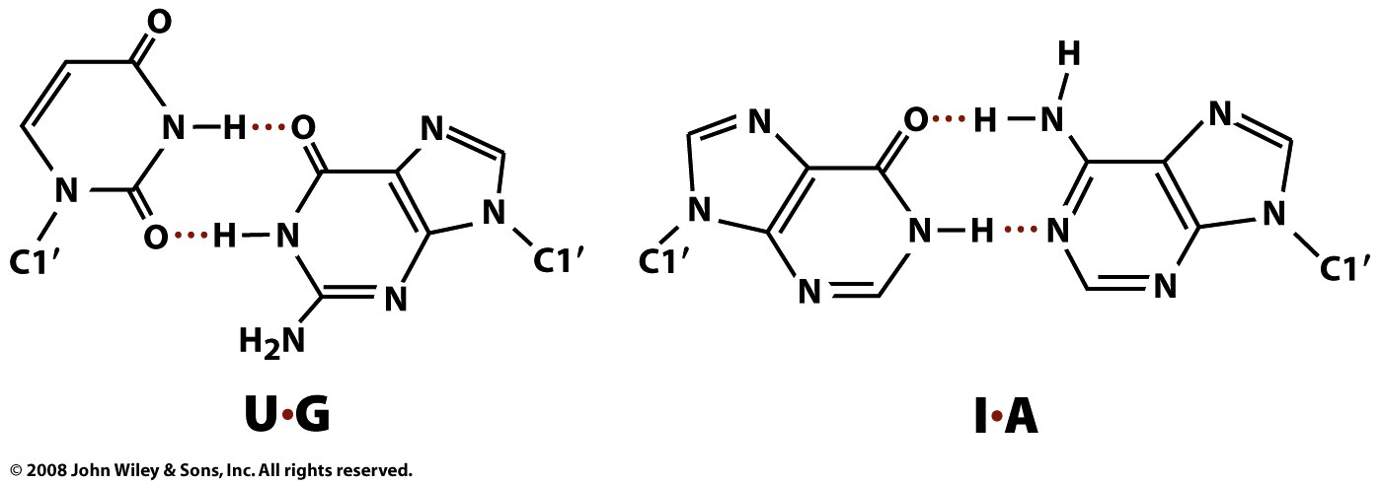
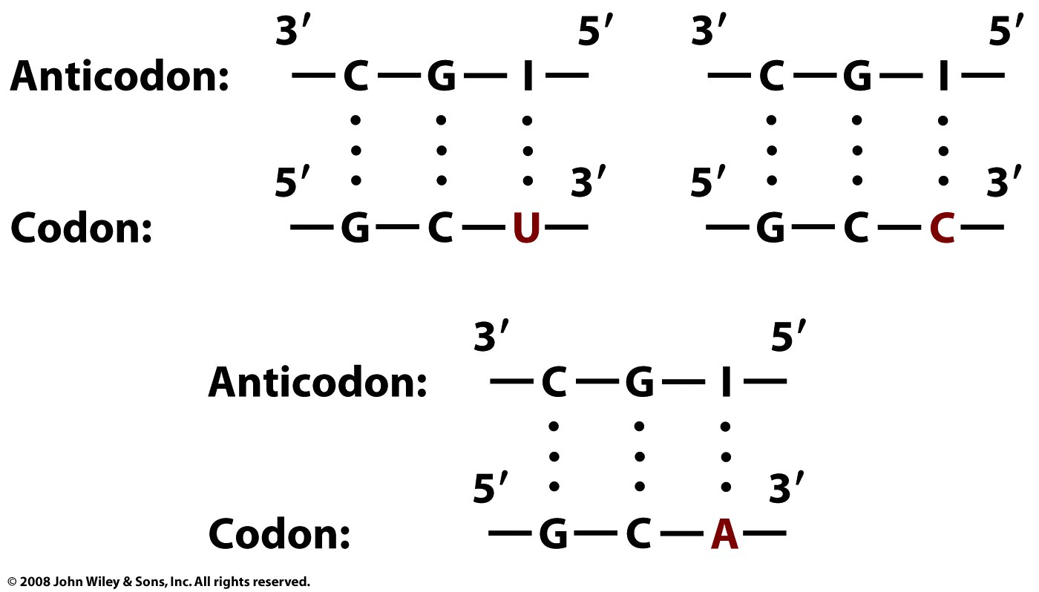
I =inosine

Slide 23
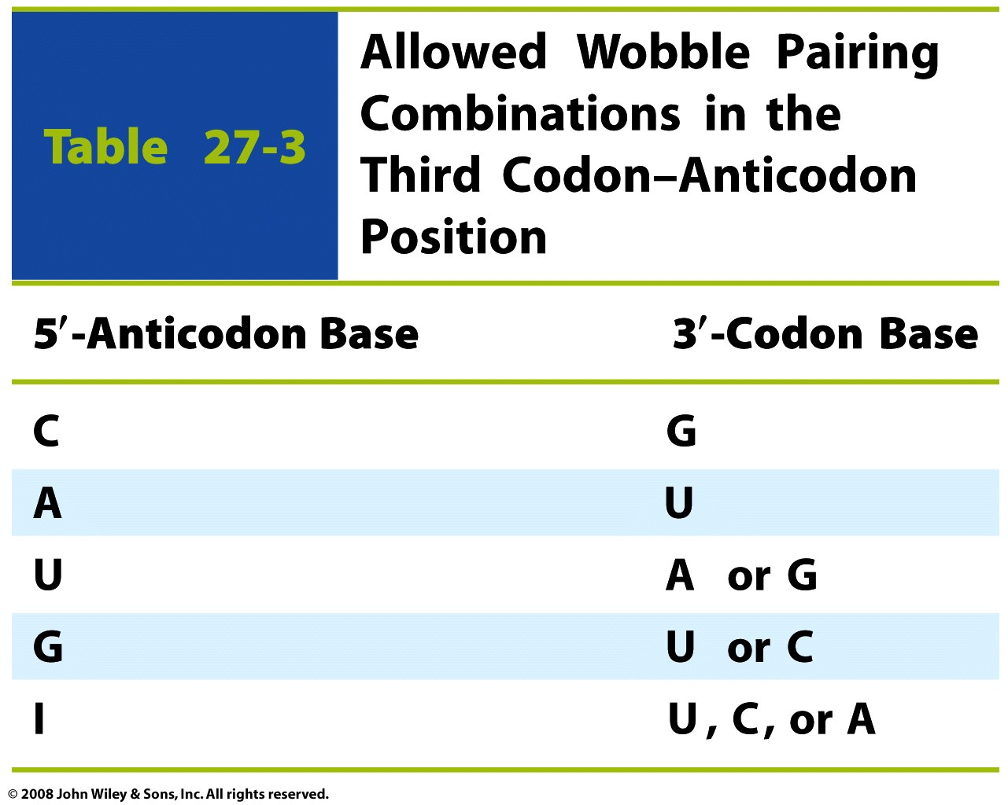
Table 27-3

Slide 24
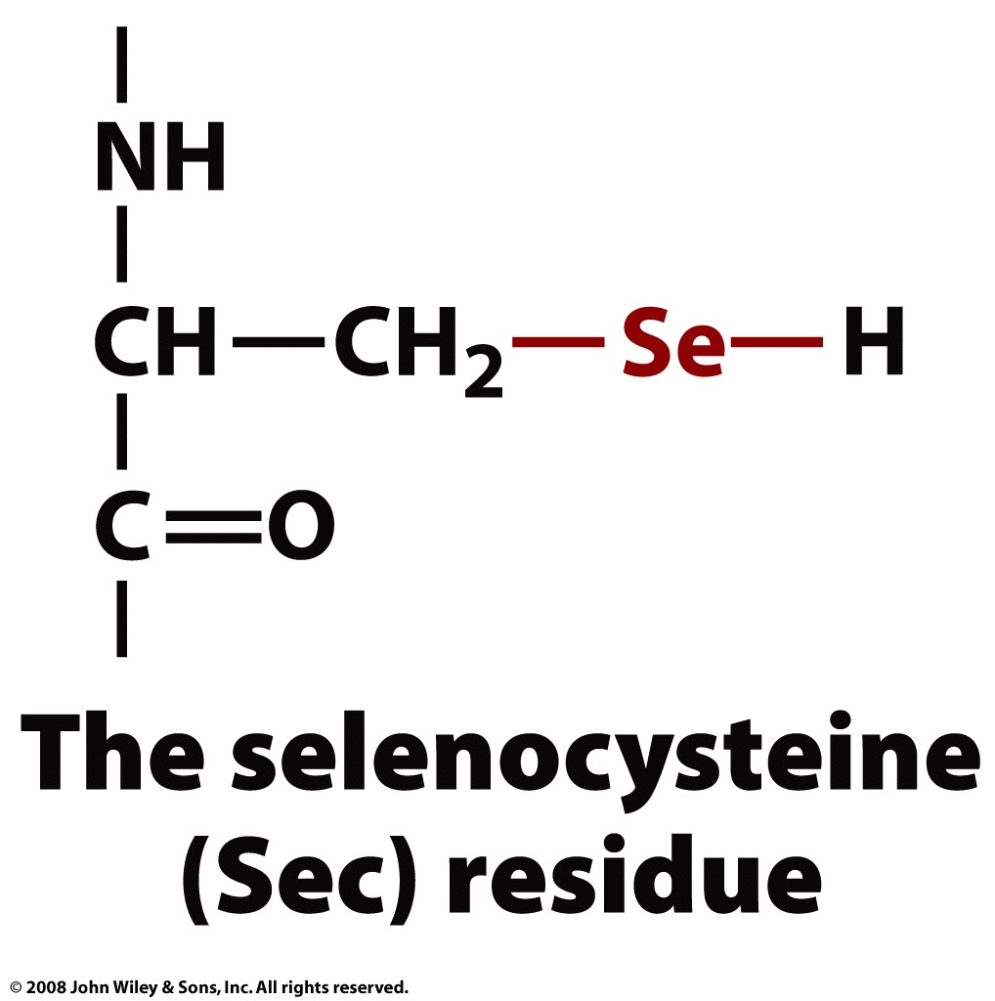
21st amino acid: modification of serine after charging
Box 27-2 figure 1

Slide 25
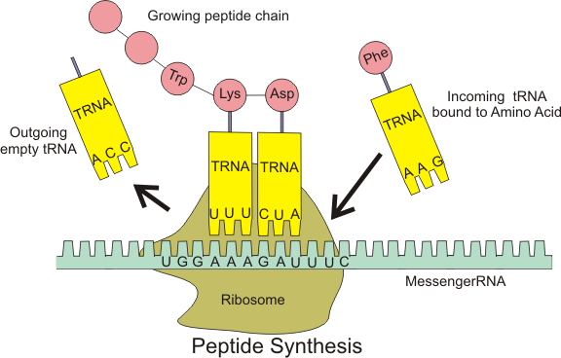
The Ribosome
A ribosome is rRNA-protein assembly that creates all coded proteins. Ribosomes read the information in the mRNA and use it to create coded proteins in a process known as translation. The ribosome translates information contained mRNA into the amino acid sequence of a protein. Ribosomes use mRNA as a template for specifying the sequence of amino acids in a protein. The ribosome translocates mRNA, "reading" its sequence and producing a chain of amino acids of sequence specified by the mRNA according to the genetic code.

Slide 26
A functioning ribosome contains two subunits, which assemble independently and can pretty much ignore each other when not synthesizing protein. The two subunits SSU=30S (in bacteria) and LSU=50S (in bacteria) assemble into an intact ribosome (70S in bacteria) when synthesizing protein. The peptidyl transferase center is in the LSU and the decoding center is in the SSU.
Ribosomal components are often named by their Svedberg (s) values, which are based upon sedimentation rates. Prokaryotic ribosomes are 70S (assembled particles), 30s (SSU) and 50s (LSU).Eukaryotic ribosomes are 80S (assembled particle), 40s (SSU) and 60s (LSU) subunits.

Slide 27
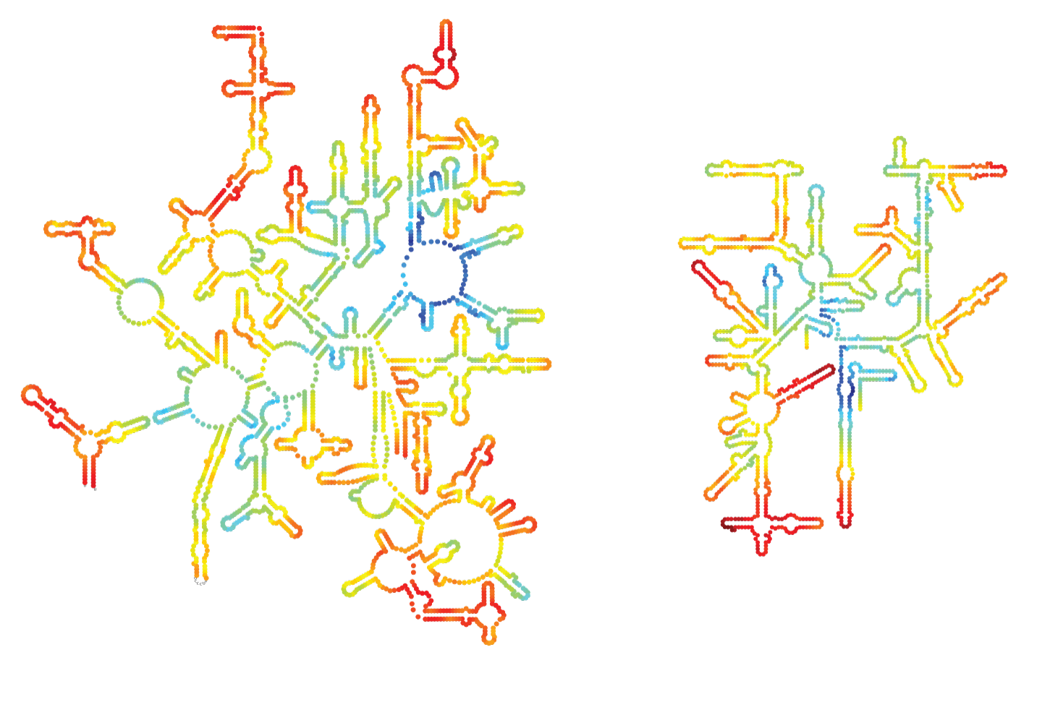
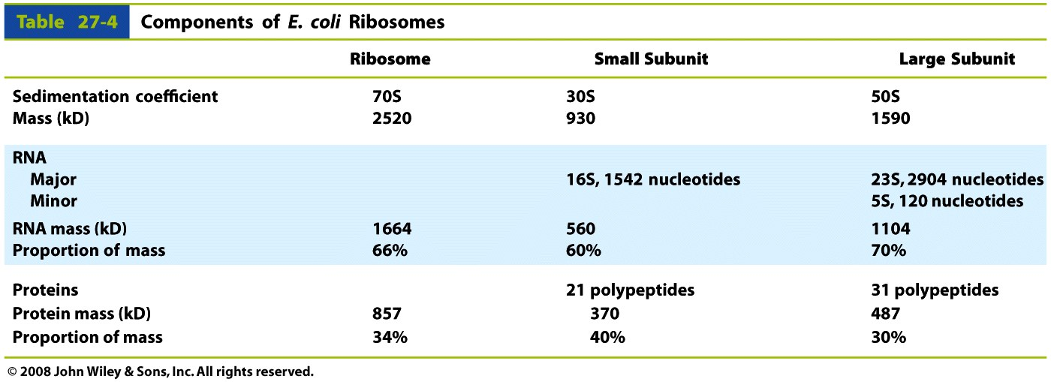
Bacterial Ribosome
Bacterial rRNAs
23S
16S
5S
LSU
SSU

Slide 28
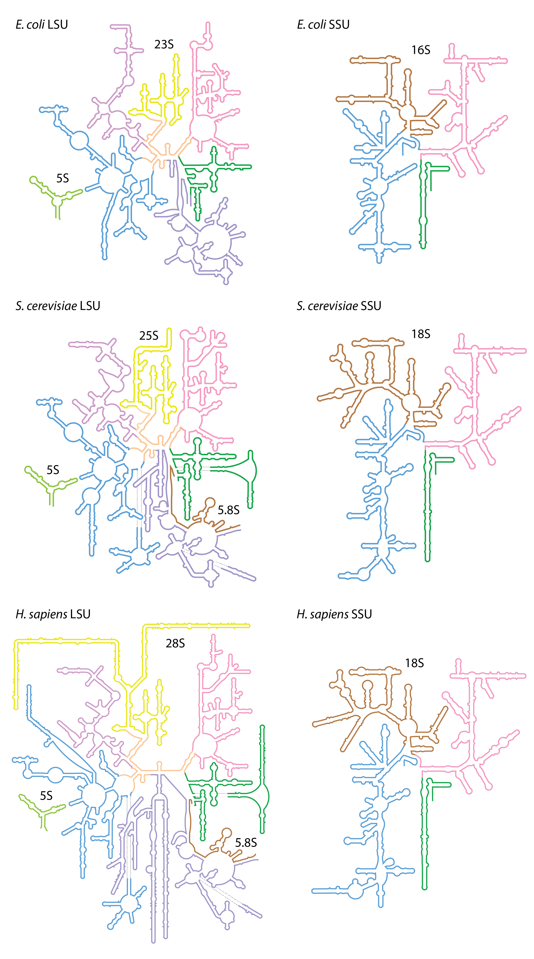

Slide 29
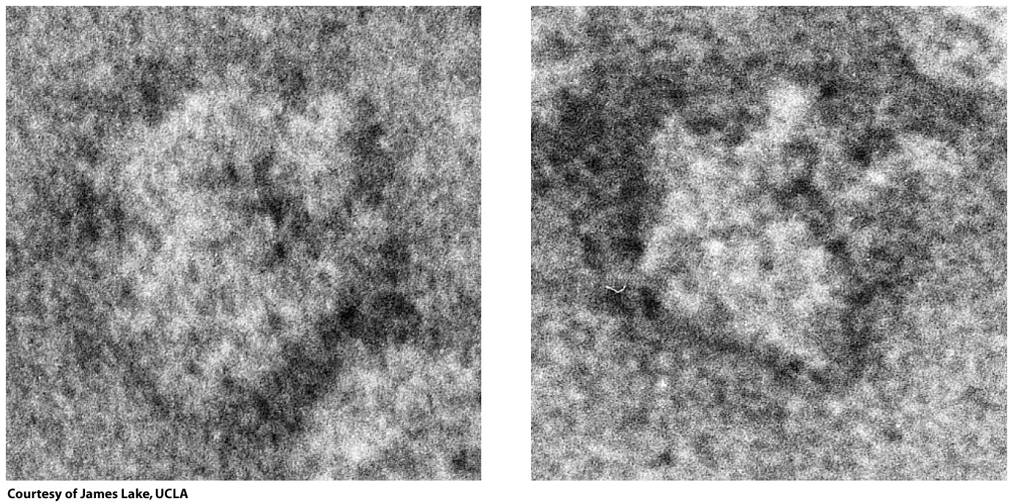
low resolution
Figure 27-13a

Slide 30
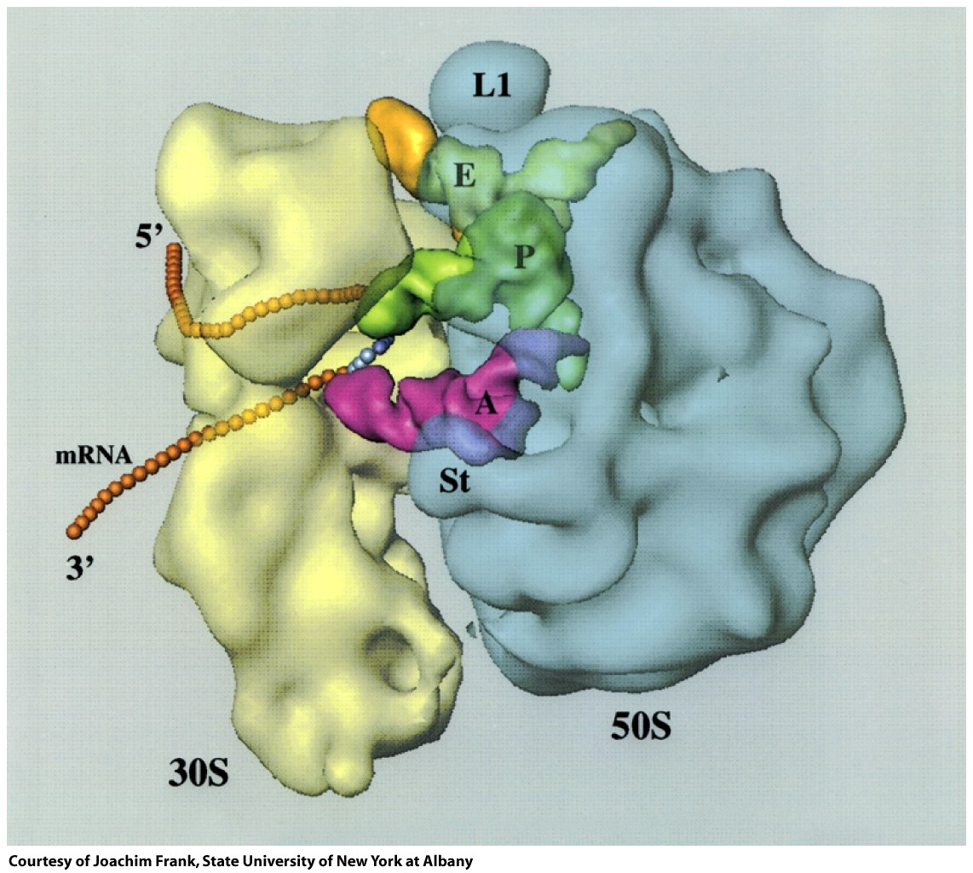
SSU
LSU
Figure 27-13b

Slide 31
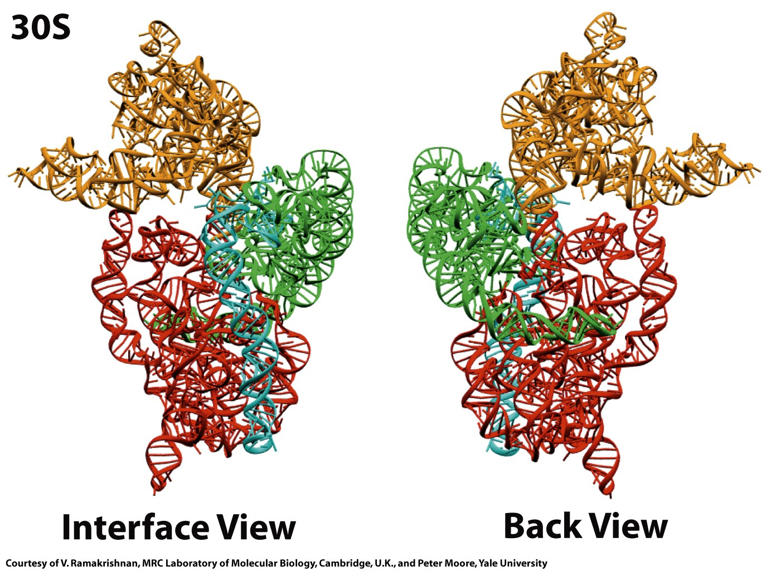
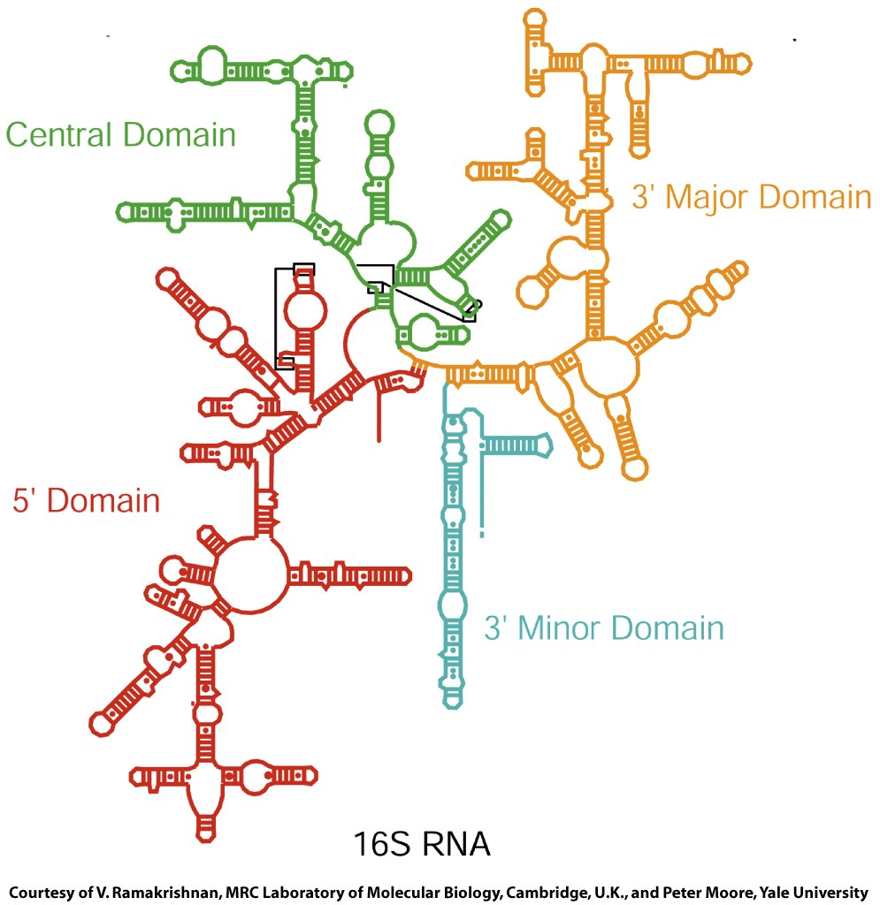
SSU
Figure 27-14a

Slide 32
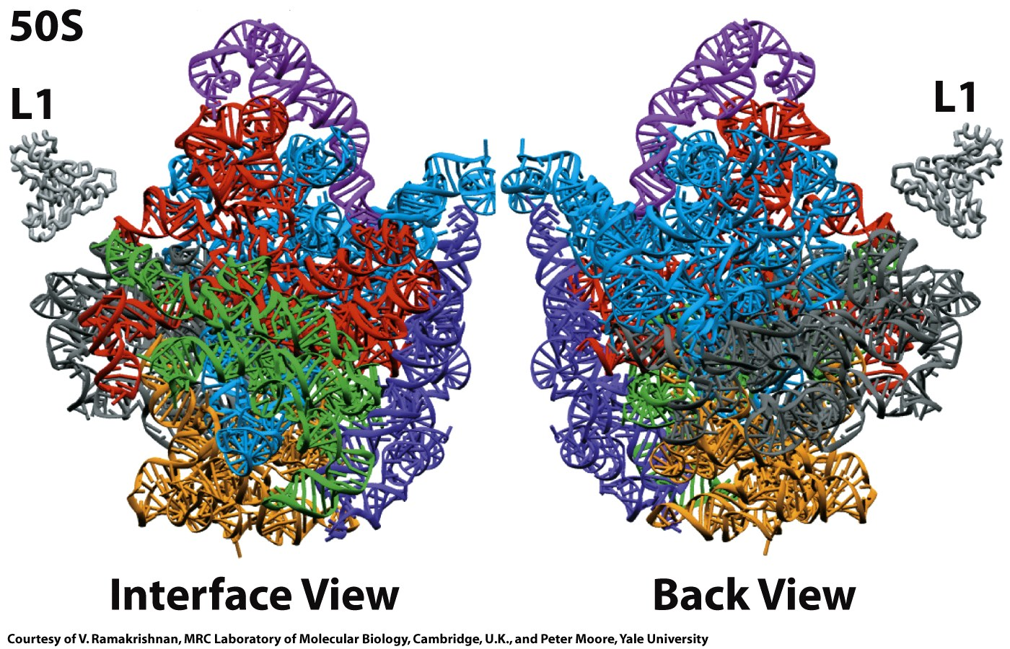
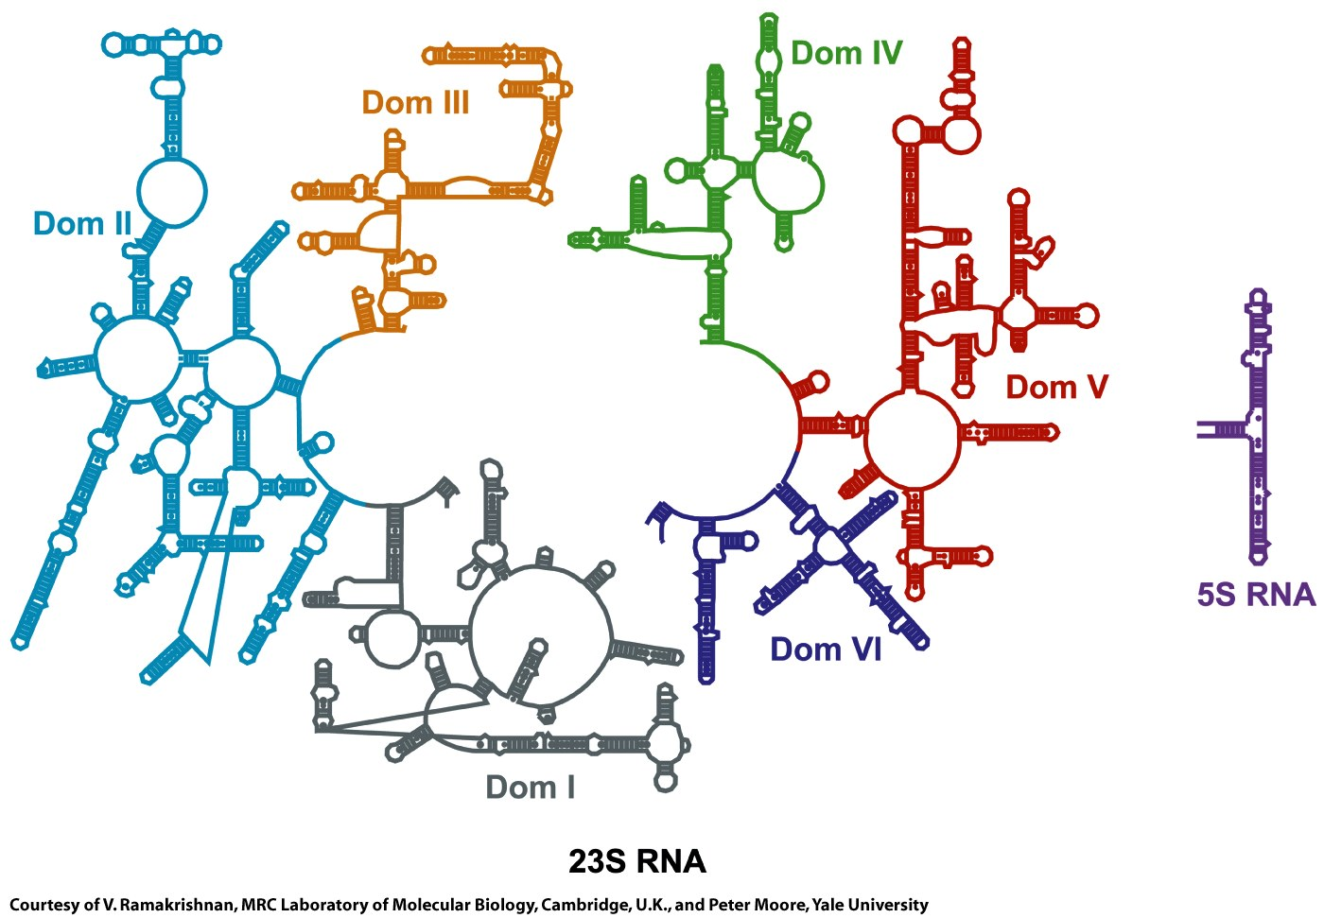
LSU

Slide 33
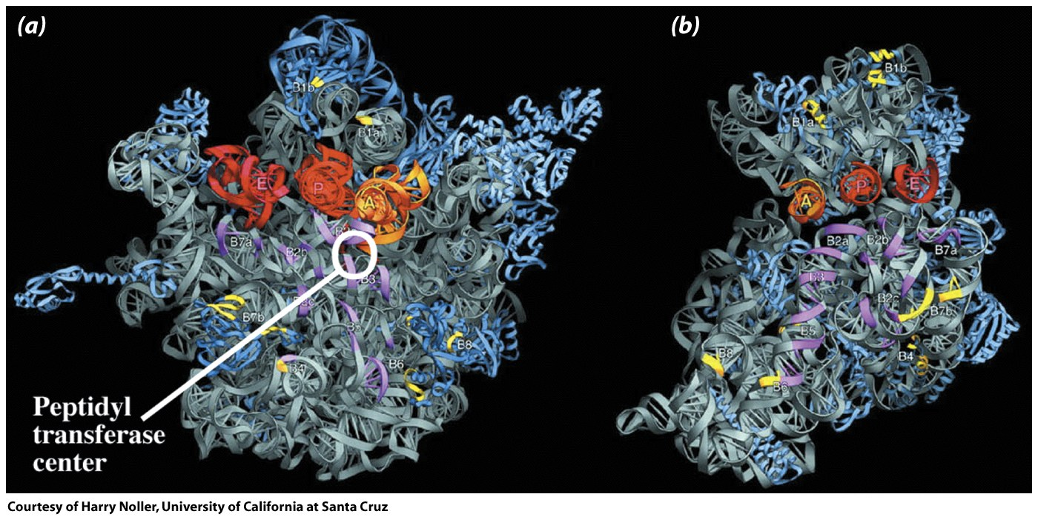
LSU
E P A
Figure 27-18

Slide 34
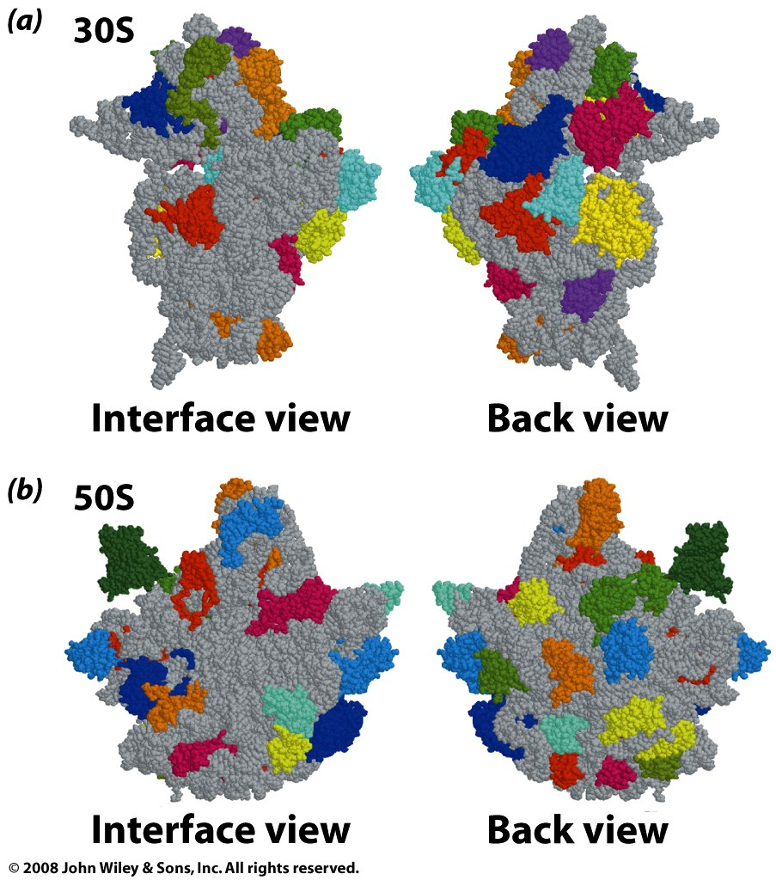
Figure 27-15

Slide 35
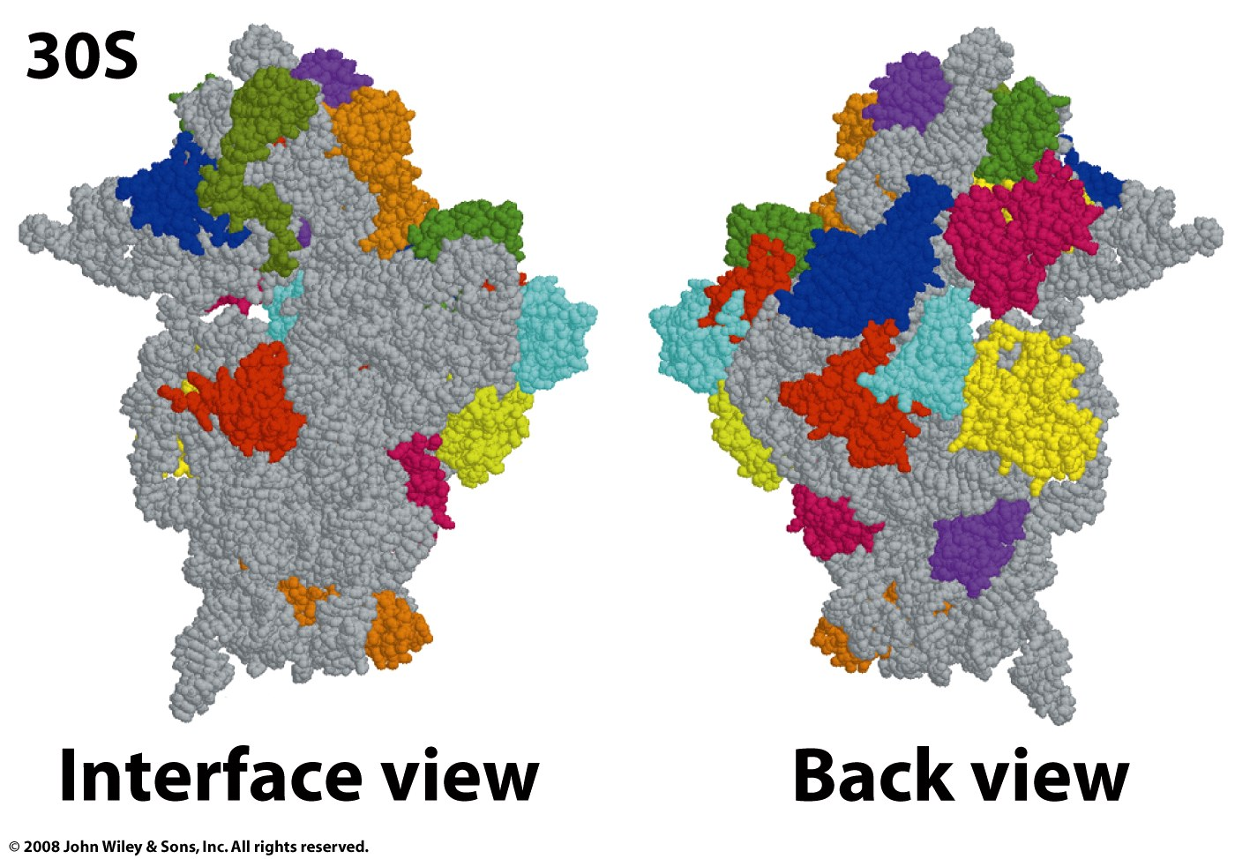
Figure 27-15a

Slide 36
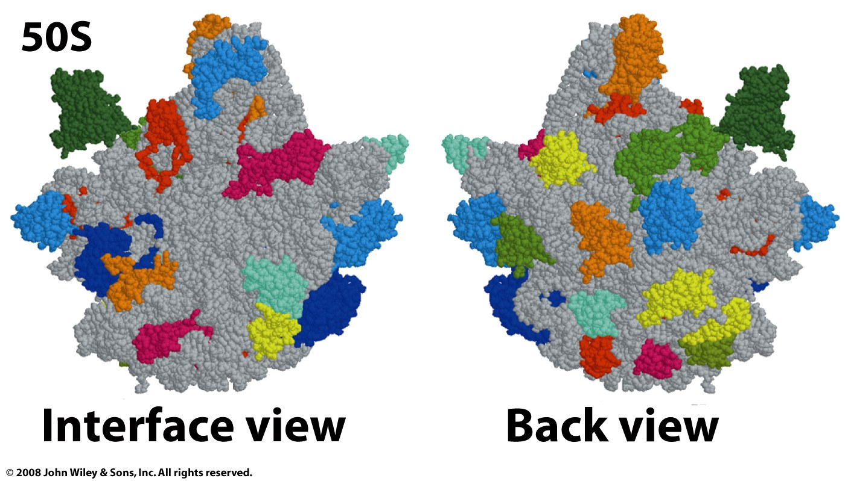
Figure 27-15b

Slide 37
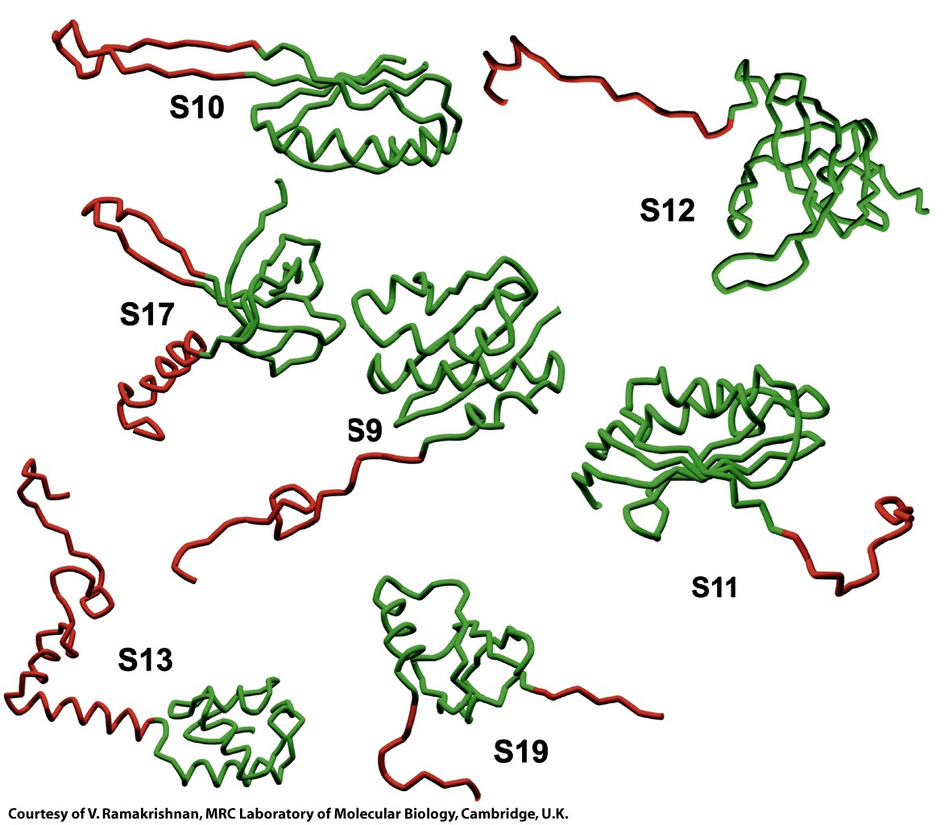
SSU proteins
Figure 27-16

Slide 38
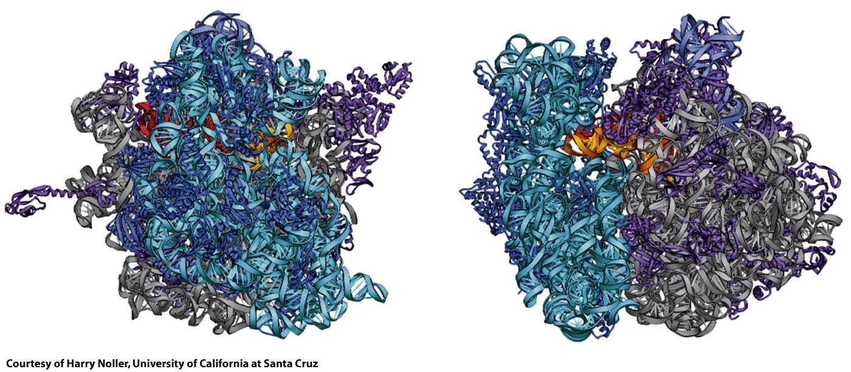
Assembled Ribosome
LSU
SSU
Figure 27-17

Slide 39
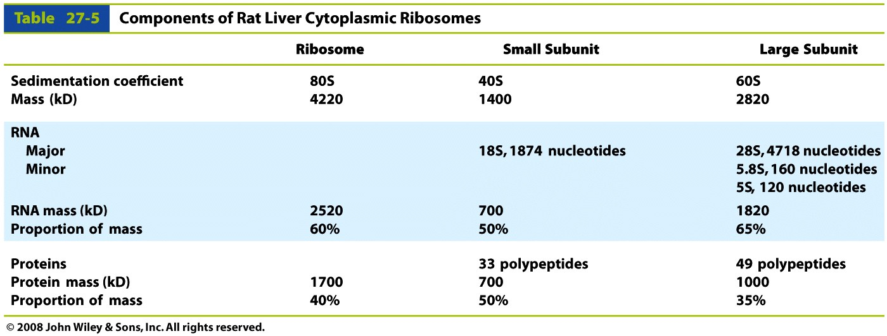
Eucaryotic Ribosomes
Table 27-5

Slide 40
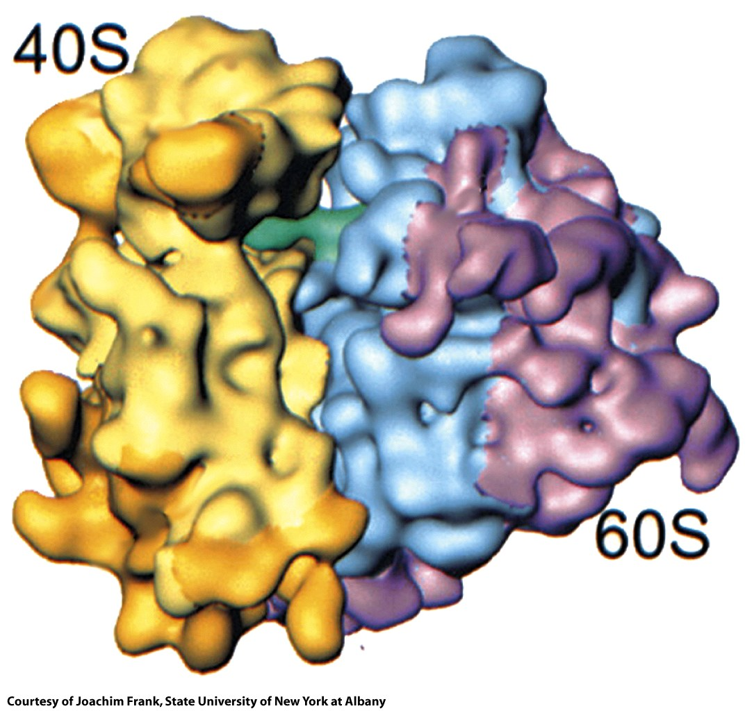
Figure 27-19

Slide 41
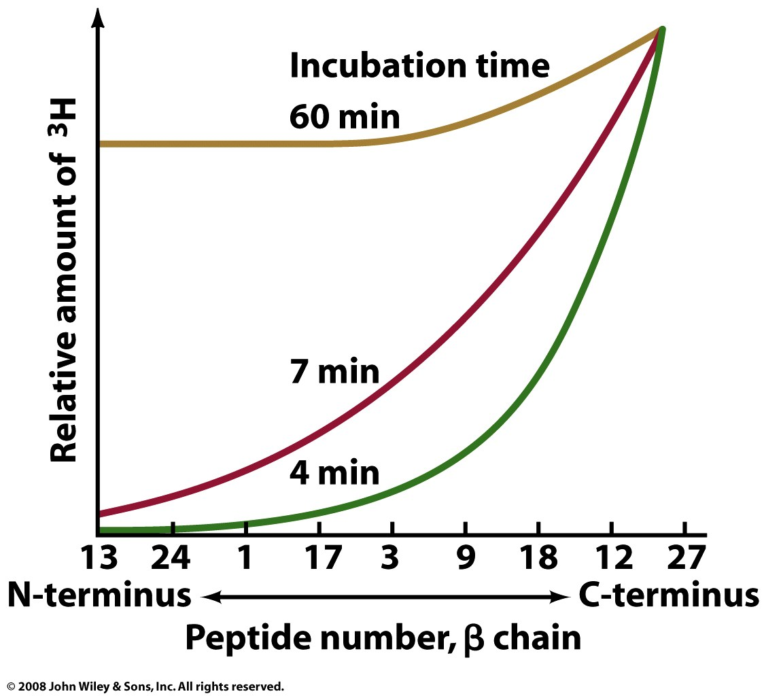
Translation proceeds in the N to C direction.
Add hot leucine, translate for time (t), do a tryptic digest (with trypsin).
Figure 27-20

Slide 42
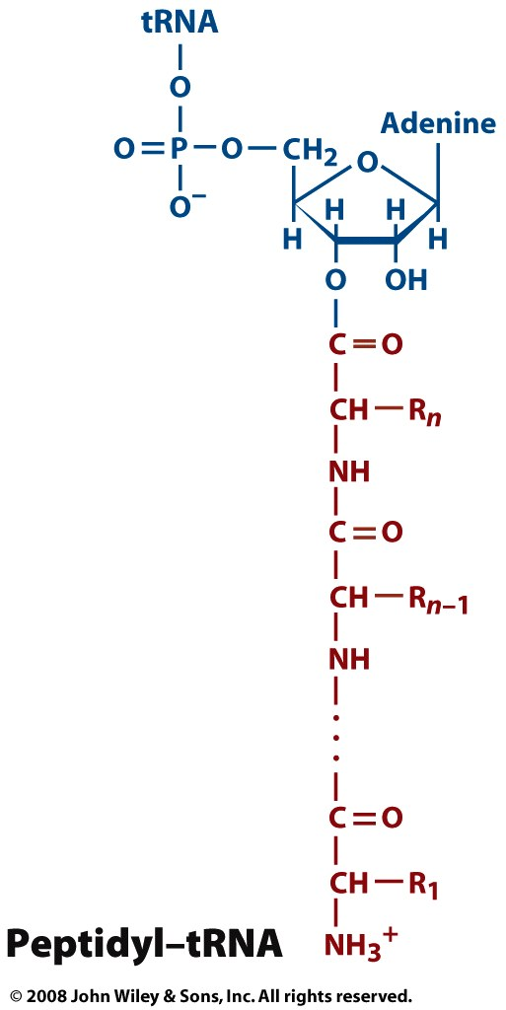
numbering scheme of a growing peptide.
The mRNA is read from the 5’ to 3’ direction.
Page 1009

Slide 43
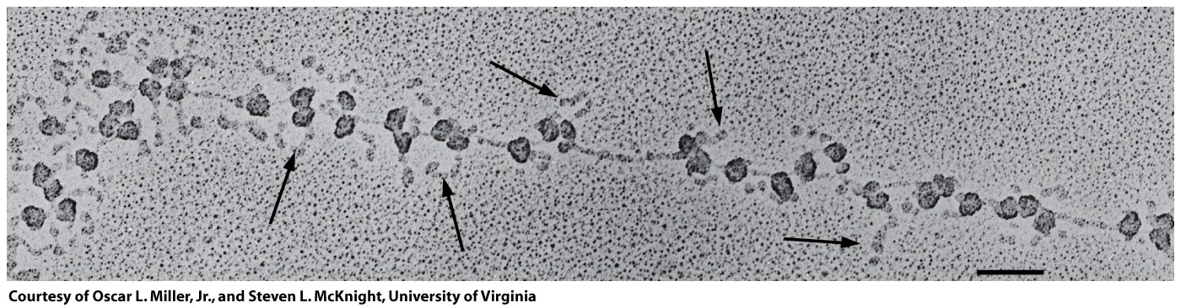
Active translation occurs on polysomes
3’ end of mRNA
5’ end of mRNA
Figure 27-22

Slide 44
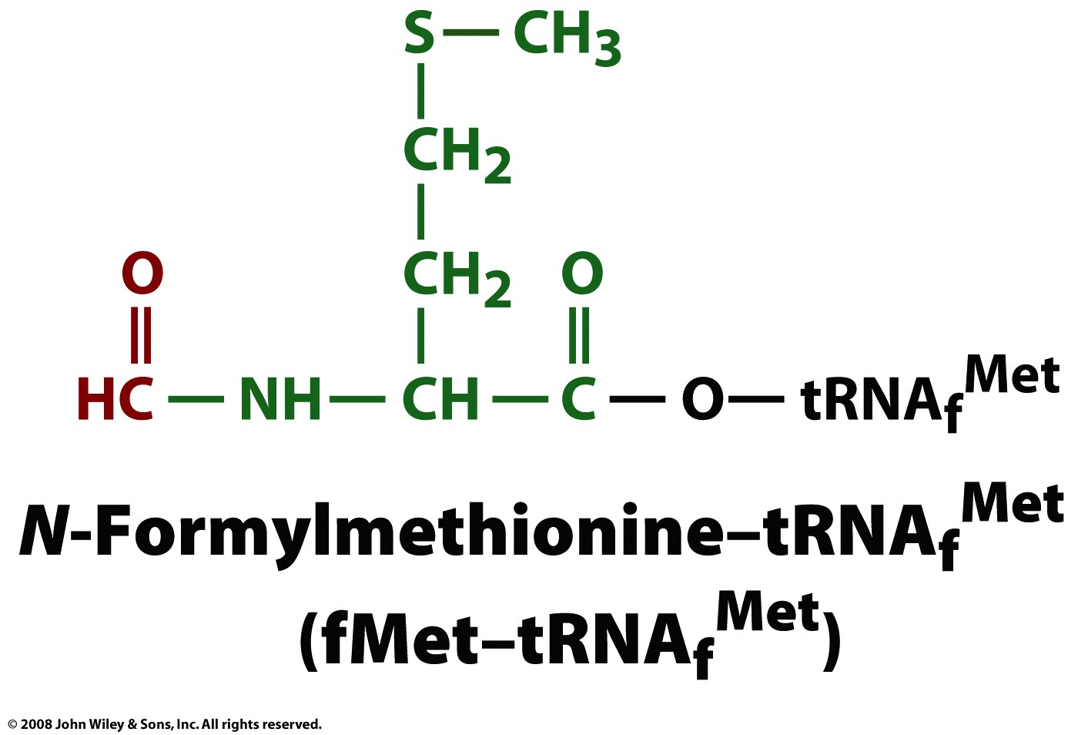
most proteins in e coli begin with f-methionine (which is removed after translation
Page 1010

Slide 45
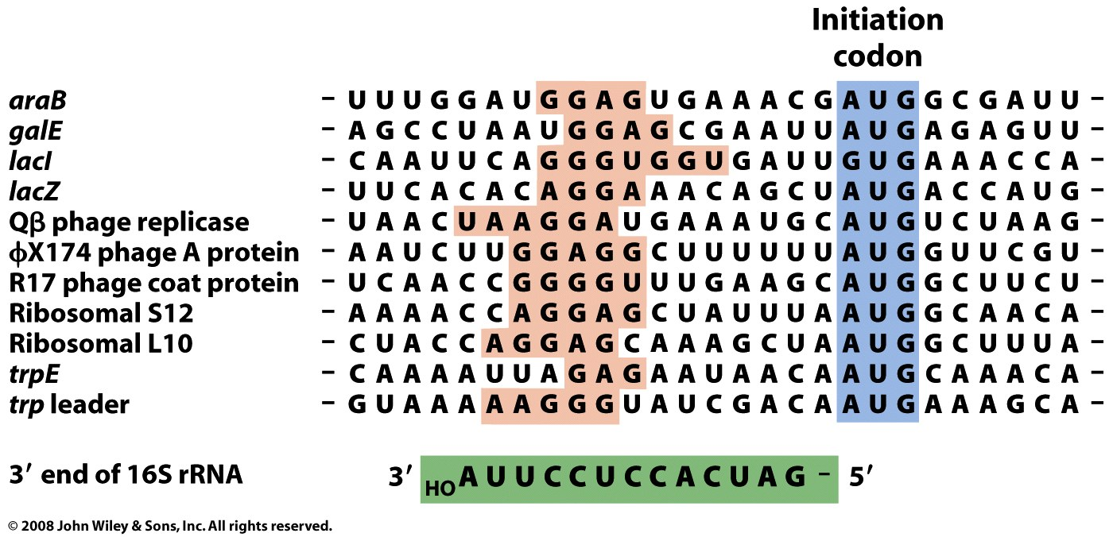
The Shine-Dalgarno sequence of the 16S (SSU) forms base pairs to 5' end of the mRNA (initiation sequence) with the help of initiation factors (IF).
Figure 27-23

Slide 46
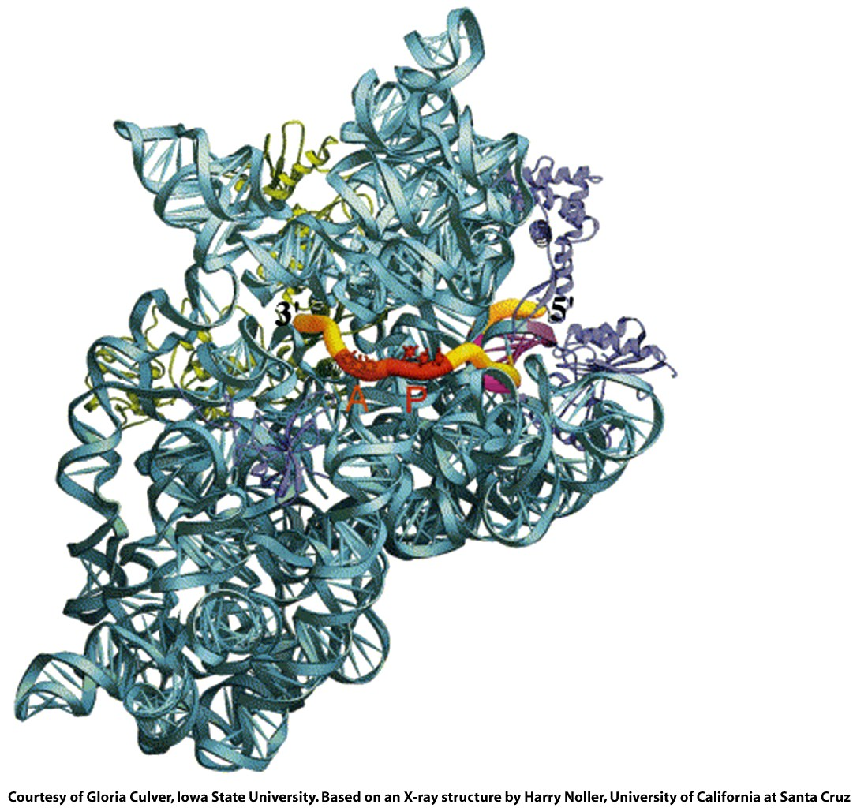
Initiation complex
SD is magenta
Figure 27-24

Slide 47
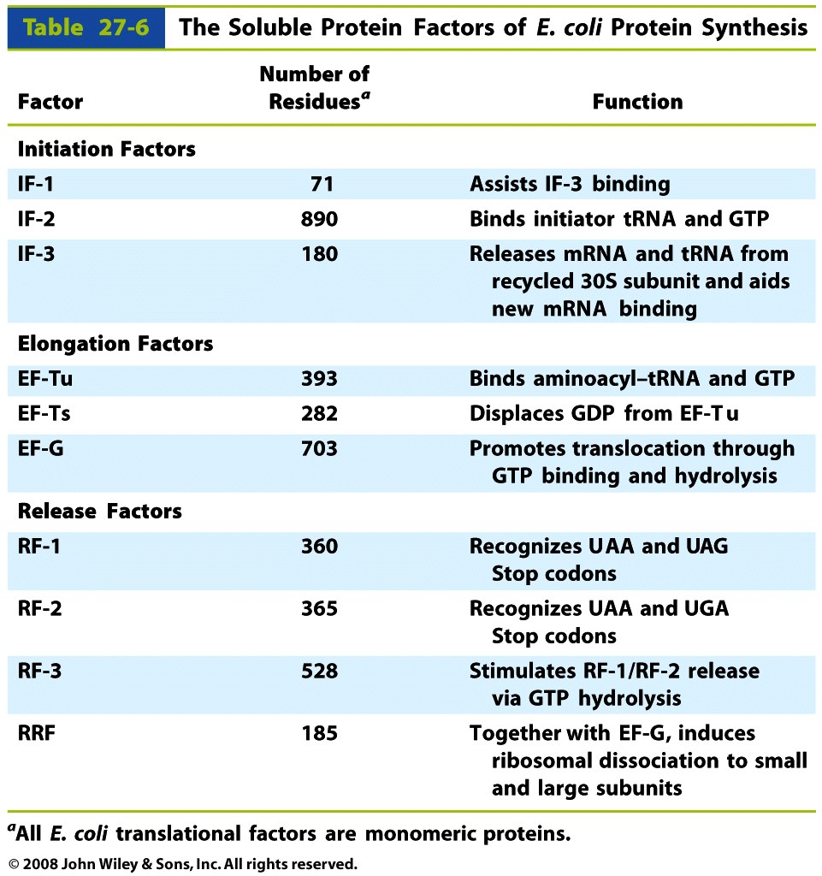
Table 27-6

Slide 48

Figure 27-25

Slide 49

Figure 27-25 part 1

Slide 50

Initiation:
mRNA + Initiation Factor 2 (IF-2) + fMet-tRNA_{f}^{met}
The Shine-Dalgarno sequence of the 16S (SSU) forms base pairs to 5' end of the mRNA (initiation sequence) with the help of initiation factors (IF’s).
Figure 27-25 part 2

Slide 51

Figure 27-25 part 3

Slide 52

Figure 27-27

Slide 53

Figure 27-27 part 1

Slide 54

Figure 27-27 part 2

Slide 55

Figure 27-27 part 3

Slide 56
Stop here chem 4511/6501, 2013

Slide 57

Page 1016

Slide 58

Figure 27-28

Slide 59

Figure 27-29

Slide 60

Figure 27-30

Slide 61

Figure 27-31a

Slide 62

Figure 27-31b

Slide 63

Figure 27-32

Slide 64

Figure 27-33

Slide 65

Figure 27-34

Slide 66

Figure 27-35

Slide 67

Figure 27-35 part 1

Slide 68

Figure 27-35 part 2

Slide 69

Figure 27-35 part 3

Slide 70

Figure 27-35 part 4

Slide 71

Figure 27-35 part 5

Slide 72

Box 27-3 figure 1

Slide 73

Box 27-3 figure 2

Slide 74

Box 27-3 figure 3

Slide 75

Box 27-3 figure 4

Slide 76

Figure 27-36

Slide 77

Figure 27-36 part 1

Slide 78

Figure 27-36 part 2

Slide 79

Figure 27-36 part 3

Slide 80

Figure 27-36 part 4

Slide 81

Figure 27-36 part 5

Slide 82

Figure 27-37

Slide 83

Figure 27-38

Slide 84

Figure 27-39

Slide 85

Figure 27-40a

Slide 86

Figure 27-40b

Slide 87

Figure 27-41a

Slide 88

Figure 27-41b

Slide 89

Figure 27-42

Slide 90

Figure 27-43

