Slide 1
Plausible Evolutionary Competitors to Proteinaceous Polypeptide

Slide 2
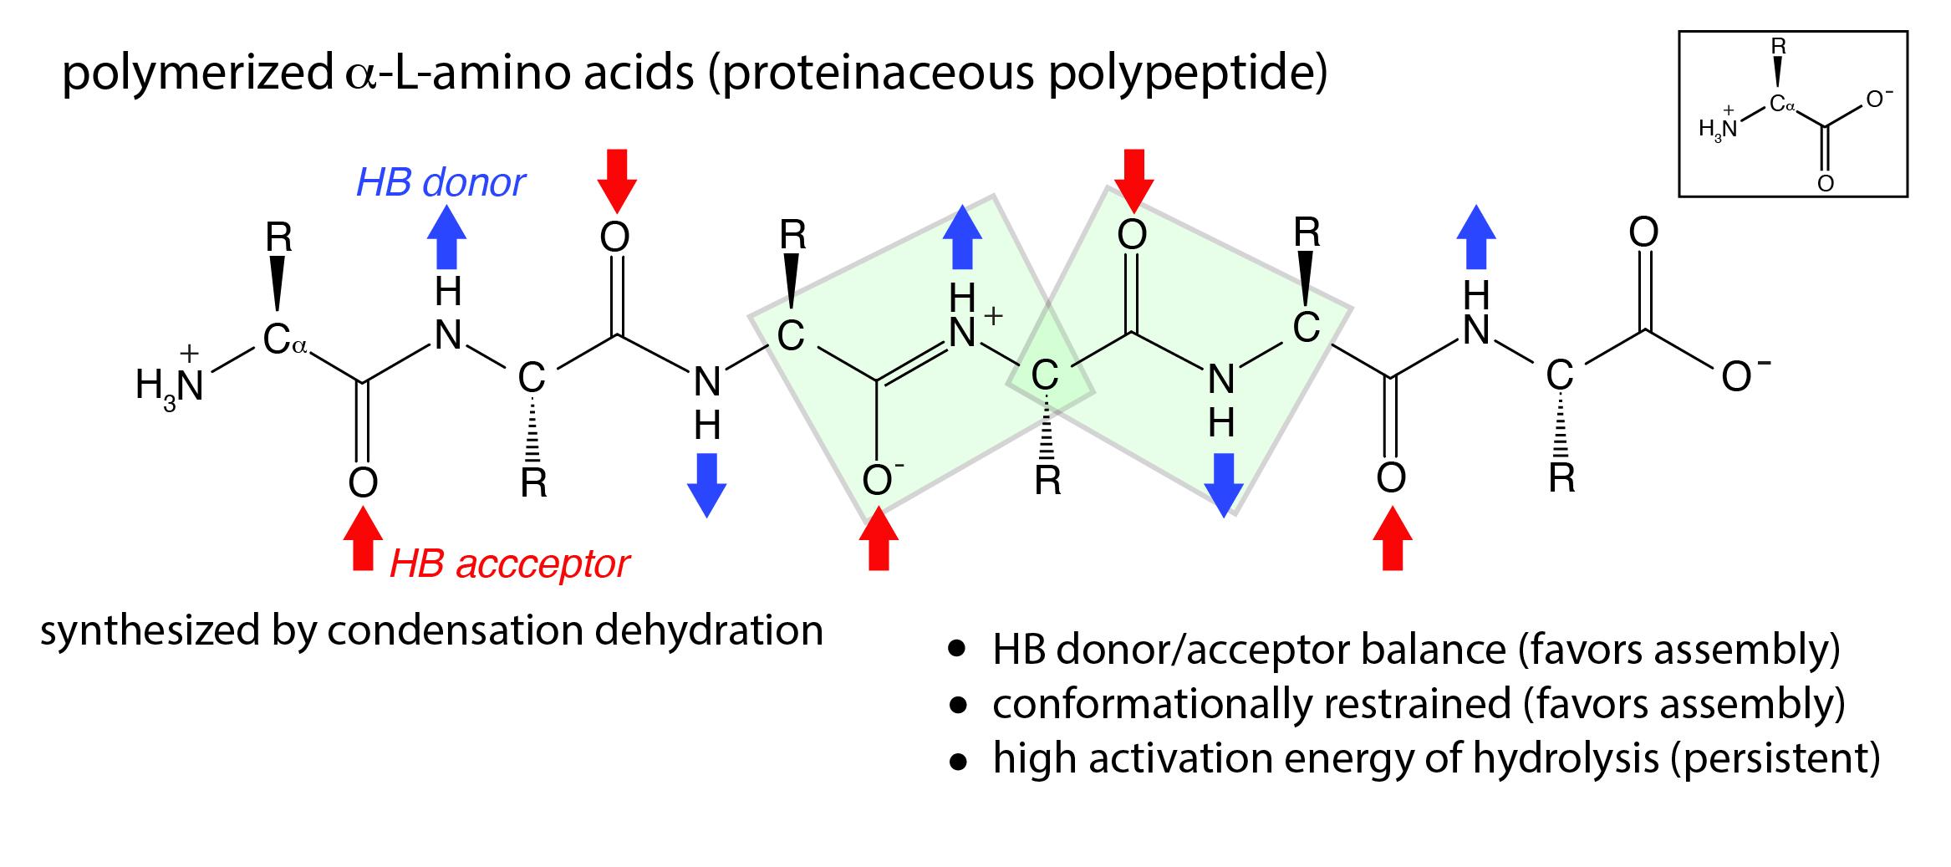

Slide 3
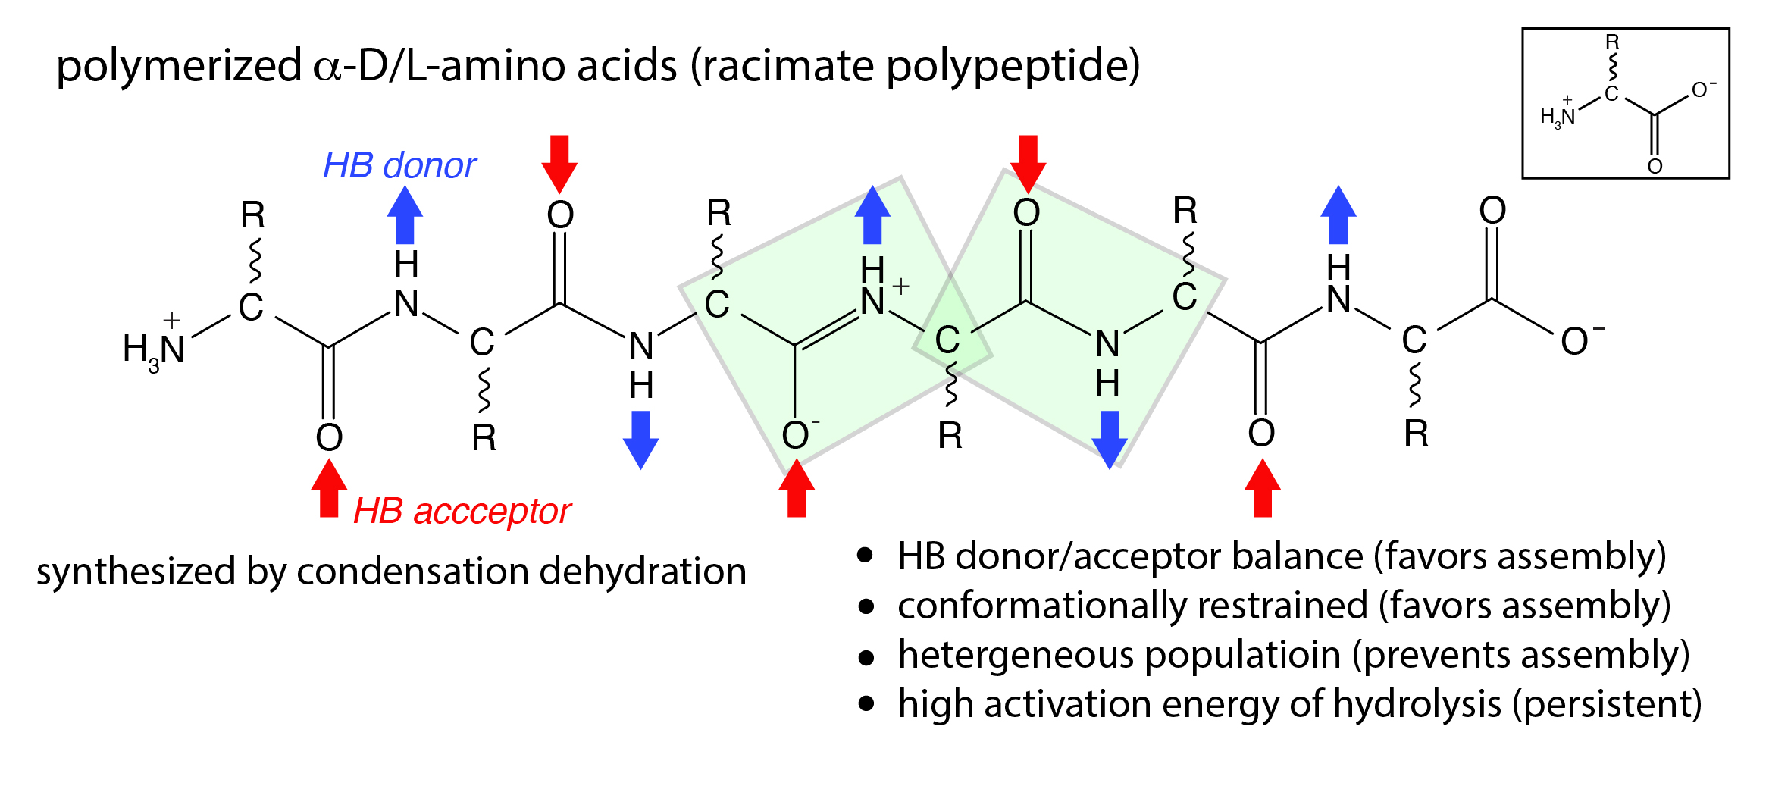

Slide 4
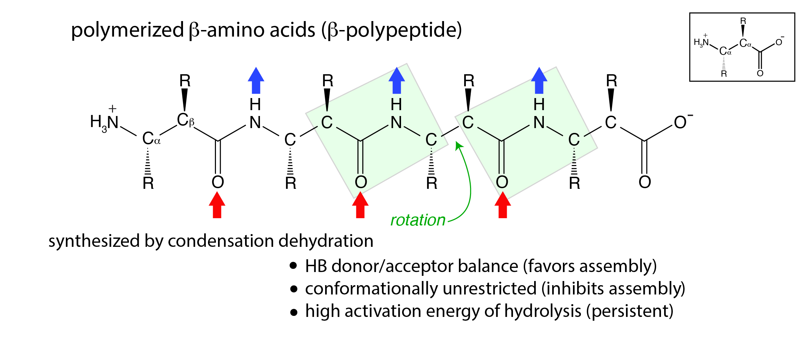

Slide 5
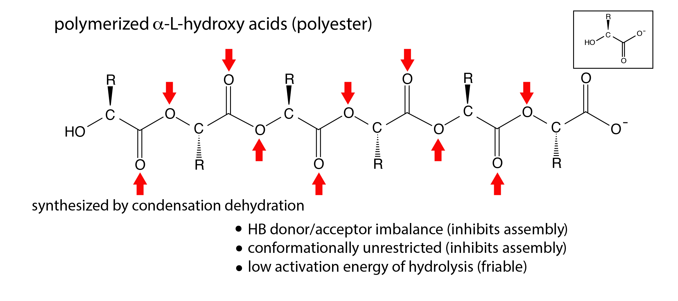

Slide 6
