Slide 1
How to draw a base pair
(with ChemDraw)
(correctly)

Slide 2
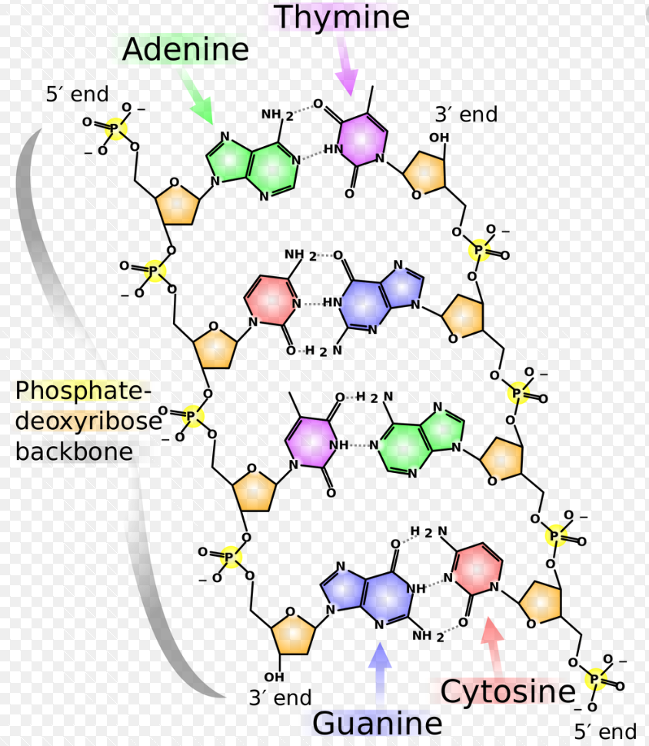
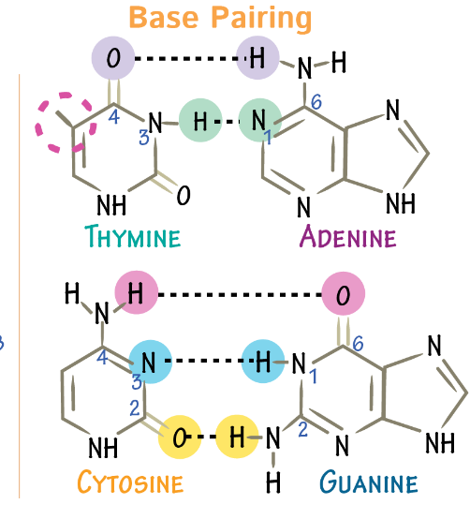
But first: How not to draw a base pair

Slide 3
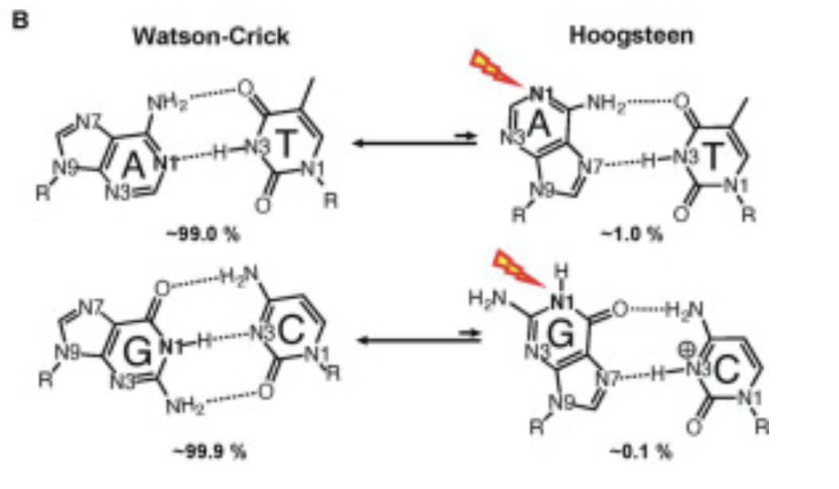

Slide 4
Draw two parallel lines that are spaced vertically about the size you intend to draw the Watson-Crick base pair.

Slide 5
Draw a third line parallel to, and equidistant between, the first two lines.

Slide 6
Draw a two more lines parallel to the three lines so that you now have five equally spaced lines.

Slide 7
Decide which base pair you will draw, and on which side you will have the purine base and on which side you will have the pyrimidine base.

Slide 8
Draw the first base hexagon oriented as shown above.

Slide 9
Add two nitrogen atoms at the positions above

Slide 10
Draw a template hexagon, as above.

Slide 11
And a second template hexagon, as above.

Slide 12
Draw the second base hexagon, include two nitrogen atoms.

Slide 13
Delete the two template hexagons.

Slide 14
T has two keto oxygens. Draw the first.

Slide 15
T has two keto oxygens. Draw the second.

Slide 16
Add the hydrogen to the WC nitrogen of the T

Slide 17
Add the methyl group to the T

Slide 18
Add the glycosidic bond, and the deoxyribose.

Slide 19
Add the double bond.

Slide 20
Draw lower WC hydrogen bond.

Slide 21
Add amino group to the A. Draw the hydrogen atoms at 120 degrees. Do not use -NH₂

Slide 22
Add the 5-membered ring to the purine (A). Indicate both nitrogen atoms.

Slide 23
Add the glycosidic bond and the deoxyribose.

Slide 24
Add all the double bonds.

Slide 25
Now the next base pair.

Slide 30
C has one keto group.

Slide 31
And an amino group

Slide 32
Draw two parallel lines that are spaced vertically about the size you intend to draw the Watson-Crick base pair.

Slide 33
Add the double bonds to the C.

Slide 34
Draw two parallel lines that are spaced vertically about the size you intend to draw the Watson-Crick base pair.

Slide 35
G has one keto group

Slide 36
G has one amino group

Slide 40
Remove the template lines

Slide 41
Number the atoms.

Slide 42
Notice the difference in the numbering of the 6-membered rings.

Slide 43
The glycosidic bond is at the N1 of the pyrimidines.
The glycoside bond is at the N9 of the purines

Slide 44
The N7, O6/N6 and O4/N4 are in the major groove.
Major Groove
Minor Groove
Major Groove
Minor Groove
The N3 and O2 are in the minor groove - and so is the N2 if it is a GC base pair.

