Slide 1
Amino Acids
An amino acid contains
an amine group,
a carboxylic acid group,
a side-chain (or R-group),
all attached to a common chiral carbon atom (Cα),
with L stereochemistry
There are twenty proteinogenic* amino acids, which are encoded by the genetic code, which is universal throughout the tree of life. Amino acids are distinguished by their sidechains.
Selenocysteine is encoded (by UGA, normally a stop) and is said to be the 21st proteinogenic amino acid but is rare (in only 25 proteins in humans).
Pyrrolysine is encoded (by UAG, normally a stop) and is said to be the 22nd amino acid but is very rare (only found in some bacteria).

Slide 2
Amino Acids Differ Only in the R Groups
(aka Sidechains)
alanine Ala (A)
arginine Arg (R)
asparagine Asn (N)
aspartic acid Asp (D)
cysteine Cys (C)
glutamic acid Glu (E)
glutamine Gln (Q)
glycine Gly (G)
histidine His (H)
isoleucine Ile (I)
leucine Leu (L)
lysine Lys (K)
methionine Met (M)
phenylalanine Phe (F)
proline Pro (P)
serine Ser (S)
threonine Thr (T)
tryptophan Trp (W)
tyrosine Tyr (Y)
valine Val (V)

Slide 3
Amino Acids are Chiral
Always draw proteinogenic amino acids like this.
(i) N to C (left to right)
(ii) R group up and out (or down and back)
Proteinogenic amino acids are L (not D).
[glycine (R=H) is not chiral]
Notes:
FIGURE 3-2 General structure of an amino acid. This structure is common to all but one of the α-amino acids. (Proline, a cyclic amino acid, is the exception.) The R group, or side-chain (red), attached to the α carbon (blue) is different in each amino acid.

Slide 4
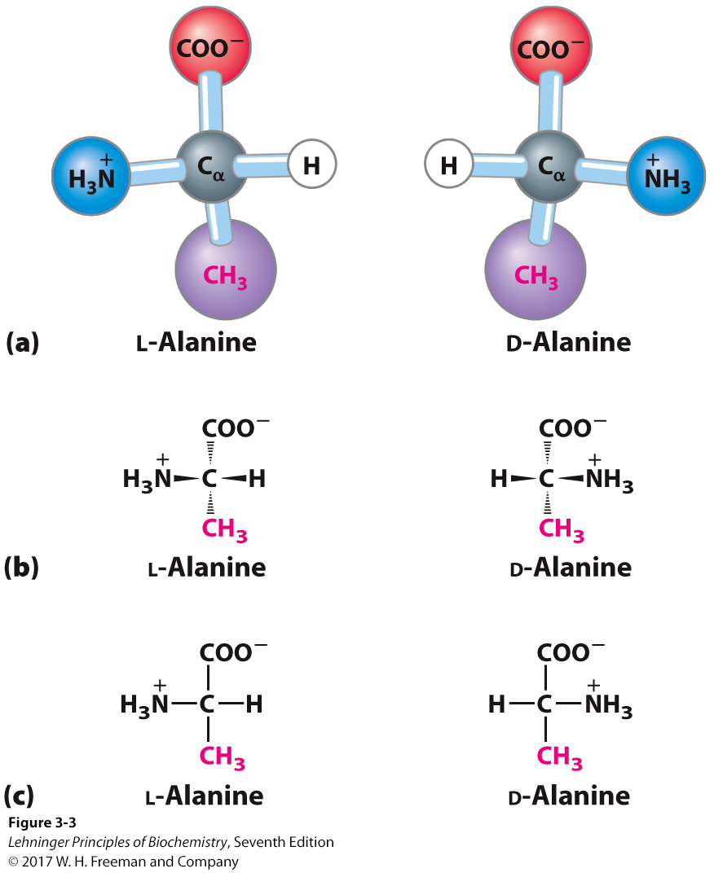
All Amino Acids Are Chiral (Except Glycine)
Proteins only contain l amino acids
Never draw amino acids like this
Notes:
FIGURE 3-3 Stereoisomerism in α-amino acids. (a) The two stereoisomers of alanine, l- and d-alanine, are nonsuperposable mirror images of each other (enantiomers). (b, c) Two different conventions for showing the configurations in space of stereoisomers. In perspective formulas (b), the solid wedge-shaped bonds project out of the plane of the paper, the dashed bonds behind it. In projection formulas (c), the horizontal bonds are assumed to project out of the plane of the paper, the vertical bonds behind. However, projection formulas are often used casually and are not always intended to portray a specific stereochemical configuration.

Slide 5
Never draw amino acids like this

Slide 6
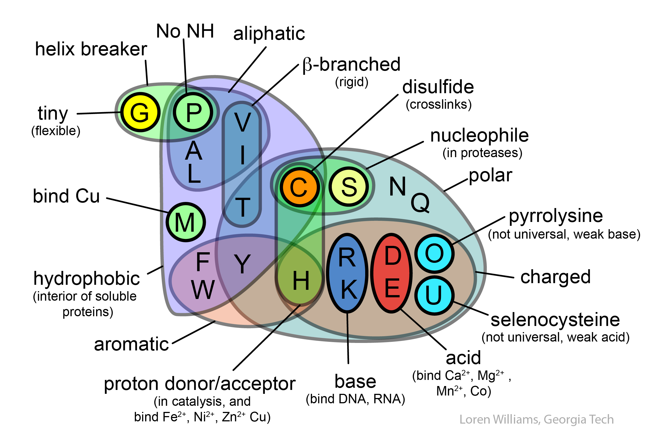

Slide 7
Histidine (protonation state)
pH > pK_{a}
pH < pK_{a}
pKa=6.05

Slide 8
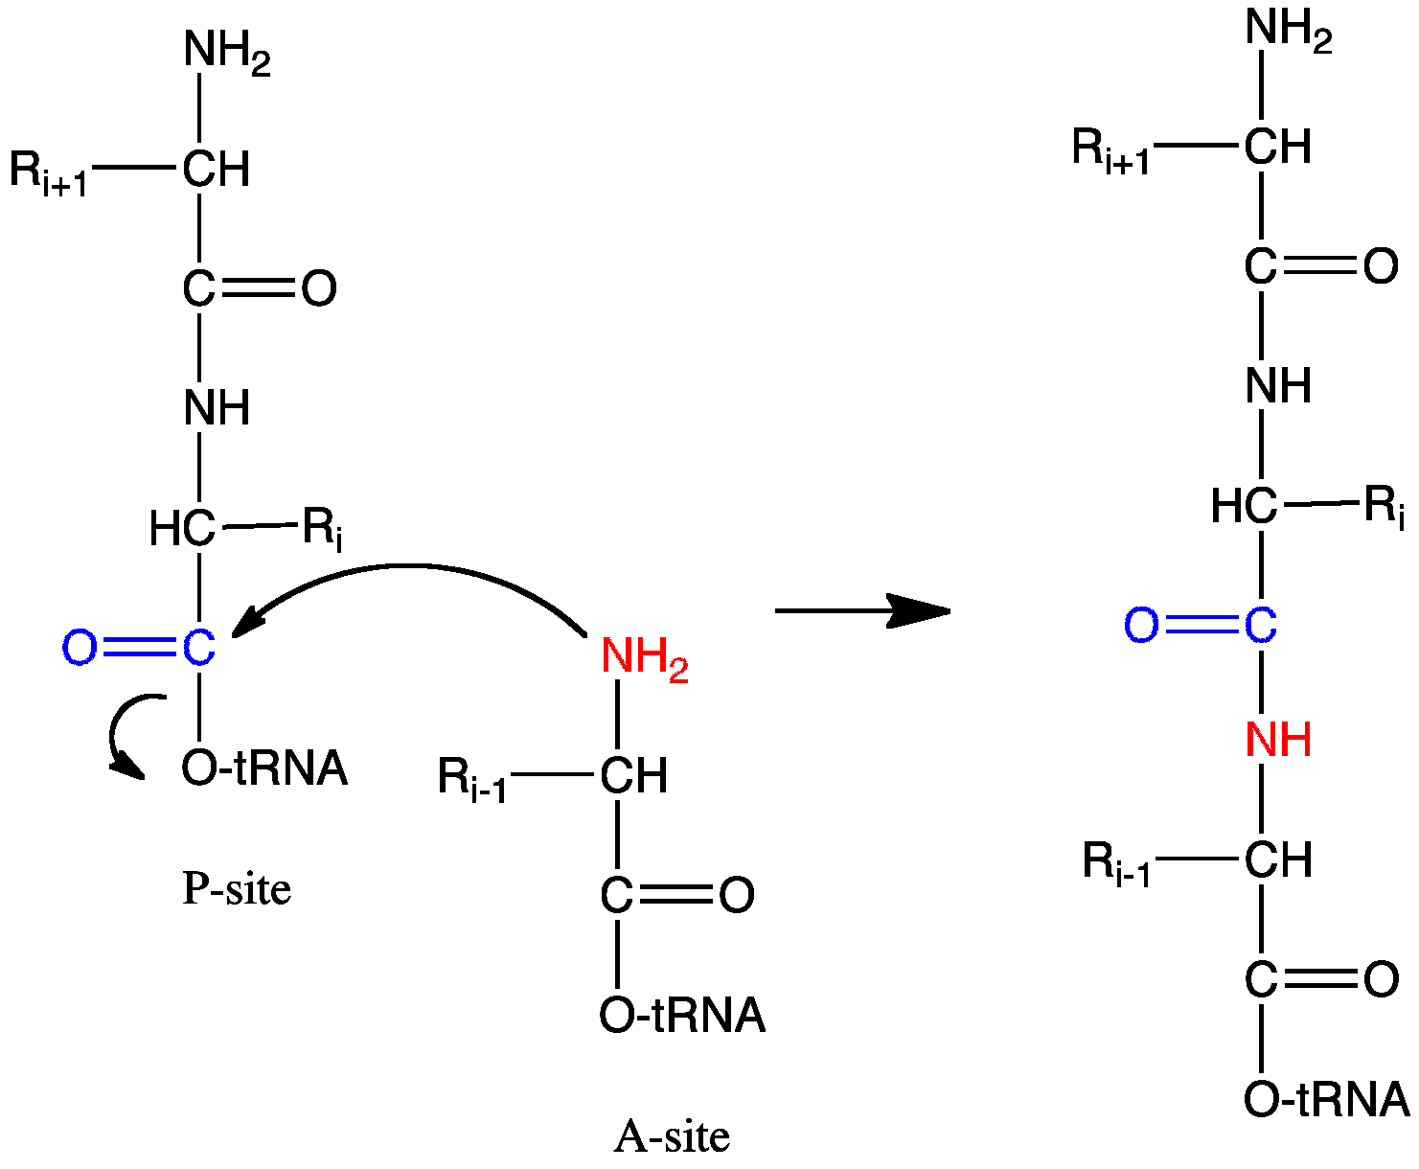
Formation of a Peptide Bond
in the ribosome

Slide 9
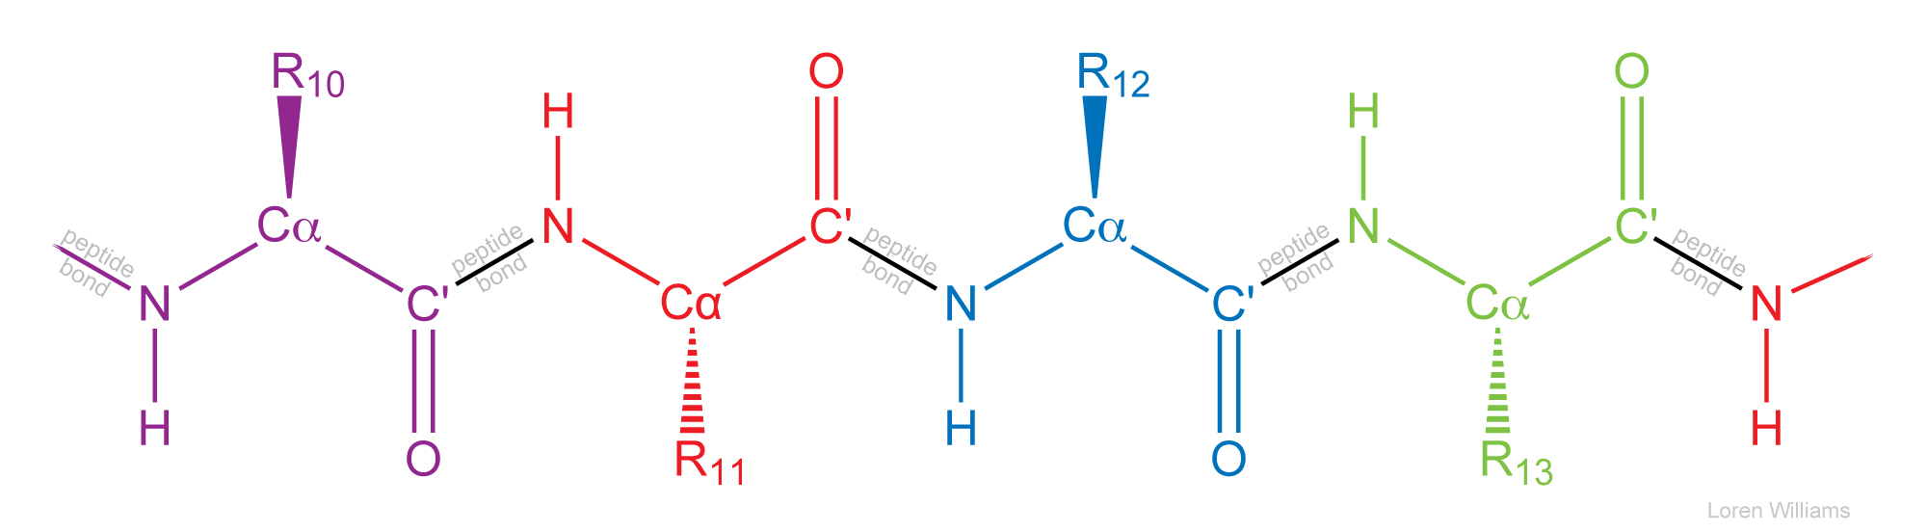
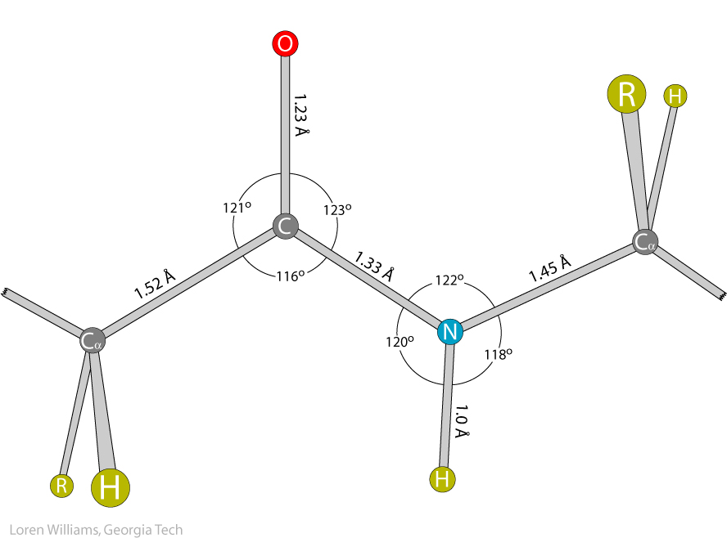

Slide 10
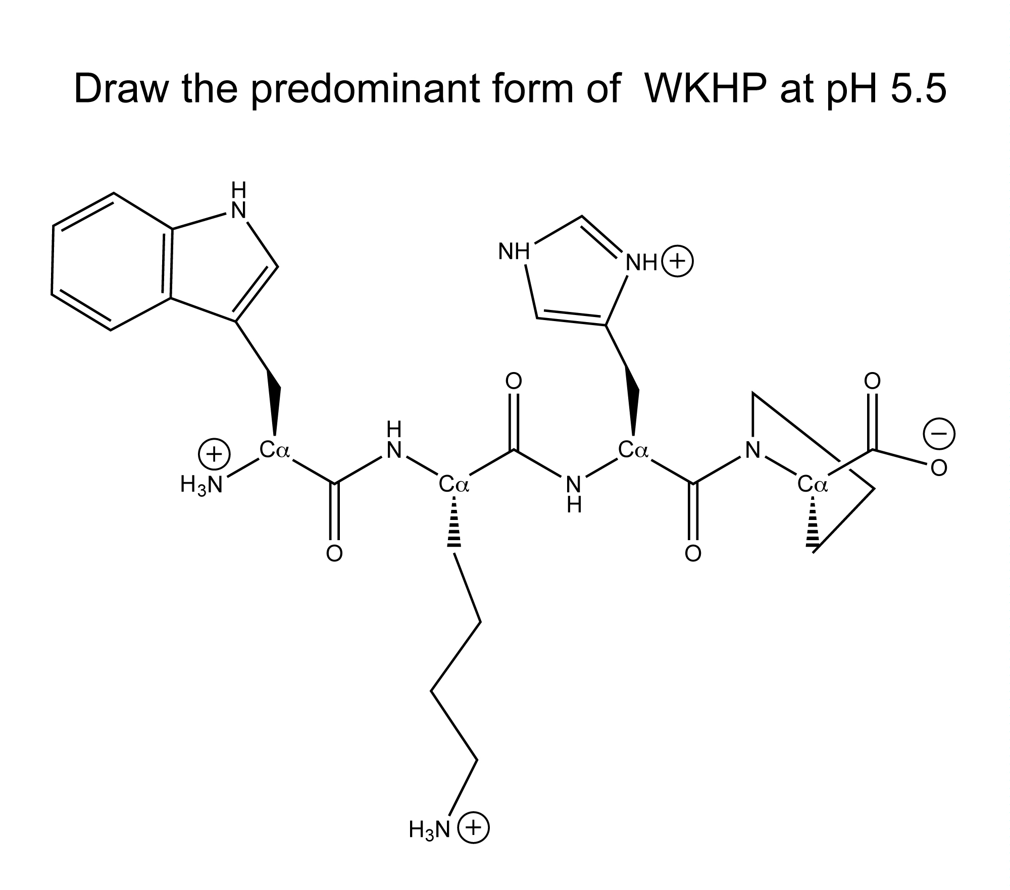

Slide 11
This is how I want you to draw peptides
N to C (---->)
correct stereochemistry at Cα
correct ionization states (His,Cys)
draw all H, except those bonded to C
no chemical mistakes

Slide 12
