Slide 1
Serine Proteases
Almost one-third of all proteases contain a Ser nucleophile in the active site.
Distinguished by catalytic triad: Asp−His−Ser
There are some strange catalytic triads and dyads; Ser−His−Glu, Ser−Lys/His, His−Ser−His, and N-terminal Ser
Four clans
chymotrypsin/trypsin (most abundant, found in bacteria, archaea, eukarya, viruses),
subtilisin,
carboxypeptidase Y,
Clp
Chymotrypsin-like proteases
digestion, hemostasis, apoptosis, signal transduction, production, immune response
Perform posttranslational proteolysis, removing
The N-terminal methionine
N-terminal signal or targeting peptide,
activation peptide to unmasks the latent activity,

Slide 2
Serine Proteases
Cascades of sequential activation of serine proteases are seen in
blood coagulation,
complement fixation,
fibrinolysis,
development,
matrix remodeling,
differentiation,
wound healing

Slide 3
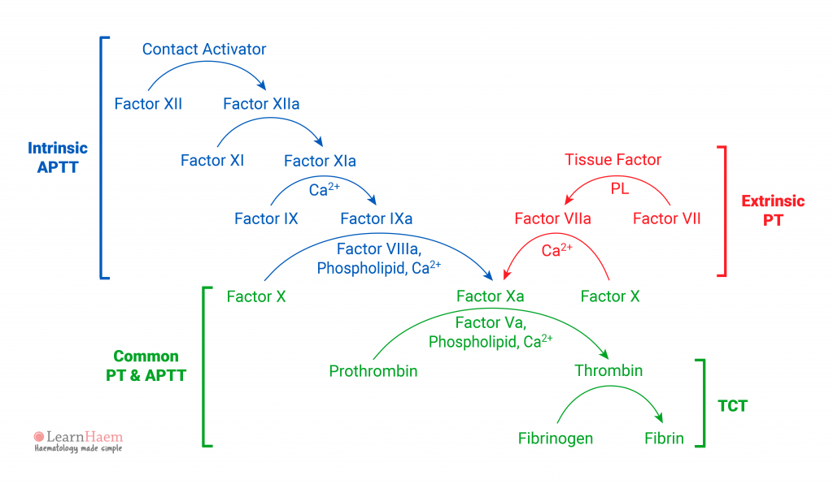

Slide 4
Trypsin Mechanism
There are many elementary steps in the mechanism
(i.e., there are many intermediates, many transition states and many rate constants)
Demonstrates the following “elements of enzymatic catalysis”
acid & base catalysis (yes)
covalent intermediates (yes)
proximity and orientation (yes)
preferential binding to and stabilization of the transition state (yes)
metal ions (no)

Slide 5
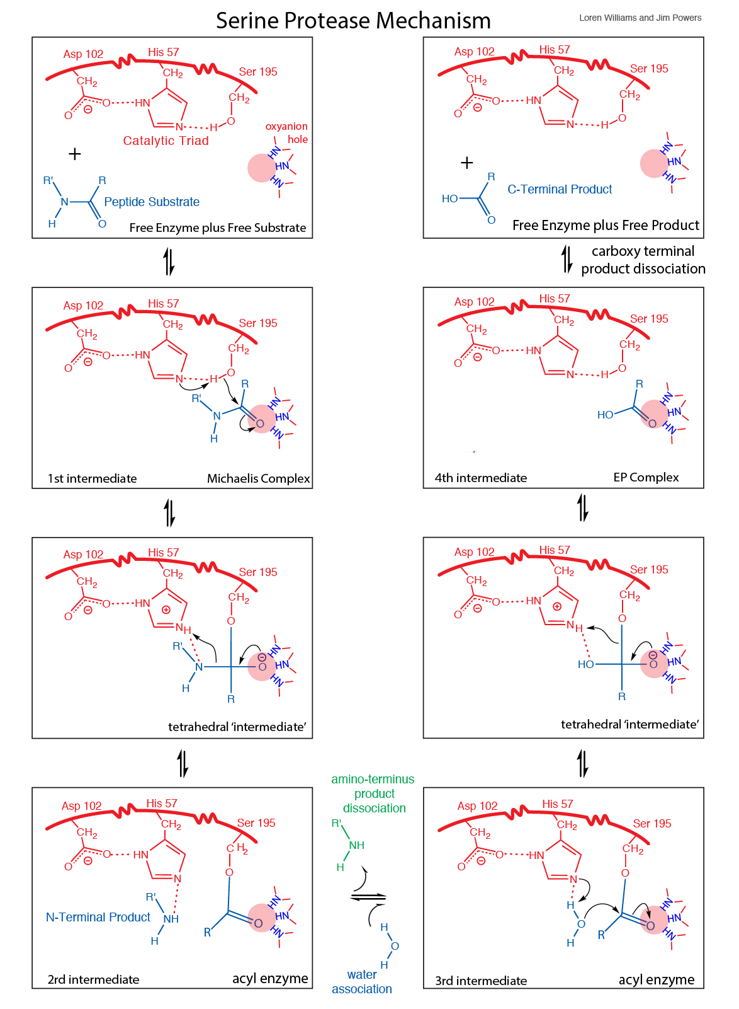

Slide 6
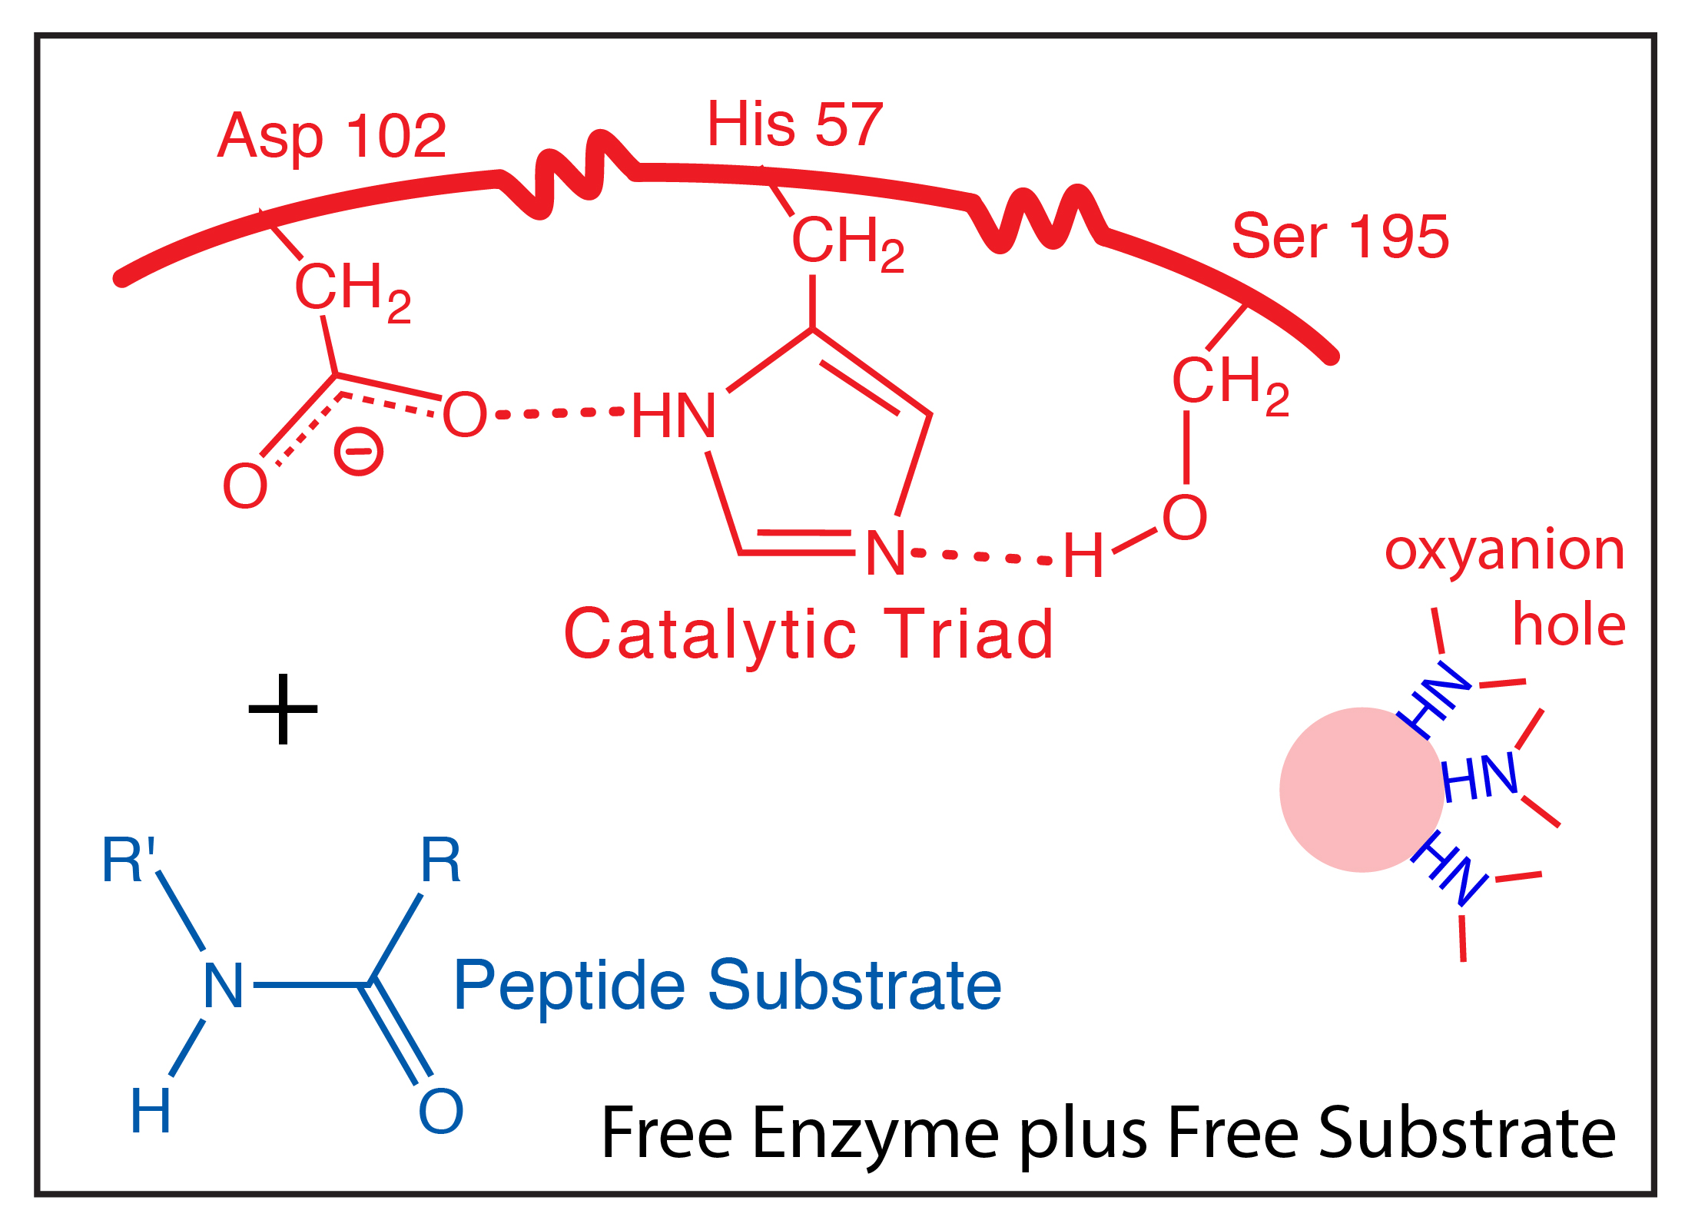
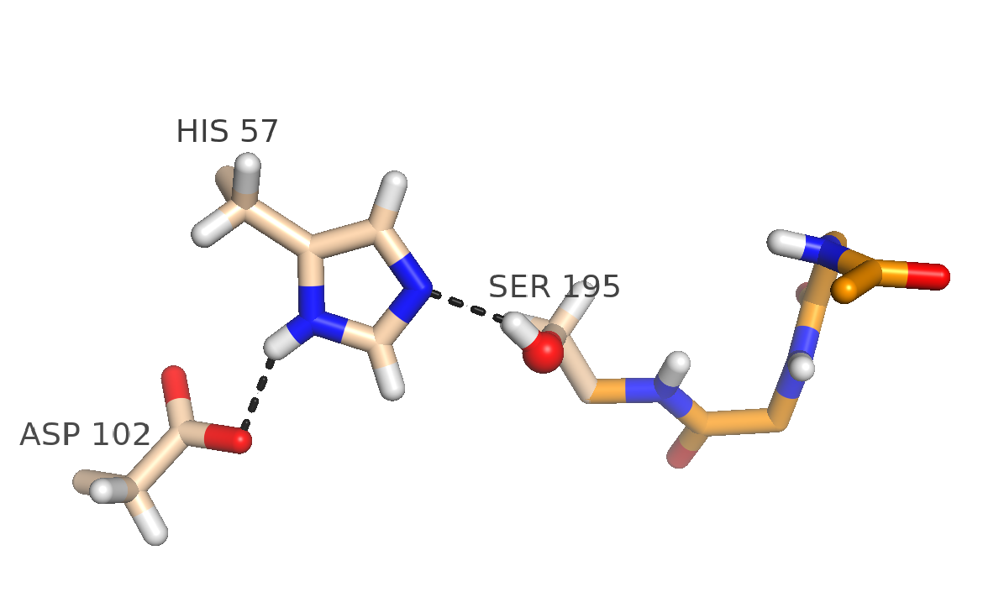

Slide 7
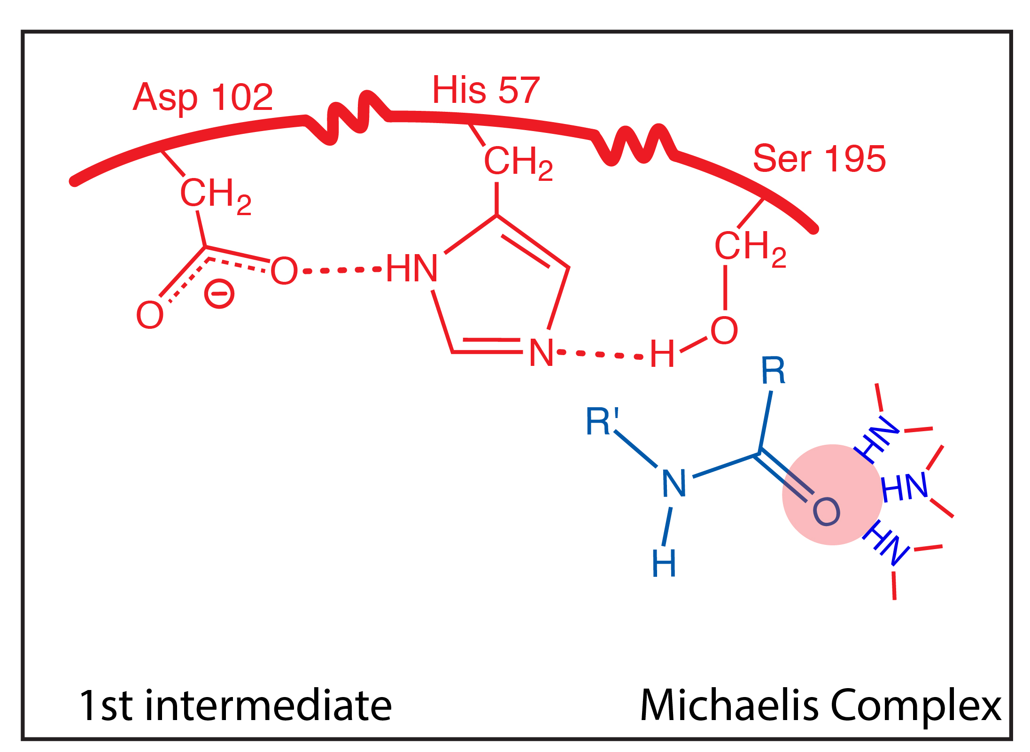
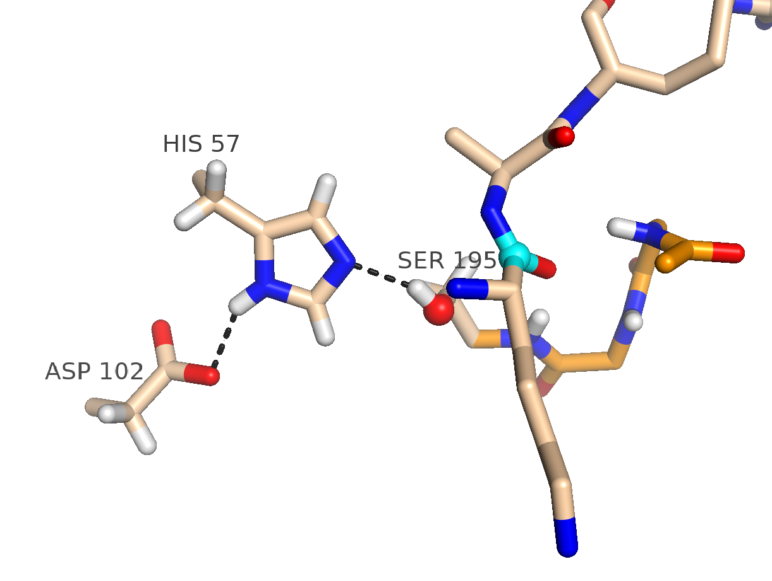

Slide 8
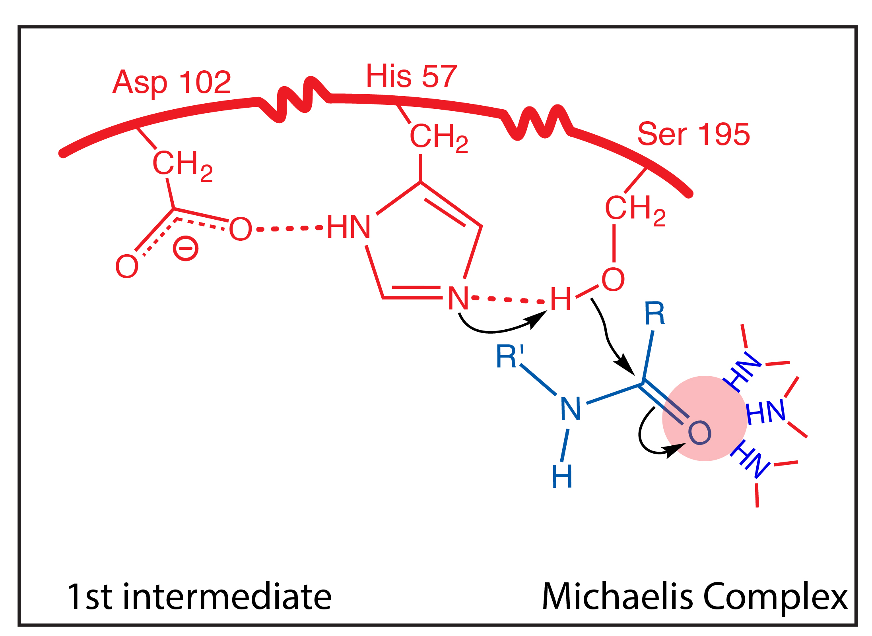

Slide 9
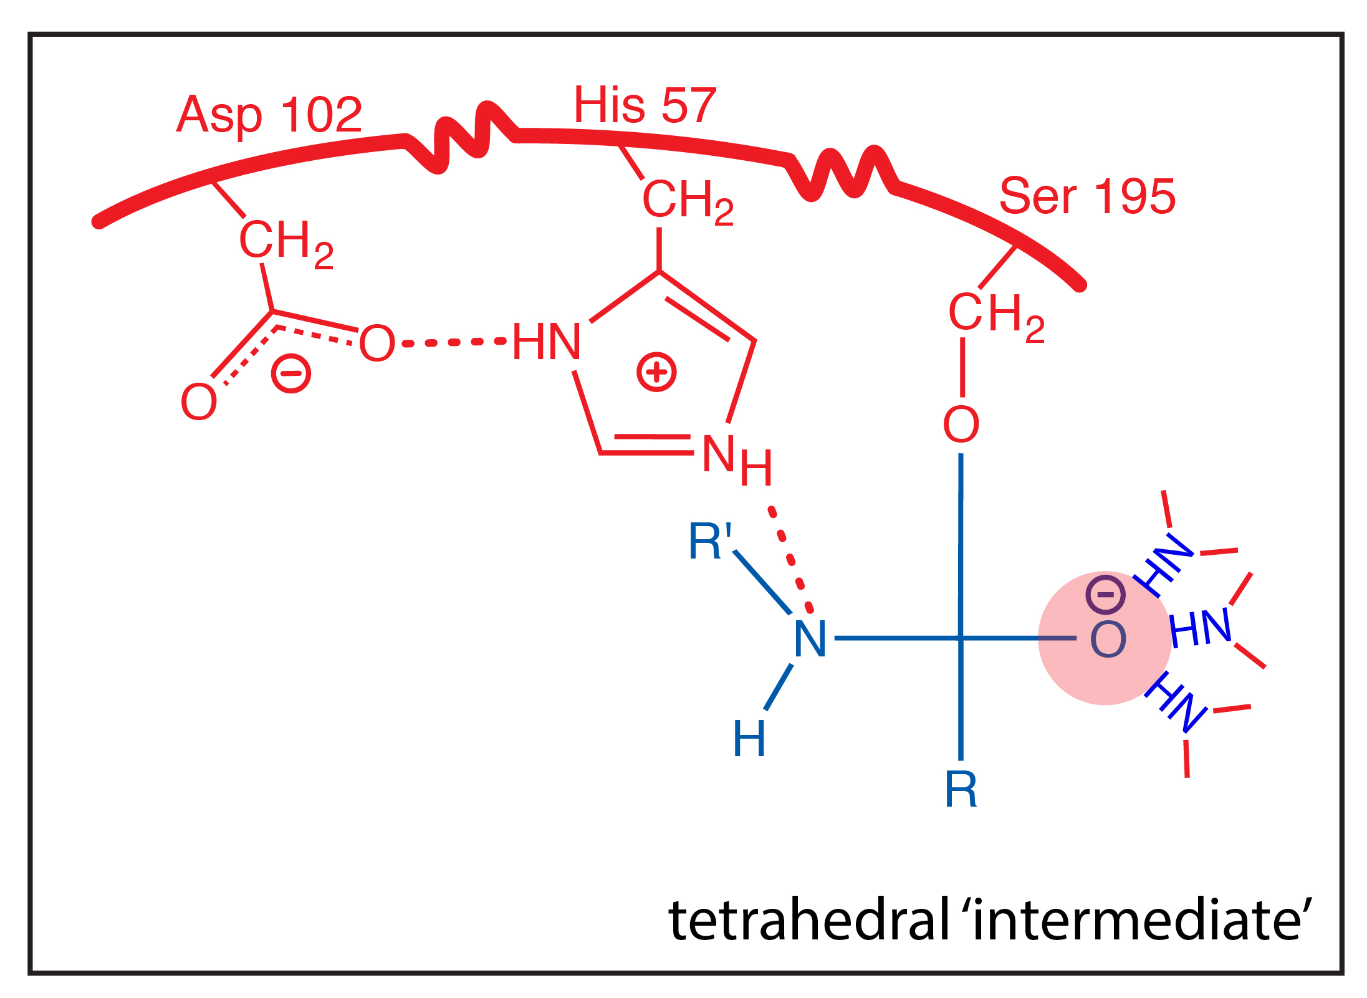
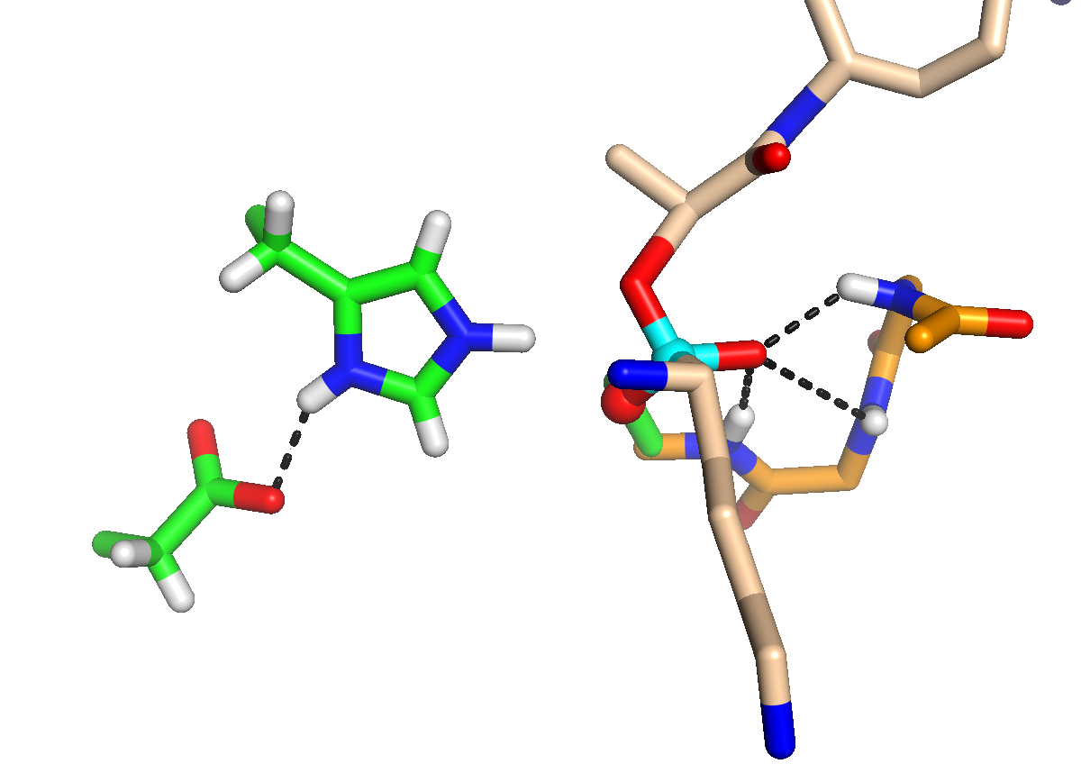
Covalent bond formed between enzyme and substrate
Covalent catalysis: intermediate resembles transition state.

Slide 10
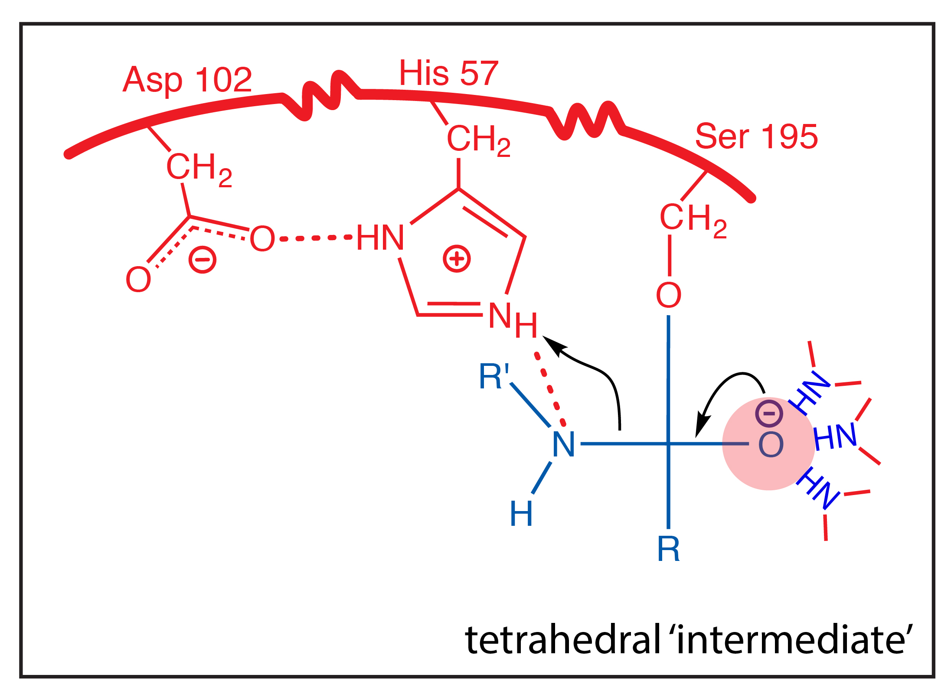

Slide 11
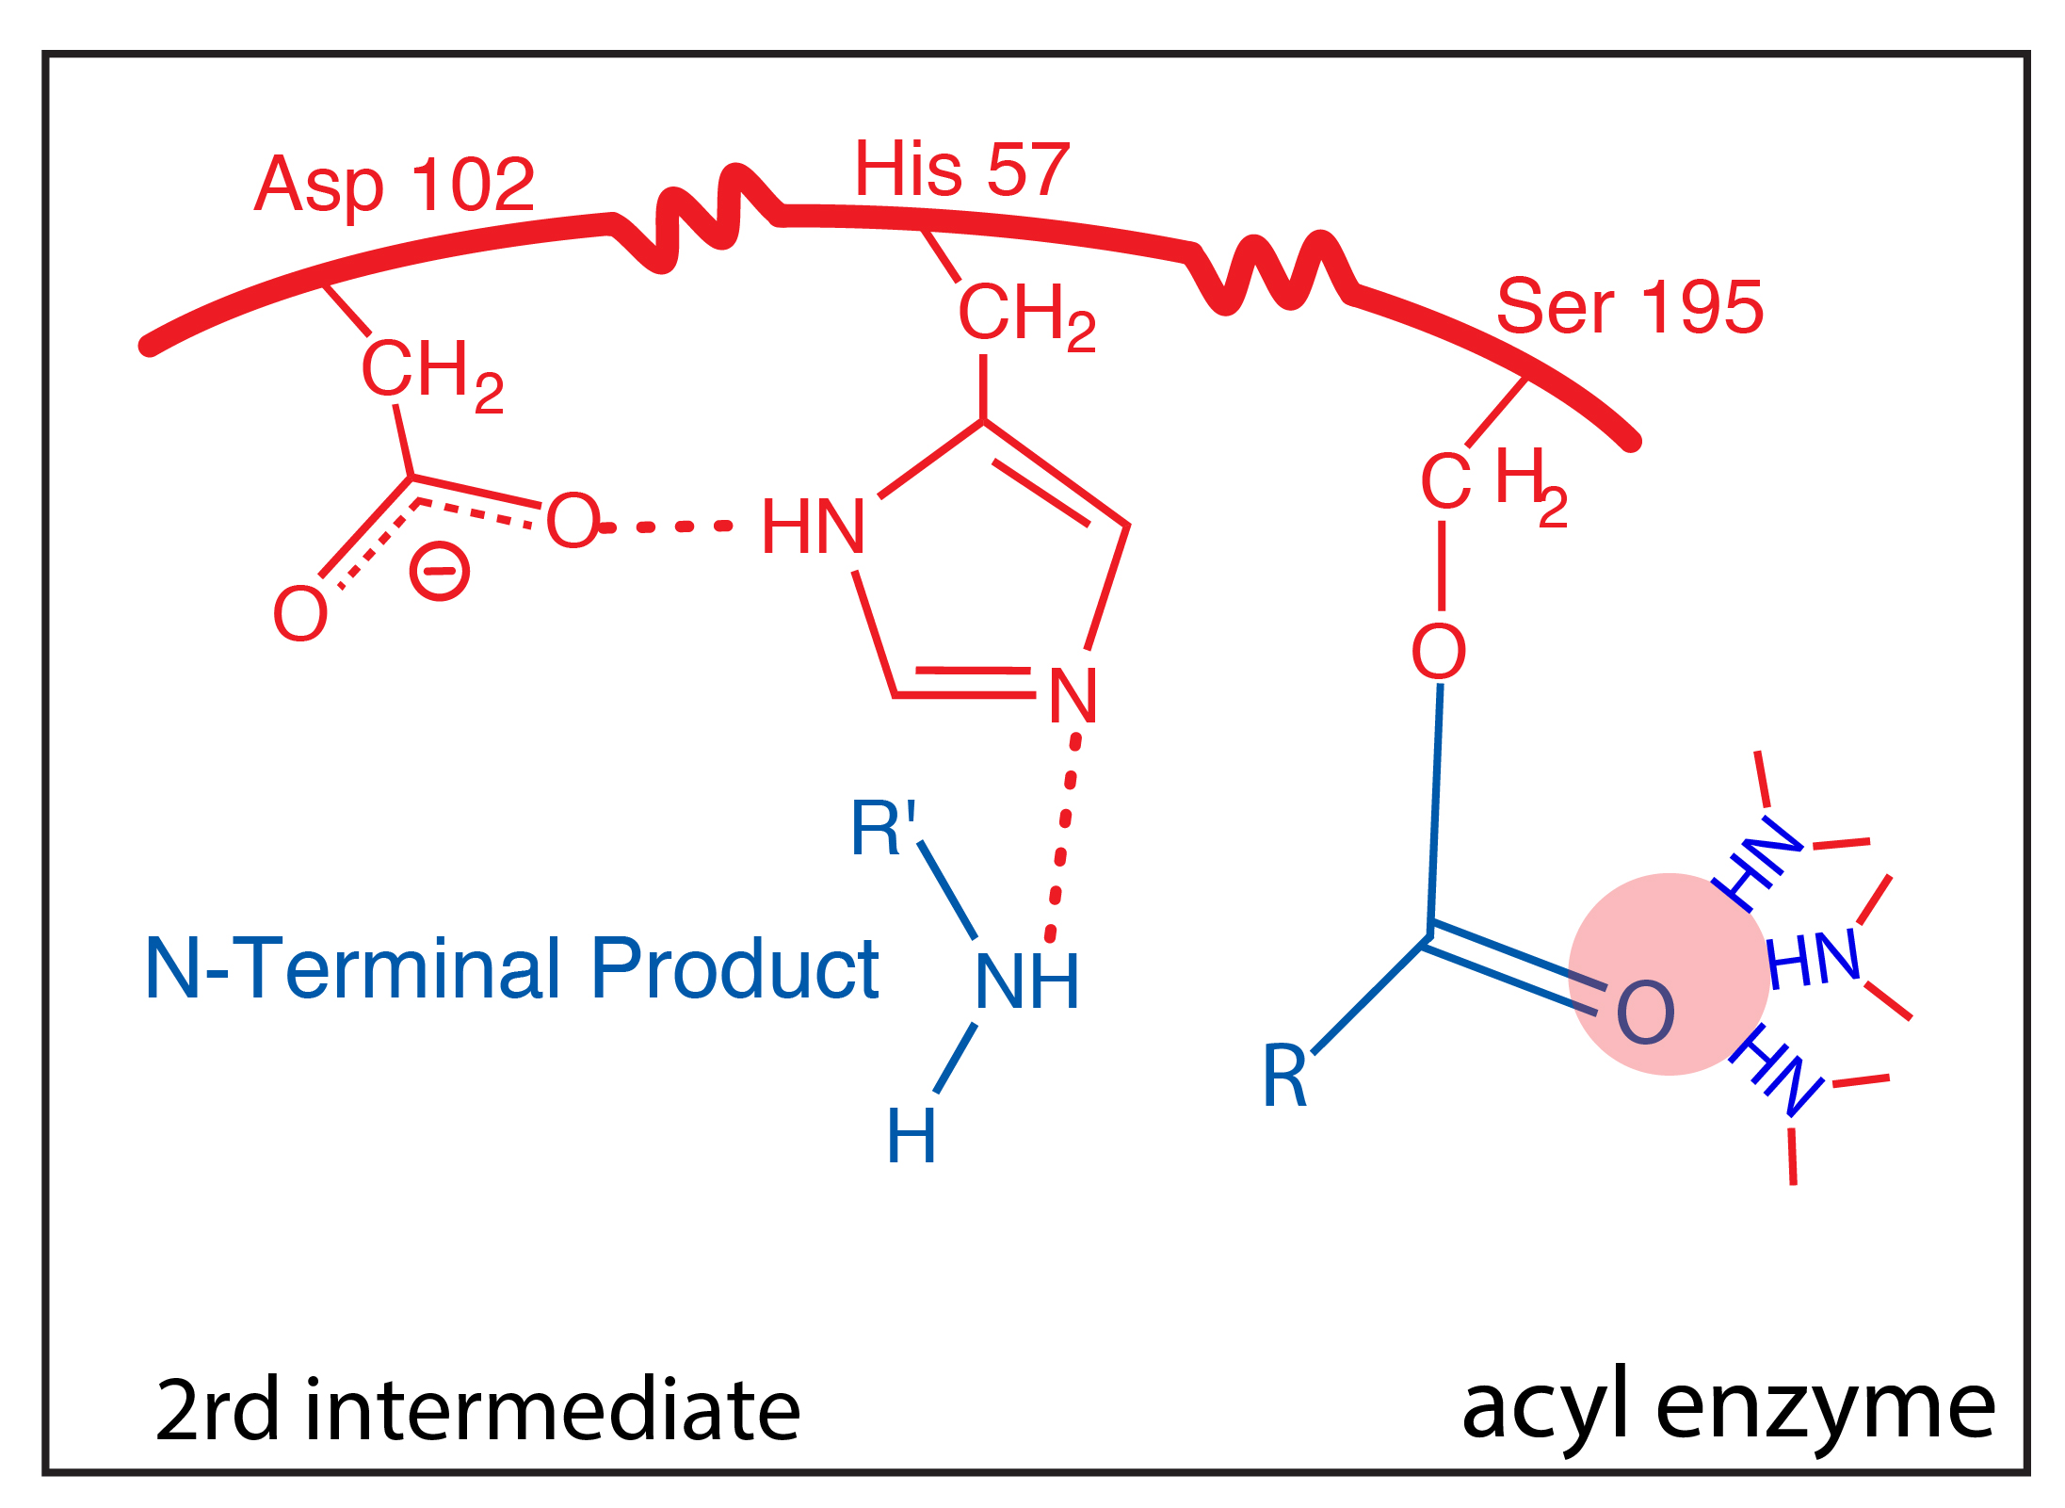

Slide 12
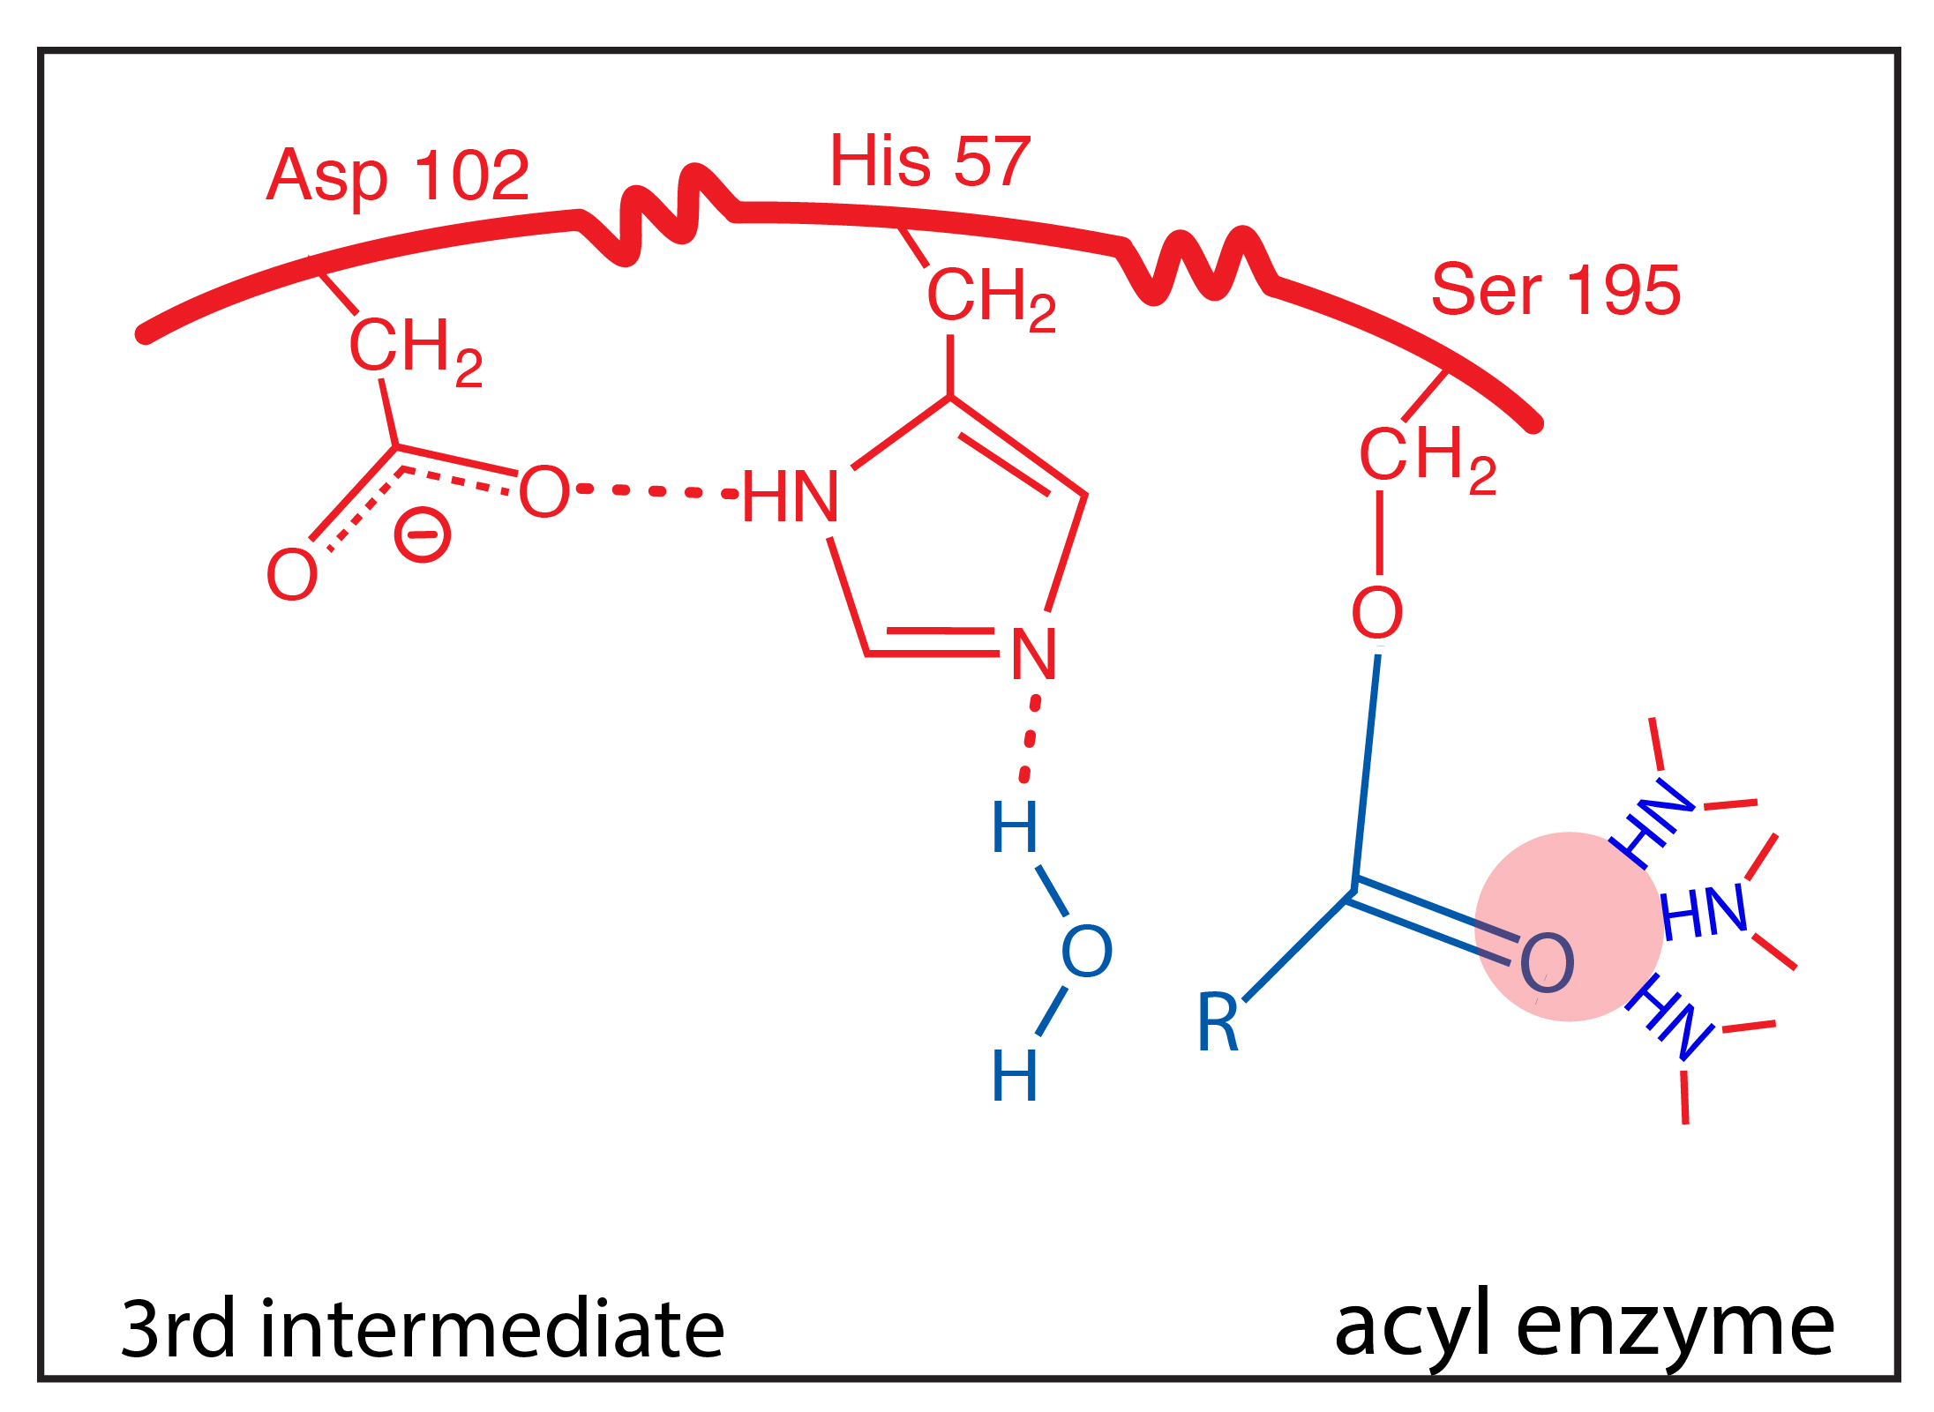

Slide 13
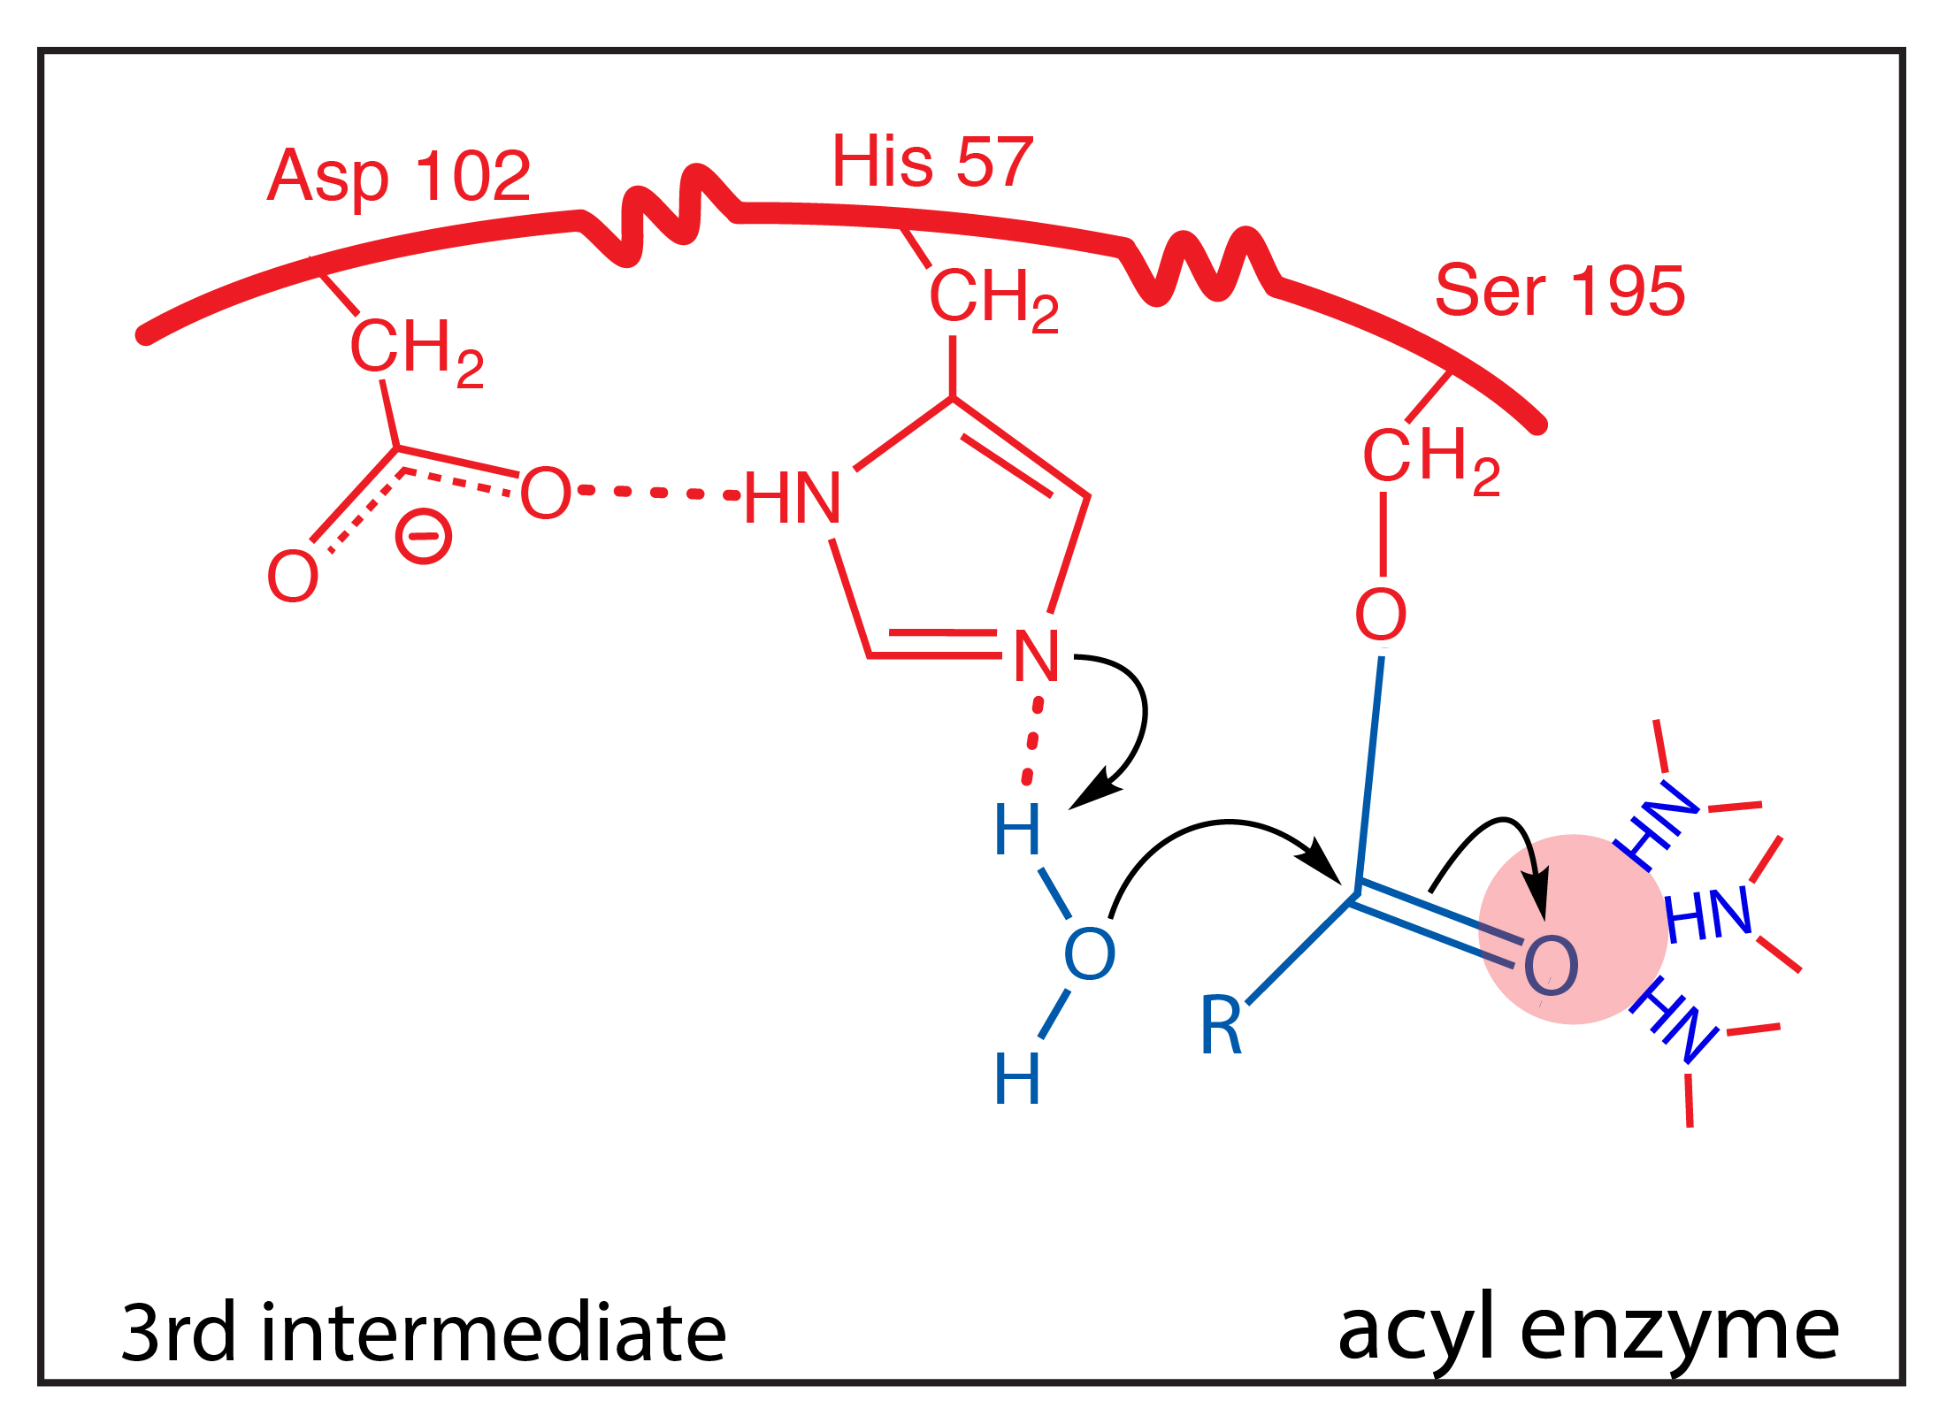

Slide 14
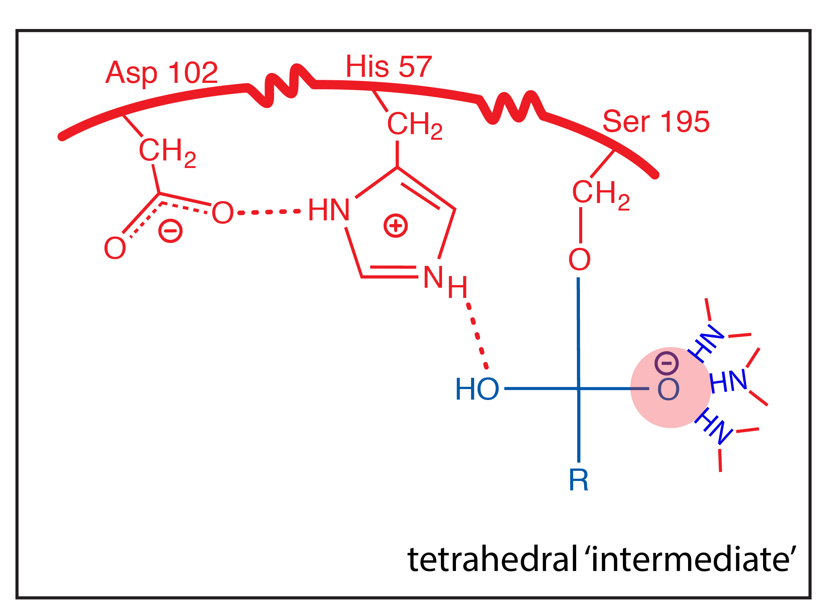

Slide 15
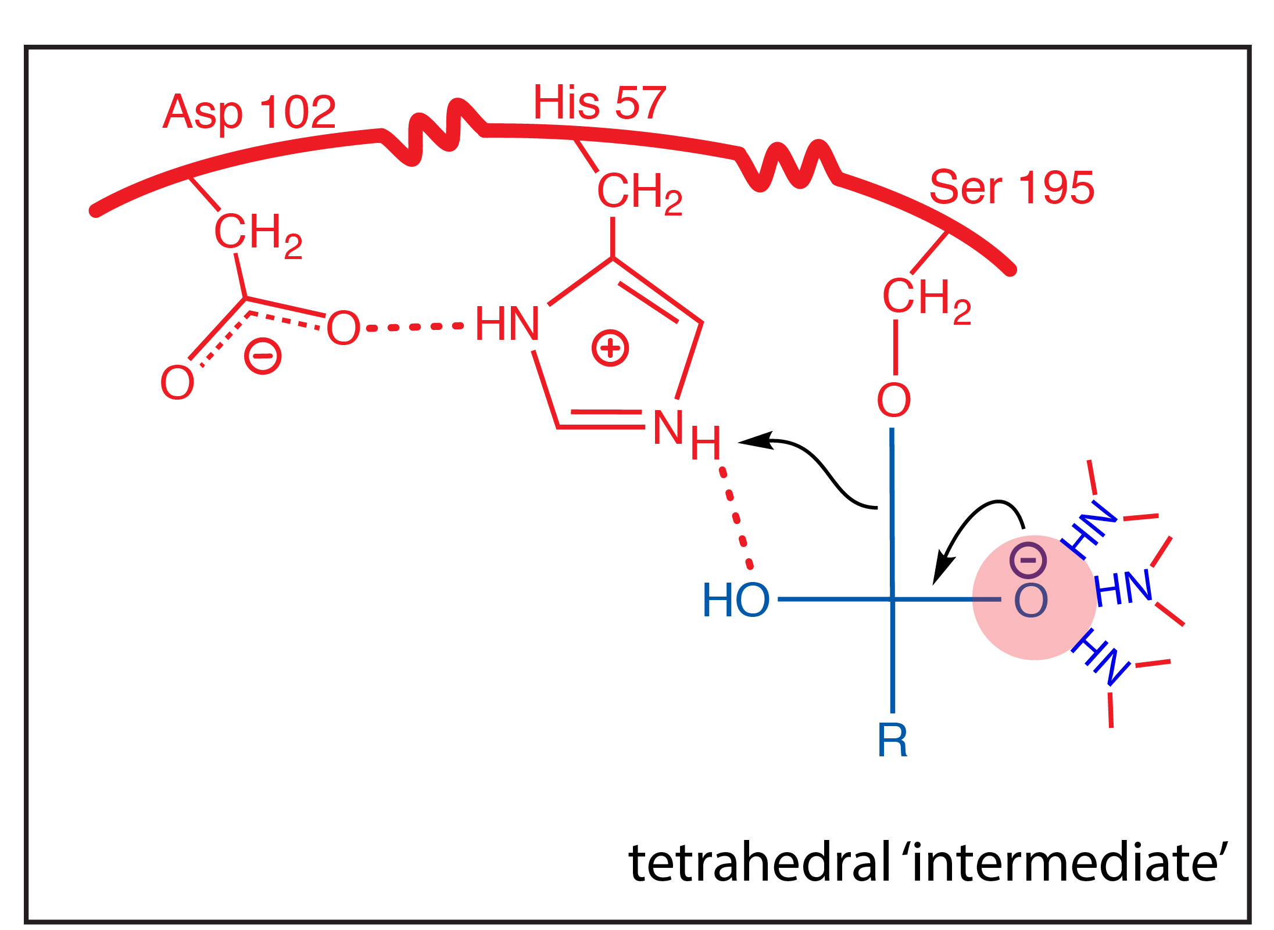

Slide 16
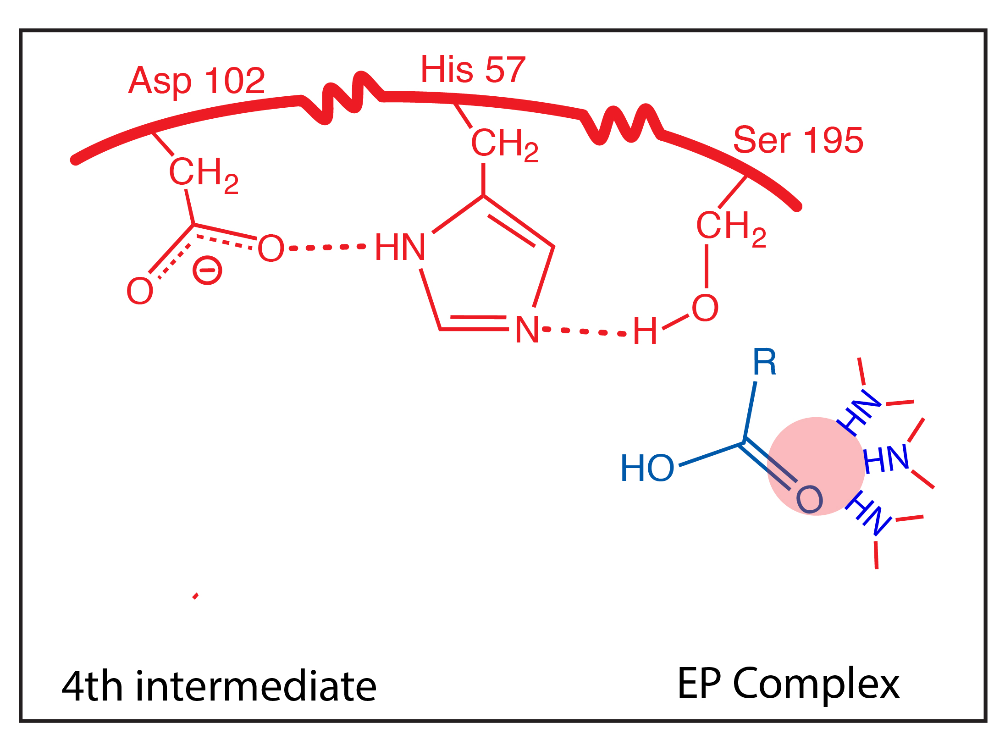

Slide 17
