Slide 1
Protein Folding

Slide 2
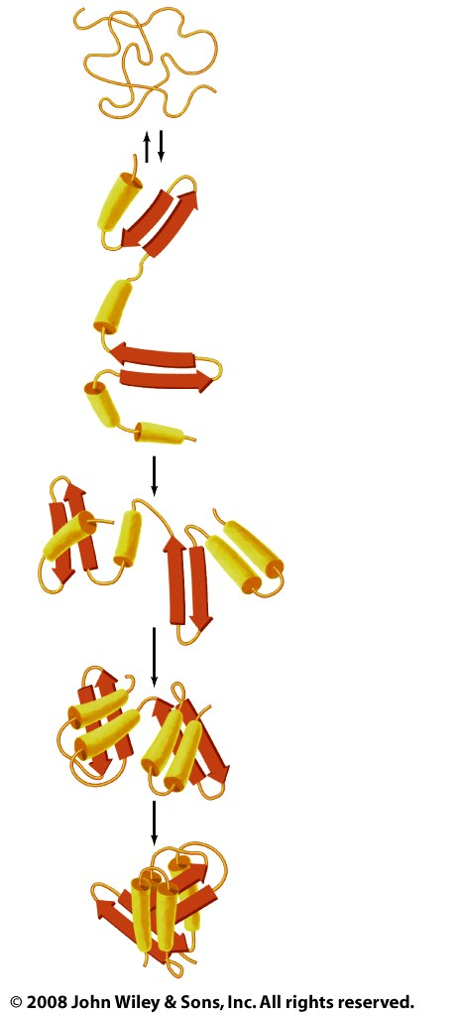
Figure 6-40

Slide 3
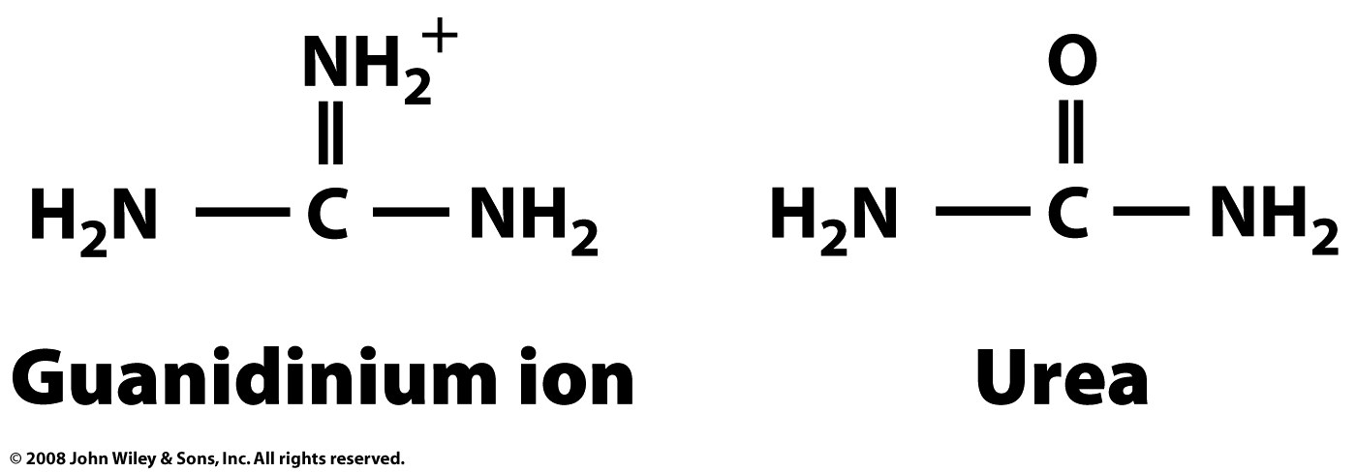
Page 159

Slide 4
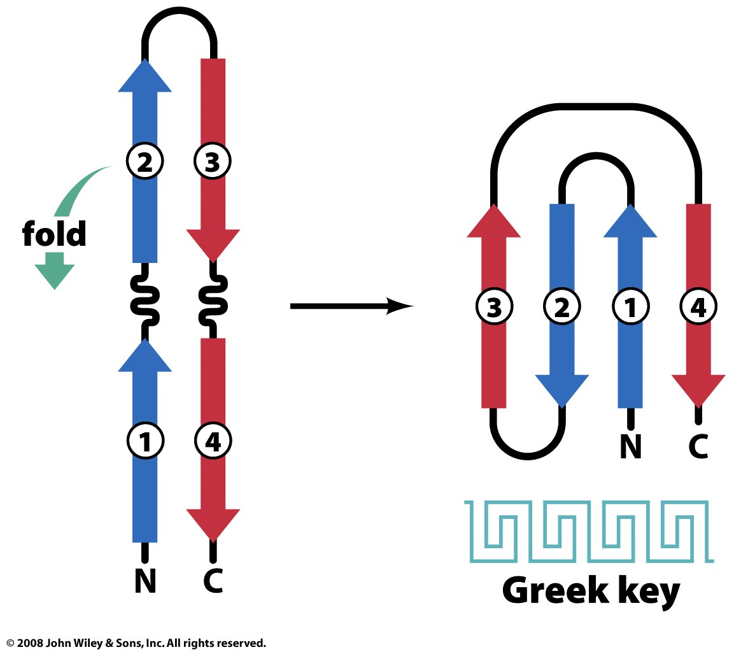
Figure 6-28d

Slide 5
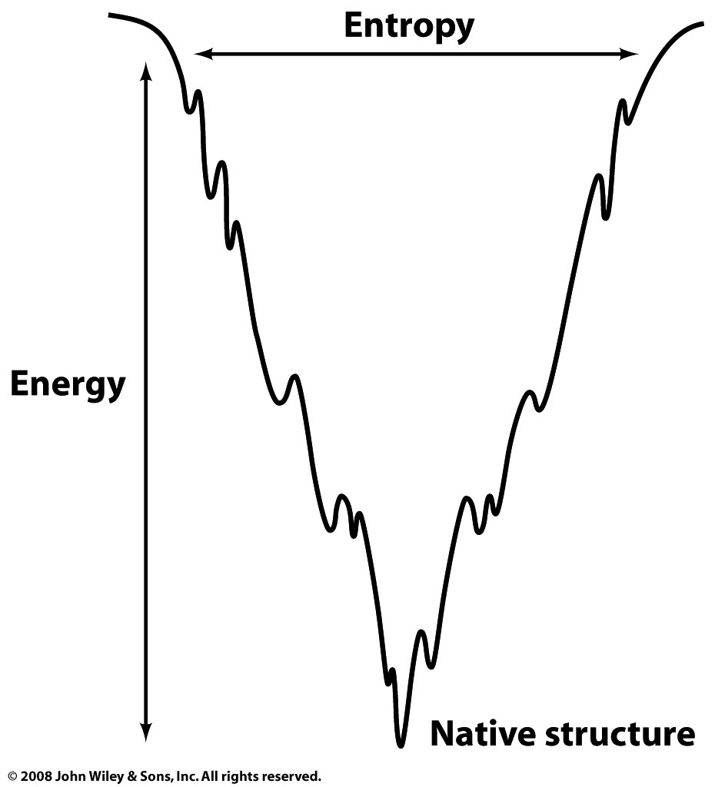
Figure 6-41

Slide 6
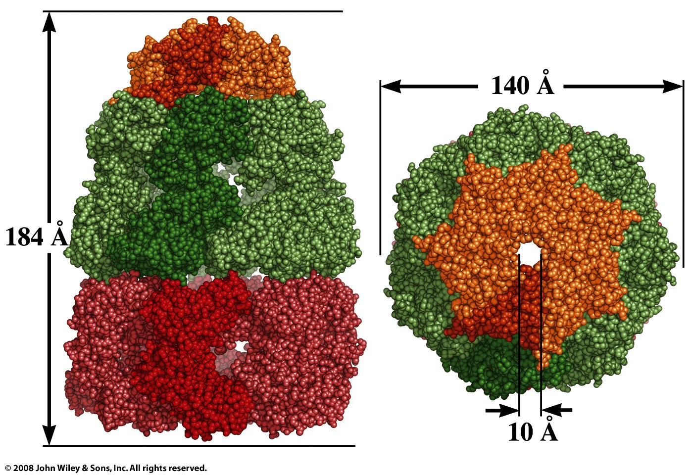
Figure 6-43a,b

Slide 7
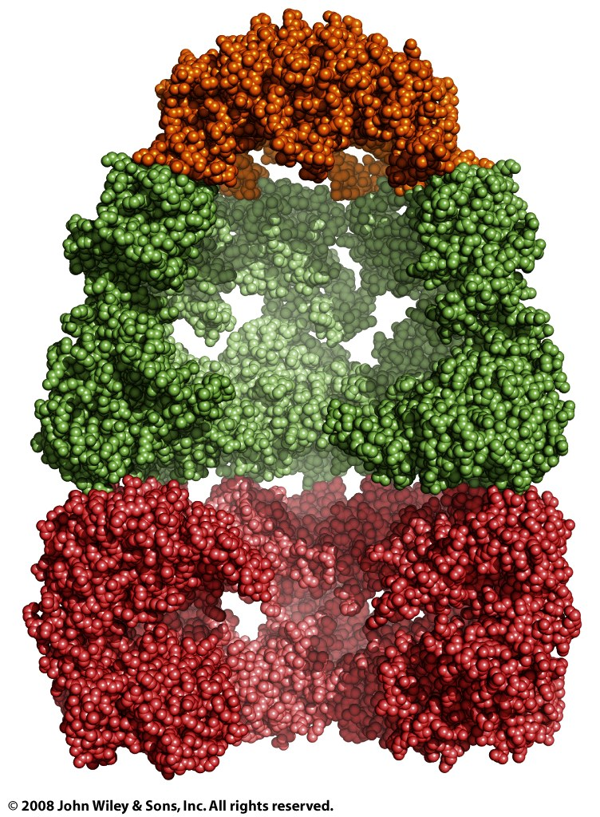
Figure 6-43c

Slide 8
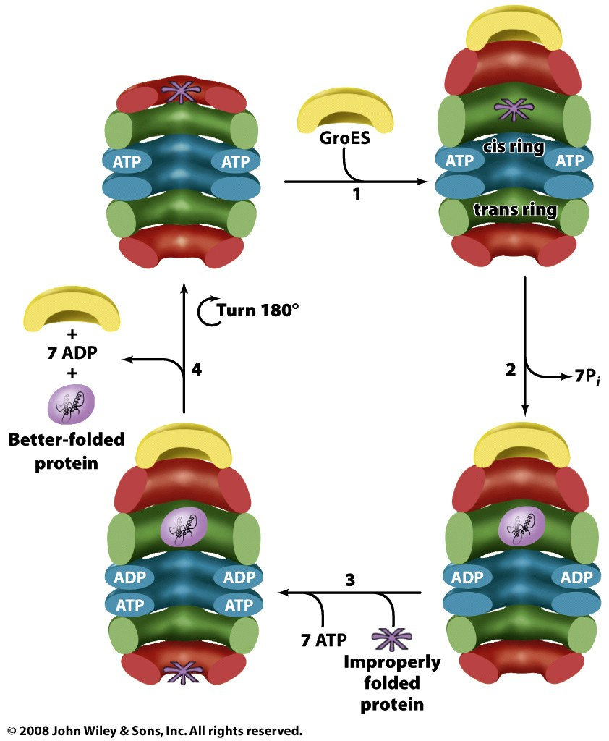
Figure 6-44

