Slide 1
α helix

Slide 2
α-helix
right-handed
most prevalent secondary structural element
most uniform secondary structure in conformation
most predictable secondary structure from sequence
the NH of i+4 donates to O of i
69 H -> O 65, 68 H-> O 64, 67 H -> O 63
13 atoms in the HB ring
100°/aa
φ = -50° to -90°, ϕ = -30 to -60°
3.6 aa per turn
1.5 Å/aa, 5.4 Å/turn (1.5 Å/aa x 3.6 aa/turn)
Amino-acids have 'propensities' for being in α-helices. Methionine, alanine, leucine, uncharged glutamate, and lysine ("MALEK" in the amino-acid 1-letter codes) have high helix-forming propensities. Proline and glycine have low helix-forming propensities.

Slide 3
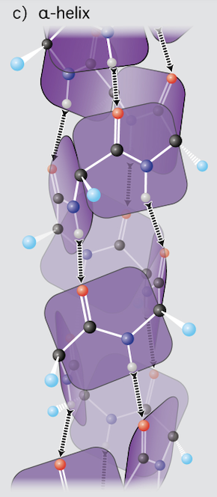

Slide 4
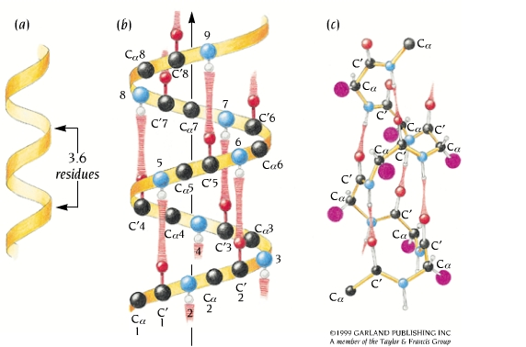
α helix
right-handed helix
100°/residue
3.6 residues per turn
1.5 Å rise per residue
5.4 Å per turn
1.5 Å/residues x 3.6 residues/turn = 5.4 Å/turn
Each N-H group forms a hydrogen bond with the C=O group four residues earlier.
Sidechains are directed out.
Peptide dipoles are aligned
φ = -50° to -90°, ϕ = -30 to -60°

Slide 5
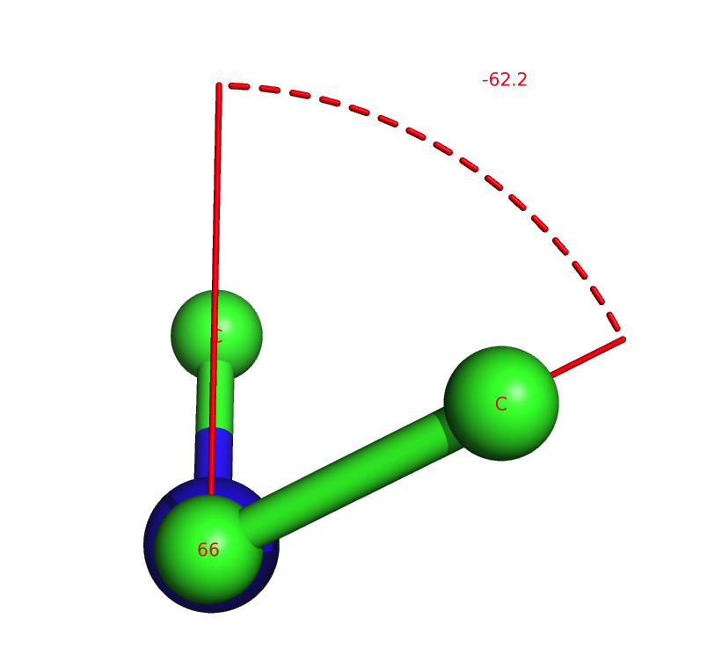
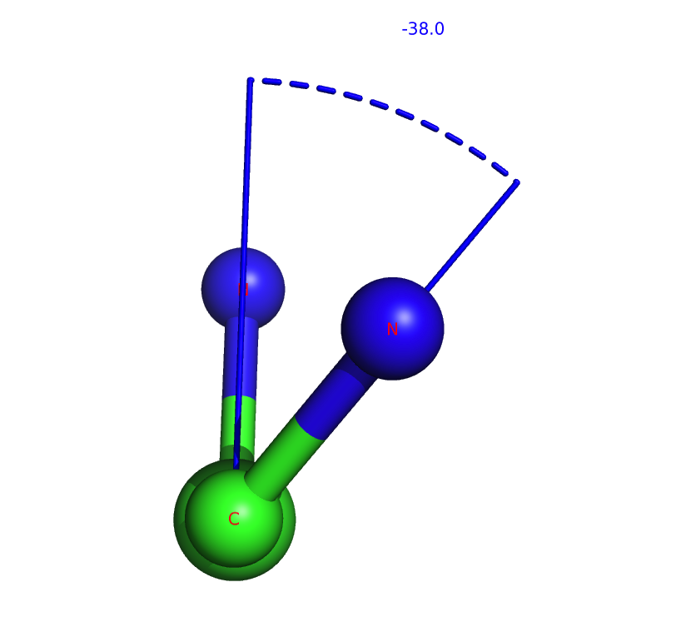
φ = -50° to -90°, ϕ = -30 to -60°
angle φ in an α-helix
angle ϕ in an α-helix

Slide 6
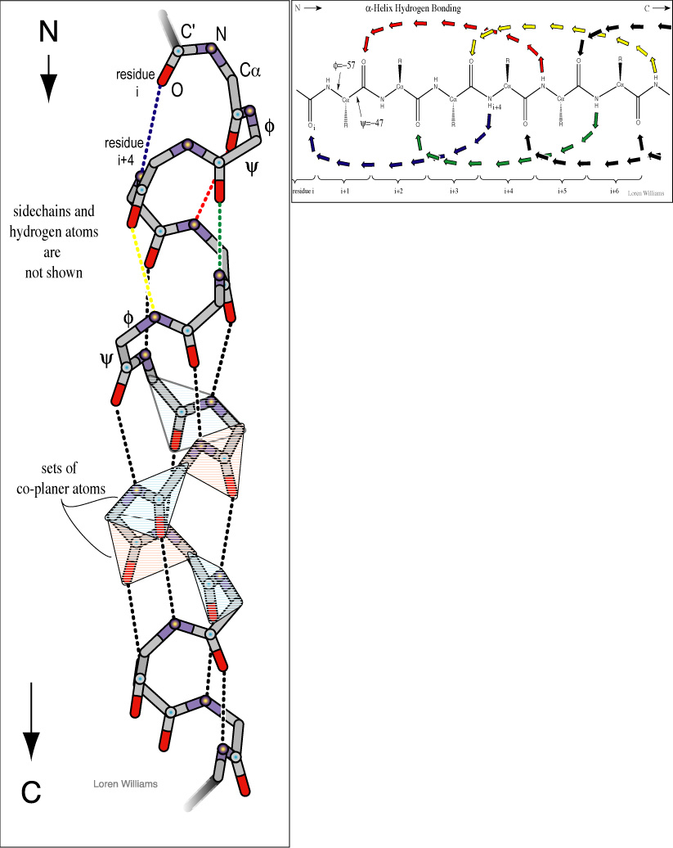
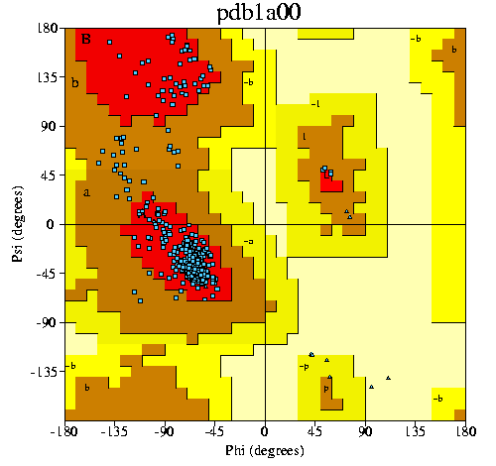
α-helix

Slide 7
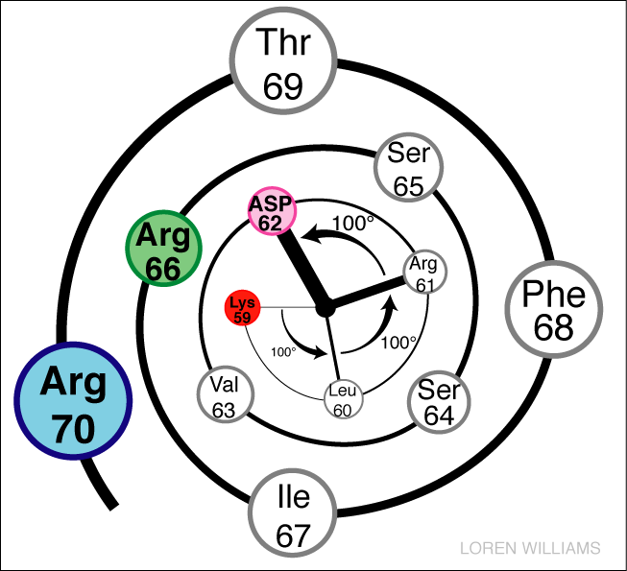
Helical Wheel

Slide 8
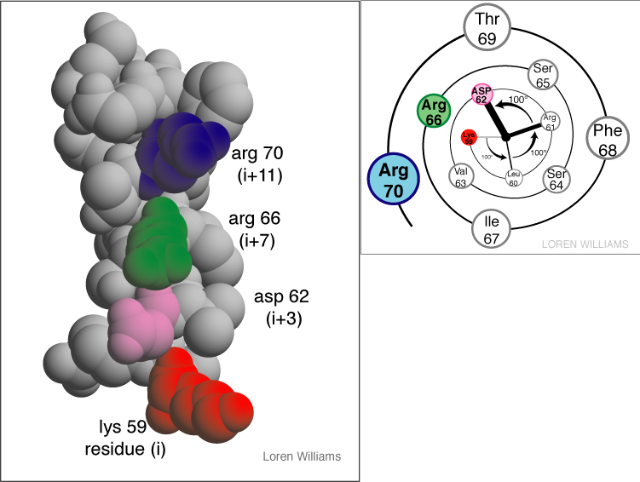

Slide 9
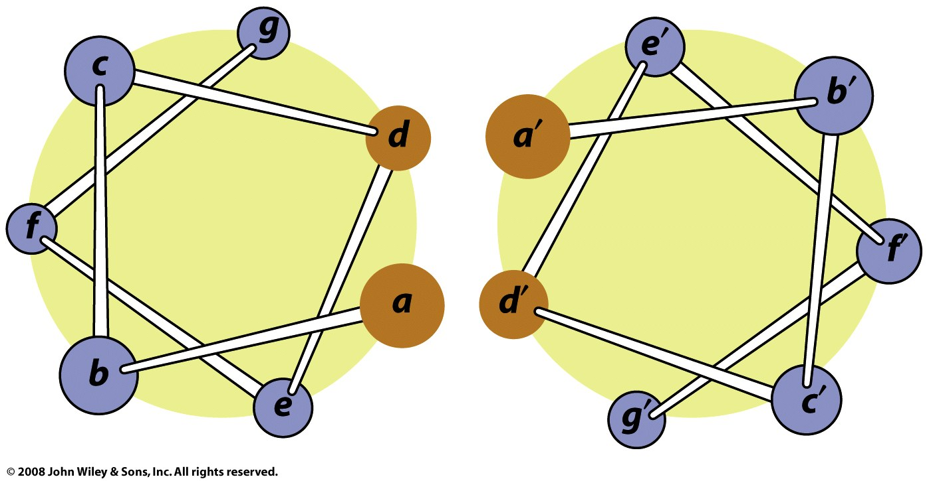
Coiled-coils: two α-helices form a "supercoil" with a heptad sequence repeat of seven aa's (a-b-c-d-e-f-g-a-b-c-d-e-f-g...). The a and d aa's are hydrophobic (d usually leucine). The e and g residues (the e and g aa's have opposing charges.

Slide 10
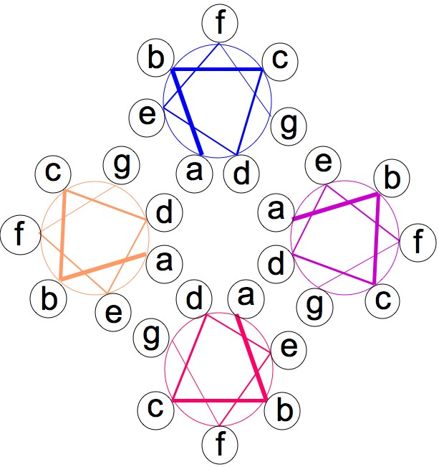
A pair of coiled-coils can form a four-helix bundle

