Slide 1
IDP Workshop, Part 1: Intrinsically Disordered Proteins
1. Why don’t IDPs and IDP Regions fold?
2. How common are IDPs and IDP Regions?
3. What are the functions of IDPs and IDP Regions?
A. Keith Dunker
Department of Biochemistry and Molecular Biology
Indiana University School of Medicine
(kedunker@iupui.edu)
Thursday, May 24, 2018
Department of Chemical and Systems Biology
Stanford University
Palo Alto, California
Notes:
1

Slide 2
Protein Structure/Function
Amino Acid Sequence
“Folding Problem”
Current
Protein Structure/
Function Paradigm
3-D Structure
Native = Ordered = Structured
Protein Function
[ “Lock & Key”; “Induced Fit” ]

Slide 3

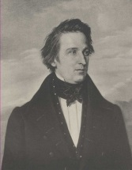
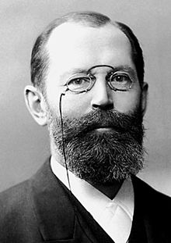
Sequence → Structure → Function:
A Very Brief History
Johann Freidrich Engelhard – Hemogloblin
ratio of total mass to Fe = 16,000 to 1.
Thus MW = 16,000 x n! - 1825
F.L. Hunefeld – First hemoglobin
crystals - 1840
Hermann Emil Fischer – The Lock and
Key Hypothesis for enzyme function - 1894

Slide 4
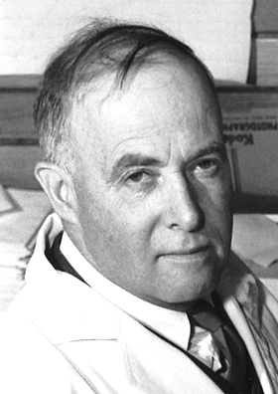
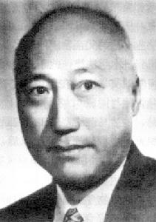
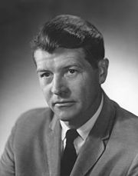
Sequence → Structure → Function:
A Very Brief History - Continued
James Batcheller Sumner – First
crystallization of an enzyme –
jackbean urease - 1926
Hsien Wu – protein structure responsible
for function, protein denaturation caused
by loss of structure - 1931
Christian Boehmer Anfinsen, Jr. – protein
refolding experiment with ribonuclease
showed that folding depends on sequence
- 1957

Slide 5


Sequence → Structure → Function:
A Very Brief History - Continued
The sequence → structure → function paradigm has dominanated discussion of proteins from the 1930s
until now.
David L. Nelson & Michael M. Cox
Lehninger, Principles of Biochemistry.
This biochemistry textbook, like all others, describes proteins in terms of sequence → structure → function.

Slide 6


Sequence → Structure → Function:
A Very Brief History - Continued
Gina Kolata has called the sequence → structure → function paradigm, “the second half of the genetic code.”
Stephen Kevin Burley, among many others, promoted the Protein Structure Initiative (PSI).
The PSI was based squarely on the sequence → structure → function paradigm. NIH spent $764 million on the PSI from 2000 to 2015. World-wide spending likely doubled this amount. The PSI awarded very large grants to a few huge teams of researchers.

Slide 7
Sequence → Structure → Function:
A Very Brief History - Continued
The PSI was based on high-throughput, industry-type work involving large teams of scientists. A few university consortia developed collaborative, industry-type teams.
Expected PSI benefits included:
● Use structures to determine protein functions;
● Solve key biomedical problems;
● Discover new drugs by structure-based methods;
● Discover improved therapeutics for many diseases;
● Improve technology for protein structure determination.
Unexpected PSI benefits:
● Discovered many IDPs and IDP regions
● Discovered many IDP- and IDP region-based functions

Slide 8
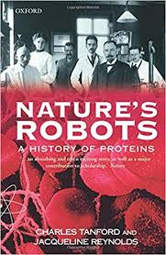
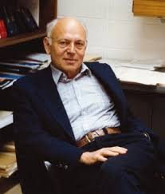
For a Detailed History of the
Sequence → Structure → Function Paradigm
Charles
Tanford
&
Jacquiline
Reynolds
Published
2001

Slide 9
Intrinsically Disordered Proteins (IDPs) and IDP Regions
● Some proteins & regions lack structure, yet carry out function.
● We call these intrinsically disordered
proteins (IDPs) and IDP Regions.
Notes:
9

Slide 10
Definition: Intrinsically Disordered Proteins (IDPs) and IDP Regions
Whole proteins and regions of proteins are intrinsically disordered if:
● they lack stable 3D structure under physiological conditions, and if:
● they are flexible molecules that form dynamic ensembles with inter-converting configurations and without particular equilibrium values for their coordinates.
Notes:
10

Slide 11
What led me to become interested in Intrinsically Disordered Proteins (IDPs)?
An IDP region in TMV coat protein undergoes a disorder-to-order transition as it binds to TMV RNA during virus assembly.
Holmes KC. Ciba Found Symp. 93:116-38 (1983)
2. Conversion of fd phage capsid from structure to molten globules enables the fd coat protein to insert into model membrane vesicles; fd coat protein loses structure but gains function.
Dunker AK et al., FEBS Lett 292: 275-278 (1991)

Slide 12

Uversky’s Rule of Three
“Three encounters with IDPs are needed before
a researcher takes them seriously.”
Vladimir
Uversky

Slide 13

Close IDP Encounter of the Third Kind,
Trigger for my IDP Research
Seminar describing an important IDP
12 Noon to 1 PM, 15 November, 1995
Washington State University
Given By Chuck Kissinger
BS / MS Washington State University
PhD University of Washington
Johns Hopkins / MIT Post Doc
Aguoron Pharmaceuticals
Notes:
13

Slide 14
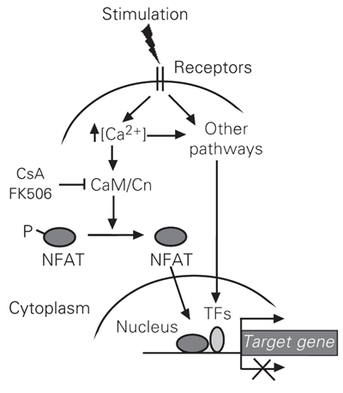
Signaling Pathway
Calmodulin (CaM)
Calcineurin (Cn)
Nuclear Factor of
Activated T- Cells (NFAT)
NFAT-poly-P in an IDP tail.
Remove Ps, activates NLS
→ NFAT → nucleus
→ turns on genes
→ T-cells activated
→ reject transplant

Slide 15
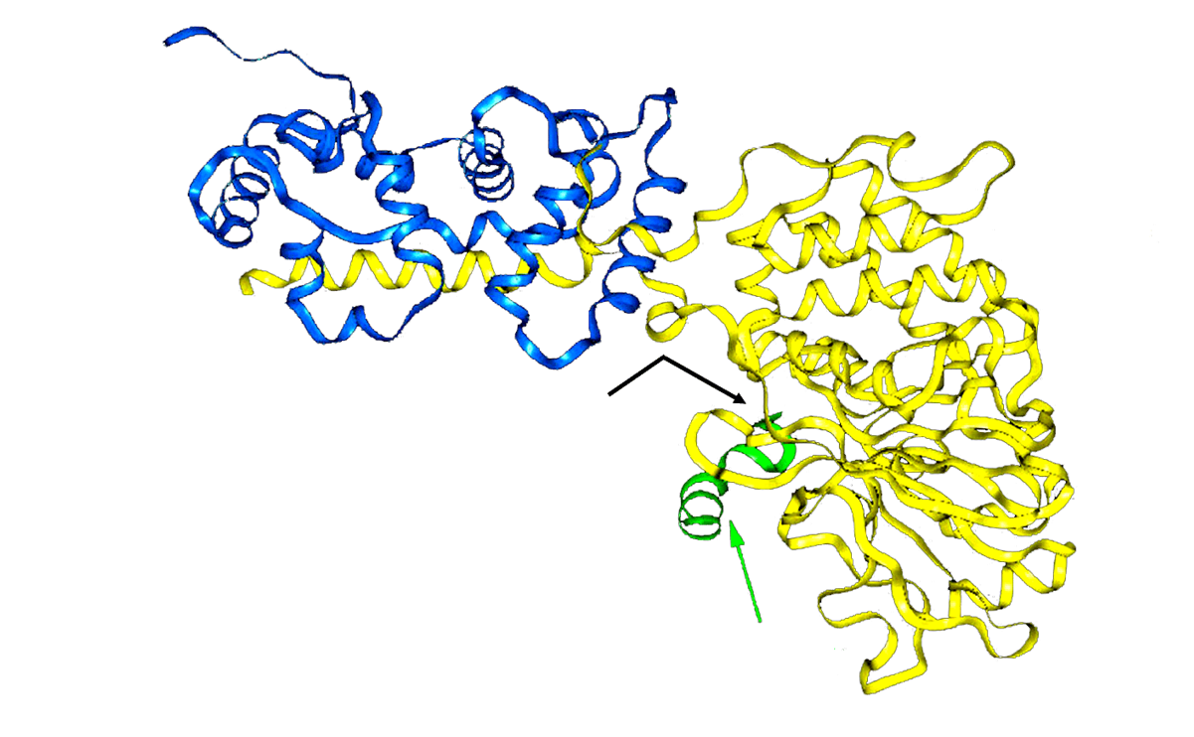
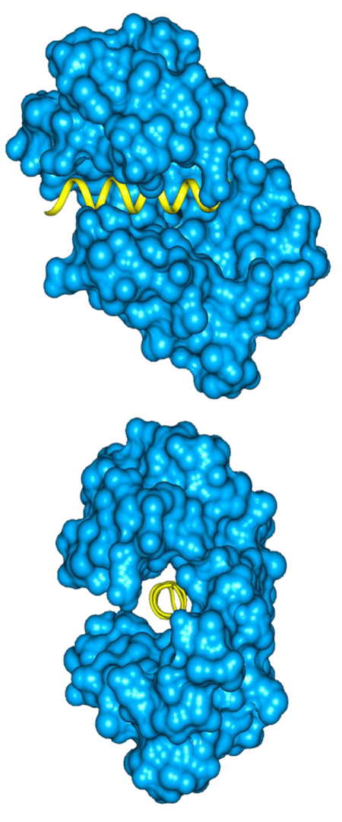
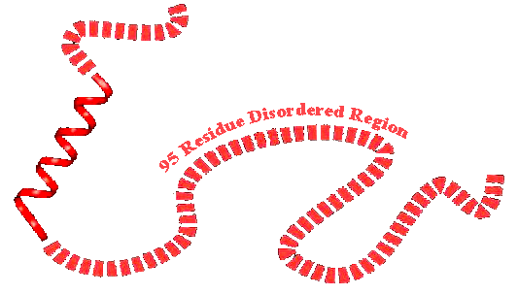
Calcineurin and Calmodulin
Meador W et al., Science
257: 1251-1255 (1992)
B-Subunit
A-Subunit
Active Site
Autoinhibitory
Peptide
Kissinger C et al., Nature 378:641-644 (1995)

Slide 16
Key Points I
● Consider CaN’s 140 residue region of missing electron density (MED): is this MED due to an IDP region or due to a structured, but wobbly domain?
● Ca²⁺/CaM surrounds an isolated helical segment of the MED region, so this segment must be separated from the body of protein – this indicates that the MED is an IDP region;
● Elsewhere it was shown that CaN is hypersensitive to protease digestion at multiple sites, and that binding of Ca²⁺/ CaM inhibits this protease digestion – this also indicates that the MED is an IDP region;
Notes:
16

Slide 17
Key Points II
● IDP function: on-off switch for CaN;
● CaN activated by Ca²⁺/ CaM – such activation is a well known, very important mechanism for regulating many enzymes and pathways;
● CaN is a phosphatase; phosphorylation / de-phosphorylation is a very important, frequently used mechanism for many signaling pathways;
● Overall, CaN’s IDP region sits at the nexus of two extremely important signaling pathways!!
Notes:
17

Slide 18
Summary of my IDP Knowledge
as of 1 PM, November 15, 1995
● An IDP region in the TMV coat protein undergoes a disorder-to-order transition as it binds to TMV RNA.
● The fd coat protein loses its rigid structure and gains the ability to dissolve in a membrane bilayer.
● A large IDP region in CaN is a Ca²⁺/ CaM-
regulated ON-OFF switch for CaN’s enzyme activity.
Notes:
18

Slide 19
After Seminar Questions: Nov 15, 1995
● Why don’t IDPs and IDP regions fold into 3D structure?
● How common are IDPs and IDP regions?
● What are the functions of IDPs and IDP regions?
Notes:
19

Slide 20
Why don’t IDPs fold into 3D structure?
● Amino acid composition determines whether a protein will fold or remain unfolded.
● For compositions that favor structure, the sequence patterns of hydrophobic / hydrophilic groups determine which 3D structure is formed.
Shakhnovich, E.I. and Gutin, A.M. Engineering of stable and fast-folding sequences of model proteins. Proc. Natl. Acad. Sci. USA 90: 7195 – 7199 (1993).
Notes:
20

Slide 21
Why don’t IDPs fold into 3D structure?
First step: collect structured proteins from PDB and also collect IDPs / IDP regions.
● X-ray Structures from PDB: structured regions and MED regions
● NMR Structures from PDB: invariant regions and highly variable regions
● Literature, one-by-one examples: whole protein disorder (IDPs) from CD or NMR spectra
Notes:
21

Slide 22
Why don’t IDPs fold into 3D structure?
How common are MED regions in the PDB?
In a 2007 report on non-redundant PDB proteins:
● 76% had ≥ 2 structure files;
● only 7% were completely structured;
● only 25% were ≥ 95% structured;
● 10% contained MED regions ≥ 30 residues;
● 40% contained ≥ 1 MED regions of 10 – 29 residues.
Le Gall T et al., J Biomol Struct Dyn 24: 325-342 (2007)
Notes:
22

Slide 23
Why don’t IDPs fold into 3D structure?
Compare AA composition in structure and IDP
● Collect an equal number of structured regions and IDP regions of a given length, say 21 residues;
● For each 21 residue region, calculate the value of attribute x; for example, “aromatic attribute” = x = (W + Y + F) / 21
● Collect regions of ~ same x values, then determine # of structured regions of attribute value x = Ns,x , # of IDP regions of attribute value x = Nd,x, and Ns,x + Nd,x = Nt,x.
● The conditional probabilities, P(S|x), and P(D|x), are ~ equal to P(Ns,x/Nt,x|x) and P(Nd,x/Nt,x|x), respectively.
● Calculate the approximate values for P(S|x), and P(D|x) for each x, then plot P(S|x) and P(D|x) versus x on the same graph.
● The Area Ratio = (Area between the curves) / (Total Area of graph);
The larger the Area Ratio (AR), the better for structure vs IDP region discrimination. AR values ranged from ~ 0.5 to ~ 0.04 for 38 different attributes tested; (W + Y + F) / 21 ranked 6th with an AR value of 0.36.

Slide 24




Why don’t IDPs fold into 3D structure?
Xie et al., Genome Informatics 9: 193-200 (1998)
Structured: P(S|x)
0
.
8
Qian
Xie
Ethan
Garner
AR = (A_{bc}/A_{t})
AR = 0.36
Rank = 6/38
0
.
6
Conditional Probability
0
.
4
0
.
2
Disordered: P(D|x)
Zoran
Obradovic
Pedro
Romero
0
0
0
.
0
5
0
.
1
0
.
1
5
0
.
2
x = (F+W+Y)/21
Notes:
24

Slide 25
Why don’t IDPs fold into 3D structure?
Amino acid sequence favors nonfolding!
● IDPs have too few aromatics – aromatics are important for the stability of hydrophobic cores;
● IDP ratio of hydrophilic amino acids to hydro-phobic amino acids is too high for folding;
● IDPs have too low of a sequence complexity
● IDPs have too large of a net charge – charge repulsion inhibits folding;
● IDPs have too many prolines – prolines cannot form backbone H–bond, so helices and sheets are destabilized by prolines.
Notes:
25

Slide 26
Why don’t IDPs fold into 3D structure?
Dunker et al., Adv. Prot. Chem. 62: 25-37 (2002)
Surface
Buried

Slide 27
How common are IDPs?
● Using amino acid compositional differences between structured proteins and IDPs and IDP regions, develop order / disorder predictor;
● Validate predictor on “out-of-sample” data;
● Apply predictor to amino acid sequences of whole proteomes.
Notes:
27

Slide 28
Prediction of Intrinsic Disorder
Aromaticity,
Hydropathy,
Net Charge,
Complexity
Disordered & Ordered Sequence Data
Attribute Selection or Extraction
Separate Training and Testing Sets
Neural Networks,
SVMs, etc.
Predictor Training
Predictor Validation on Out-of-Sample Data
CASP Expt: 2002 – 2010
Bal. ACC ~ 0.75; AUC ~ 0.86
Prediction
Notes:
28

Slide 29
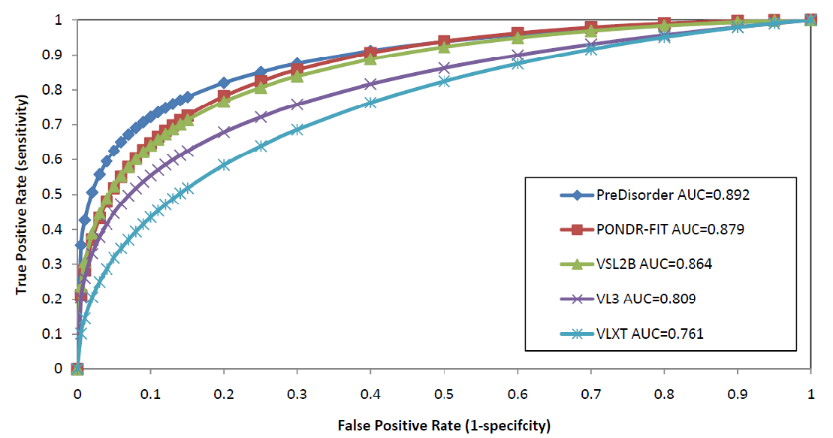
Comparison on CASP 8 Dataset
Bal ACC = 80%
AUC =
0.89
→
→
Bal ACC = (%Corr-O)/2 + (%Corr-D)/2
AUC = Area Under Curve
Perfect: AUC = 1.0
Random: AUC = 0.5
Zhang P, et.al. (unpublished results; not quite same as CASP evaluation)

Slide 30

How common are IDPs?
Bin Xue
Plasmodium
Human
Halophiles
Vladimir Uversky
Xue et al., J
Biomol Struct
Dyn 30: 137-149
(2012)

Slide 31
How common are IDPs?
More recent, improved approach
Combine structure / disorder prediction and structure prediction by sequence similarity to all currently known protein 3 D structures.
For the human proteome:
Fukuchi, S., et al., Binary classification of protein molecules into intrinsically disordered and ordered segments. BMC Struct Biol. 11:29 (2011); For Human: 35% residues are in IDPs or IDP regions. (Weakness → used Pfam for structured proteins)
For 1,765 proteomes (8 different order / disorder predictors):
Oates, M.E. et al., D²P²: database of disordered protein predictions. Nucleic Acids Res. 41(Database issue):D508-516 (2013). For Human: 35% - 50% residues in IDPs or IDP regions.
(Strength → used SUPERFAMILY for structured proteins)
Notes:
31

Slide 32
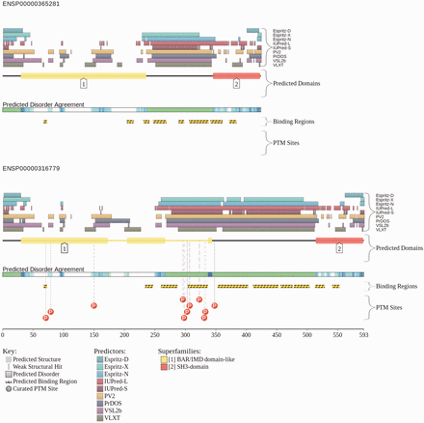


Human BIN1 from D²P²
Various
IDP Predictors
SUPERFAMILY
Domains
Binding regions
PTM Sites
Two
transcripts
from one
gene;
INSERTION
Matt Oates
Insertion
from
alternative
splicing.
Julian Gough
Oates et al., NAR
41: D508-516 (2013)

Slide 33
What are the functions of IDPs?
● Individual examples of IDPs and IDP regions and their functions: (calcineurin – CaN), lac repressor, signaling domain partners, p53, BRCA1; (p21/p27/p57)
● Bioinformatics study to comprehensively determine functions of structured proteins and of IDPs and IDP regions.
Notes:
33

Slide 34
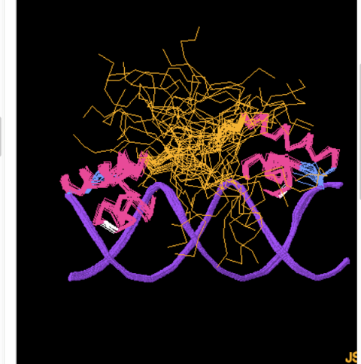
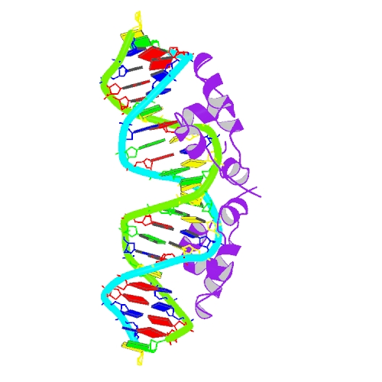
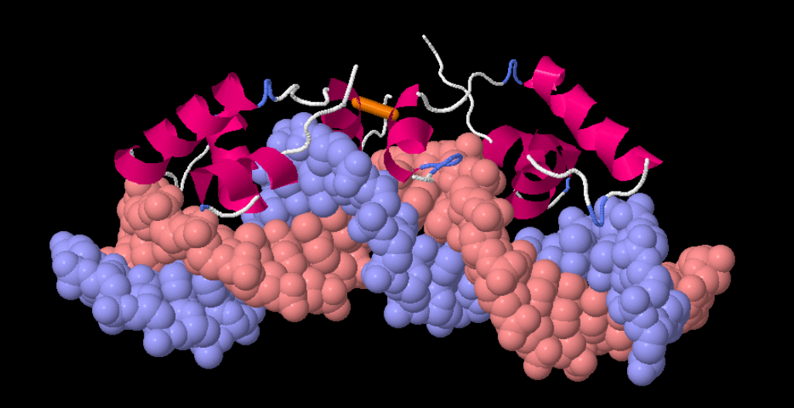

The Lac Repressor
Kalodimos et al., Science 305:386-389 (2004)
● Upon binding to nonspecific DNA, a large segment of the Lac Repressor remains an IDP region that interacts transiently with DNA phosphates.
● Upon encountering its binding sequence, the IDP region → structure and is involved in recognizing the cognate DNA binding sequence and in increasing the binding affinity. Also, the DNA becomes bent.
Proteopedia, Life in 3D, the
free, collaborative 3D
Encyclopedia was used for
these images – provided by:
Joel Sussman

Slide 35
IDPs & Function:
Signaling Domain Partners
More than 100 signaling domains such as SH1, SH2, PDZ, GYF, etc. Most of these these domains bind to IDP regions. Discuss only GYF domain.
● GYF domain: has GP[YF]xxxx[MV]xxx[GN]YF motif;
● GYF domain also known as CD2BP2 and other names;
● CD2: “cluster of differentiation”2 – on surface of T-cells;
● CD2 contains an IDP region that binds to the GYF domain.
Signaling Domains (SH2, SH3) discovered by Tony Pawson

Slide 36






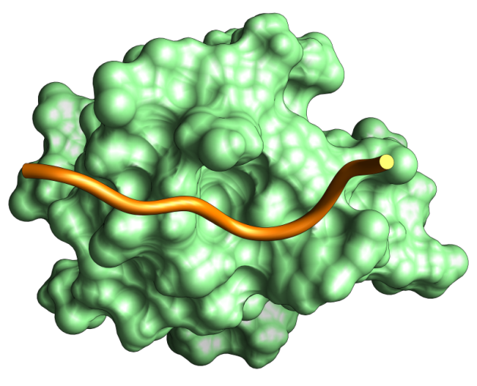









































Protein Signaling Domain Example:
GYF Domain Bound to CD2 IDP Region
Tony
Pawson
Exterior TM Cytoplas.
I I I I
See Also “Simple Modular Architecture Research Tool” (SMART)
Notes:
36

Slide 37
IDPs & Function: p53
p53: main isoform ~ 400 AA residues
● About 50% of this protein’s residues are in two IDP regions, which are located at the two termini;
● This protein is a tumor suppressor, it initiates apoptosis, it arrests cell growth, it increases genome stability, it inhibits angiogenesis, and it activates the expression of hundreds of genes;
● This protein binds to DNA and to over 100 different protein partners; these many interactions enable the long list of functions given above.
Notes:
37

Slide 38
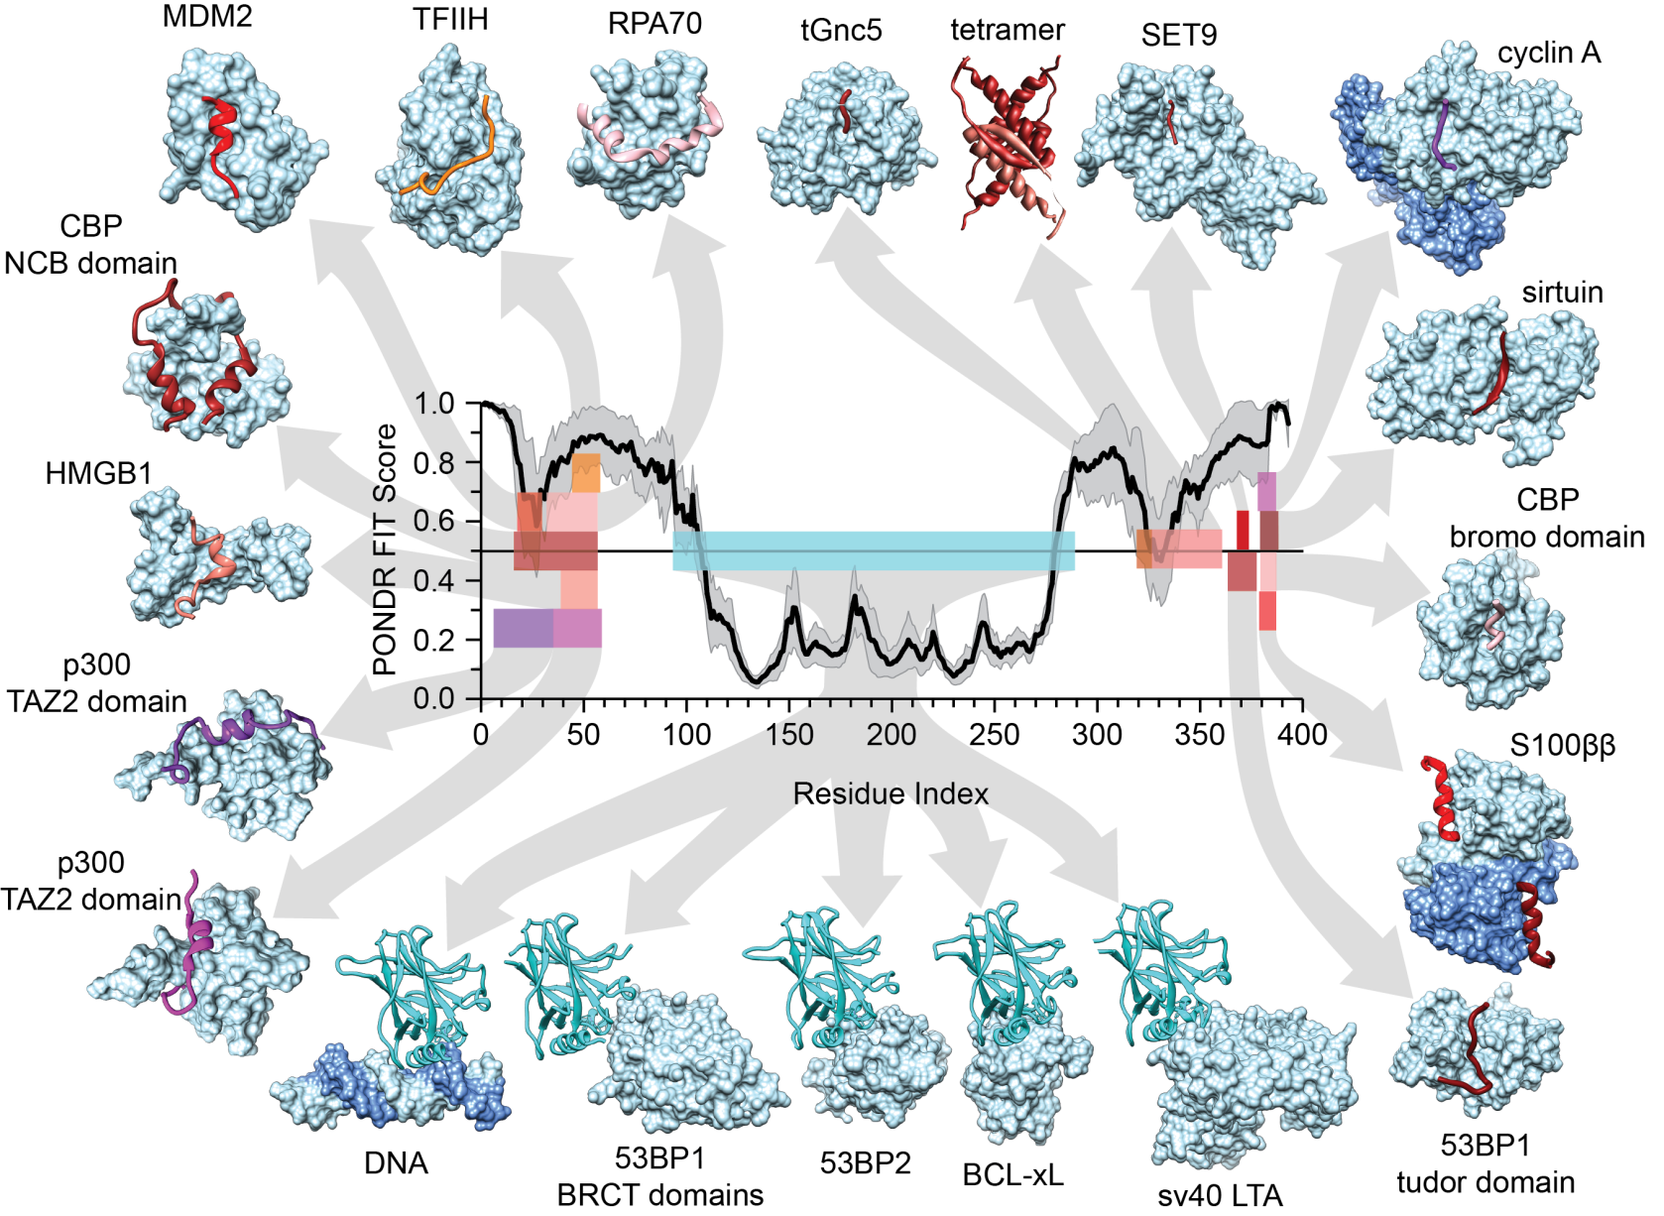

p53 binding
Note IDP tails!
Molecular
Recognition
Features (MoRFs)
Modified from: Oldfield & Dunker, Ann Rev Biochem 83: 553 – 584 (2014)
Chris Oldfield

Slide 39
IDPs & Function: BRCA1
BRCA1: main isoform ~ 1,860 AA residues
● About 83% of this protein is in one long, central IDP region of more than 1,500 residues;
● This protein is involved in DNA repair, in cell-cycle check point control, in transcription regulation, in apoptosis, in mRNA splicing, and in the activation of the expression of many genes;
● This protein binds to DNA and > 400 different protein partners; again these many interactions enable the long list of functions given above.

Slide 40
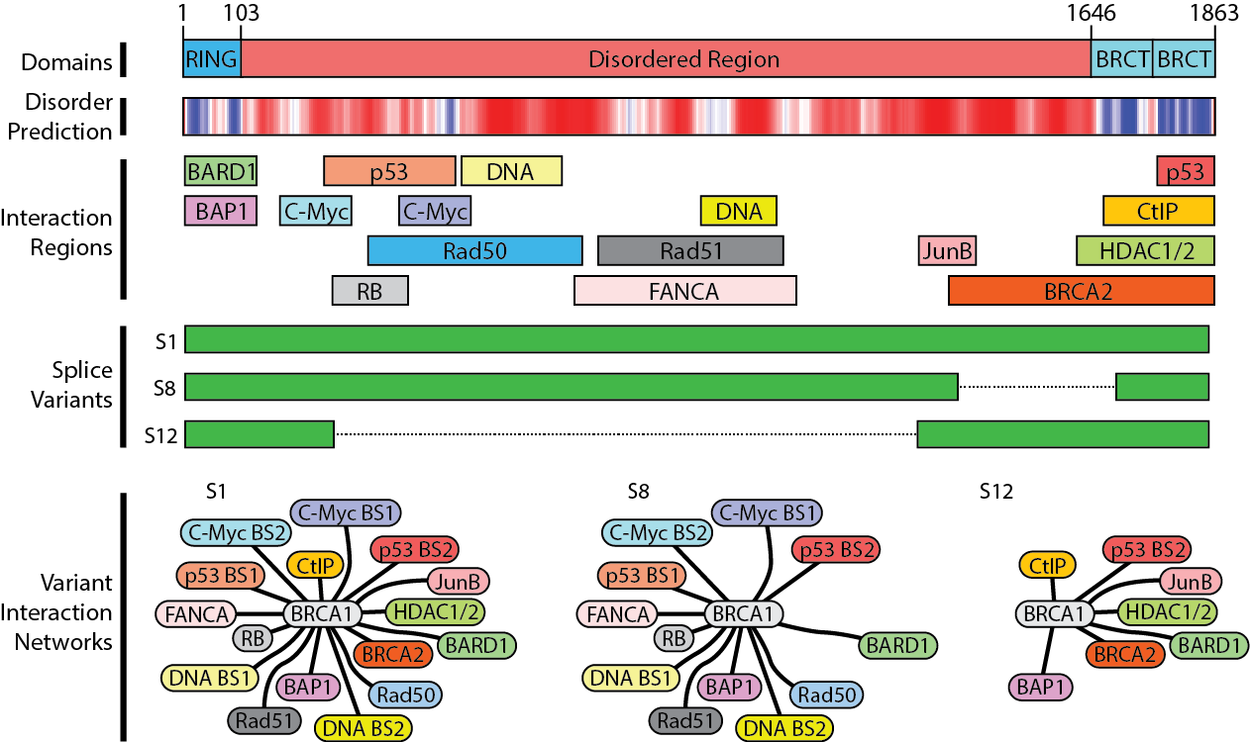
BRCA1
1863
residues;
103 ordered at the N-term;
217 ordered at the C-term;
1543 form one
long IDP region
in between.
Dunker AK et al.
Semin Cell Devel
Biol 37: 44-55 (2015)

Slide 41
IDPs & Function: p21/p27/p57
p21 / p27 / p57:
● Each of these molecules is 100% IDP by both prediction and experiment;
● Each of these proteins is an inhibitor of the cyclin dependent kinase (CDK)-cyclin complex;
● Each of these proteins is involved in cell-cycle check point control;
● Removal of each of these proteins from the CDK-cyclin complex involves a multistep process that may act as a signal coordinator.

Slide 42
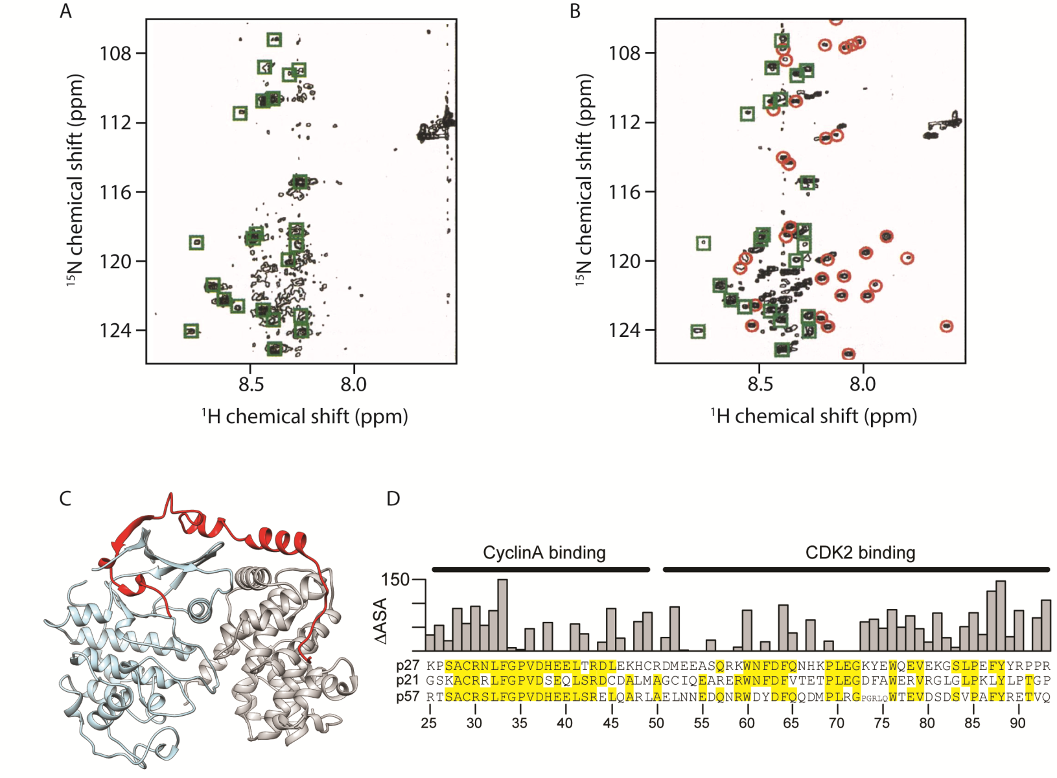
p21^{Waf1/Cip1/Sdi1} p27^{Kip1} p57^{Kip2}
Reviewed in:
Dunker AK &
Oldfield CJ
IDPs Studied
by NMR,
Adv Expt Med
& Biol; Felli &
Pierattelli (eds),
Springer
International
Publishing,
Switzerland
pp. 1-34 (2015)
Intrinsic Disorder → Structure
p21 alone p21 + CDK
p27
Cyclin A
CDK2
Notes:
42

Slide 43
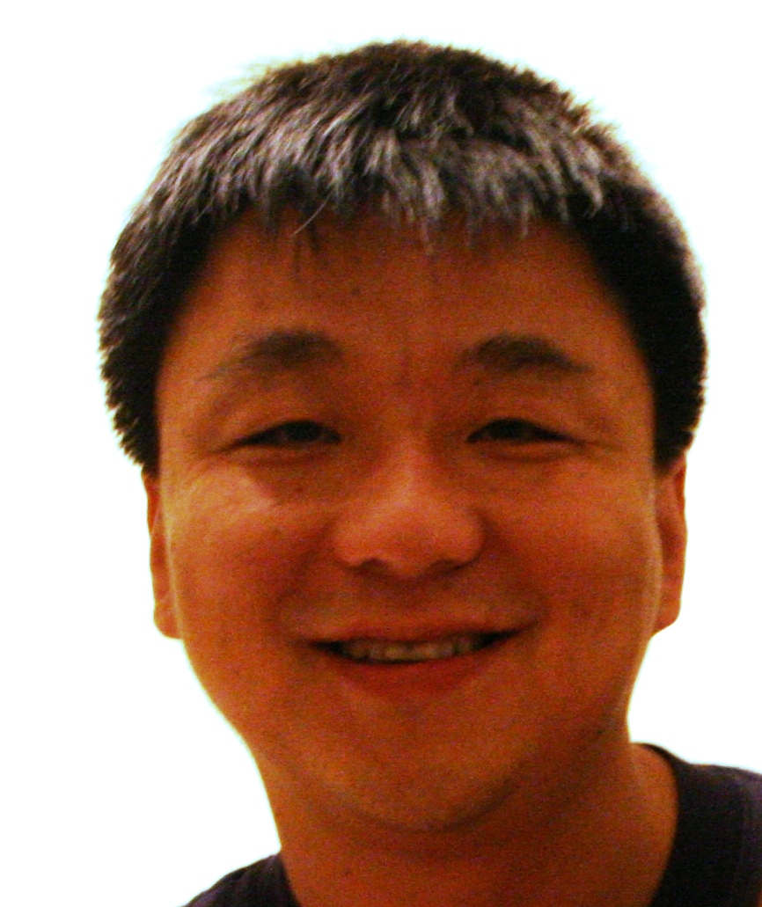
IDPs & Function
Global Analysis
Hongbao Xie
Zoran Obradovic
● Collect SwissProt function-specific sequences;
● Collect matching random-function sequences; Repeat 1,000 times;
● Predict disorder for each function-specific & 1,000 random-function sets → all RFS ~ fit one Gaussian;
● Rank structure- and disorder-associated functions by Z-scores ( Z-score = [x – <x>]/σ );
– values = more structure, + values = more disorder

Slide 44
Top 10 Biological Processes Most Strongly Associated with Low-prediction of Disorder (e.g. with Structure)
KEYWORDS | Proteins (number) | Families (number) | Length (Ave) | Z –Score
GMP Biosynthesis | 225 | 3 | 473 | –17.6
Amino-acid Biosynthesis | 7098 | 212 | 361 | –17.1
Transport | 19888 | 2199 | 378 | –14.9
Electron Transport | 4633 | 346 | 272 | –13.7
Lipid A Biosynthesis | 533 | 13 | 291 | –13.2
Aromatic Catabolism | 320 | 105 | 300 | –12.4
Glycolysis | 2255 | 50 | 390 | –12.1
Purine Biosynthesis | 1208 | 28 | 445 | –11.9
Pyrimidine Biosynthesis | 1310 | 27 | 383 | –11.7
Carbohydrate Metabolism | 1797 | 180 | 404 | –11.7
Xie H, et al., J. Proteome Res 6: 1882-1932 (2007)

Slide 45
Top 10 Biological Processes Most Strongly Associated with High-Prediction of Disorder
KEYWORDS | Proteins (number) | Families (number) | Length (Ave) | Z –Score
Differentiation | 1406 | 422 | 439 | 18.8
Transcription | 11223 | 1653 | 442 | 14.6
Transcription Regulation | 9758 | 1554 | 413 | 14.3
Spermatogenesis | 332 | 189 | 280 | 13.9
DNA Condensation | 317 | 130 | 300 | 13.3
Cell Cycle | 4278 | 612 | 494 | 12.2
mRNA Processing | 1575 | 249 | 516 | 10.9
mRNA Splicing | 716 | 180 | 459 | 10.1
Mitosis | 718 | 215 | 620 | 9.4
Apoptosis | 810 | 211 | 465 | 9.4
Xie H, et al., J. Proteome Res 6: 1882-1932 (2007)

Slide 46
What are the functions of IDPs?
IDPs Used for Signaling and Regulation!
● Sequence → Structure → Function (Z < – 1)
– Catalysis,
– Membrane transport,
– Binding to DNA, RNA, molecules or IDP regions.
  ● Sequence → IDP Ensemble → Function (Z > + 1)
  – Signaling, Dunker AK, et al., Biochemistry 41: 6573-6582 (2002)
  – Regulation, Dunker AK, et al., Adv. Prot. Chem. 62: 25-49 (2002)
  – Recognition, Xie H, et al., Proteome Res. 6: 1882-1898 (2007)
  – Control. Vucetic, S. et al., Proteome Res 6: 1899-1916 (2007)
  Xie H, et al., Proteome Res 6: 1917-1932 (2007)
Notes:
46

Slide 47
Summary
Sequence → Structure → Function
● Structured proteins are for catalysis, transport, and binding to molecules, to macromolecules, and to IDP regions;
Sequence → IDP Ensembles → Function
● IDPs are for signaling, regulation, recognition, and control.

Slide 48
Intrinsically Disordered Proteins
THANK YOU!!!
(kedunker@iupui.edu)
Funding: NIH, NSF, INGEN
IUPUI Signature Centers Initiative
Notes:
48

