Slide 1
Loren’s Principles of Evolution
Evolution is lazy – it does the easy thing
Evolution is stupid – it does not plan ahead
Evolution is smart – it has a long memory
Evolution is a thief – it would rather steal than invent
Evolution will win – time and numbers are on its side
Evolution will trick you – it is way more complicated than you think
Evolution evolves – Chemical to Darwinian to Neutral Constructive to…

Slide 3
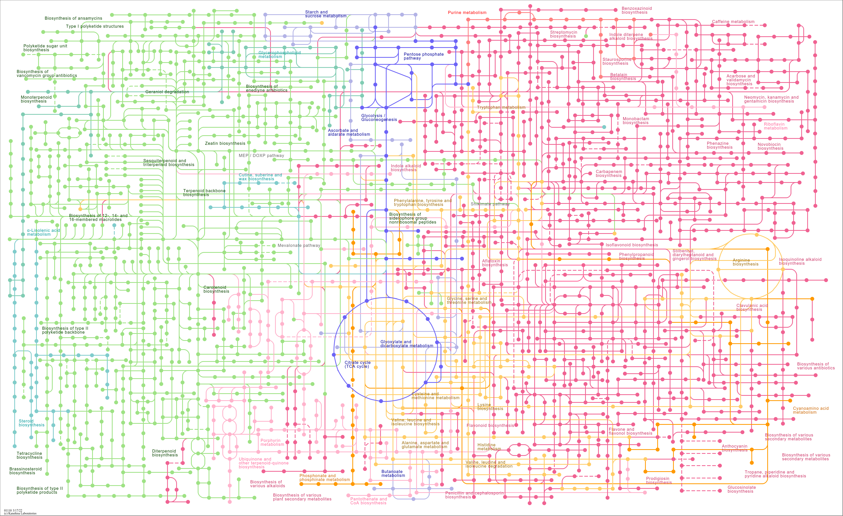

Slide 4
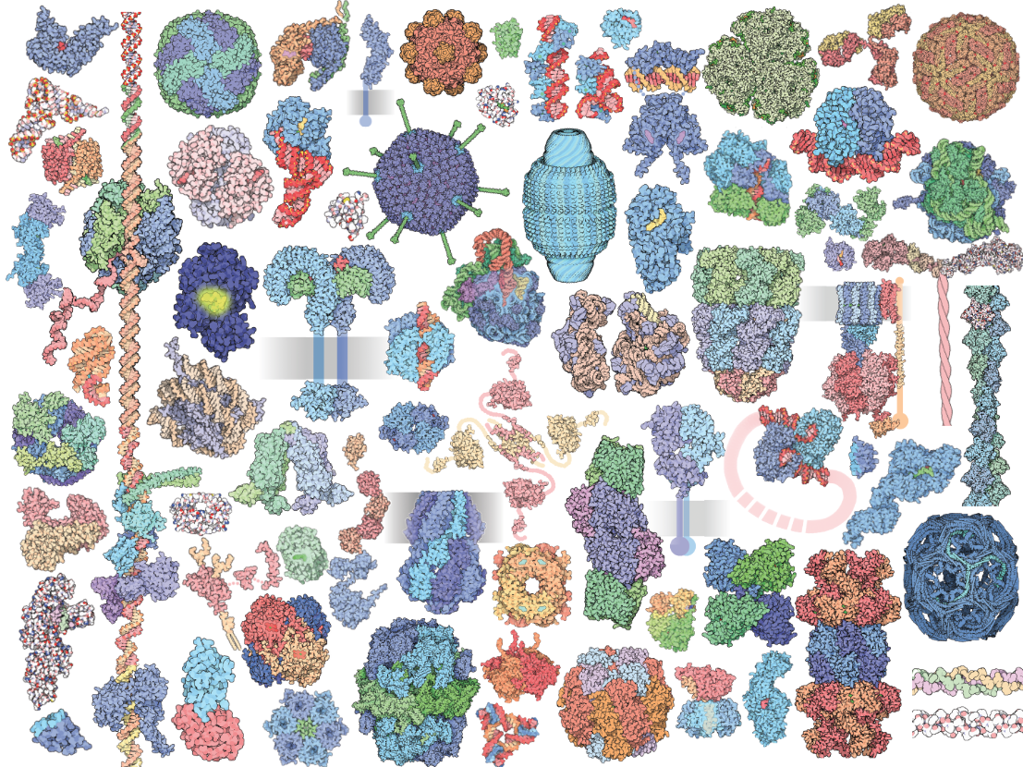
David Goodsell
35
Notes:
Structure and function of extant species do not reveal information on origins.
Exaptive/adaptive recursion opens new phenotypic landscapes from which it launches new rounds of exaptive/adaptive recursion.
Ancestral landscapes are not generally recognizable or predictable from extant landscapes.

Slide 5
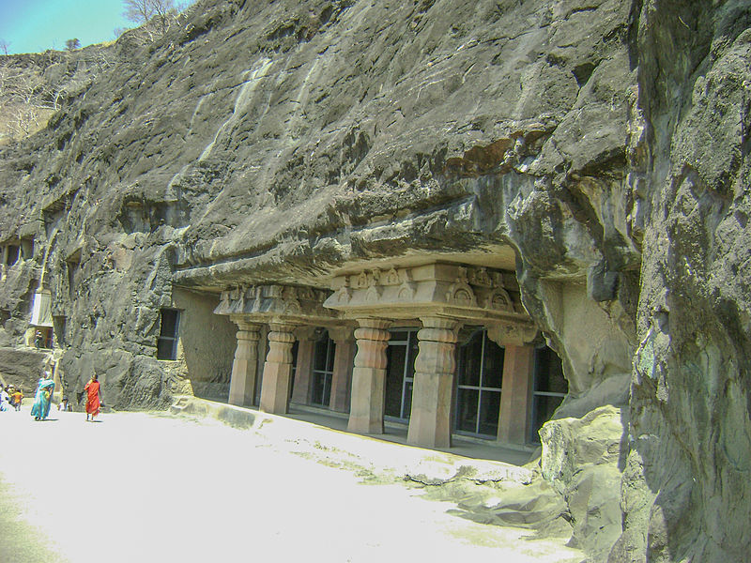

Slide 7
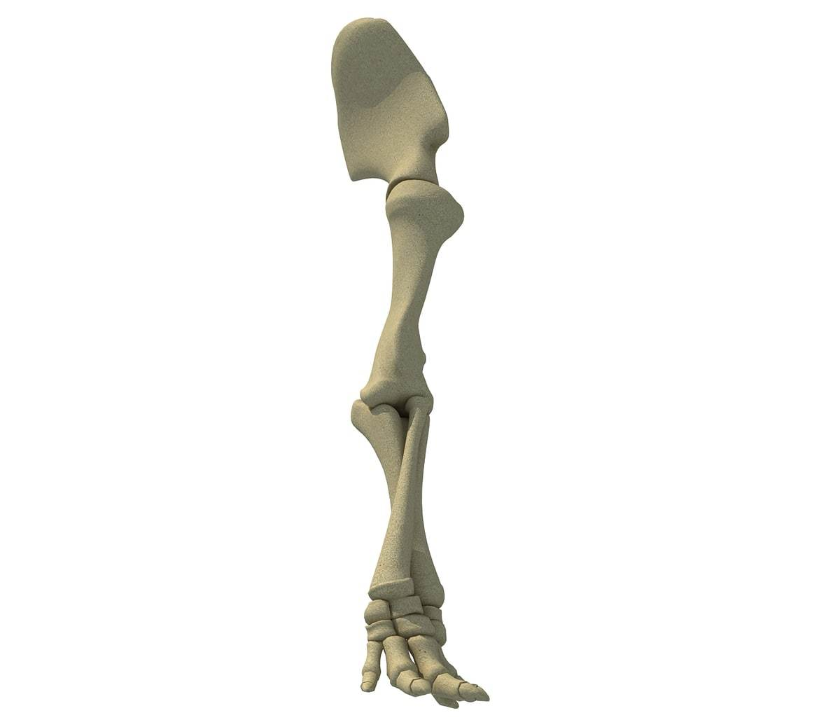
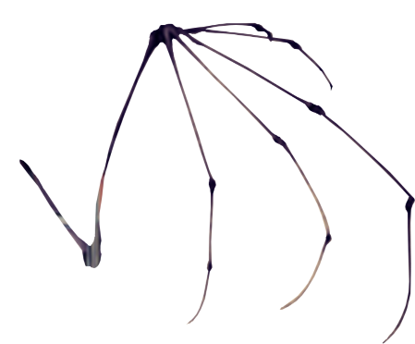
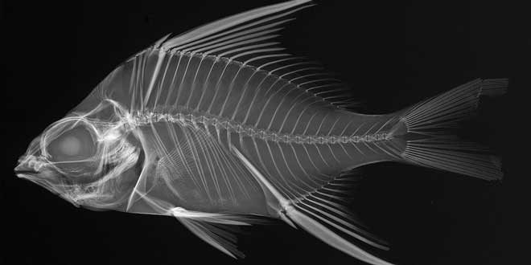
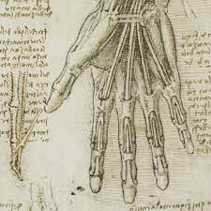

Slide 8
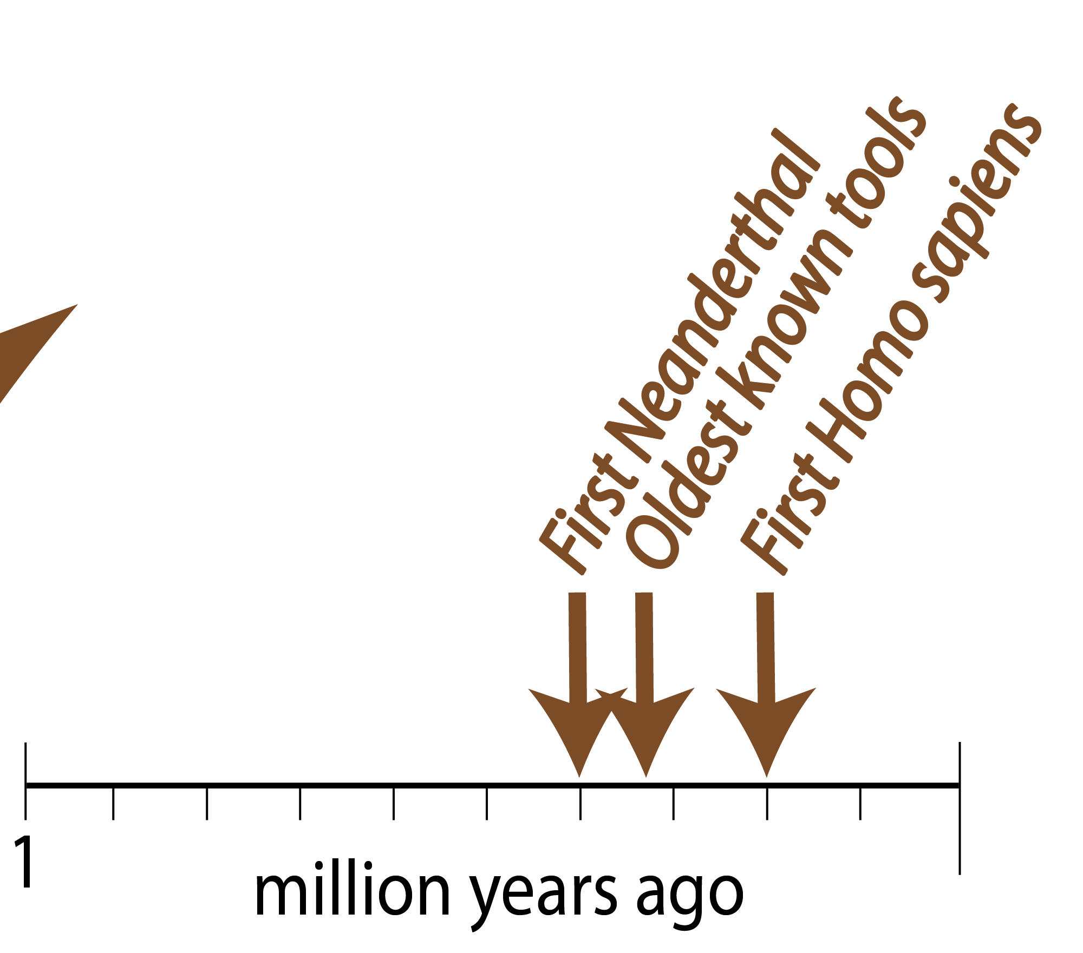

Slide 9
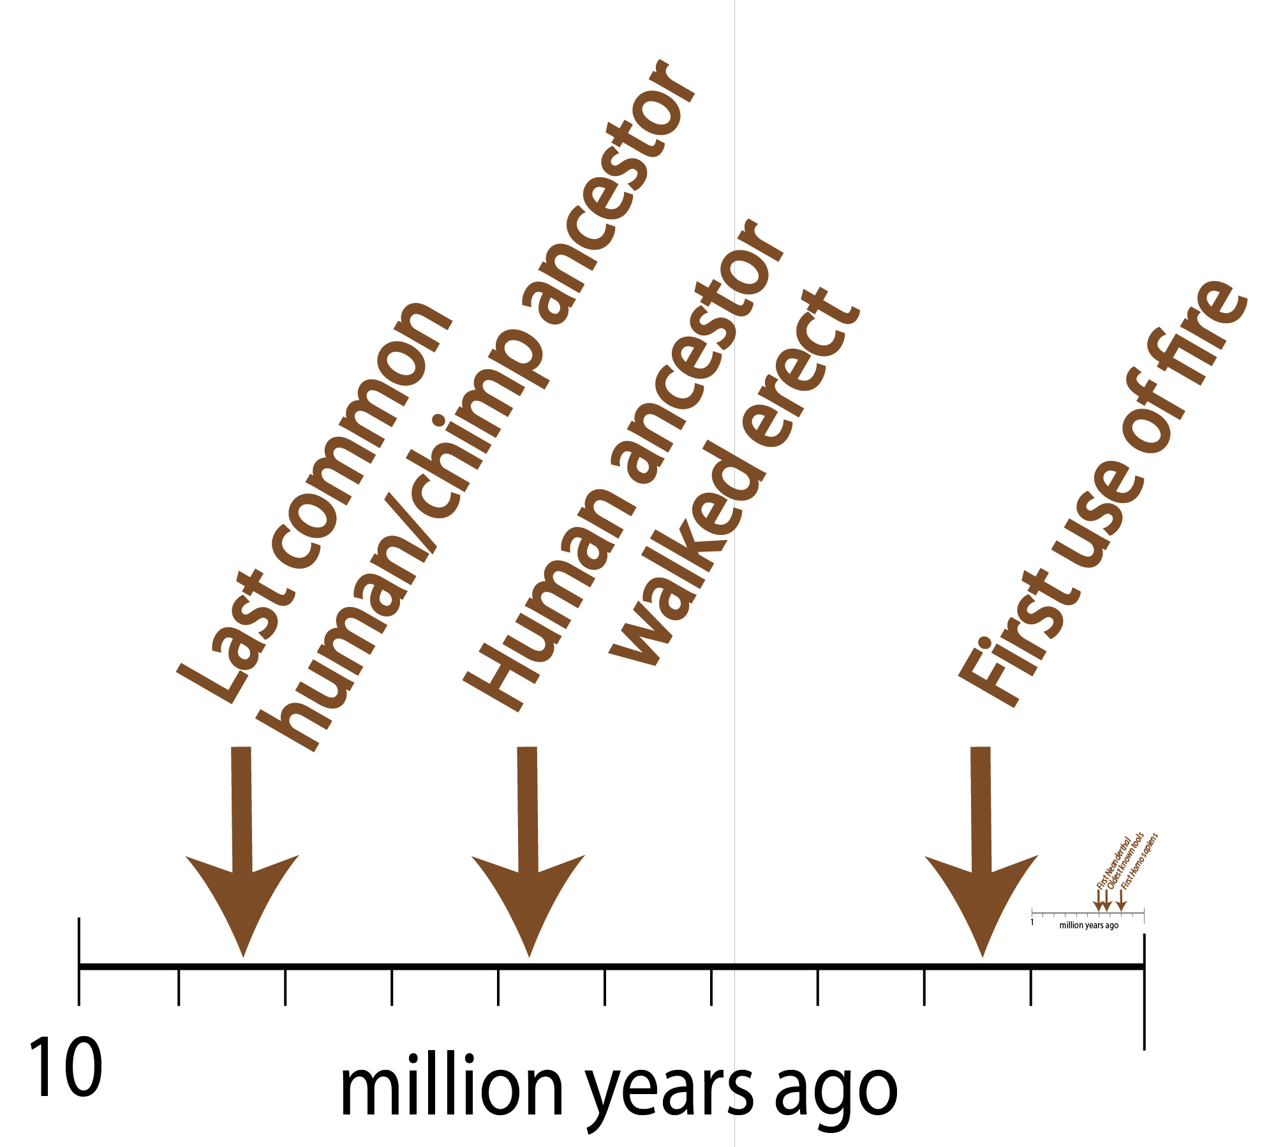

Slide 10
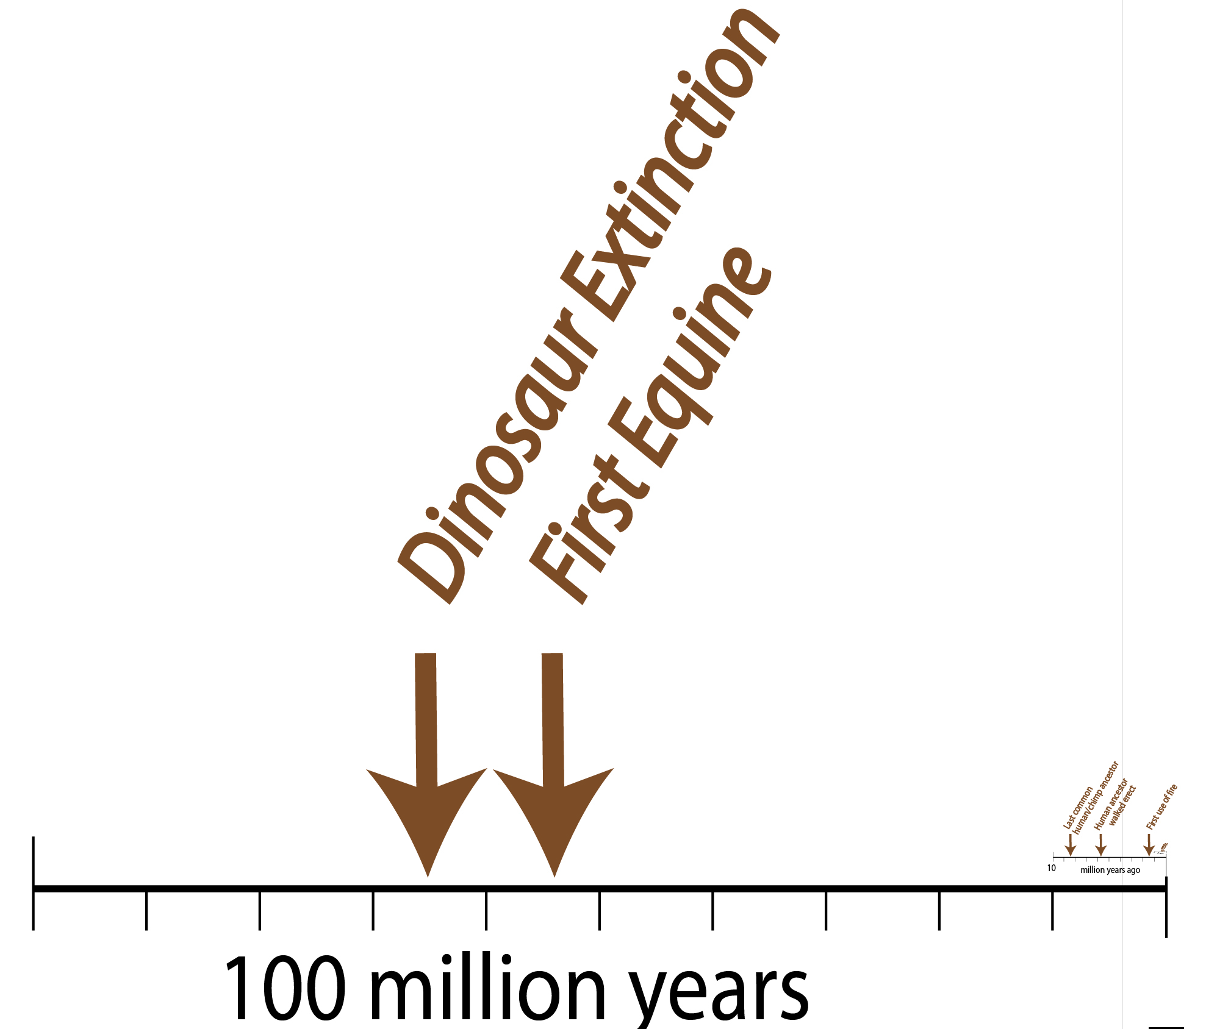
Billion years ago

Slide 11
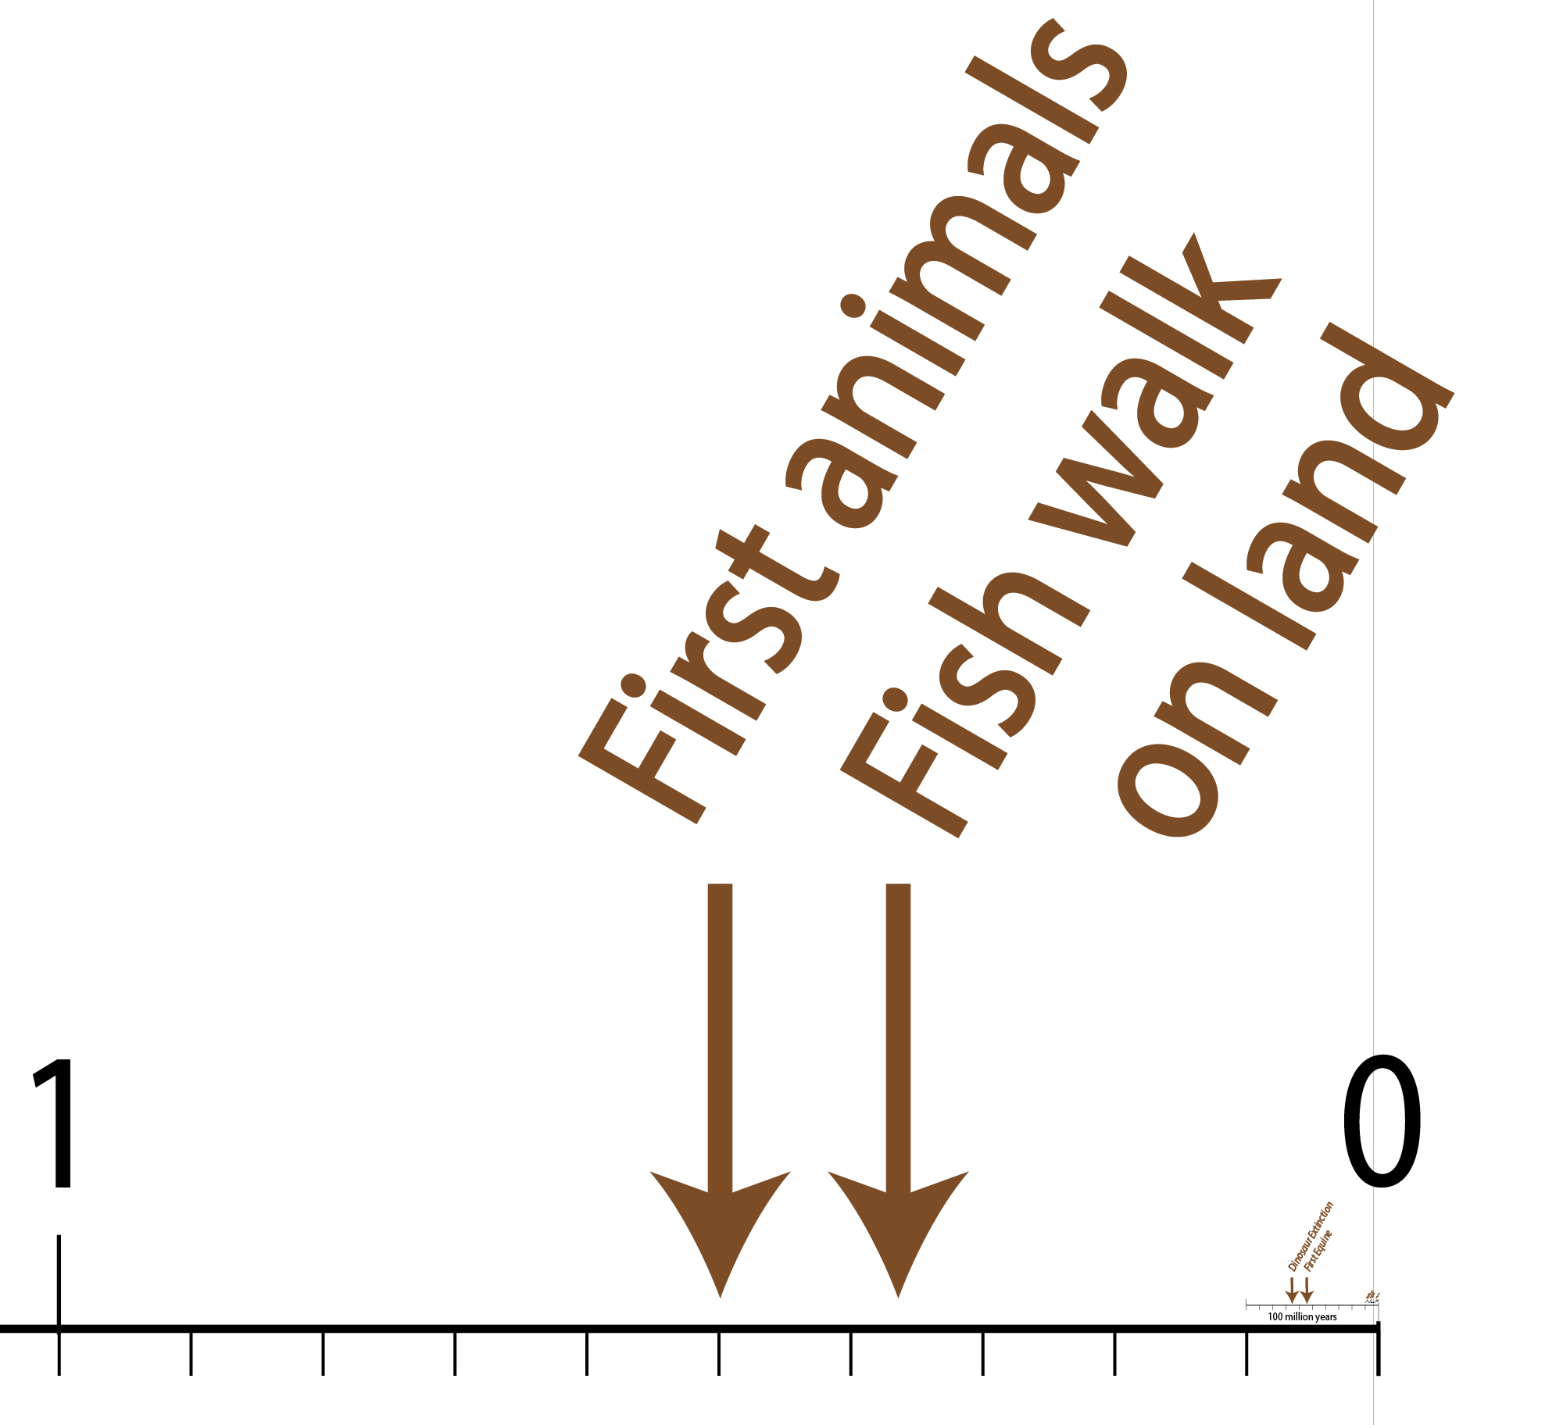
billion years ago

Slide 12
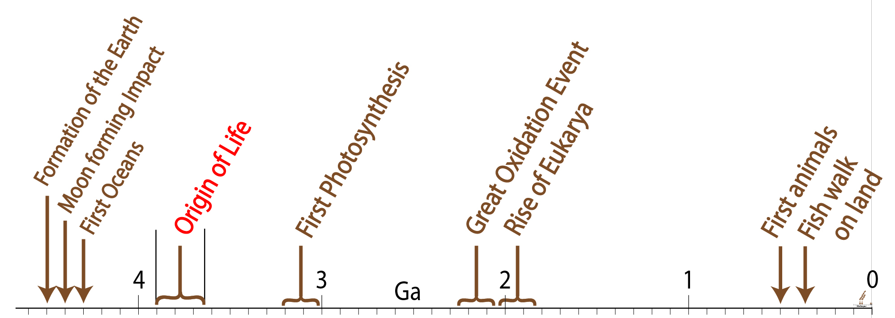
billion years ago

Slide 13
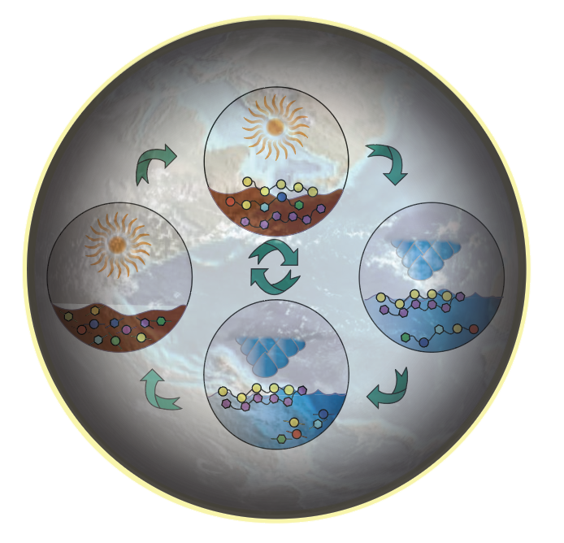
Geochemical processes (spinning planets) cause organics to polymerize (by dehydration) and depolymerize (by hydrolysis).

Slide 14
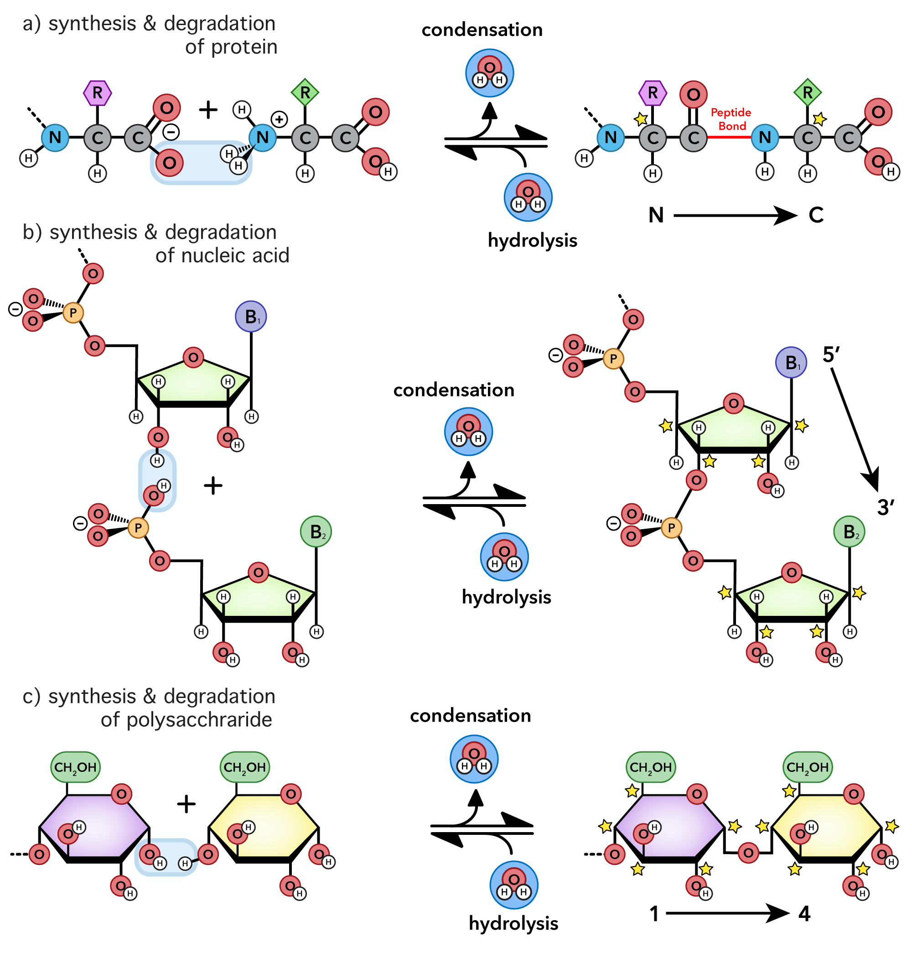
Biological cause ‘building blocks’ to polymerize (by dehydration) and depolymerize (by hydrolysis).

