Slide 1
Biological Membranes
Membranes
are bilayers
are formed by two layers of phospholipid/sphingolipid/etc
are two-dimensional liquids
enclose and separate aqueous compartments
are selective barriers (water and ions cannot pass)
contain small molecules (cholesterol, etc)
contain large molecules (proteins)

Slide 2
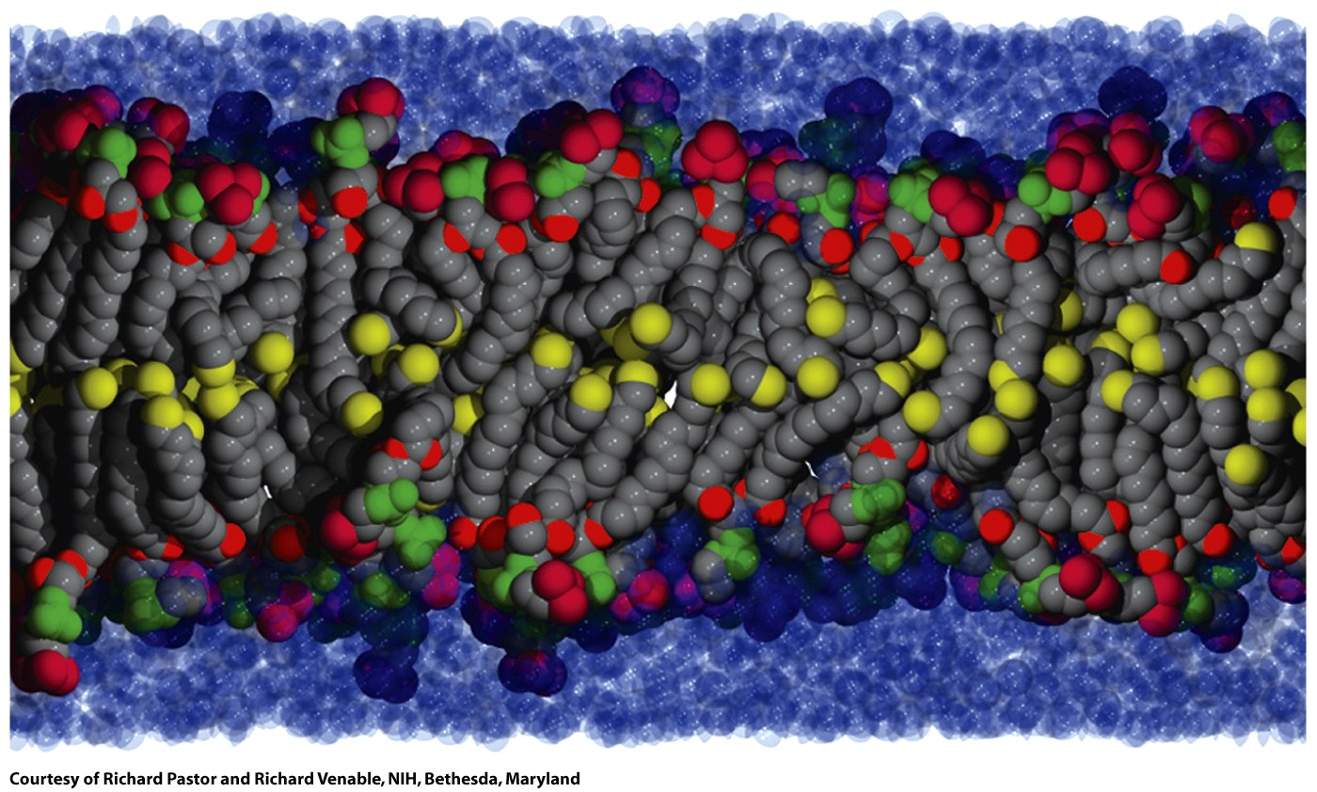
A biological bilayer is fluid, dynamic and disordered. Here the terminal carbon atoms are yellow.
Figure 9-17

Slide 3
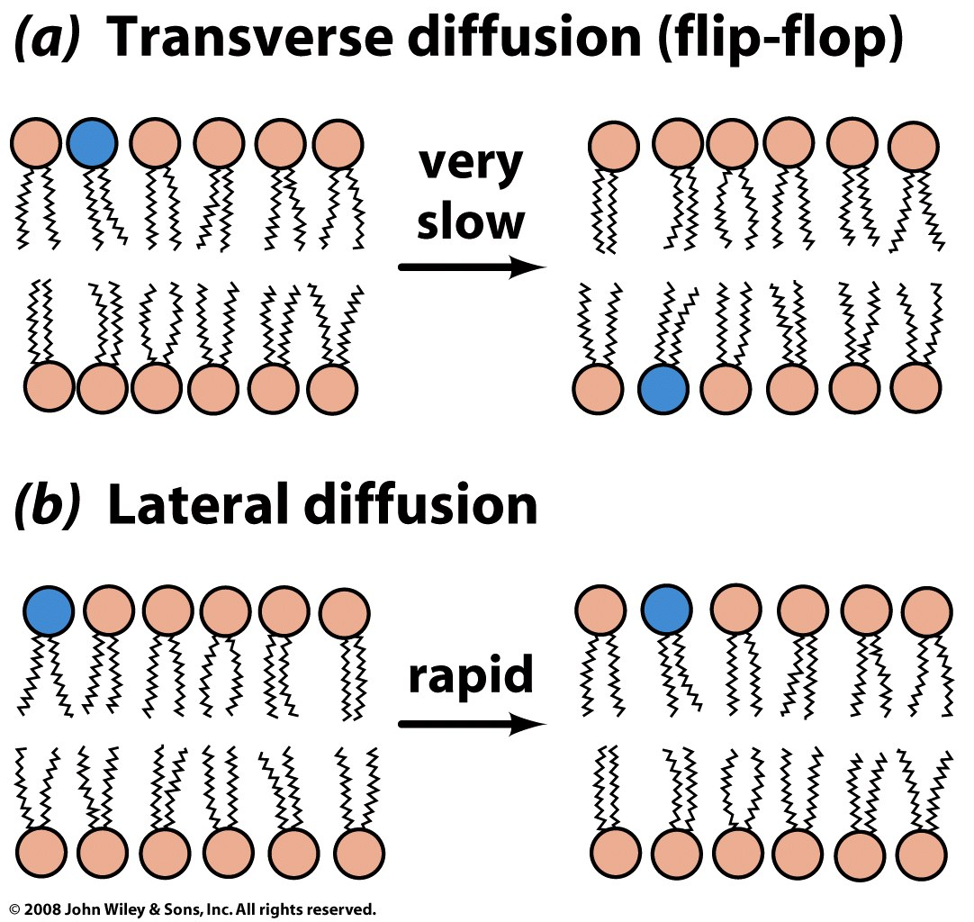
Figure 9-16

Slide 4
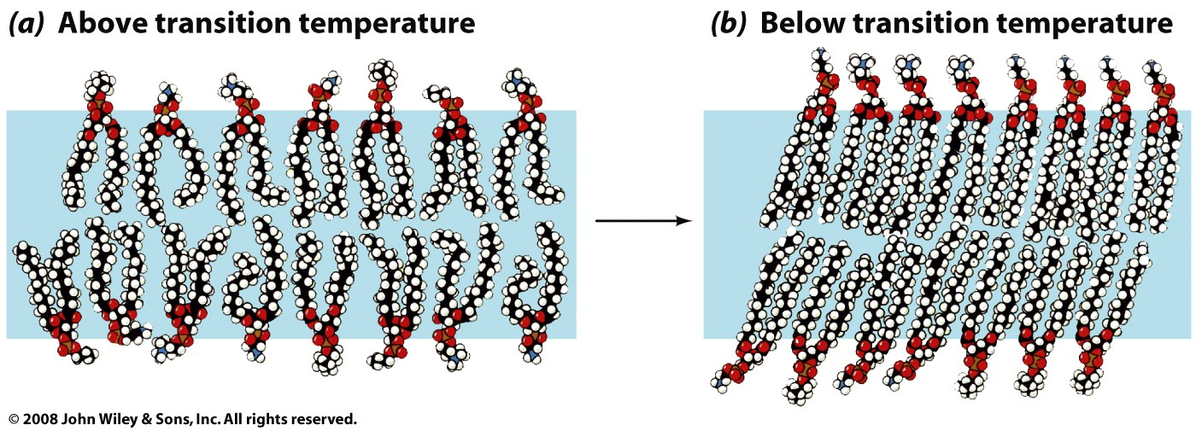
Membrane Phase Transitions
A bilayer can undergo transitions between phases with changing temperature. A bilayer can adopt a solid gel-like phase state at low temperatures and more fluid phase at higher temperature. The degree and extent of unsaturation, hydrocarbon chain length, cholesterol content and other factors can effect the phase transition temperature and the properties of the phases: including, dynamics, rates of diffusion, and resistance to stretching and bending.
Cholesterol modulates membrane fluidity. The hydroxyl group of cholesterol is generally near the polar head groups of the phospholipids. The steroid and the hydrocarbon chain are embedded in the membrane.

Slide 5
Membrane Proteins
can be up to half of the mass the membrane
transport ions and metabolites across membranes
transport lproteins and RNA across membranes
send and receive chemical signals
propagate electrical impulses
attach cells to each other
anchor other proteins to specific locations in the cell
regulate intracellular vesicular transport
controll membrane lipid composition
organize and maintain shapes of organelles and cells

Slide 6
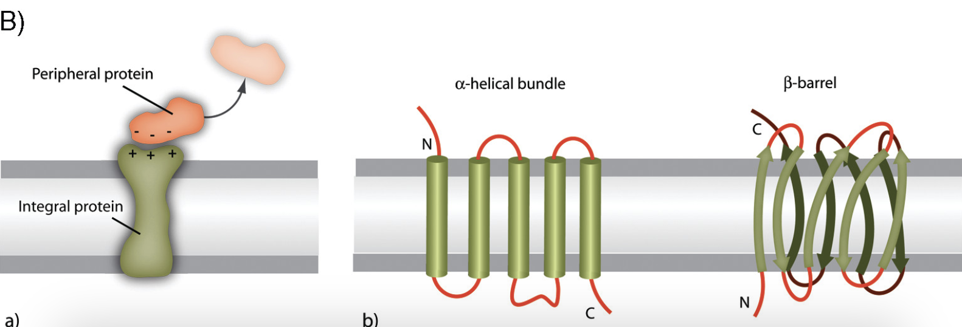
Membrane proteins can be peripheral or integral. Integral membrane proteins come in two flavors: α-helical bundles and β-barrels.

Slide 7
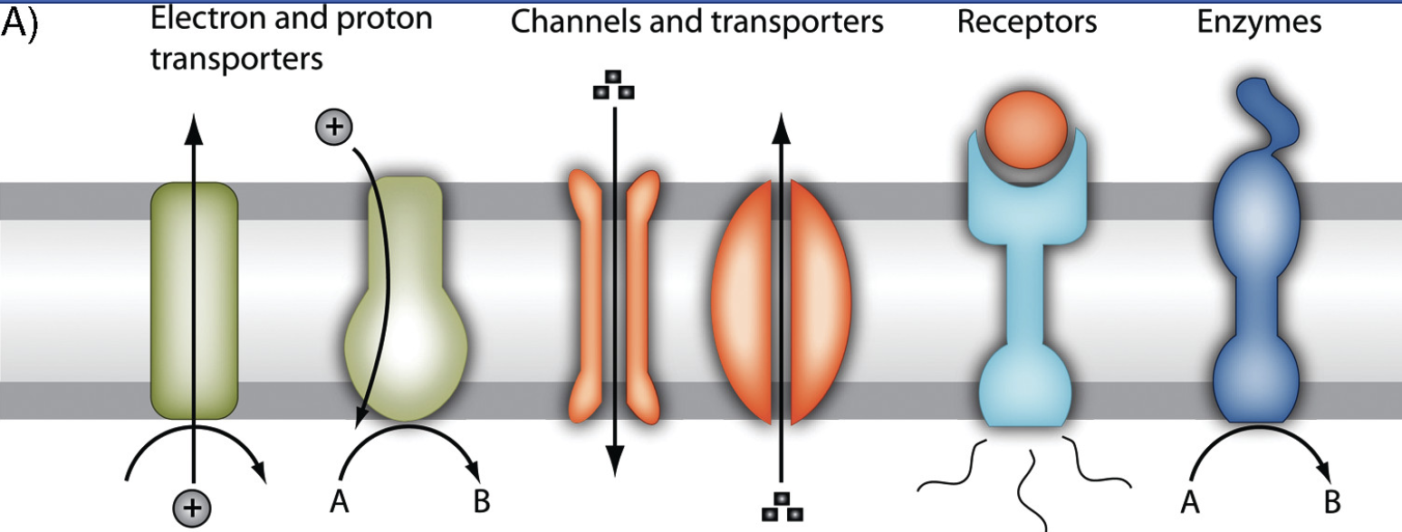
Membrane proteins are involved in
energy transport during photosynthesis or respiration,
transport of molecules across membranes,
transmission of chemical signals across membran
catalysis of chemical reactions.

Slide 8
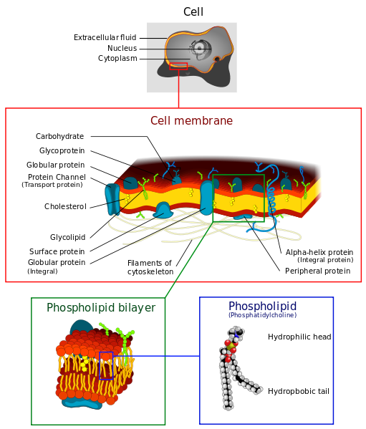
from wikipedia

Slide 9
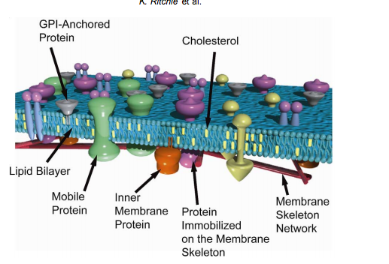
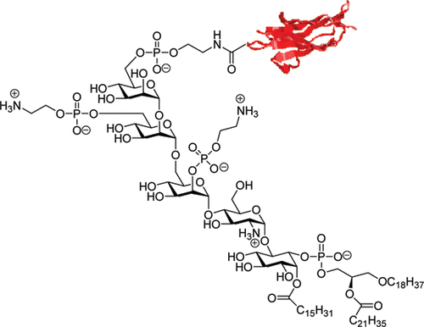
GPI:
Glycosylphosphatidylinositol
Molecular Membrane Biology, 2003, 20, 13/18

Slide 10
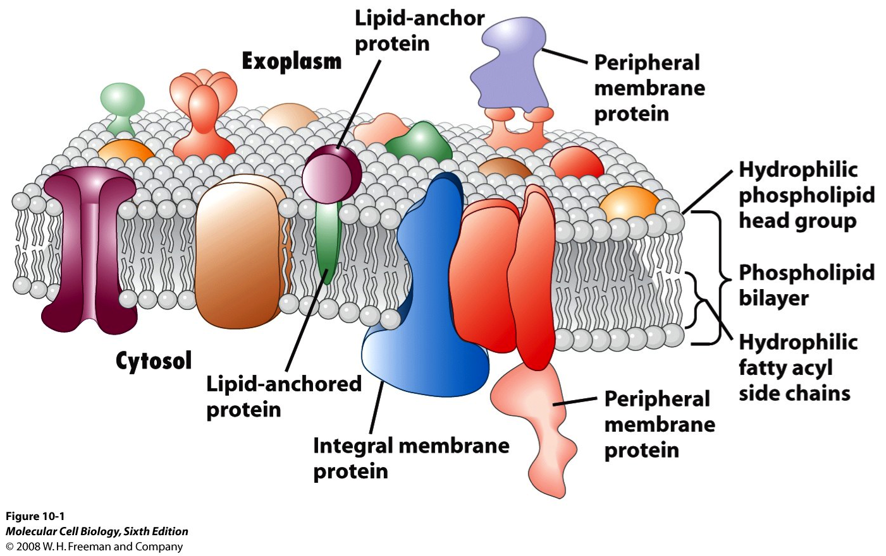

Slide 11
Membrane Potentials
Membrane redox potential refers to differences in the electron transfer potential between the inside and outside of the membrane. The inside of a cell is more reductive than the outside of a cell.
Membrane chemical potential refers to differences in chemical concentrations between the inside and outside of the membrane. A high concentration of glucose a cell drives transport of glucose across membrane.
Membrane electrostatic potential Is the difference in electrical charge between the inside and outside of the membrane. The inside of the cell is negatively charged compared to the outside, and the membrane potential is typically around -70 mV. A net negative charge inside a cell cs reated by the presence of negatively charged DNA, RNA, membranes, etc, and the efflux of positively charged potassium ions.

Slide 12
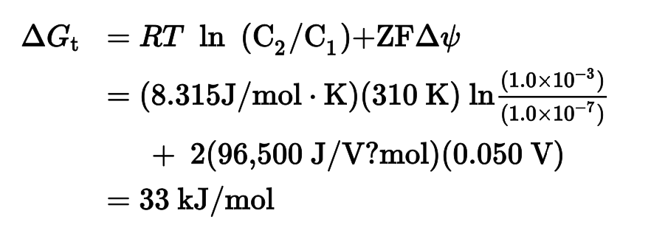
The driving force for ion transport has two components
Effect of electric field
Effect of concentration gradient
For a calcium ion [Ca²⁺] = 10⁻⁷ M inside, 10⁻³ M outside
and a 50 millivolt potential

Slide 13
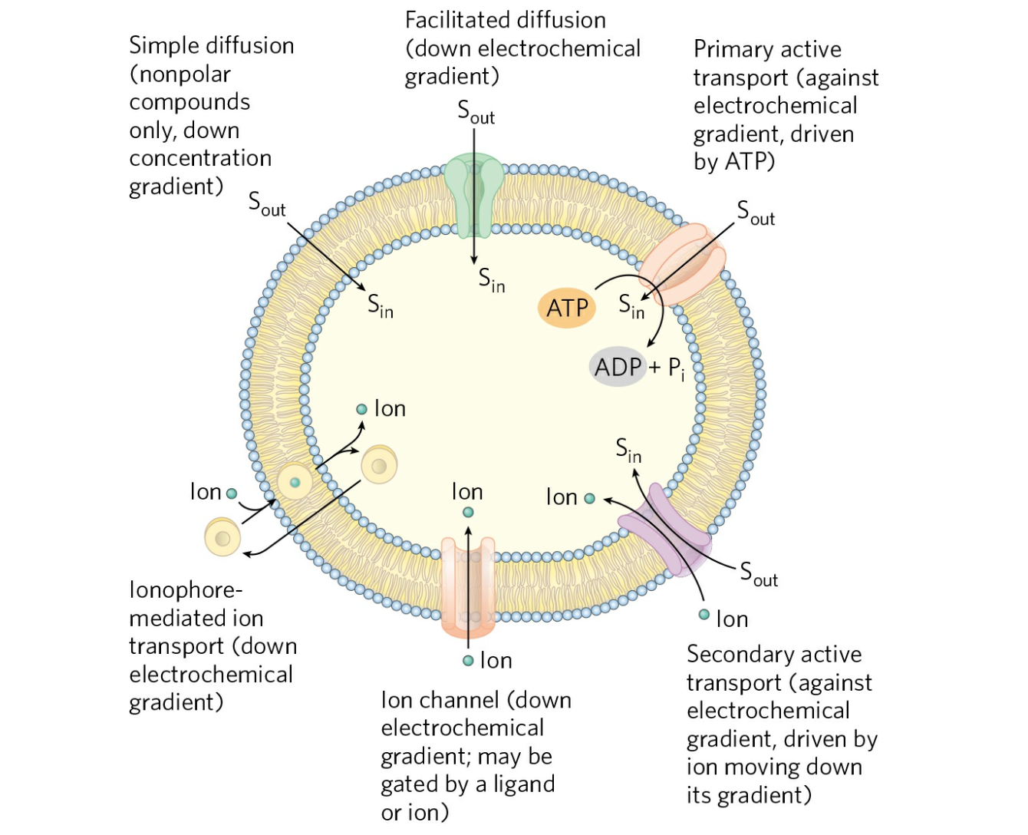

Slide 14
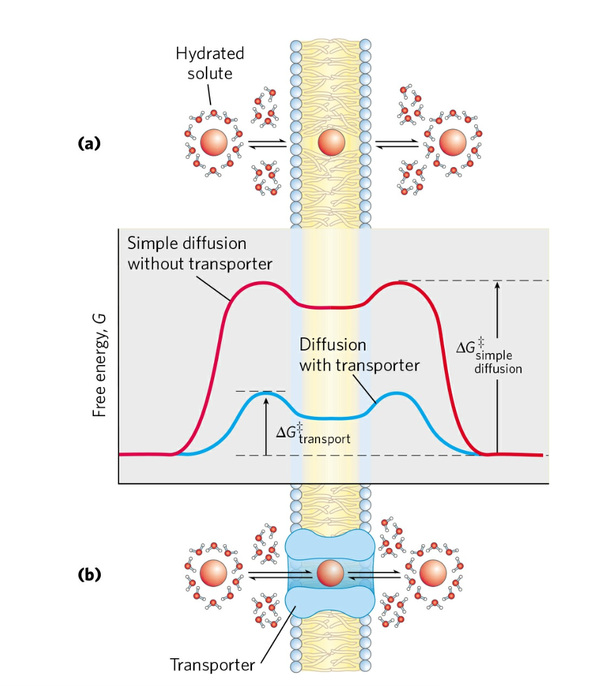

Slide 15
