Slide 1
Annotated Timeline
of
Molecular Biology Techniques
and Advances
that are important
in 2024
Revised 1/9/2024

Slide 2
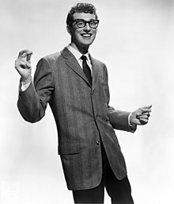
1950’S
Notes:
Buddy Holly

Slide 3
Notes:
Central Dogma
The arrows represent information flow in form of sequence

Slide 4
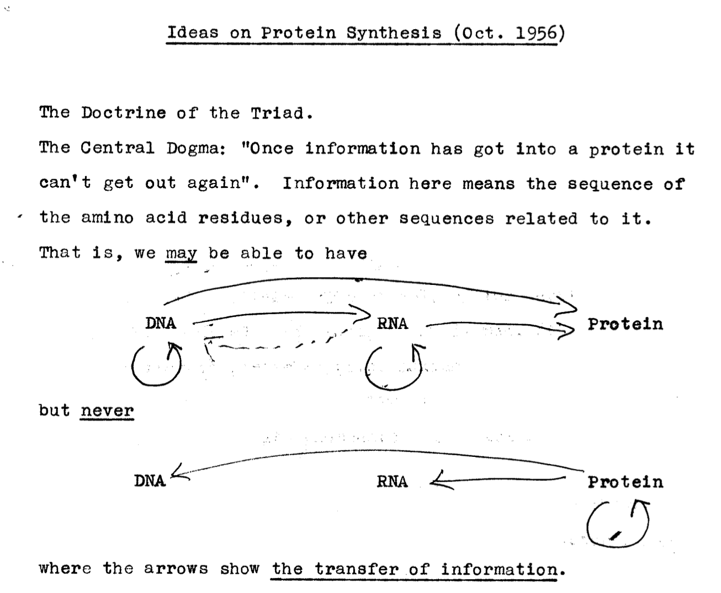

Slide 5
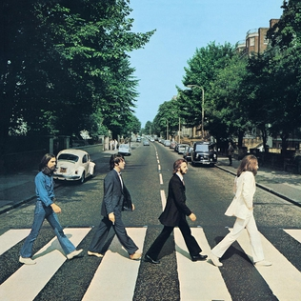
1960’S
Notes:
Beatles

Slide 6
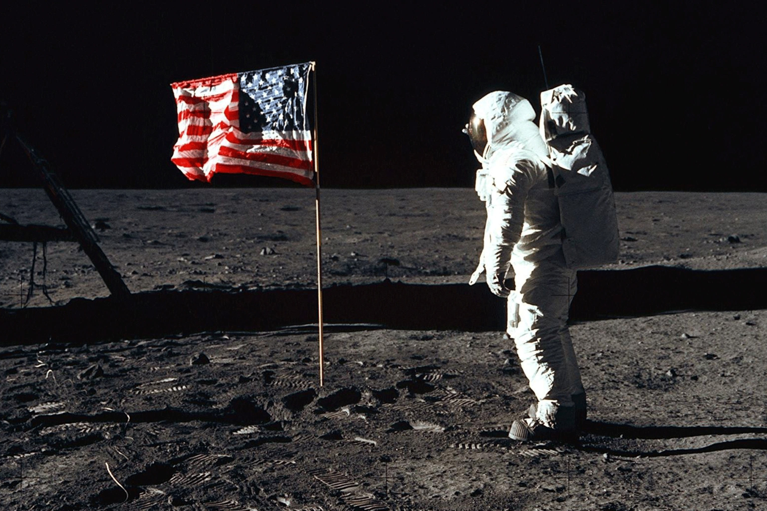
A slow decade for biology, but lots of other exciting things were going on.

Slide 7
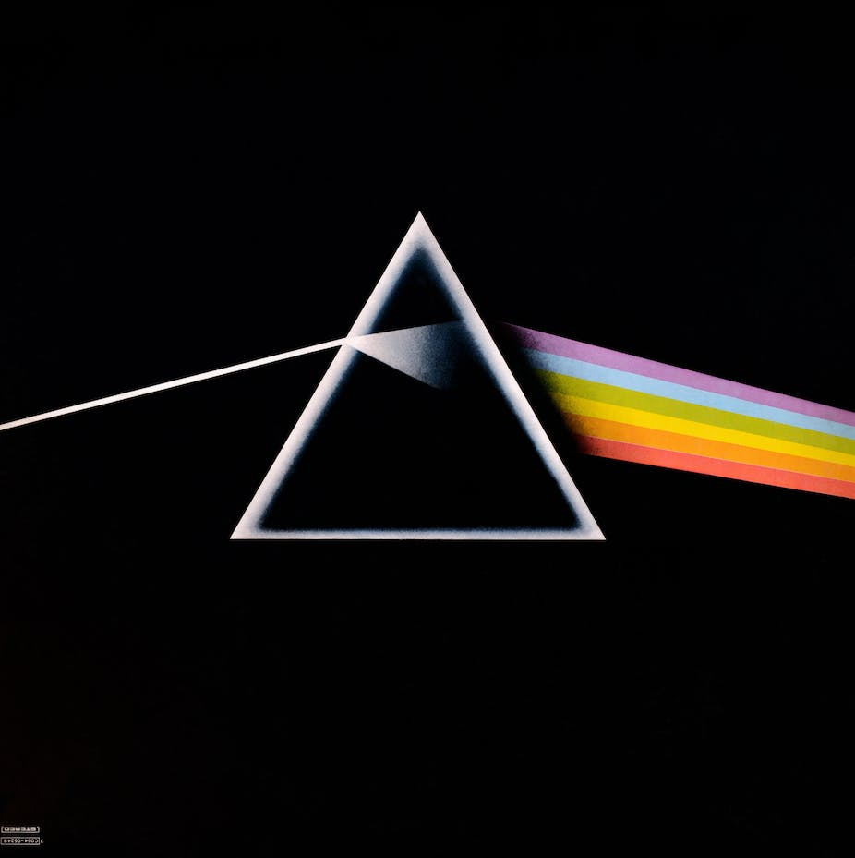
1970’S
Notes:
Pink Floyd, Stevie Wonder

Slide 10
Founded in 1974 by Don Comb

Slide 13
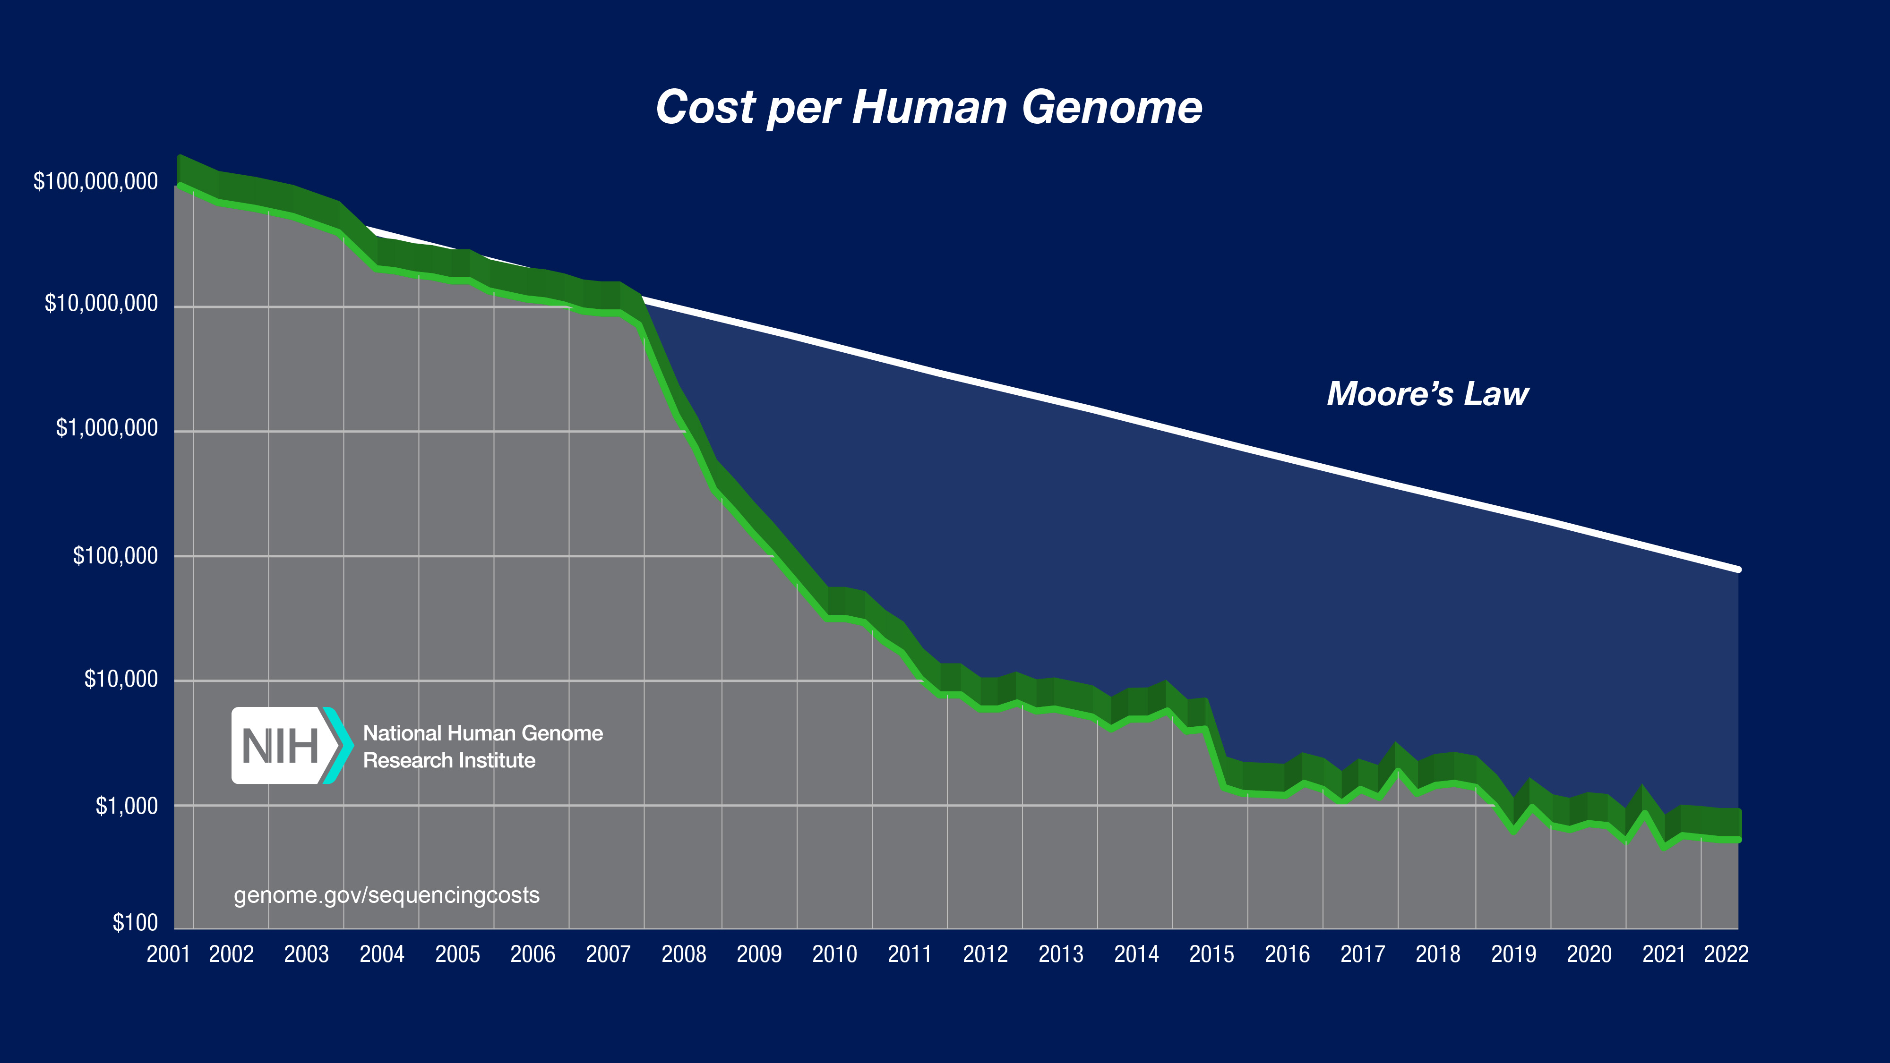
https://www.genome.gov/sites/default/files/inline-images/2022_Sequencing_cost_per_Human_Genome.jpg
The cost of sequencing a human genome from 2001 to 2019

Slide 17
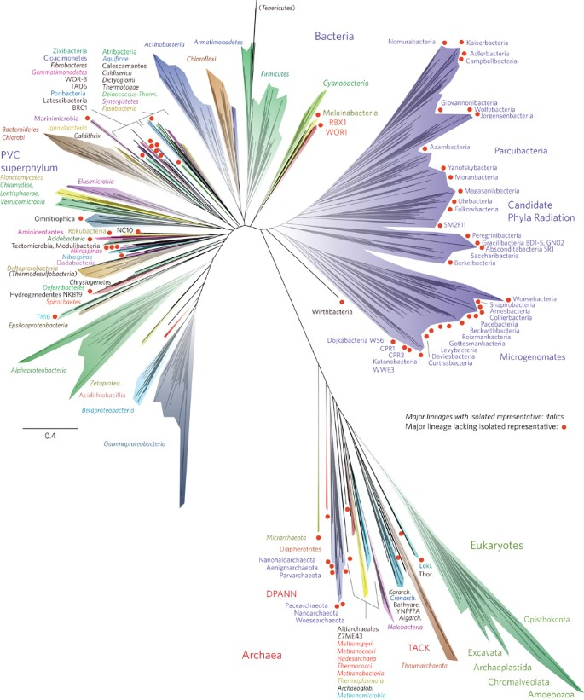
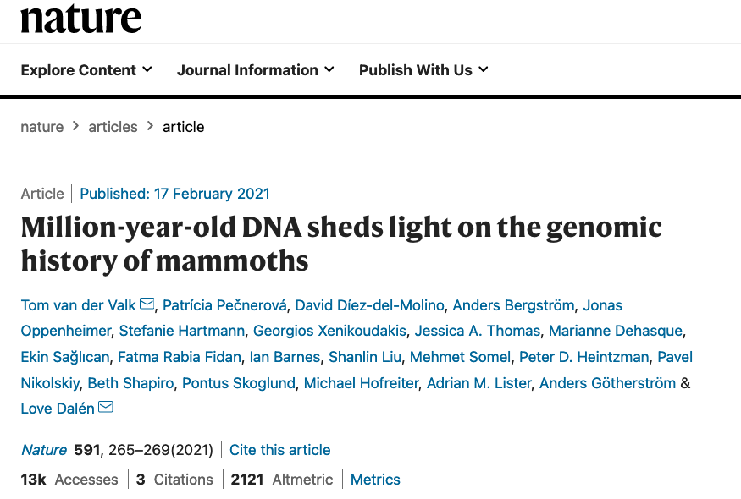

Slide 19
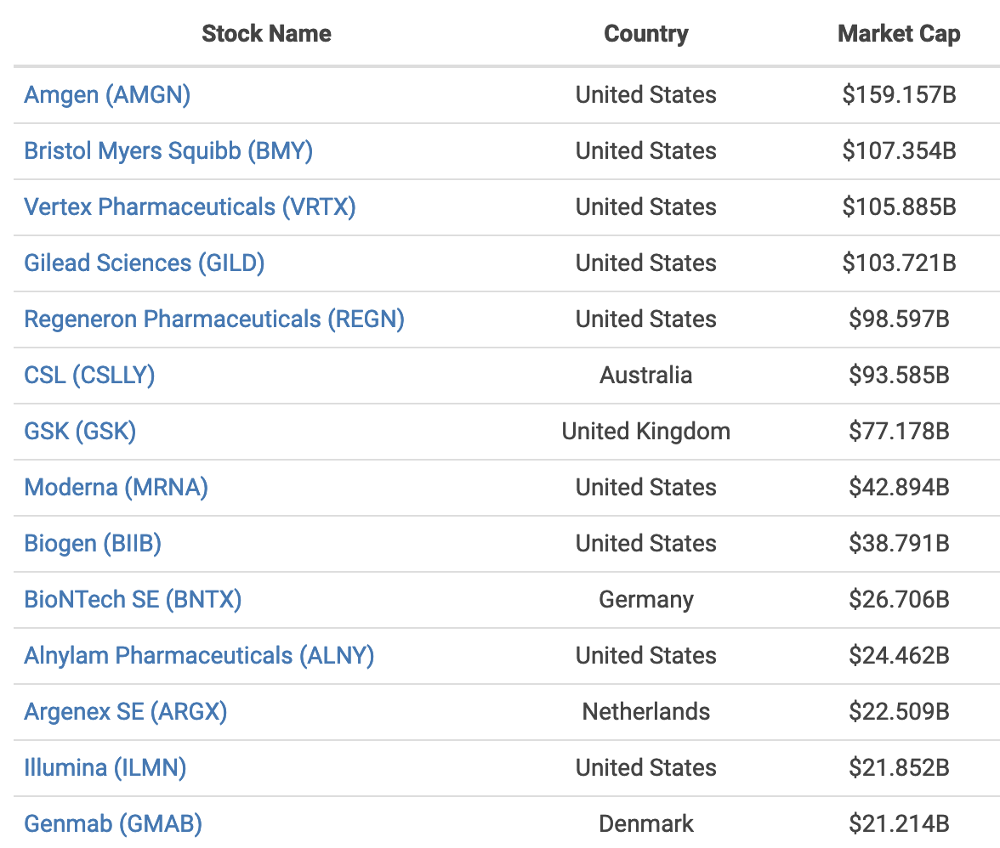

Slide 20
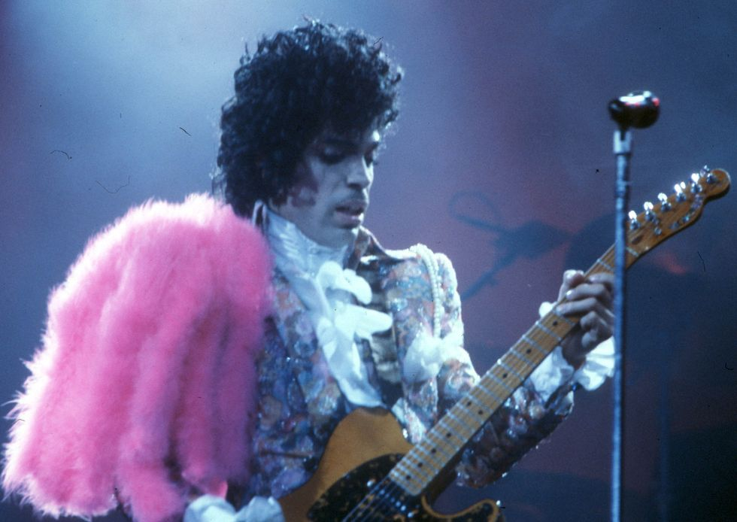
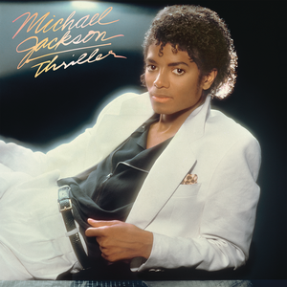
1980’S
Notes:
Prince and Michael Jackson

Slide 22
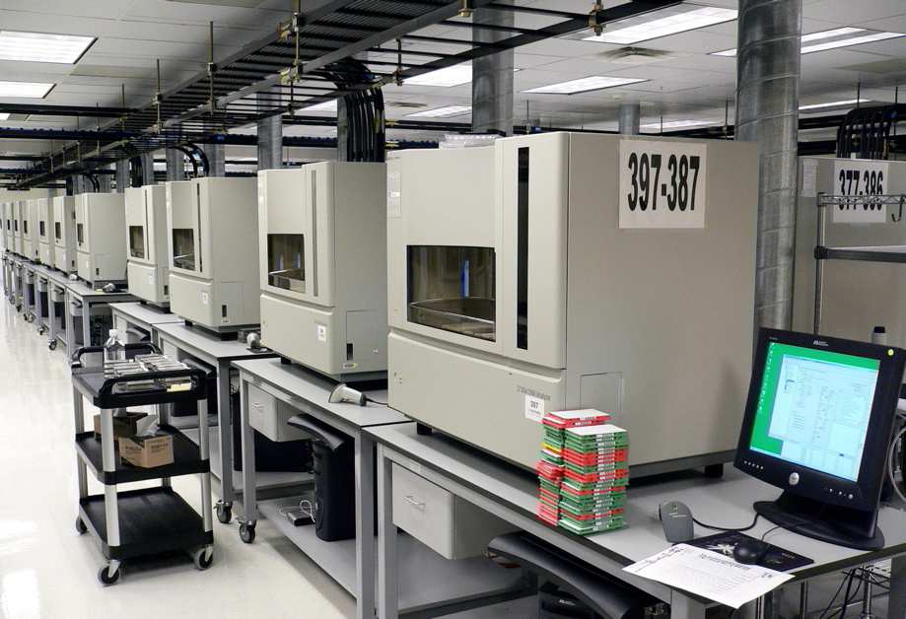

Slide 23
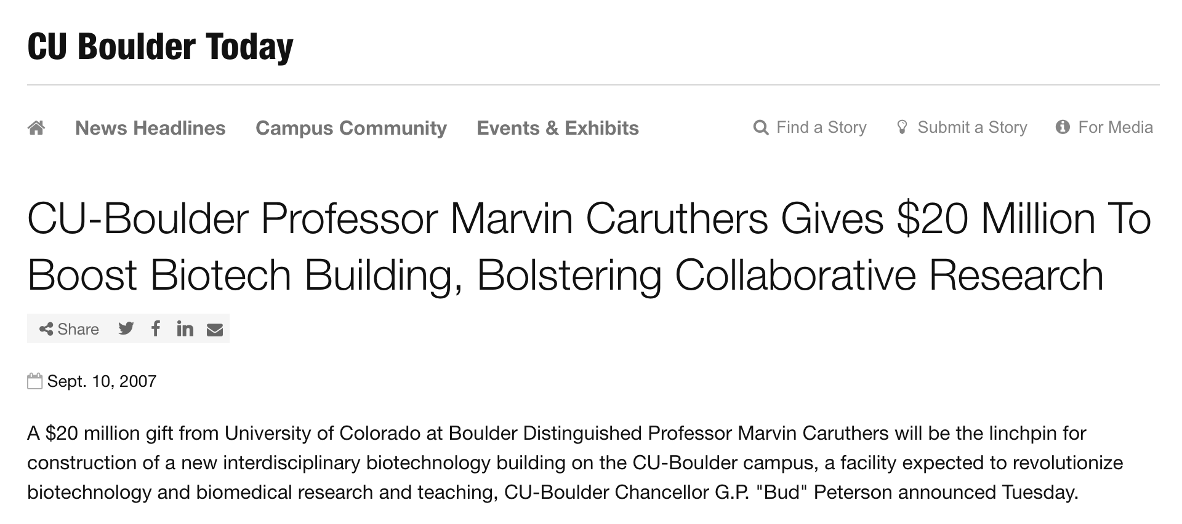

Slide 24
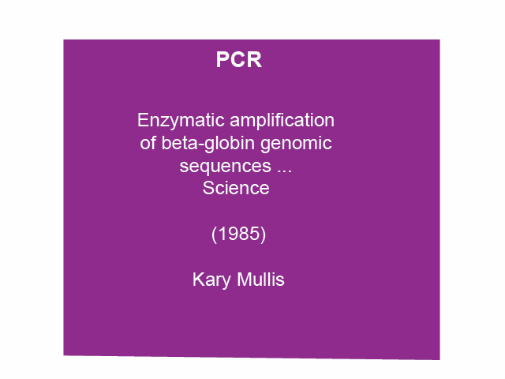

Slide 26
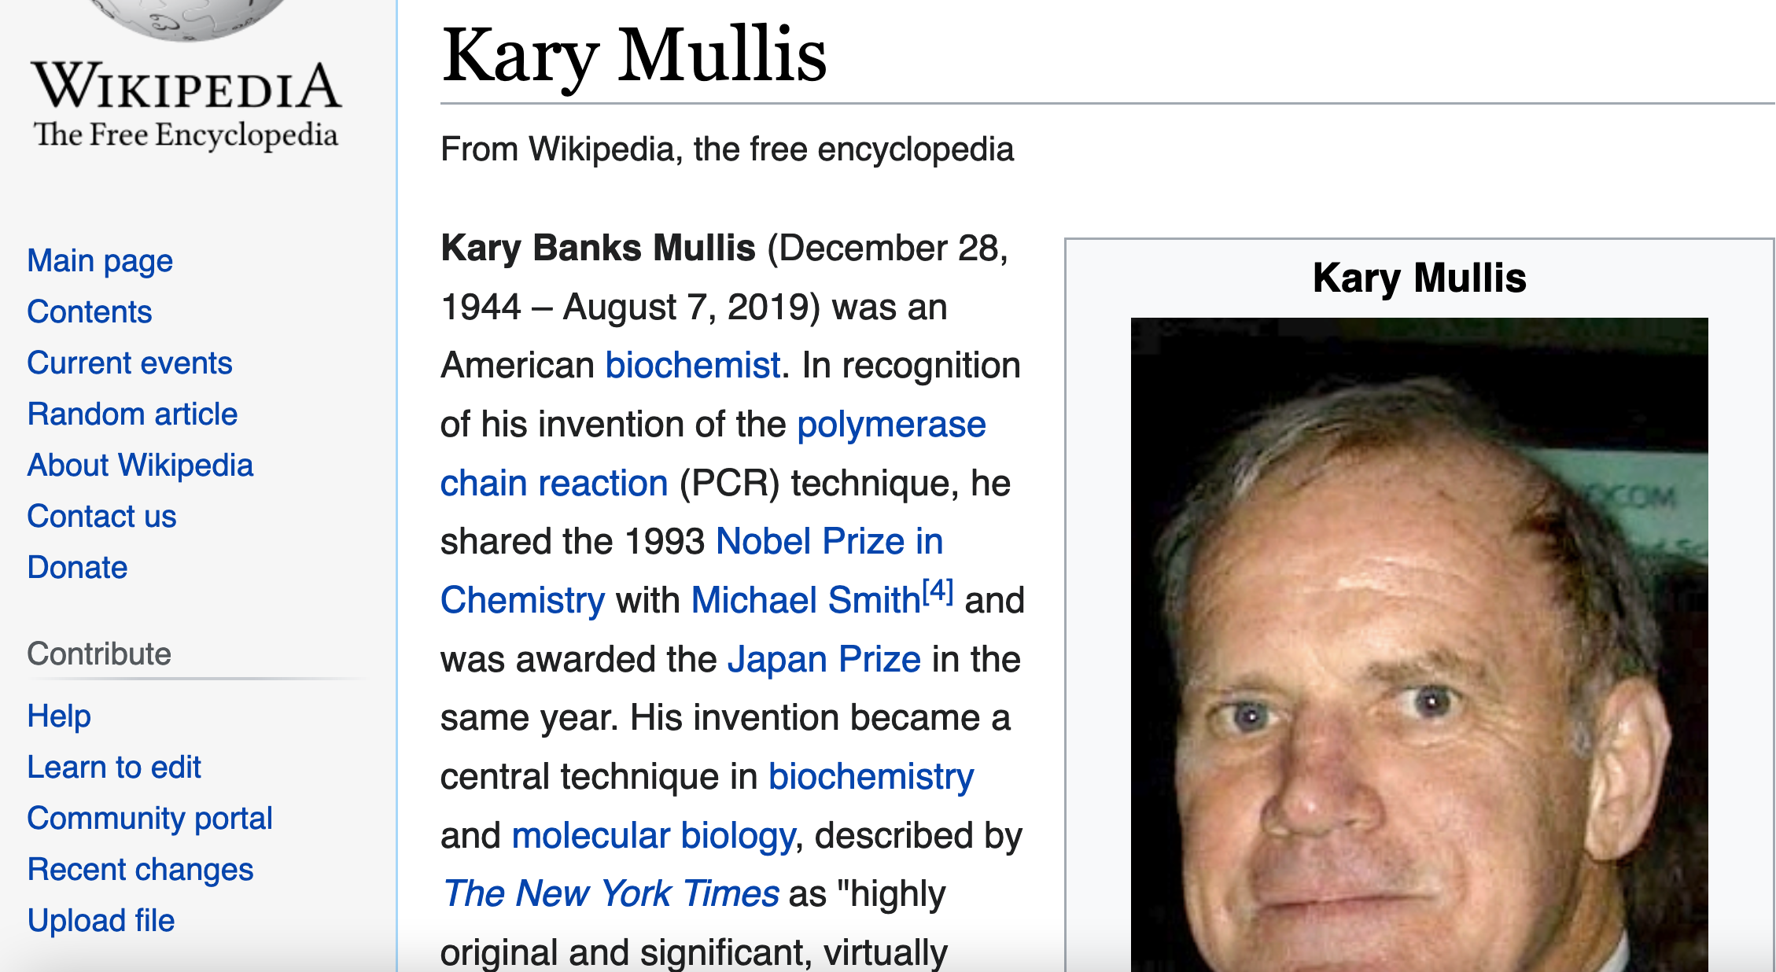

Slide 28
Olke

Slide 29
Moderna and Lonza have entered a 10-year strategic collaboration to facilitate the large-scale manufacture of Moderna’s mRNA vaccine (mRNA-1273) and additional future Moderna products at Lonza’s facilities in the United States and Switzerland. This image shows a large-scale manufacturing facility at Lonza’s Ibex Dedicate facility in Visp, Switzerland. [Lonza]

Slide 30
1990’S
Notes:
Nirvana

Slide 32
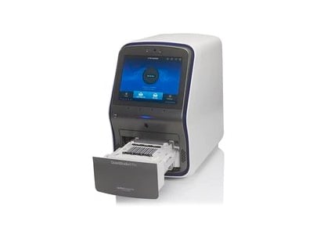

Slide 34
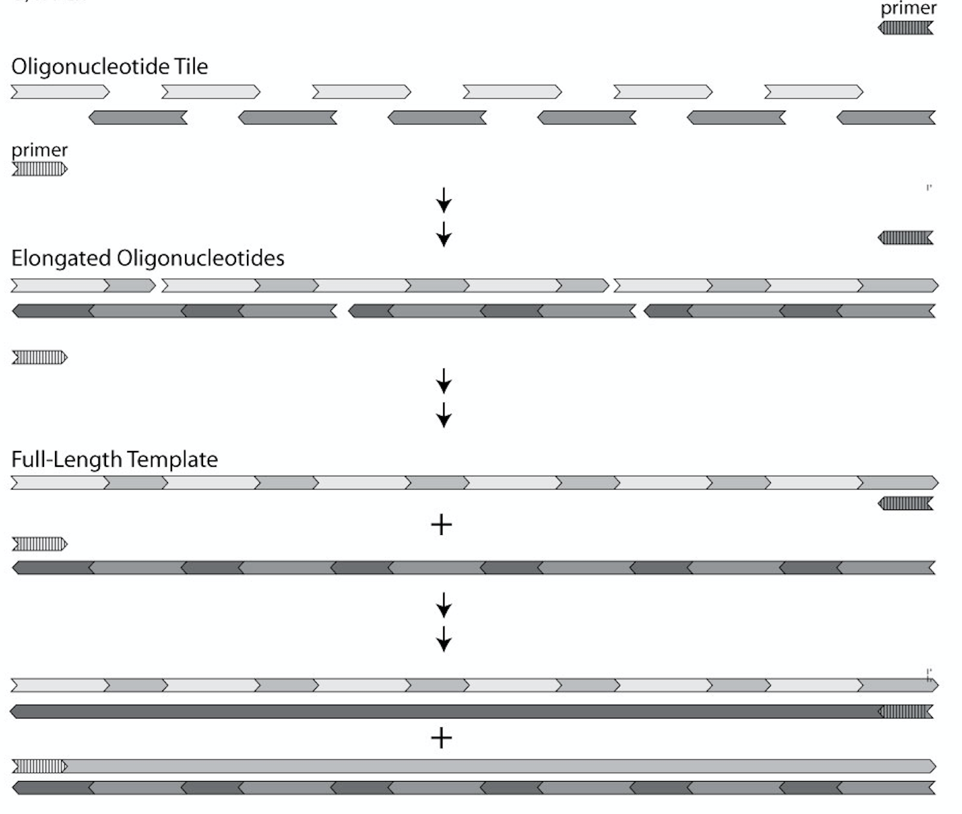

Slide 35
2000’S
Notes:
Radiohead and Pink

Slide 37
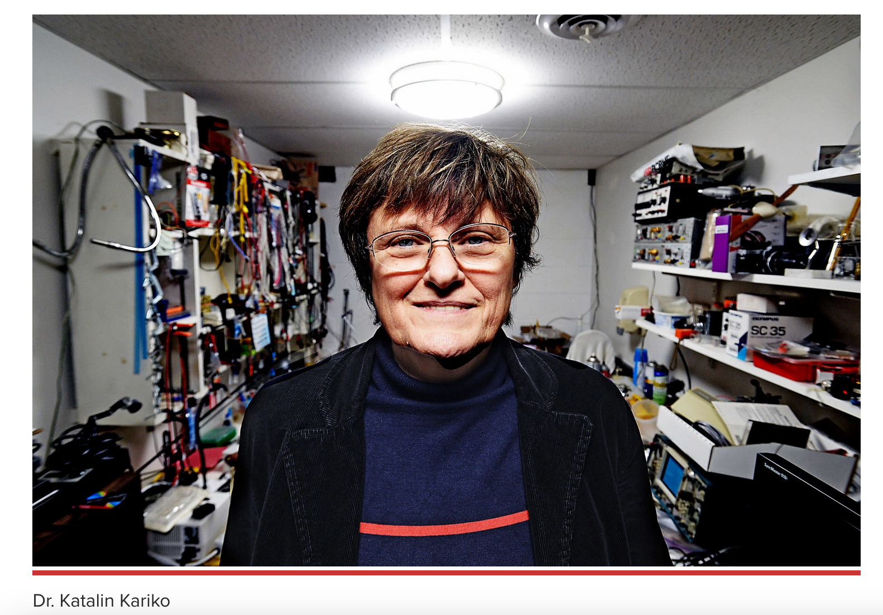

Slide 39
2010’S
Notes:
Artic Monkeys

Slide 40
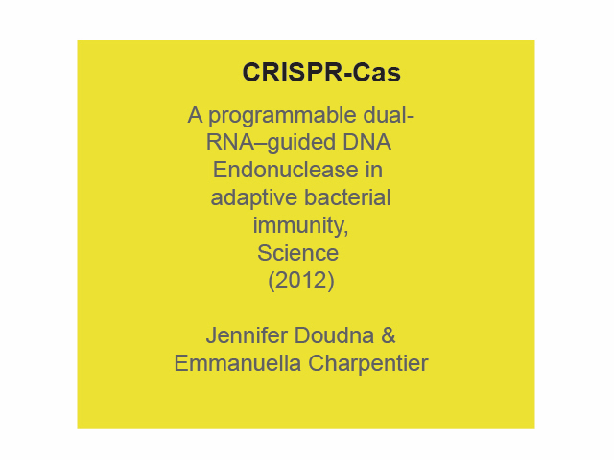

Slide 41
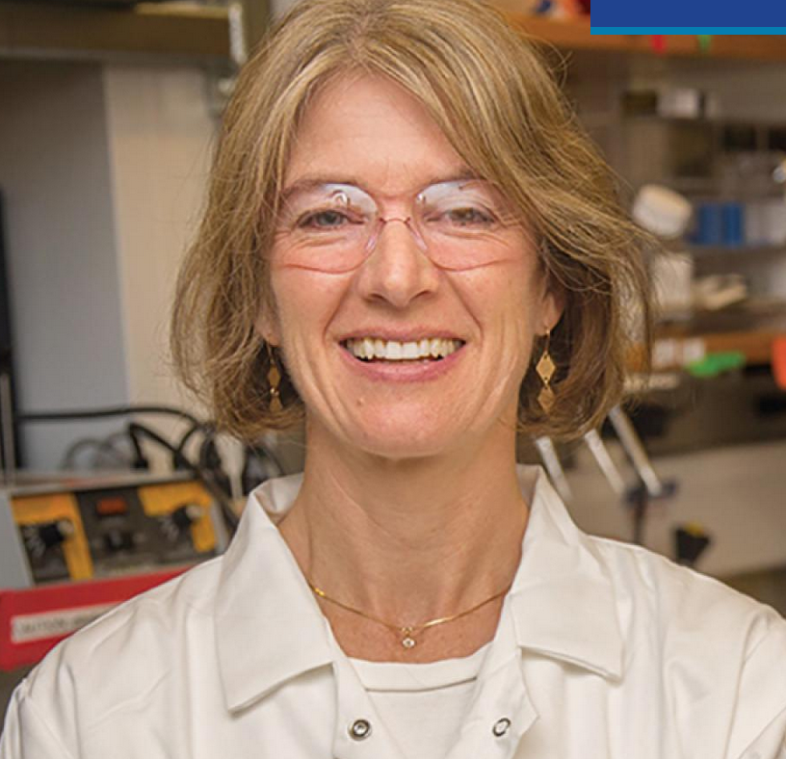

Slide 43
2020’S
Notes:
Taylor Swift

