Slide 1
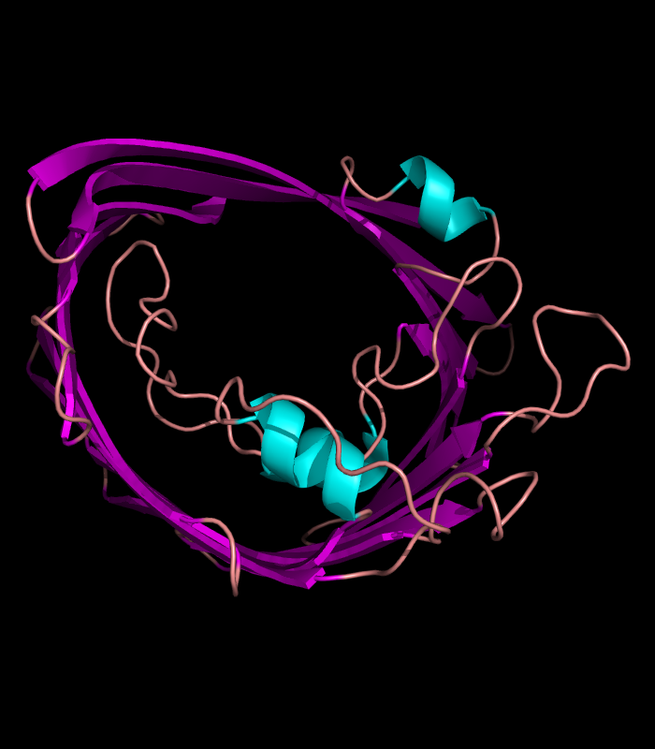
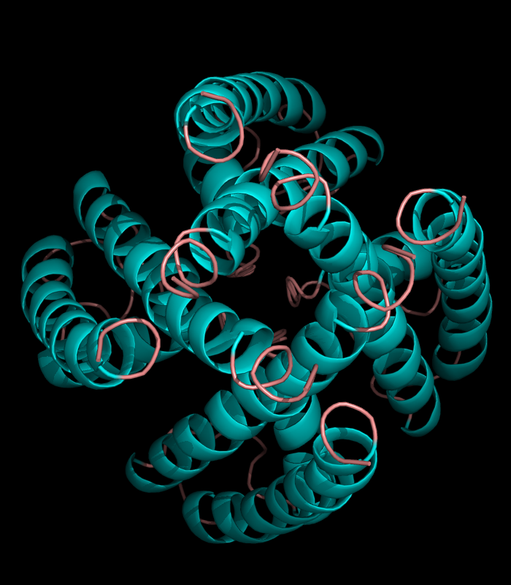
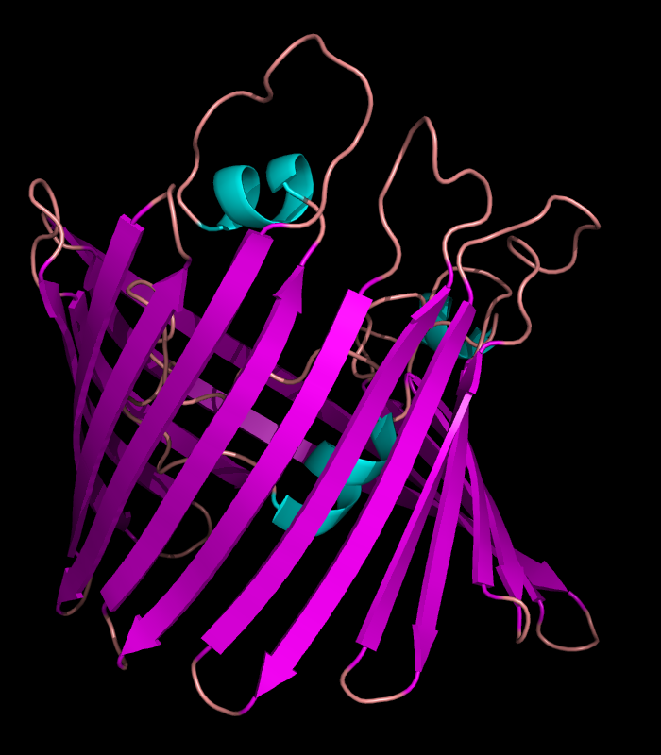
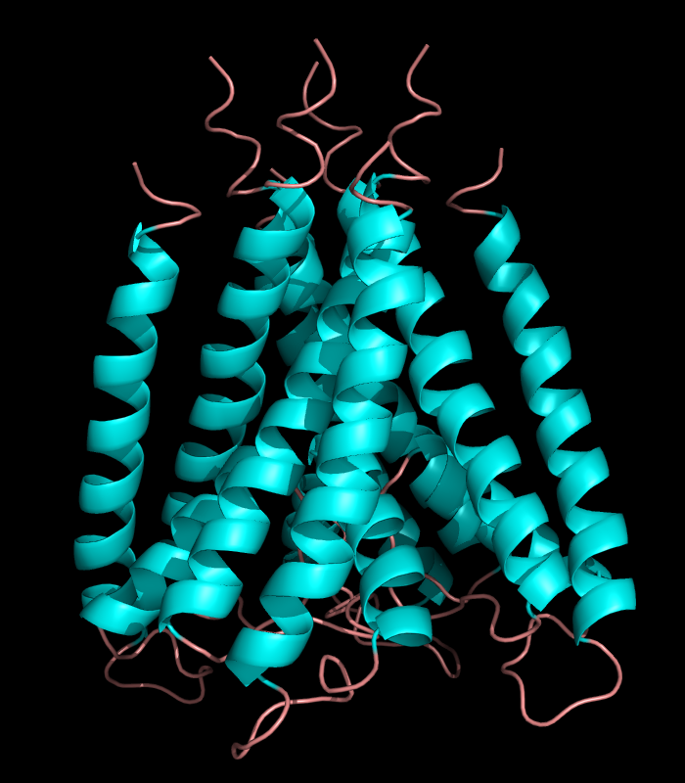

Slide 2
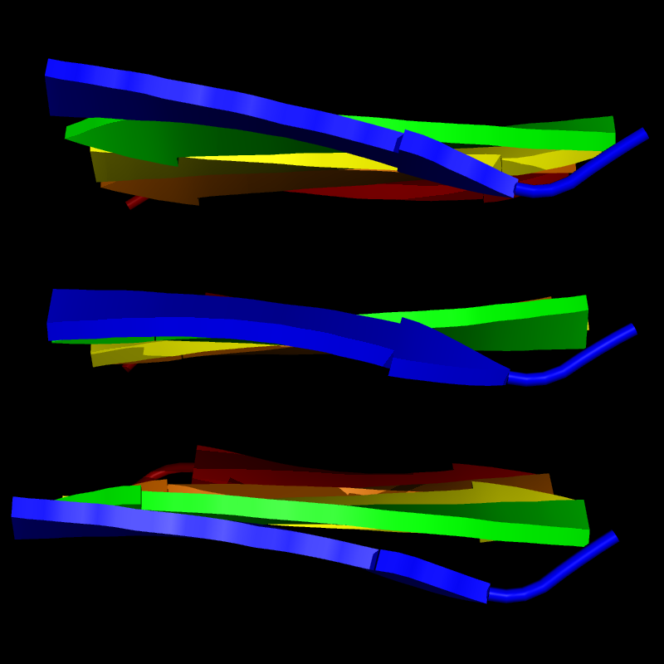
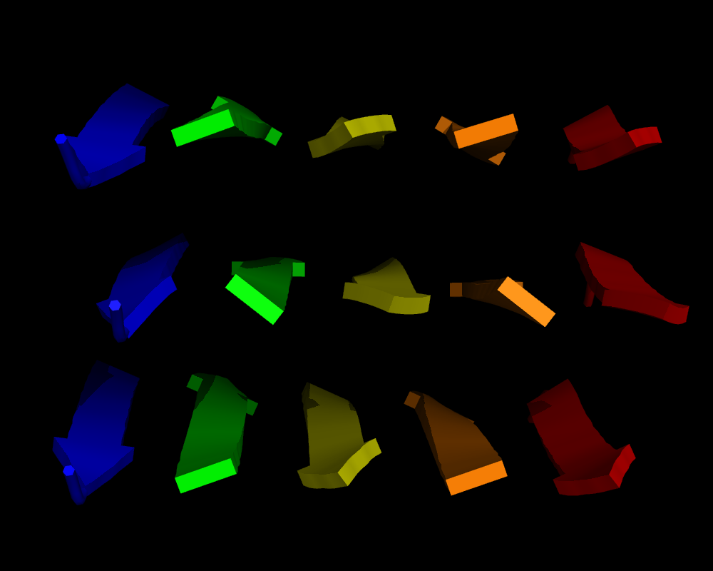

Slide 3
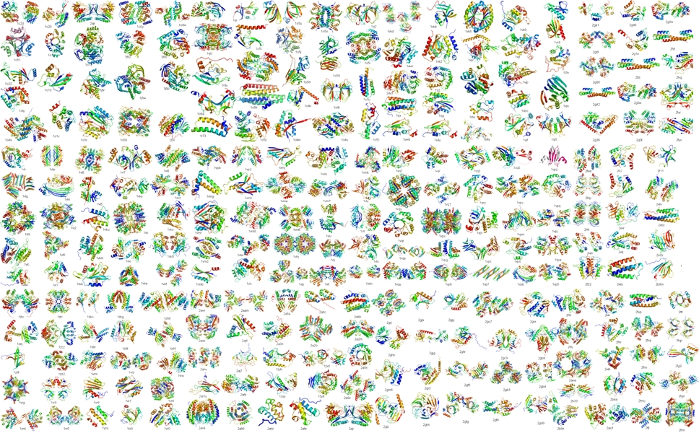

Slide 5
Figure 6-1 part 1

Slide 6
Figure 6-1 part 2

Slide 7
Figure 6-1 part 3

Slide 8
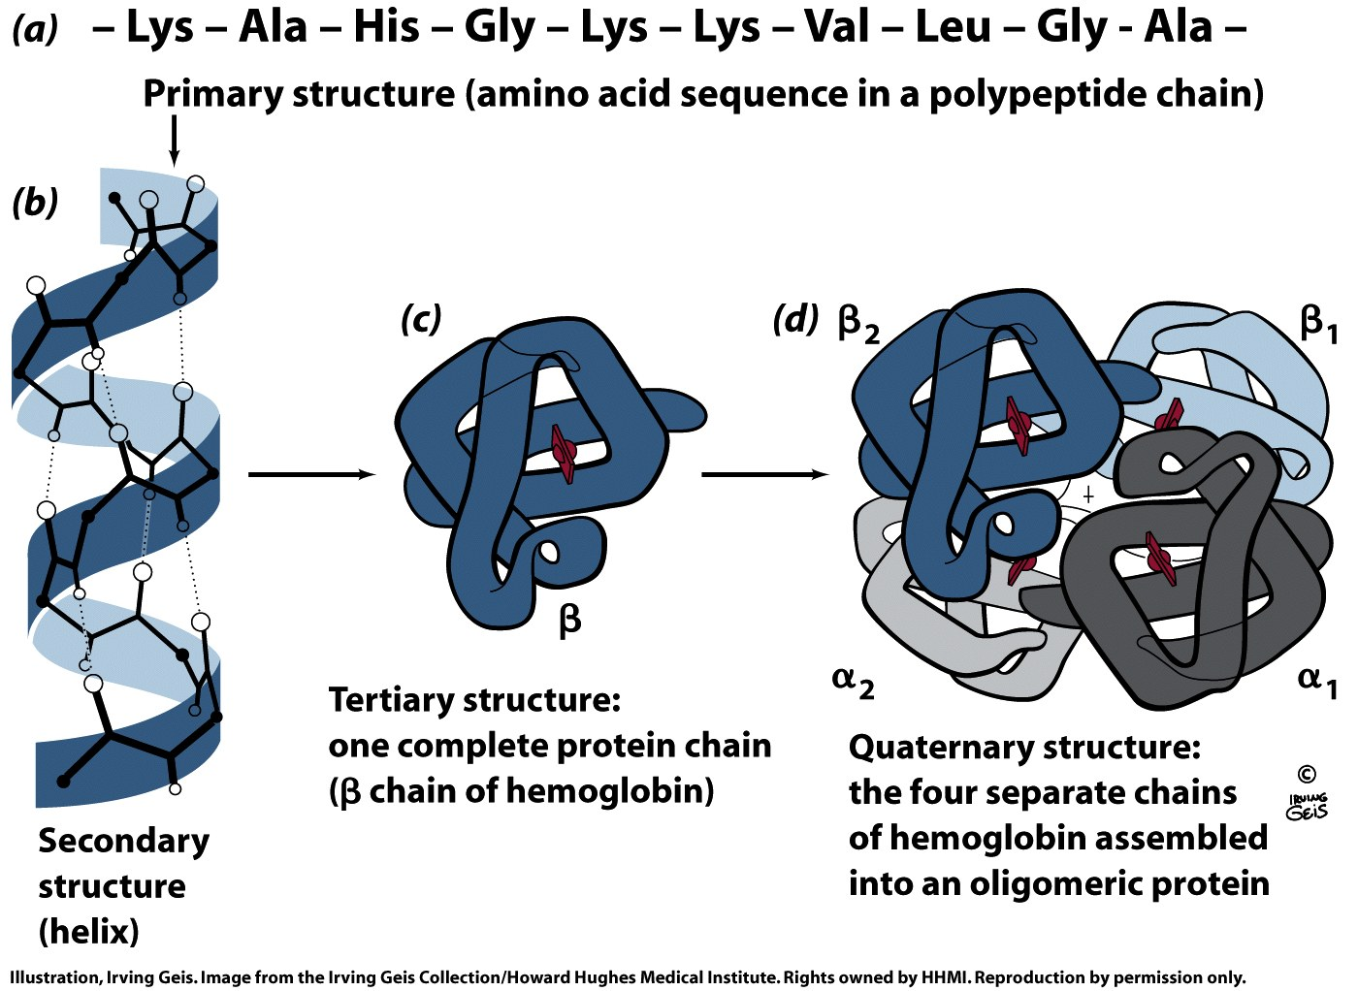
Figure 6-1 part 4

Slide 9
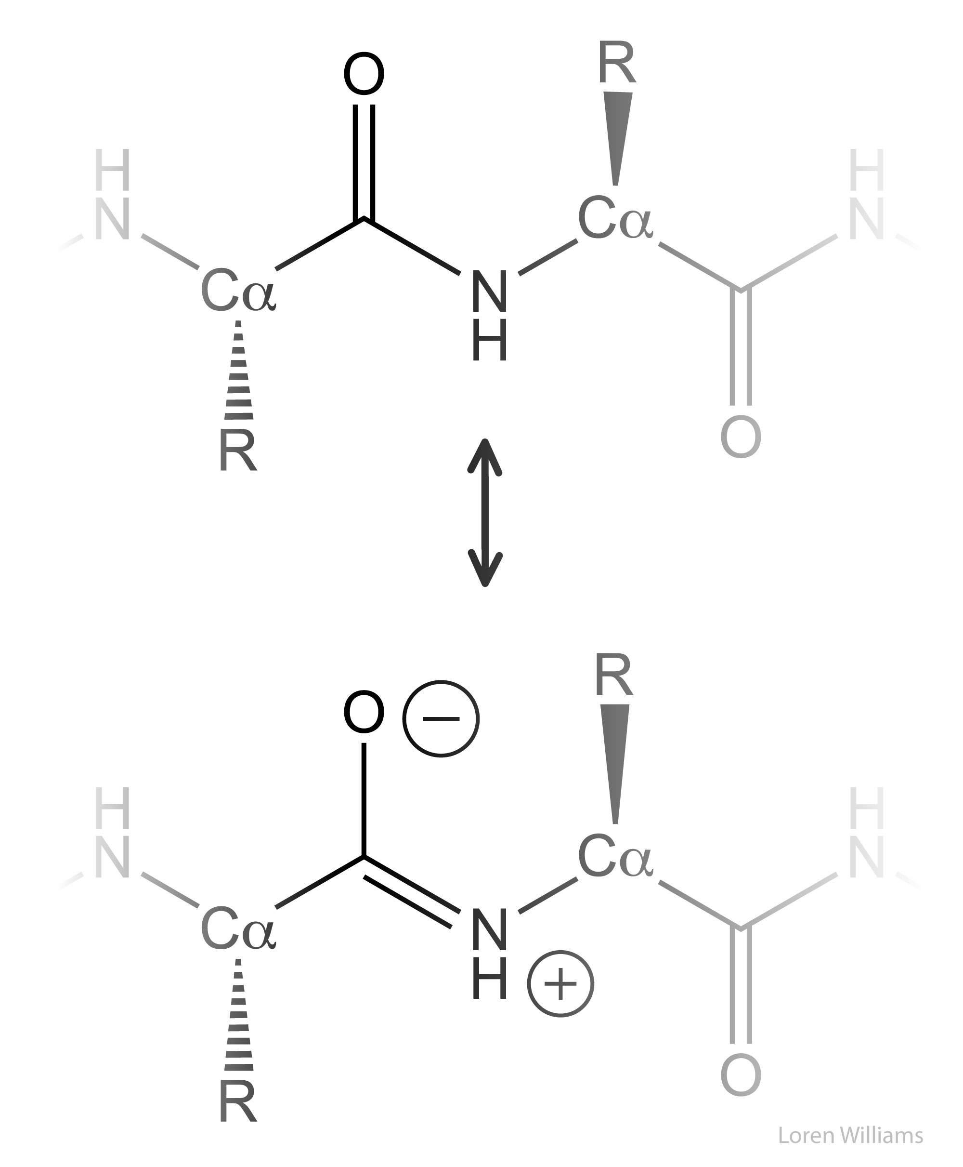
The Peptide Bond: Resonance
Page 127

Slide 10
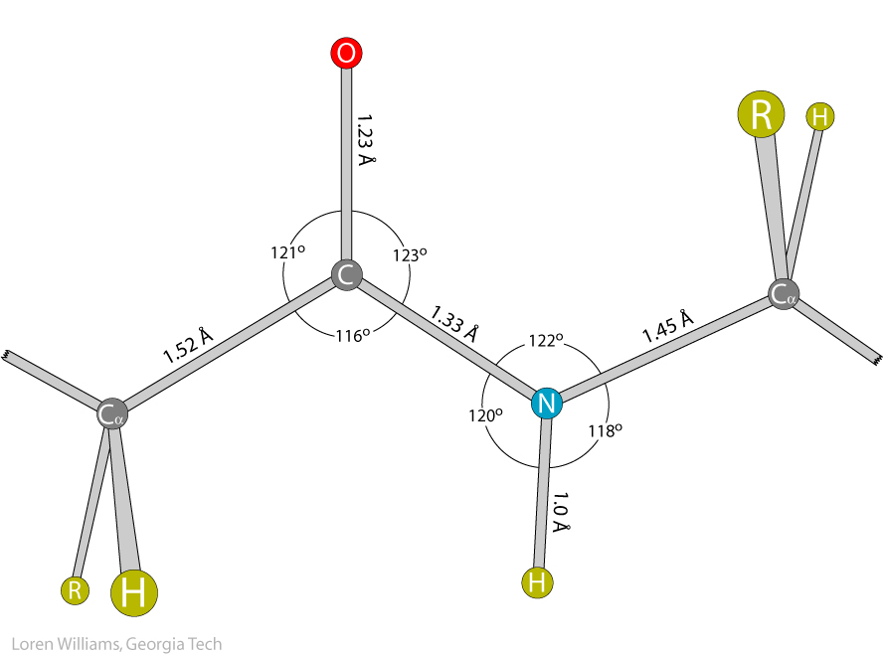

Slide 11
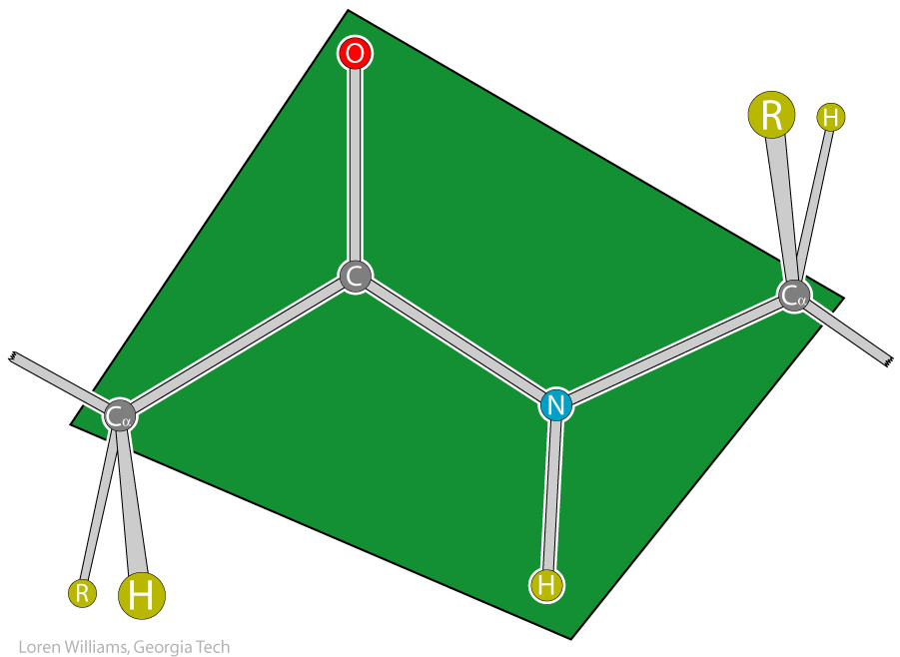

Slide 13
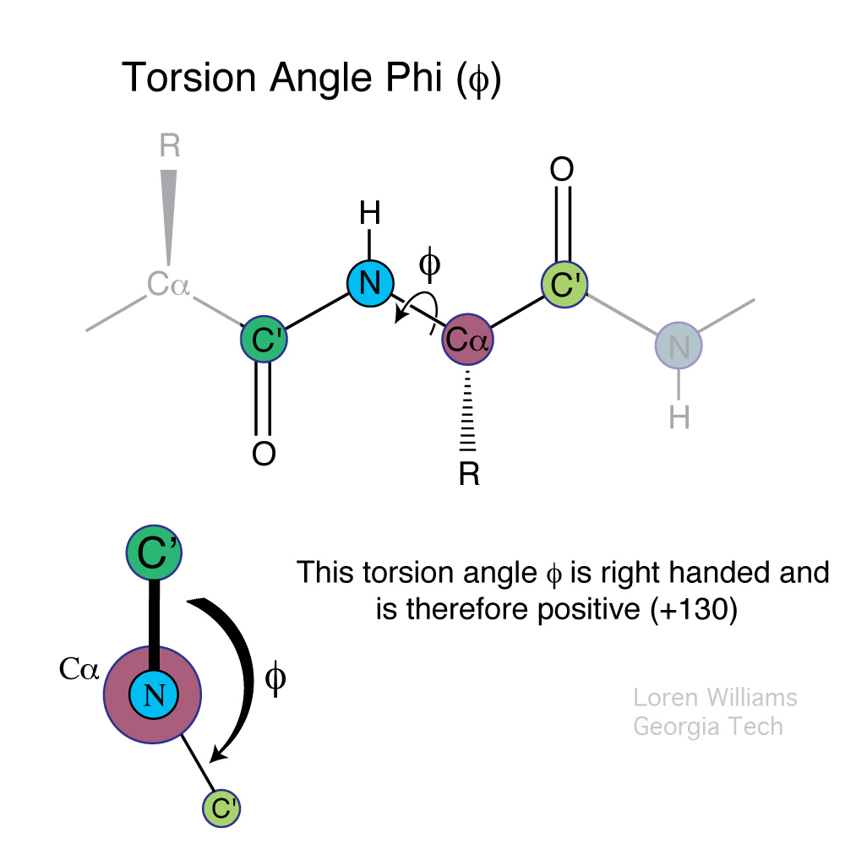

Slide 14
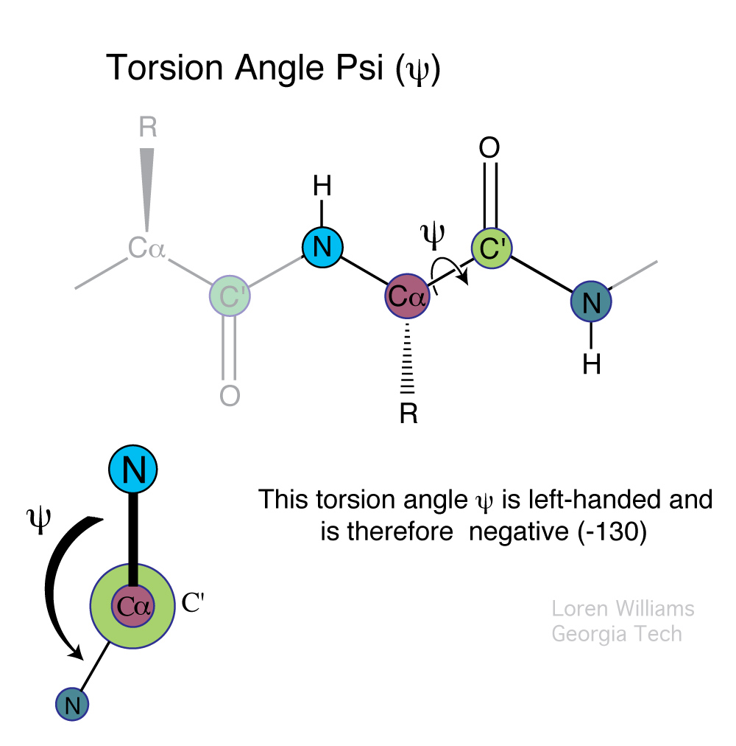

Slide 15
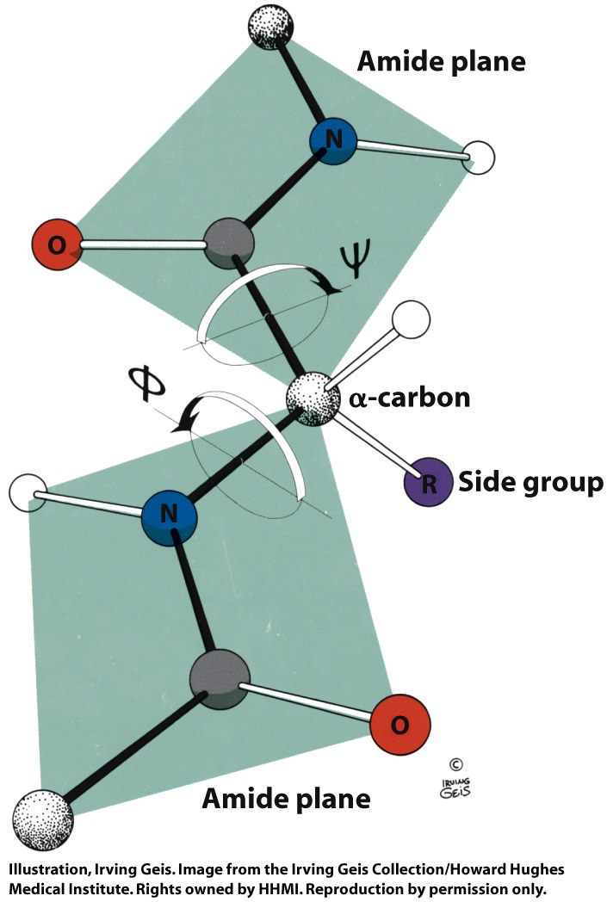
Figure 6-4

Slide 16
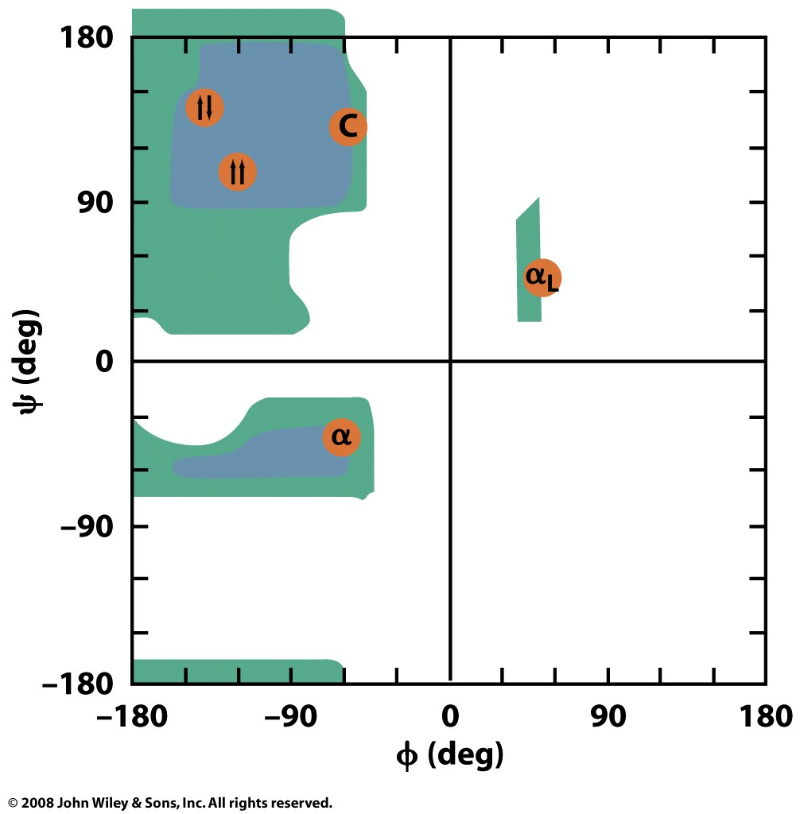
Figure 6-6

Slide 17
α helix

Slide 18
α-helix
right-handed
most prevalent secondary structural element
most uniform secondary structure in conformation
most predictable secondary structure from sequence
the NH of i+4 donates to O of i
69 H -> O 65, 68 H-> O 64, 67 H -> O 63
13 atoms in the HB ring
100°/aa
φ = -50° to -90°, ϕ = -30 to -60°
3.6 aa per turn
1.5 Å/aa, 5.4 Å/turn (1.5 Å/aa x 3.6 aa/turn)
Amino-acids have 'propensities' for being in α-helices. Methionine, alanine, leucine, uncharged glutamate, and lysine ("MALEK" in the amino-acid 1-letter codes) have high helix-forming propensities. Proline and glycine have low helix-forming propensities.

Slide 19
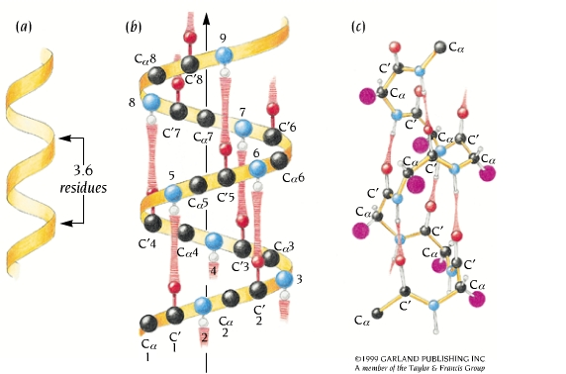
α helix
right-handed helix
100°/residue
3.6 residues per turn
1.5 Å rise per residue
5.4 Å per turn
1.5 Å/residues x 3.6 residues/turn = 5.4 Å/turn
Each N-H group forms a hydrogen bond with the C=O group four residues earlier.
Sidechains are directed out.
Peptide dipoles are aligned
φ = -50° to -90°, ϕ = -30 to -60°

Slide 20
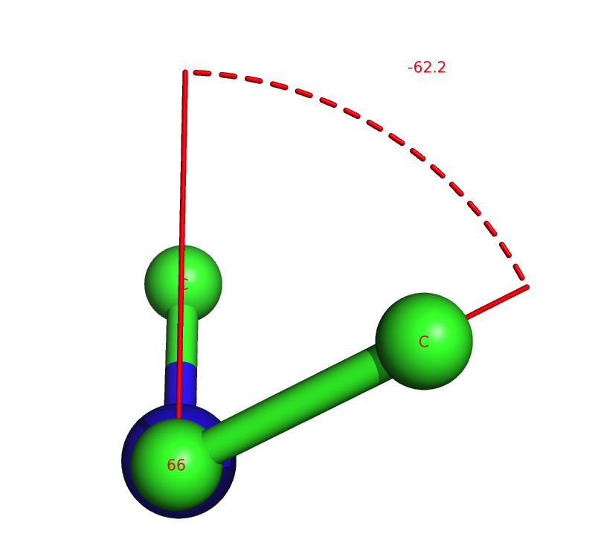
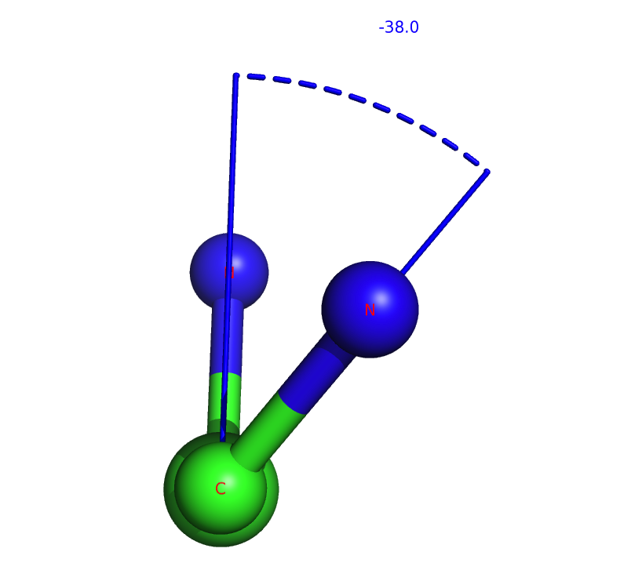
φ = -50° to -90°, ϕ = -30 to -60°
angle φ in an α-helix
angle ϕ in an α-helix

Slide 21
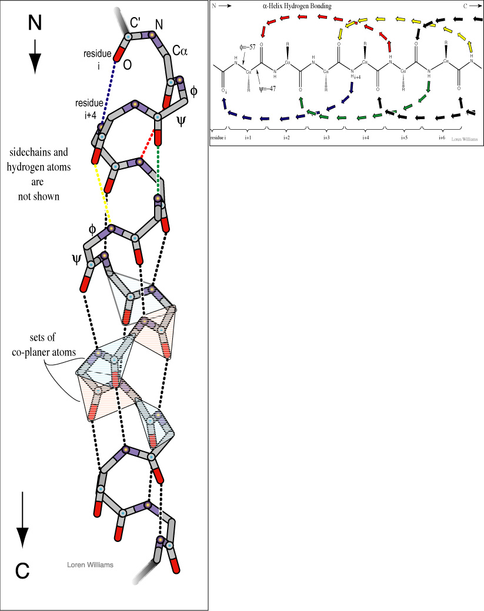
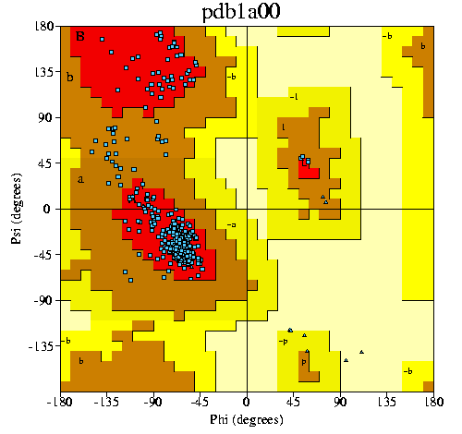
α-helix

Slide 22
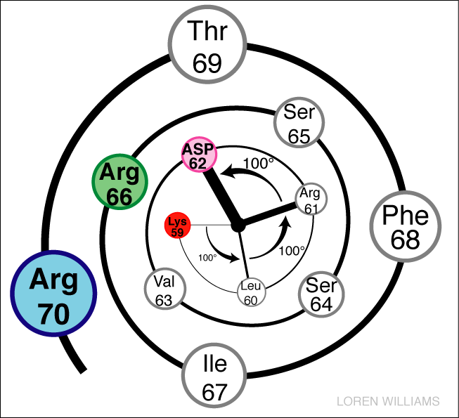
Helical Wheel

Slide 23
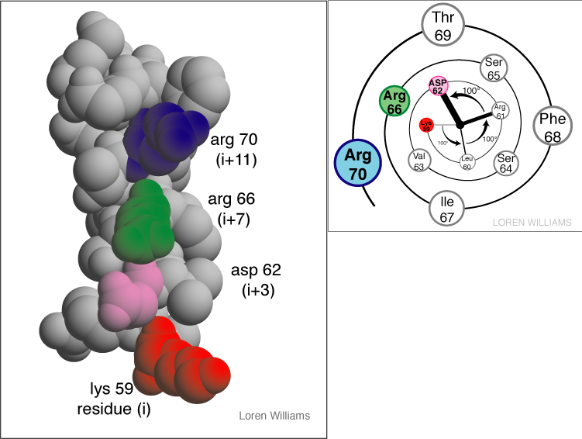

Slide 24
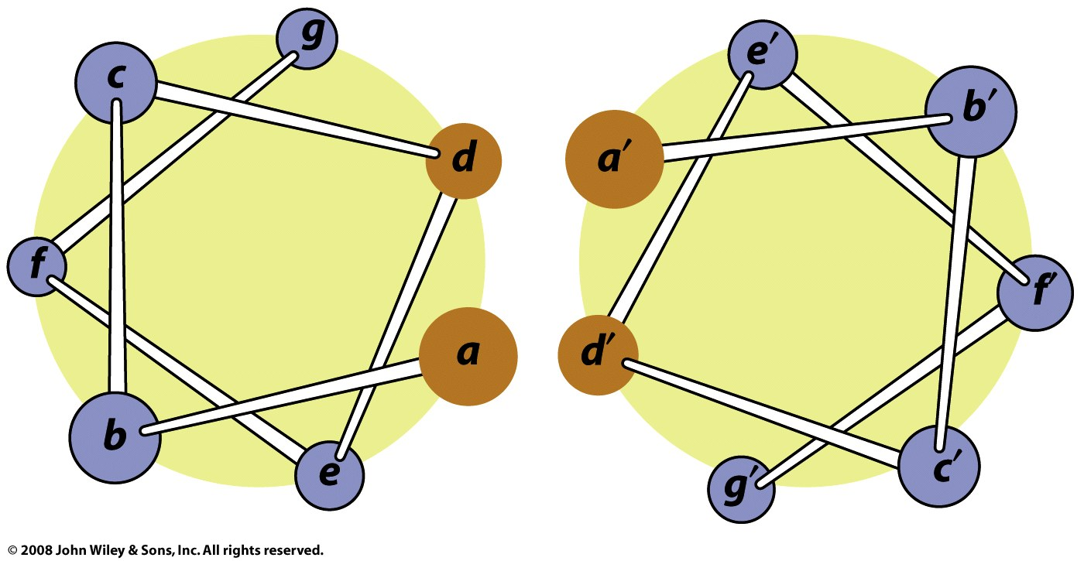
Coiled-coils: two α-helices form a "supercoil" with a heptad sequence repeat of seven aa's (a-b-c-d-e-f-g-a-b-c-d-e-f-g...). The a and d aa's are hydrophobic (d usually leucine). The e and g residues (the e and g aa's have opposing charges.

Slide 25
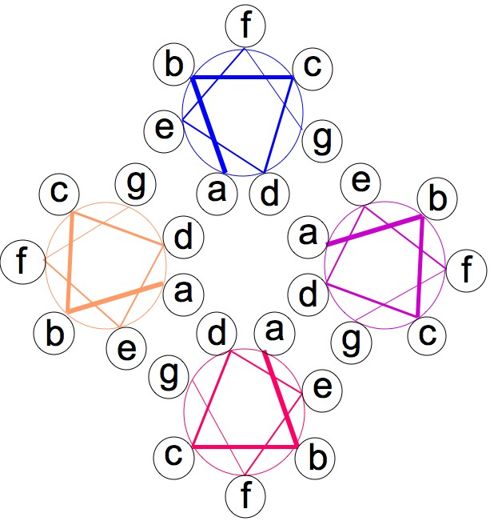
A pair of coiled-coils can form a four-helix bundle

Slide 26
β-sheet

Slide 27
β strand: a single continuous stretch of amino acids involved in backbone hydrogen bonds another strand
β sheet is an assembly of at least two β strands.
Backbone N-H groups of one strand form hydrogen bonds with backbone C=O groups of adjacent strands.
Sicechain disposition: Successive side chains are above, then below the plane of the sheet.
Parallel and Antiparallel: Antiparallel sheets have the strongest inter-strand H-honds, which are linear, which is their preferred geometry.
φ = -110° to -140°, ϕ = +110° to +135°

Slide 28
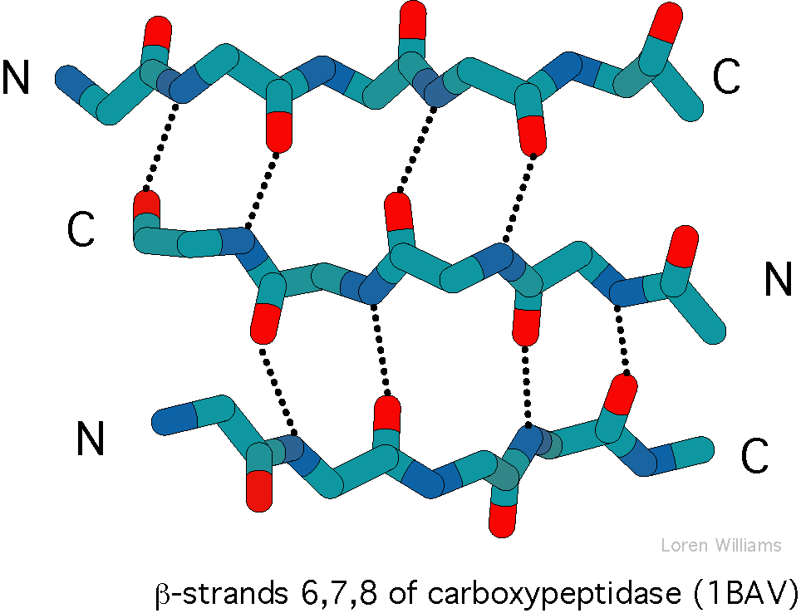
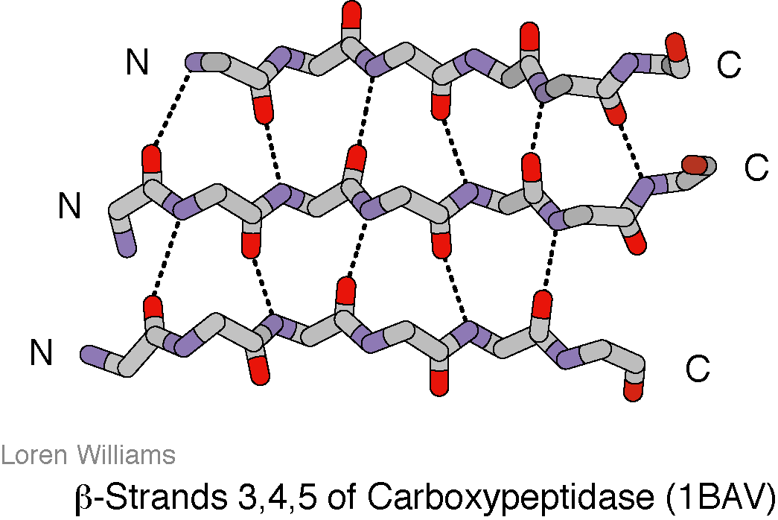
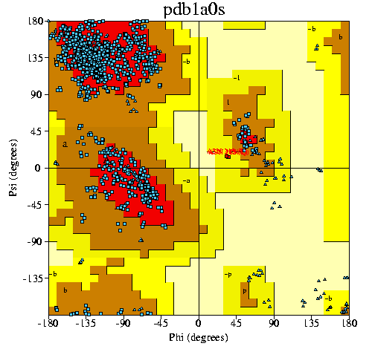
β-sheet
φ = -110° to -140°
ϕ = +110° to +135°
Antiparallel sheets are more extended: with larger |φ| and larger ϕ.

Slide 29
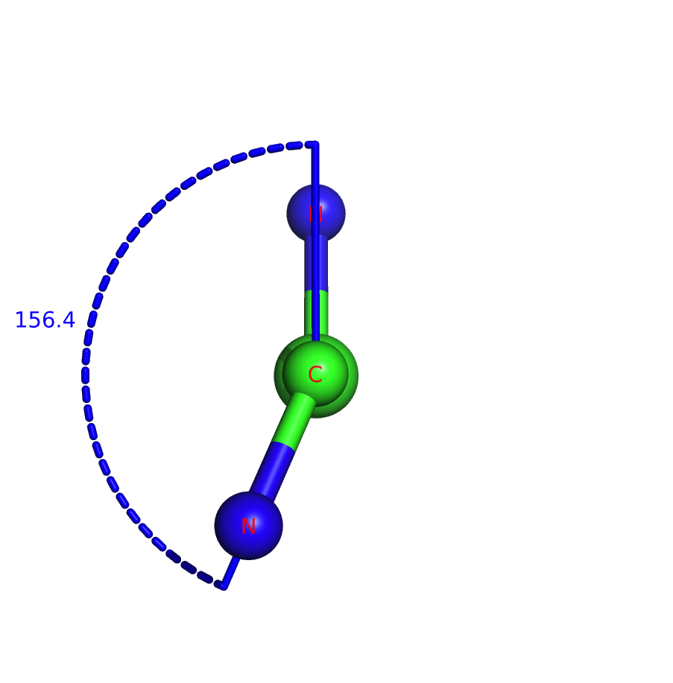
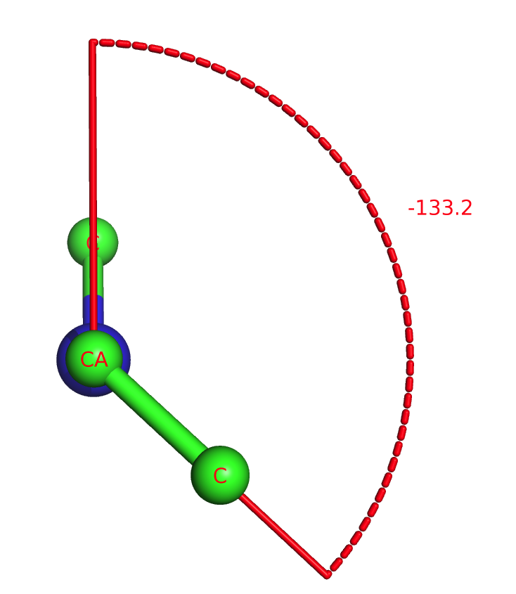
angle φ in an β-sheet
angle ϕ in an β-sheet
φ = -110 to -140 and ϕ = +110 to +135

Slide 30
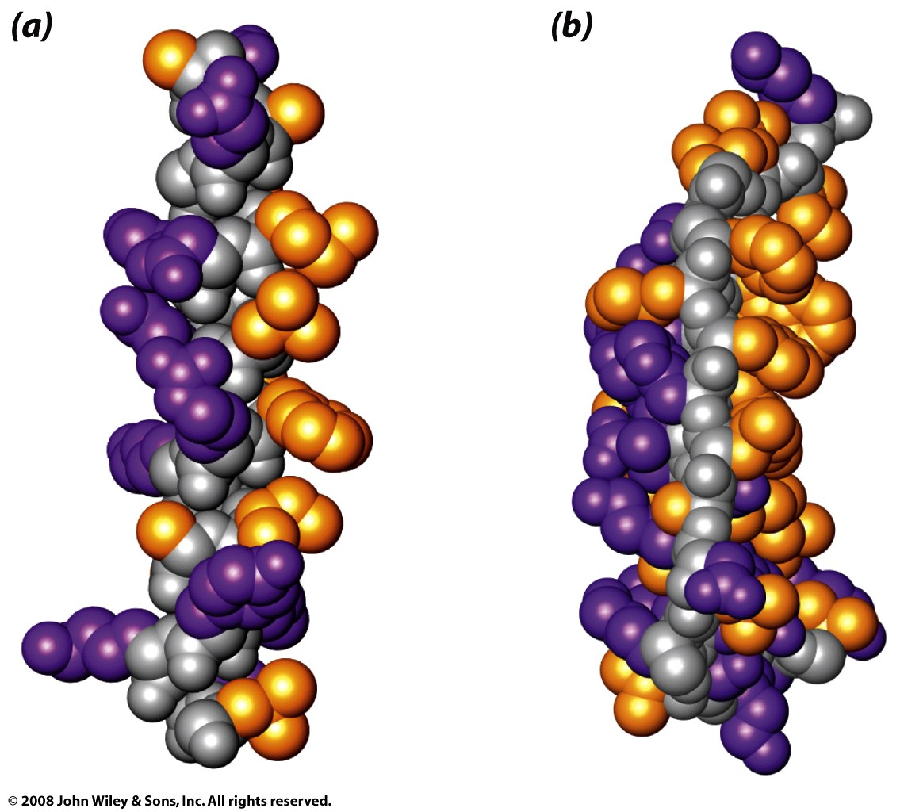
amphipathic α-helix and β-sheet
Figure 6-26

Slide 31
sidechain properties

Slide 32
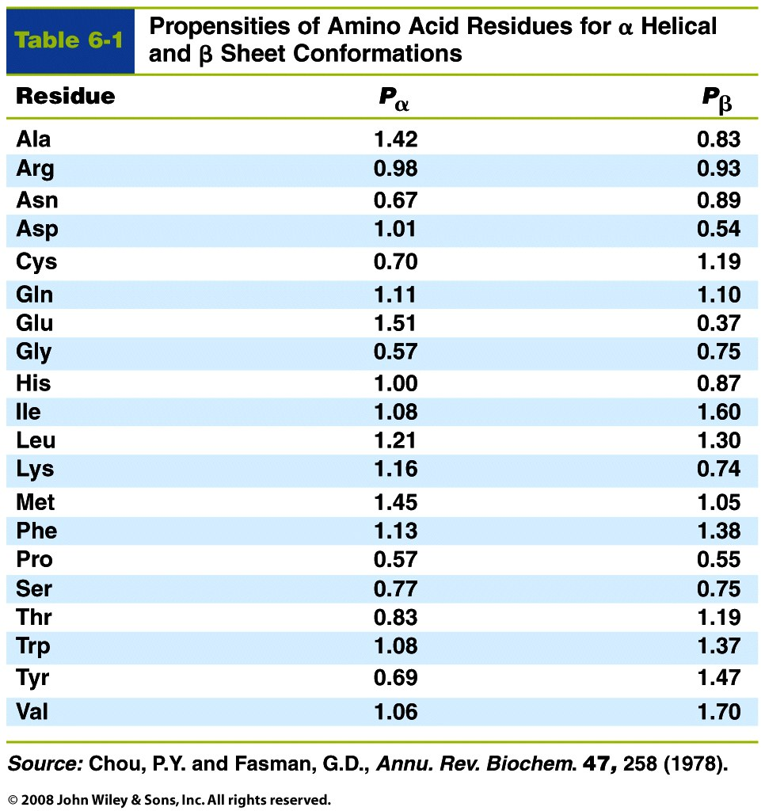
Table 6-1

Slide 33
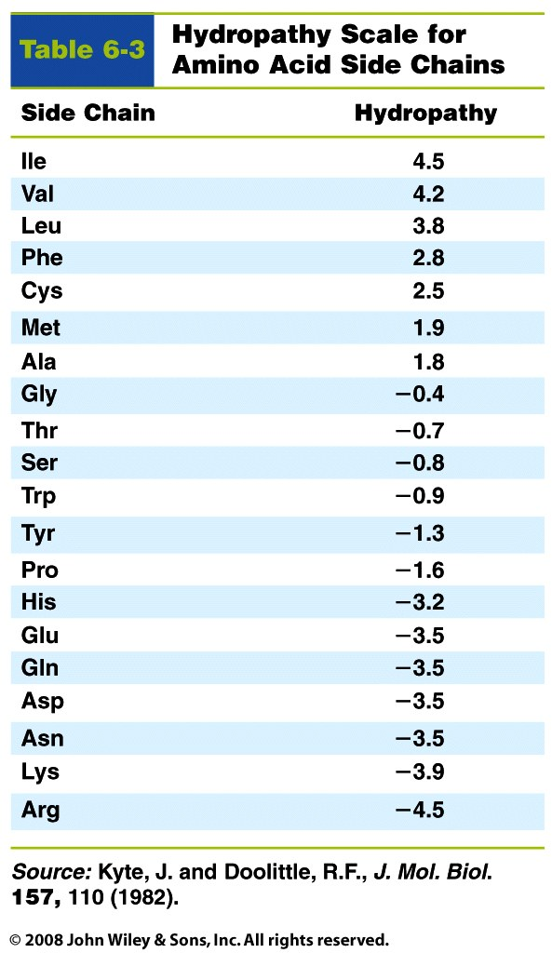
Table 6-3

Slide 34
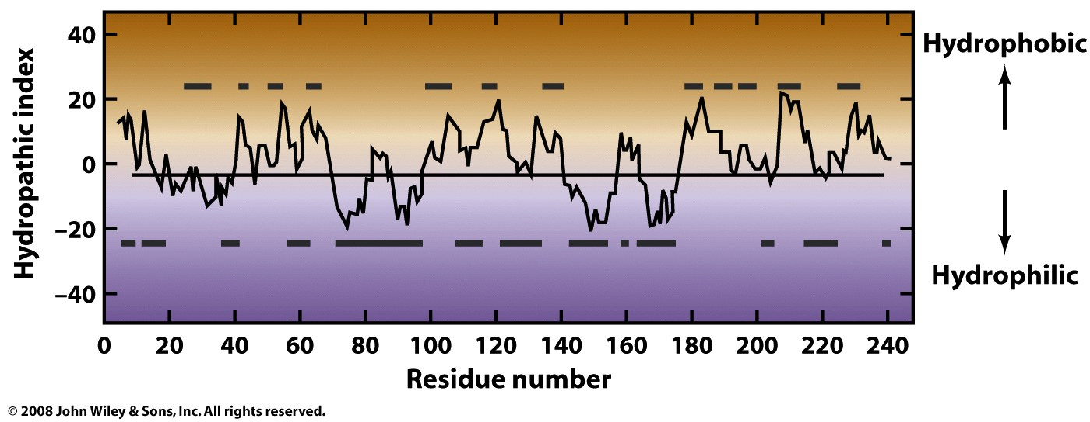
Figure 6-35

Slide 35
β-turns

Slide 36
The β-turn
(1__ - 2 PRO -3 GLY - __ )
a simple protein structural motif
generally found on protein surfaces
turns the backbone around by 180 degrees to fold back on itself
links two anti-parallel two beta strands
that are adjacent in primary structure,
that are adjacent in secondary structure
is a short loop of two to five amino acids
frequently contains glycine at position 3, (small H side chain allows extreme phi-psi).
frequently contains proline at position 2, (P forces the backbone into the appropriate conformation)

Slide 37
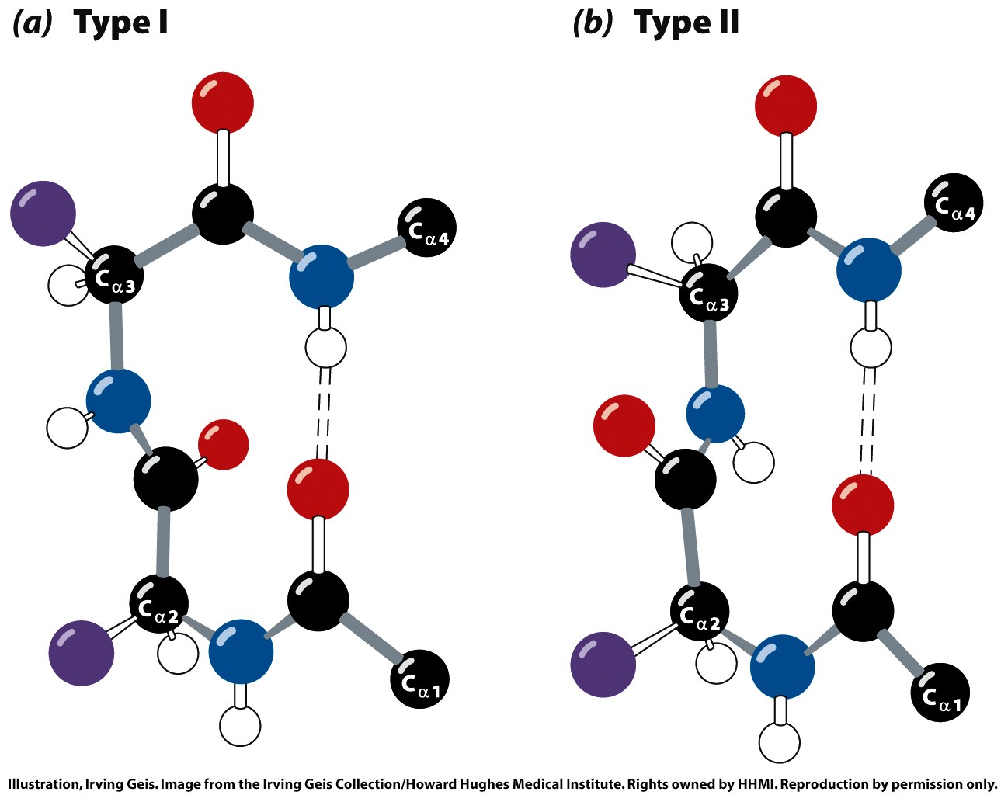
Make a table of delta phi/delta psi, to compare type I and type II
Figure 6-14

Slide 38
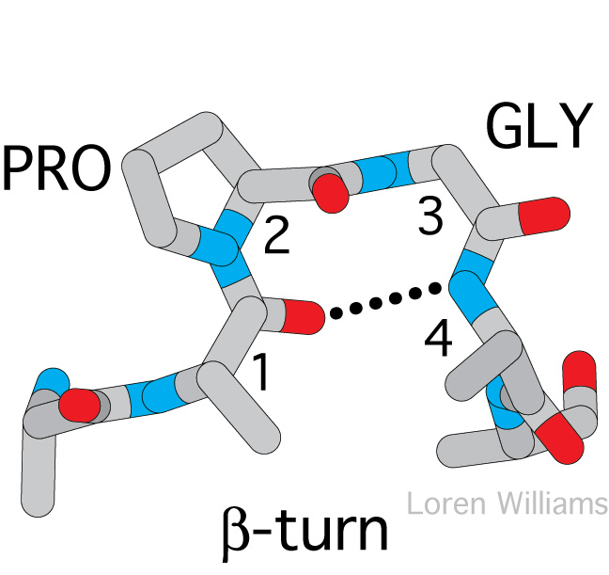

Slide 39
Fibrous Proteins

Slide 40
α-keratin

Slide 41
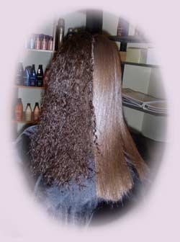
coiled-coil
fibrous structural protein
in skin, hair and nails
high frequence of cysteine that forms disulfide bridges to confer strength, form, rigidity.

Slide 42
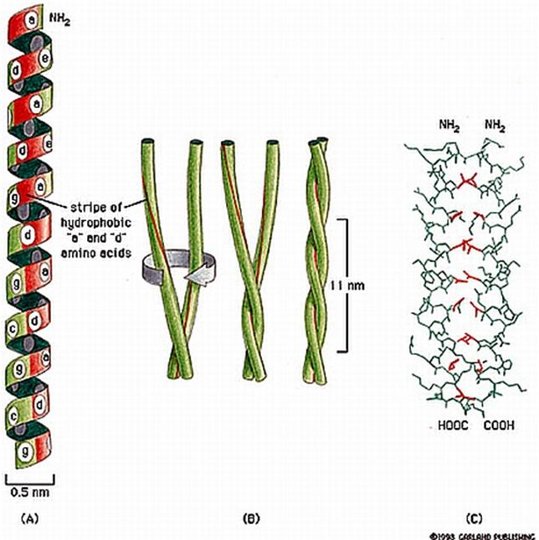

Slide 43
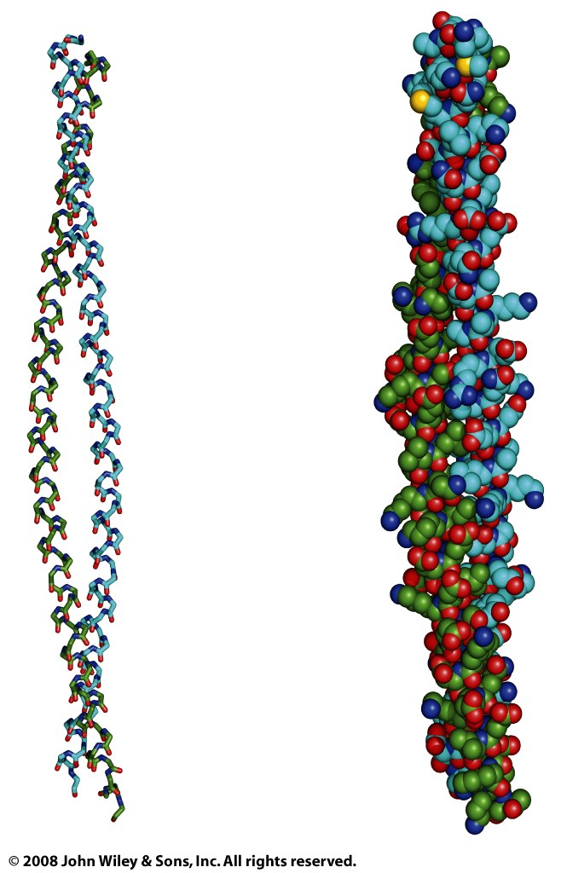
Figure 6-15b

Slide 44
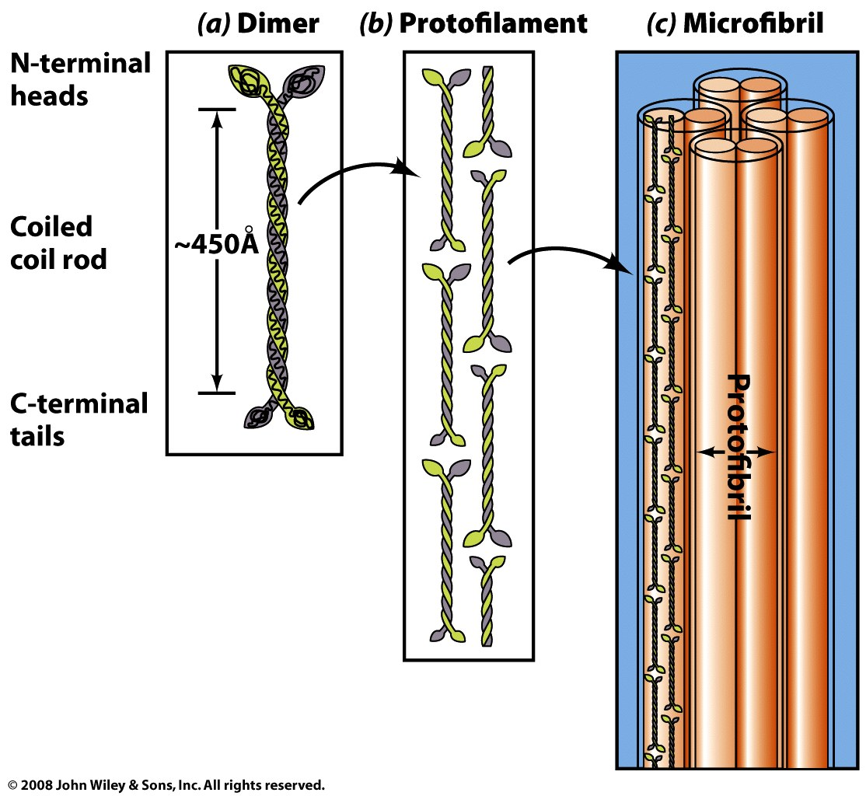
α-keratins: Hair, horns, claws, nails, hooves…

Slide 45
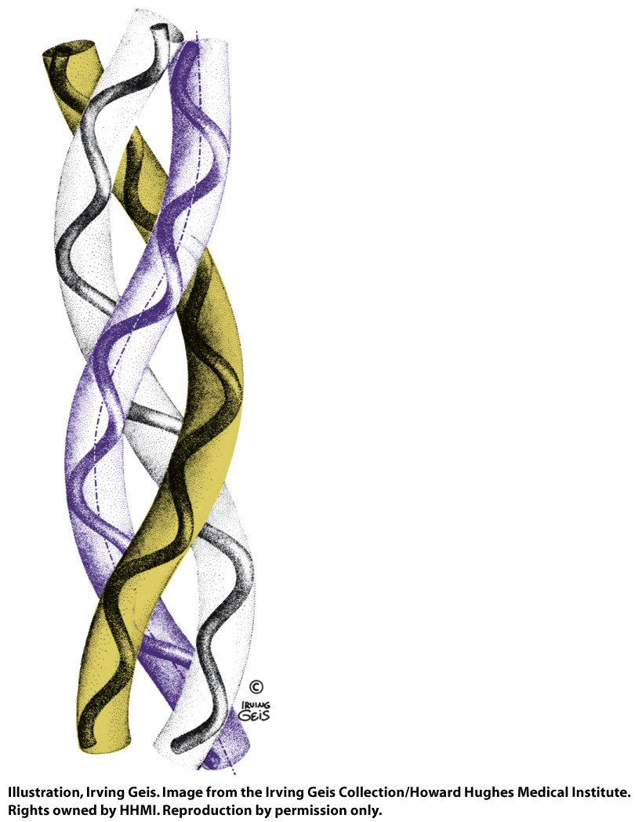
Collagen

Slide 46
Collagen
protein found in connective tissue of vertebrates
tendons, ligaments, skin, corneas, cartilage, bones, blood vessels, etc.
is the matrix of bone on which mineral constituents are precipitated
is the most abundant protein in mammals
right-handed triple helix
each triple helix is wound together with the two other triple helices to form a right handed fiber
amino acid sequence is repeating Gly-X-Y, where X is often proline and Y is proline or hydroxyproline
every third residue lies near the center of the triple helix and can only be glycine
the number of amino acid in a chain averages around 1,000
Collagen has many modified amino acid sidechains (hydroxyproline and hydroxylysine)
Hydroxyproline helps to stabilize the triple helix via hydrogen bonds.
Hydroxylysine provides attachment sites for polysaccharides
Hydroxylation of proline requires ascorbic acid (vitamin C). Deficiency of vitamin C reduces hydroxyproline production, leading to weakened collagen fibers and the condition known as scurvy.

Slide 47
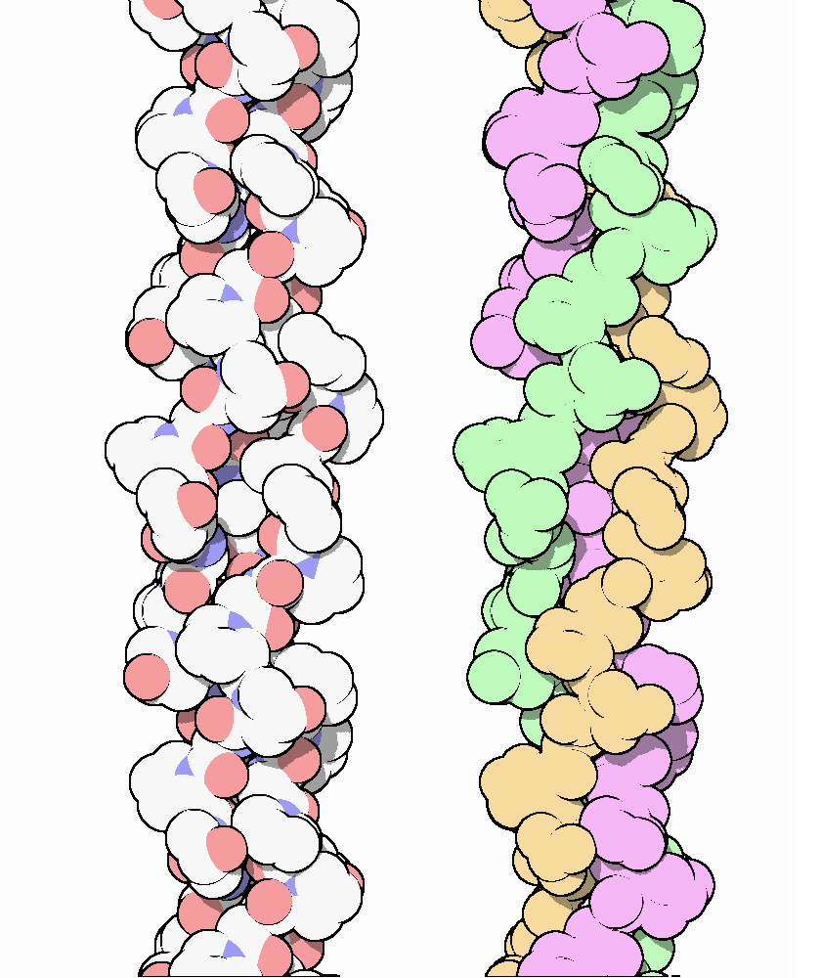
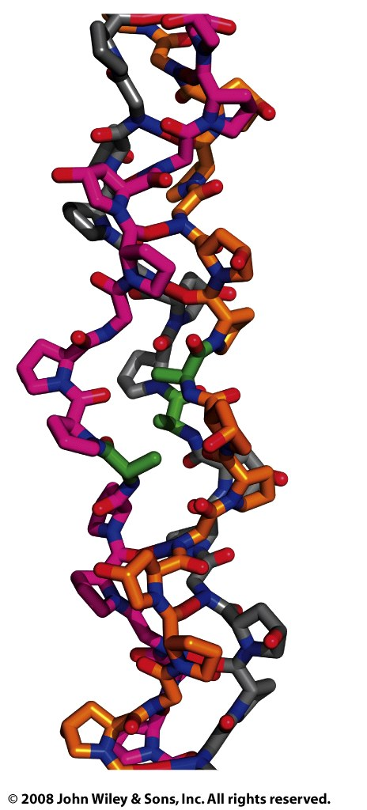

Slide 48
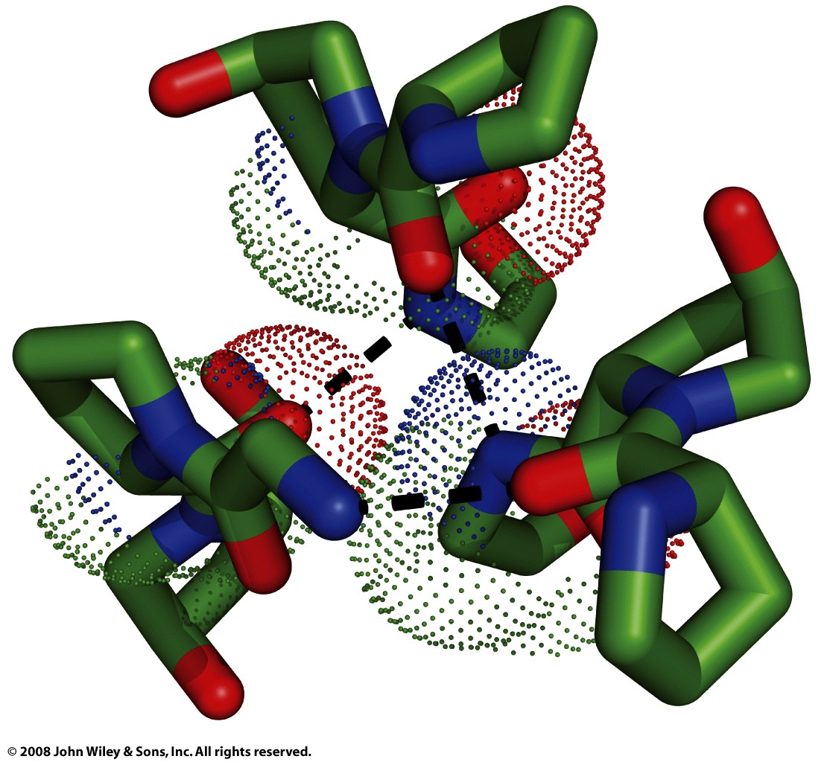
Figure 6-18b

Slide 49
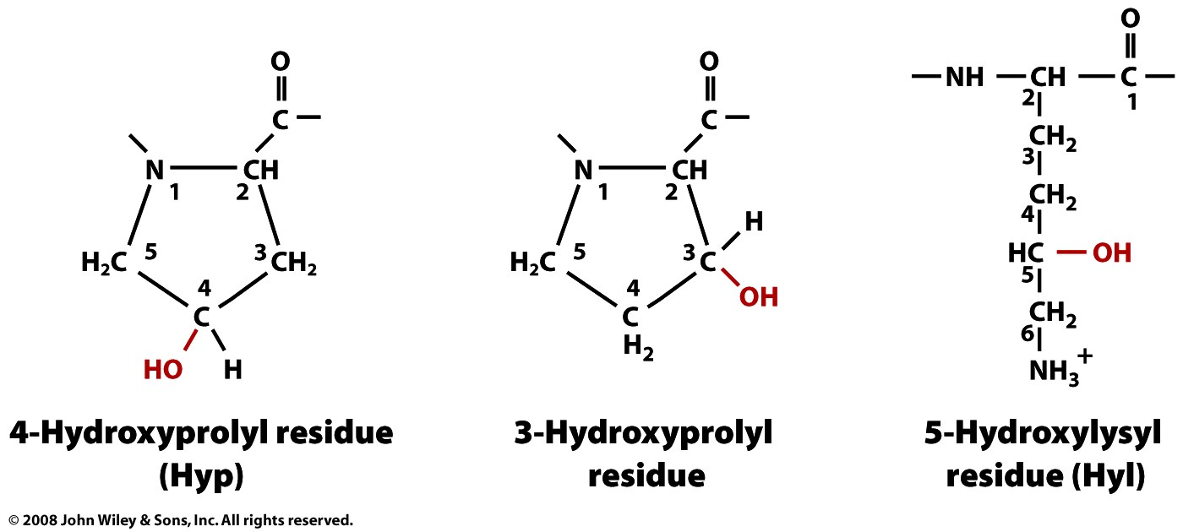
Page 137

Slide 50
Globular Proteins

Slide 51
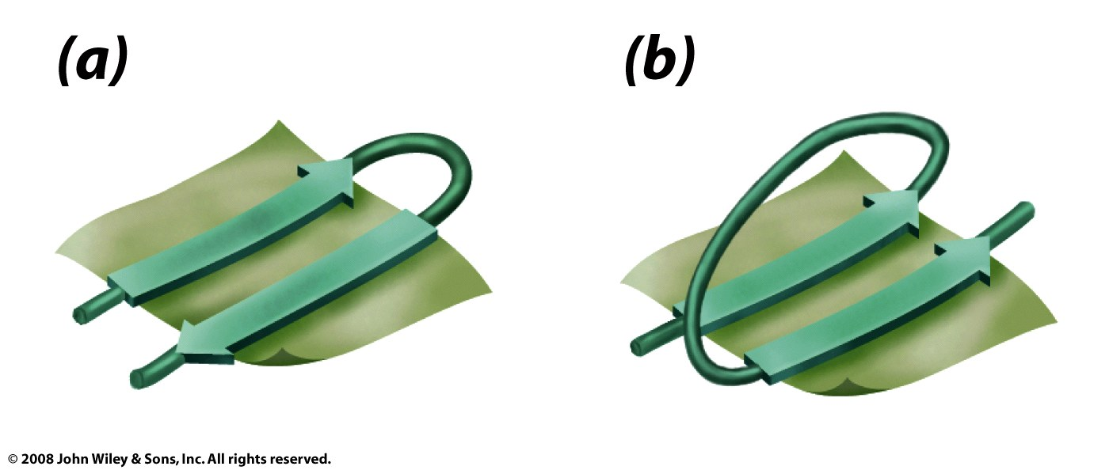
Antiparallel sheets often use beta turns
Parallel sheets use beta-alpha-beta
Figure 6-13

Slide 52
porin
all β-sheet (almost).

Slide 53
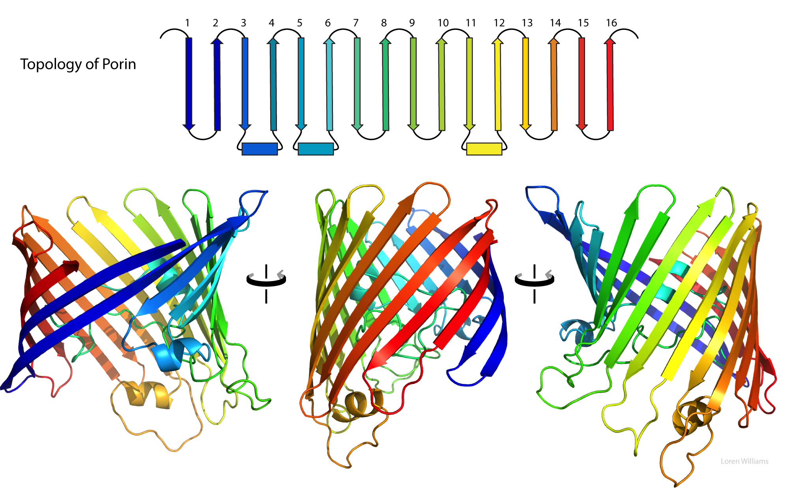

Slide 54
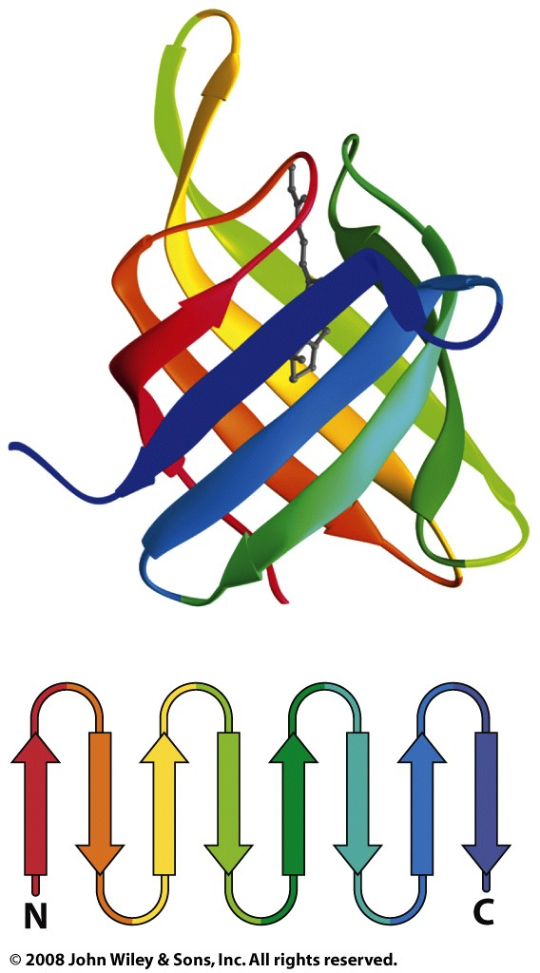
Retinol Binding Protein
Retinol and retinoic acid play crucial roles in the modulation of gene expression and overall development of an embryo. Regulation of transport and metabolism of retinol necessary for a successful pregnancy is accomplished via RBP.
all β-sheet

Slide 55
The TIM barrel
a conserved protein fold
15 distinct enzyme families are TIM barrels.
one of the most common protein folds
contains eight α-helices and eight parallel β-strands
contains alternating α-helix - β-strand - α-helix - β-strand-...
has a tightly packed core with many bulky hydrophobics
named after triosephosphate isomerase,
the active site is always at the C-terminal end beta barrel.
mixed β-sheet /α-helix (closed sheet)
There is very little sequence similarity between various TIM barrels

Slide 56
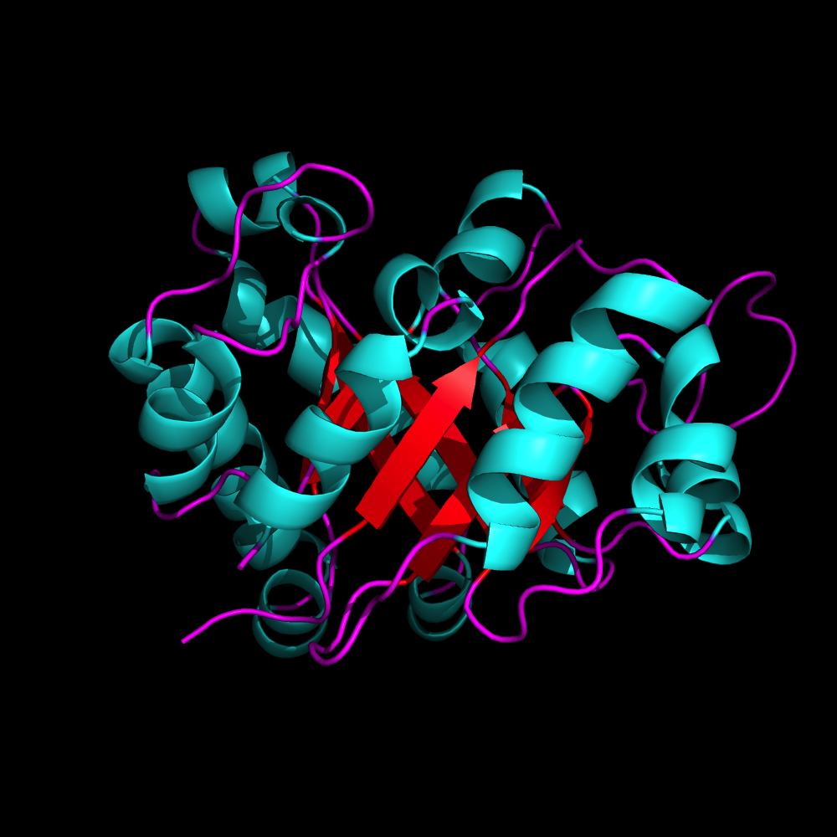
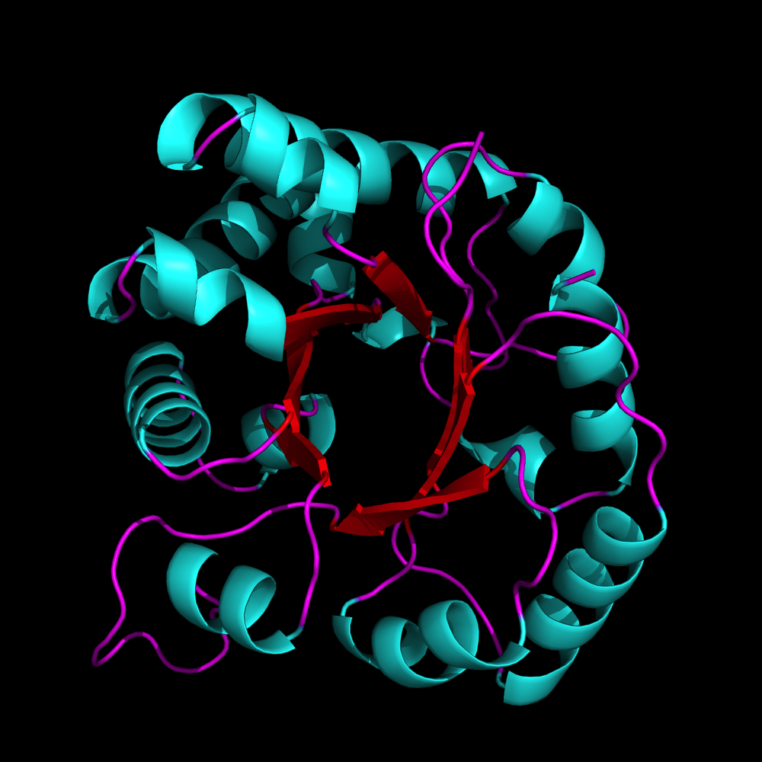
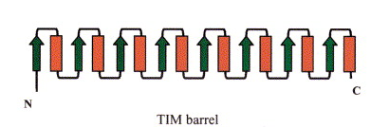
TIM Barrel

Slide 57
Figure 6-28a

Slide 58
Figure 6-30c

Slide 59
Carboxy-
peptidase
mixed β-sheet /
α-helix (open sheet)

Slide 60
Carboxy-
peptidase

Slide 62
all α-helix

Slide 63
Protein Folding

Slide 64
Figure 6-40

Slide 65
Page 159

Slide 66
Figure 6-28d

Slide 67
Figure 6-41

Slide 68
Figure 6-43a,b

Slide 69
Figure 6-43c

Slide 70
Figure 6-44

