Slide 1
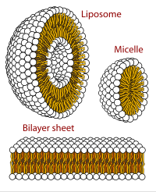
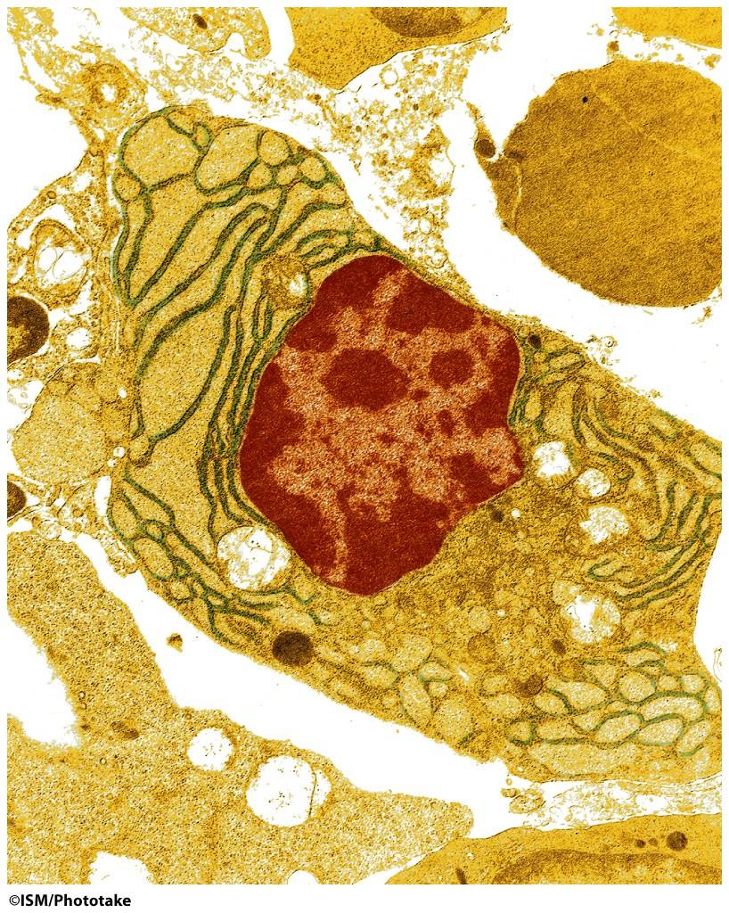
Membranes
enclose and separate aqueous compartments
act as selective barriers
contain embedded proteins and small molecules (cholesterol, etc)

Slide 2
Lipids:
are hydrophobic or amphiphilic
fatty acids,
Trigycerides (fatty acids + glycerol),
phospholipids,
sphingolipids,
saccharolipids,
polyketides,
sterol lipids,
prenol lipids
peptides (sometimes).
Figure 9-1

Slide 3
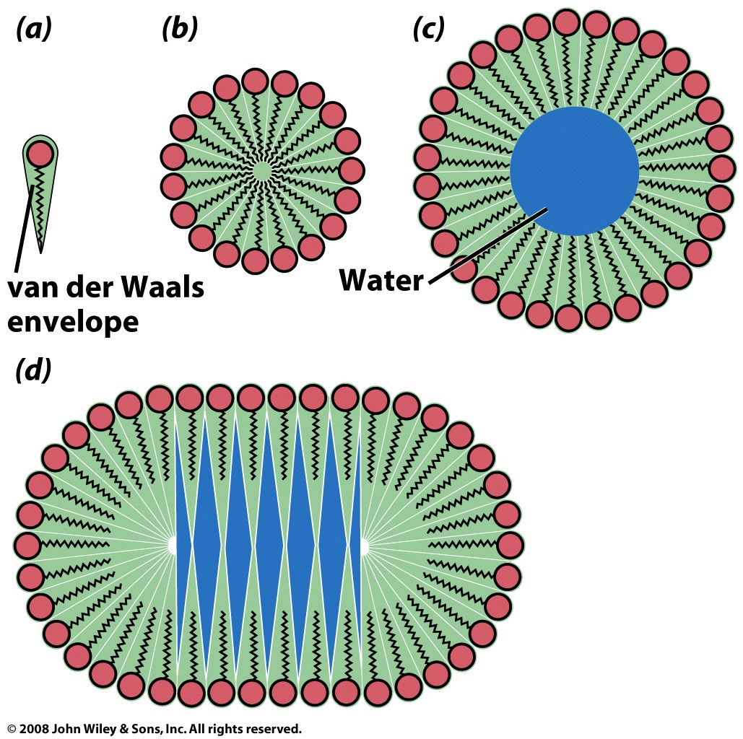
single-tailed lipids
Figure 9-13

Slide 4
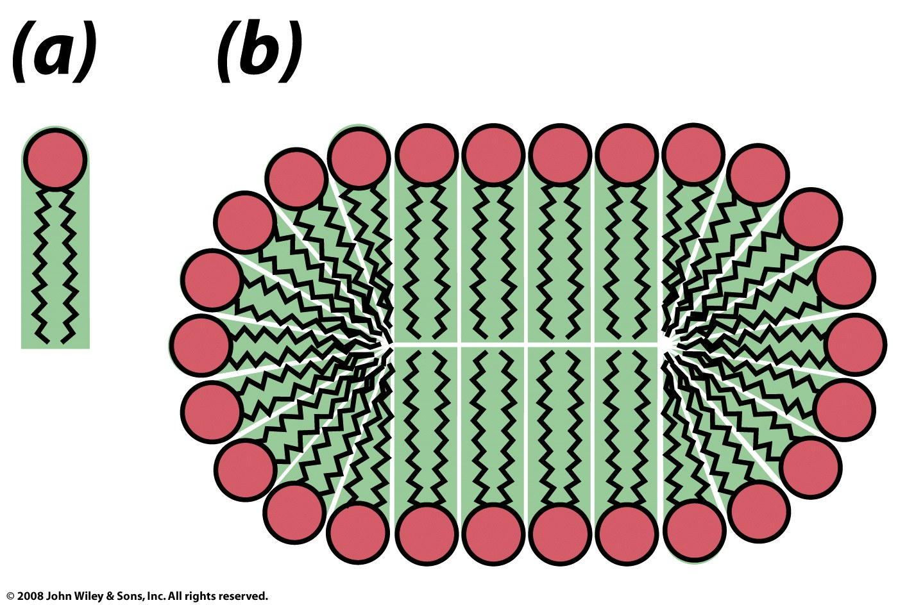
two-tailed lipids
Figure 9-14

Slide 6
Lipid Bilayers
A lipid bilayer is a thin membrane formed by two layers of phospholipid/sphingolipid/etc. The membrane is a flat sheet with polar surfaces that sandwich a hydrophobic core. A membrane can form a continuous barrier that is impermeable to most hydrophilic molecules and ions.
Lipid bilayers self-assemble in water. Hydrophobic interactions provide the primary driving force for assembly.
The cell membranes of almost all living organisms and many viruses are made of a lipid bilayers, as are the membranes surrounding the cell nucleus and other organelles.
The cell membrane (plasma membrane) separates the interior of a cell from the outside.

Slide 7
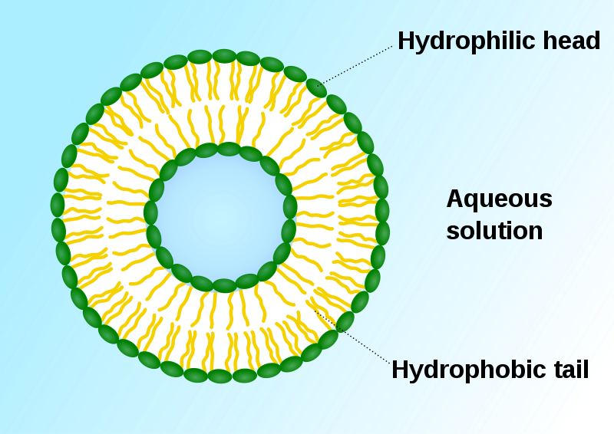
Lipid Bilayers
A liposome, with an inside and an outside: formed by phospholipids in an aqueous solution. Green: polar head groups.

Slide 8
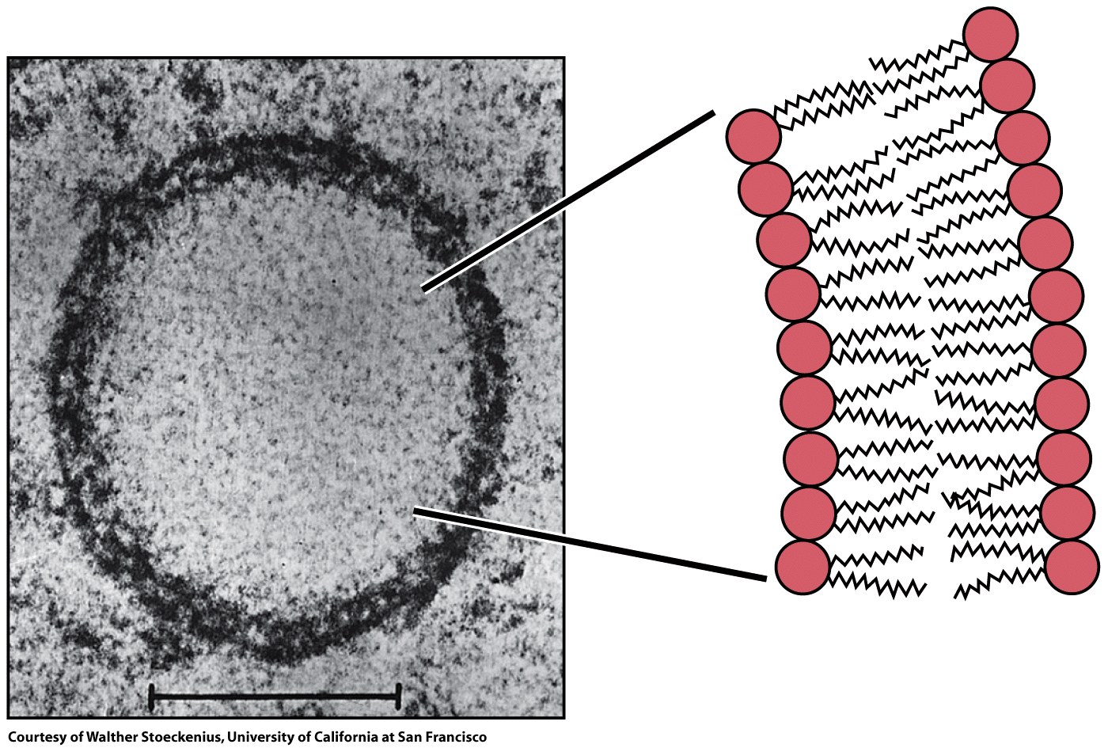
Figure 9-15

Slide 9
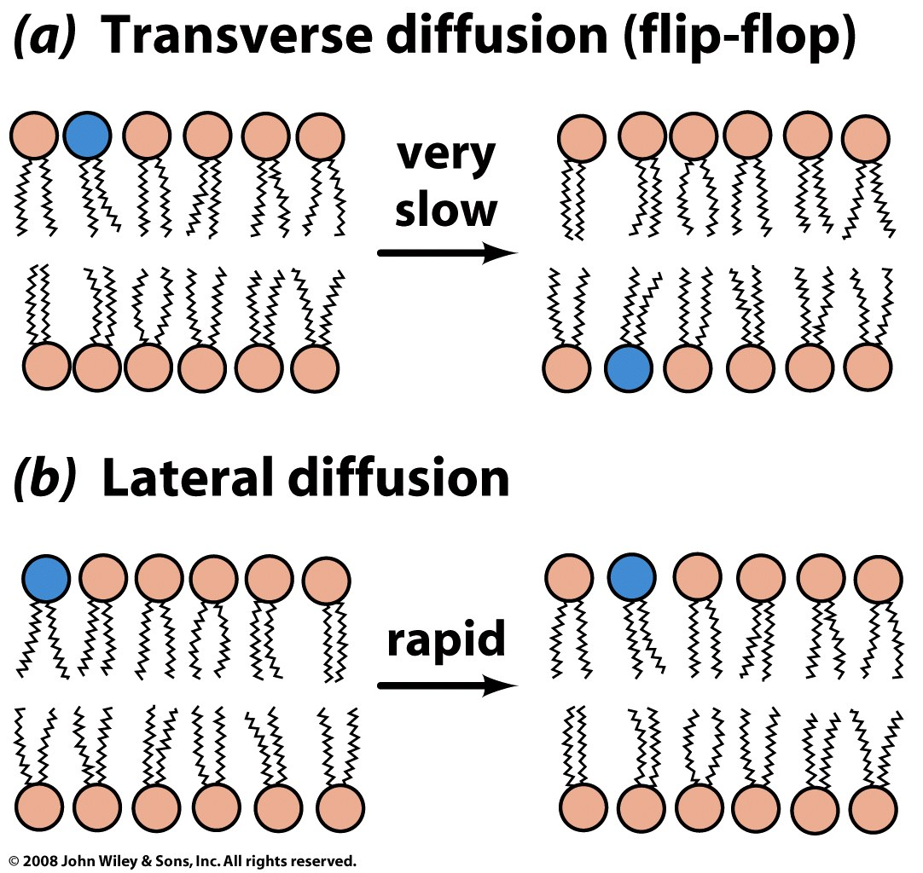
Figure 9-16

Slide 10
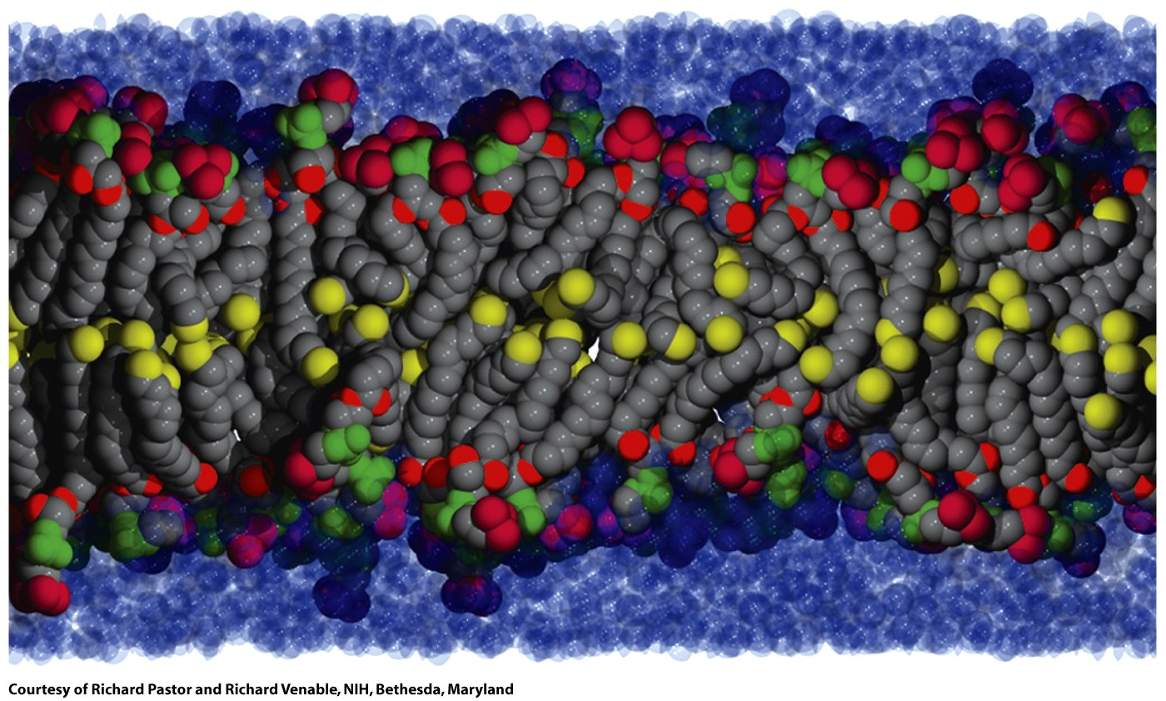
A biological bilayer is fluid, dynamic and disordered. Here the terminal carbon atoms are yellow.
Figure 9-17

Slide 11
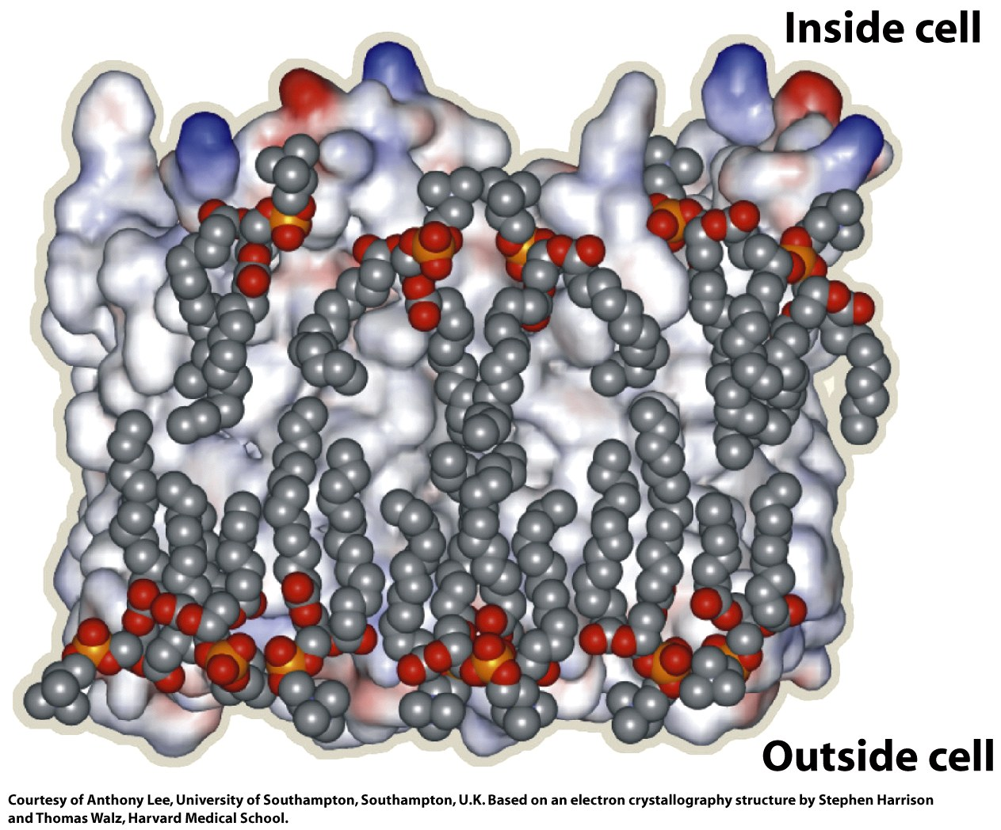
Figure 9-19

Slide 12
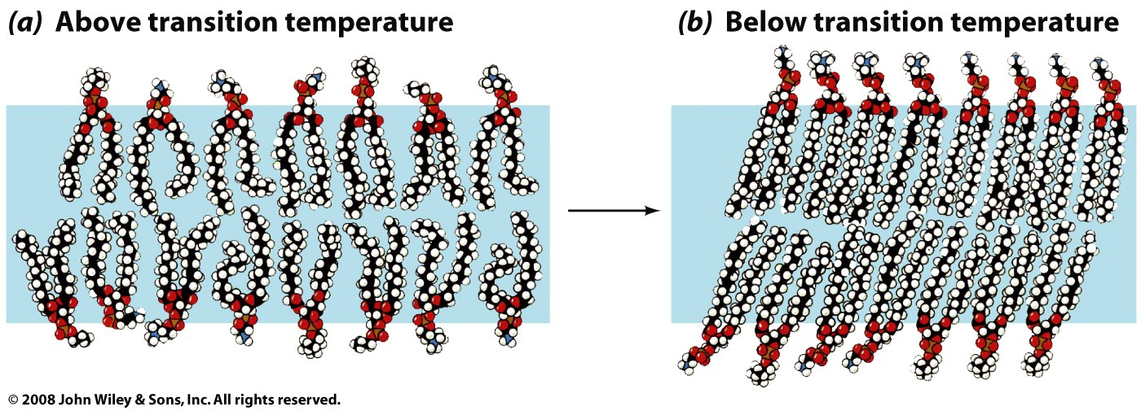
A bilayer can undergo transitions between phases, with changing temperature. A bilayer can adopt a solid gel-like phase state at low temperatures and more fluid phase at higher temperature. The degree and extent of unsaturation, hydrocarbon chain length, cholesterol content and other factors can the phase transition temperature and the properties of the phases: including, dynamics, rates of diffusion, and resistance to stretching and bending.
Cholesterol modulates membrane fluidity. The hydroxyl group of cholesterol is near polar head groups of the phospholipids. The steroid and the hydrocarbon chain are embedded in the membrane.

Slide 13
Fatty acids:
Carboxylic acids of long chain hydrocarbons,
Amphipaths
With wide spectrum of biological function
energy storage
structure (cell membranes)
precursors of hormones and bile salts,
facilitate absorption of fat-soluble vitamins (vitamin A).

Slide 14
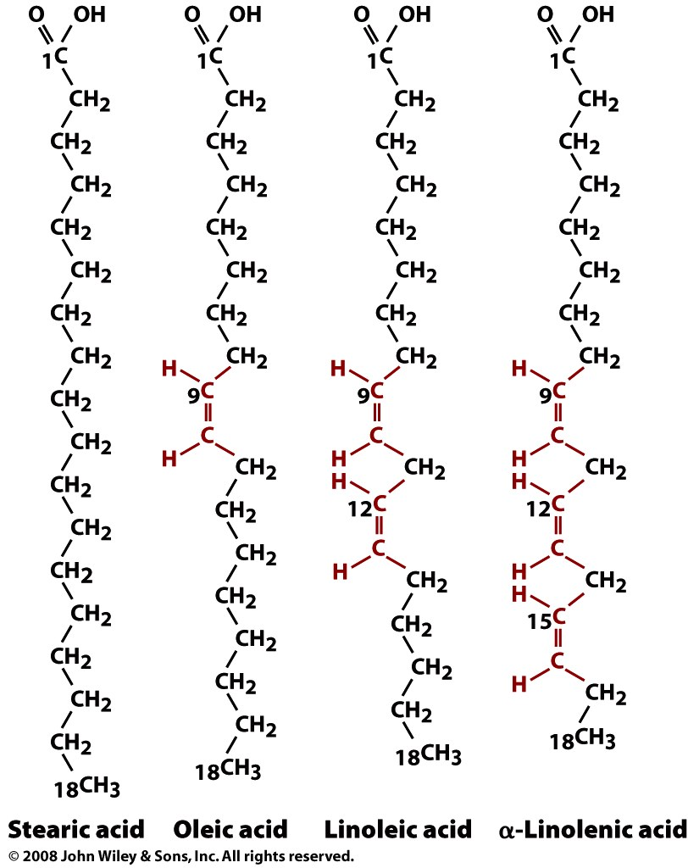
anions at physiological pH
Fatty acids:
Carboxylic acids of long chain hydrocarbons,
Amphipaths
Double bonds are always cis in biological fatty acids.
saturated
unsaturated
unsaturated
unsaturated

Slide 15
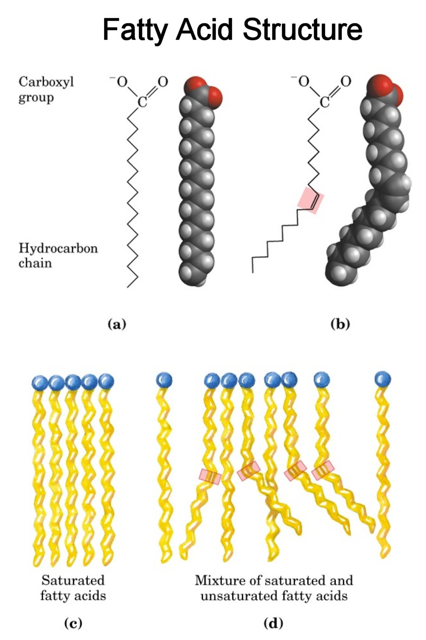
saturated
unsaturated

Slide 16
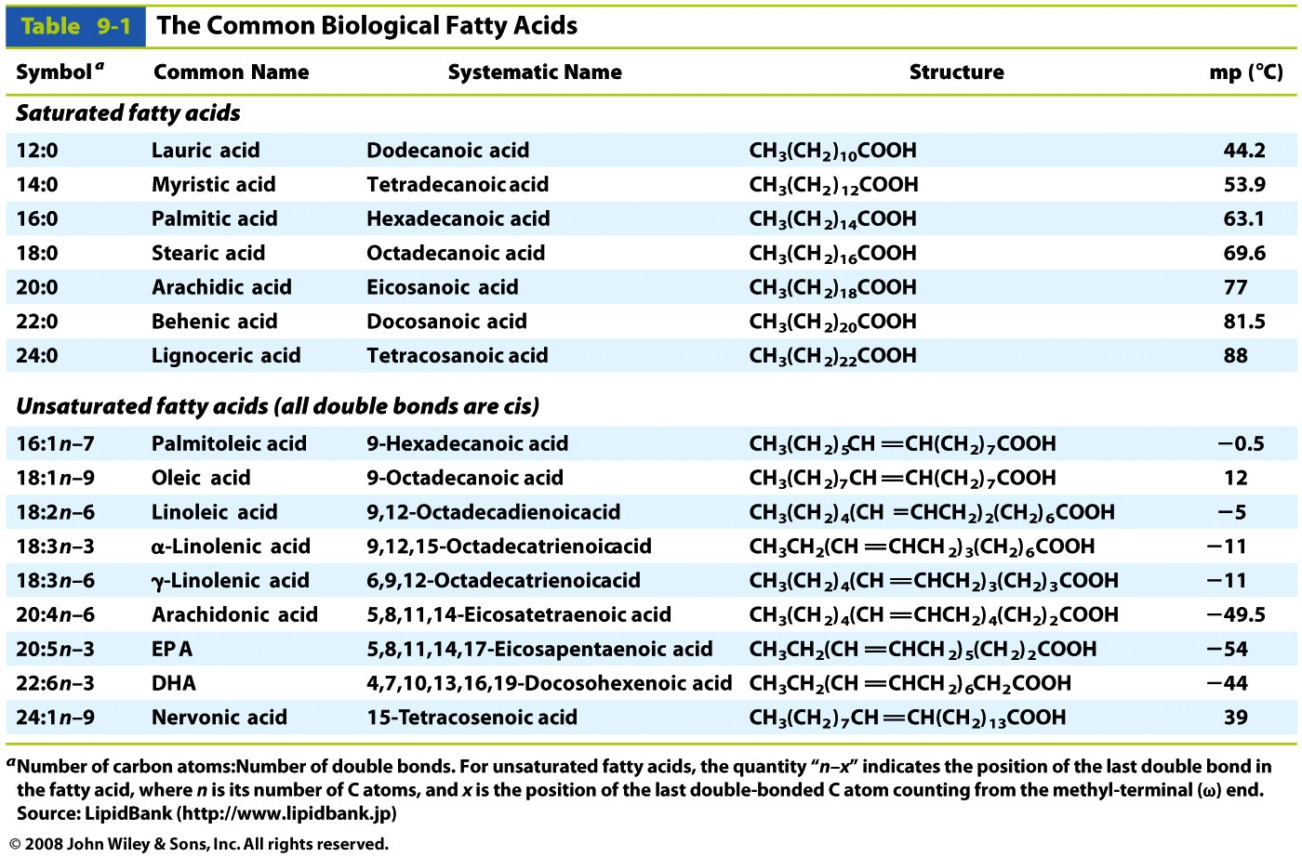
Table 9-1

Slide 17
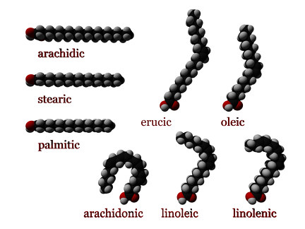

Slide 18
Unsaturated Fatty Acids in biology are cis isomers, not trans.
Cis: adjacent hydrogen atoms are on the same side of the double bond. The double bond is non-rotatable, and so it freezes the conformation.
The cis isomer causes the chain to bend, restricts the conformational freedom, and alters packing between chains.
More double bonds (more unsaturation) means less the flexibility and worse packing.

Slide 19
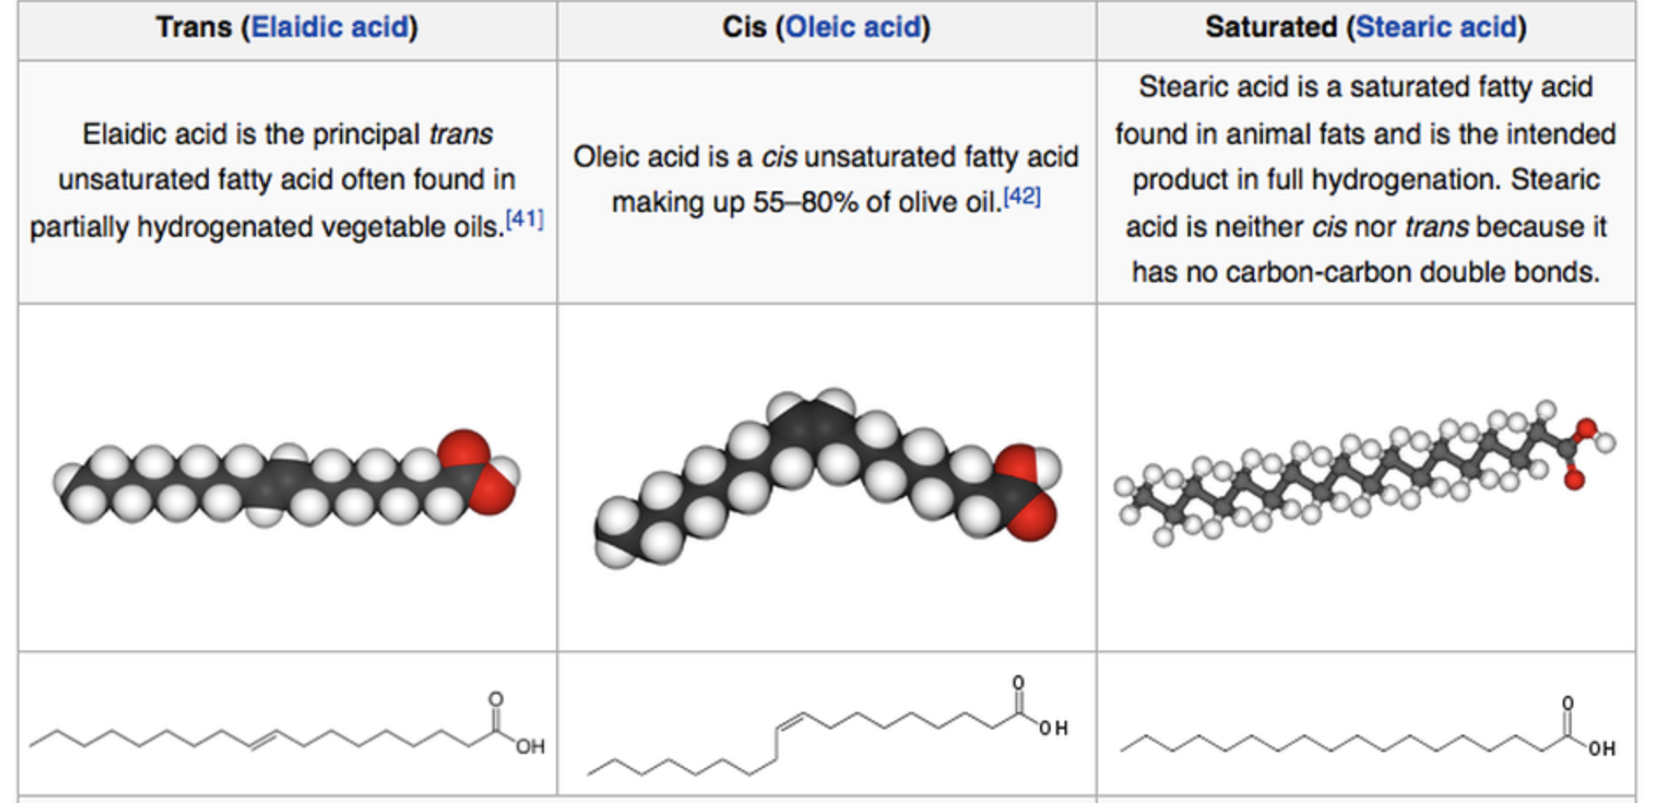
Trans fatty acids are made by industrial hydrogenation of vegetable oils. Trans fats are more robust and give superior performance in deep fryers

Slide 20
ω-Fatty Acids
n−3 fatty acids (aka ω−3 or omega-3 fatty acids) are unsaturated fatty acids with the first C=C bond in the n−3 position (the third bond from the methyl terminus).
α-Linolenic acid all-cis-9,12,15-octadecatrienoic acid, aka 18:3 (n−3).
Eicosapentaenoic acid (20:5, n−3; EPA)

Slide 21
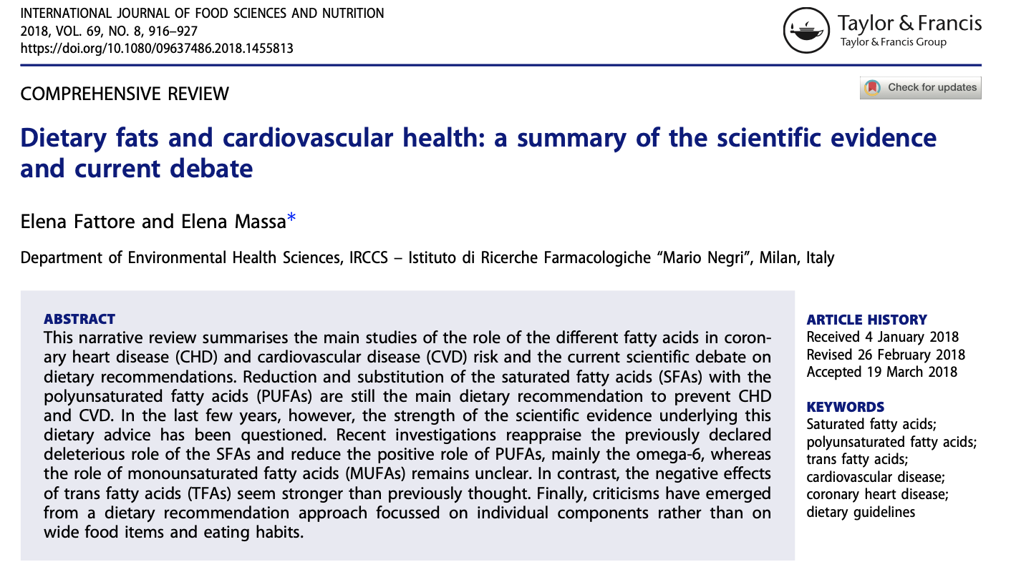
Food products can be listed as “0 grams of trans fats” if they contain less than 0.5 grams of trans fat per serving. Avoid “partially hydrogenated oils”.

Slide 22
Summary,
Polyunsaturated fatty acids (PUFA) seem healthy.
Saturated Fatty acids are unhealthy.
Omega-3 partially unsaturated fatty acids seem healthy; but effects not fully supported by recent meta-analyses of randomized controlled trials.

Slide 23
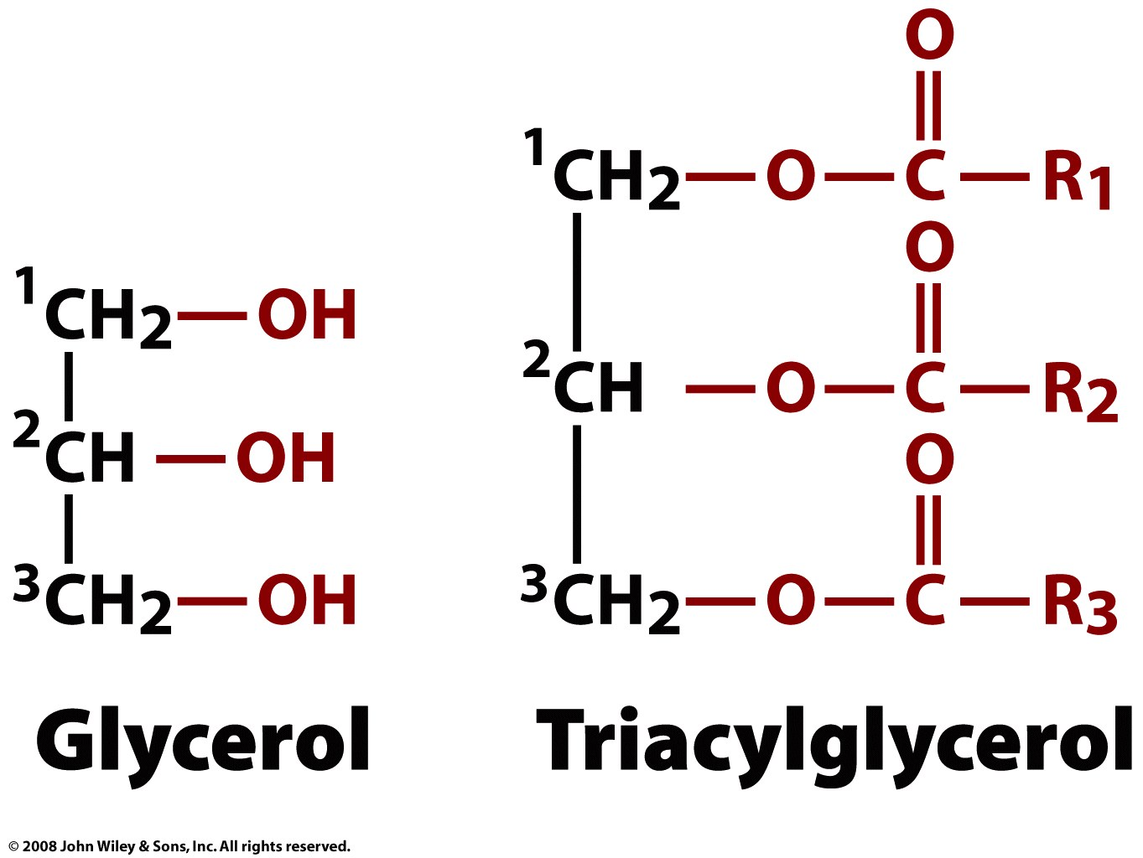
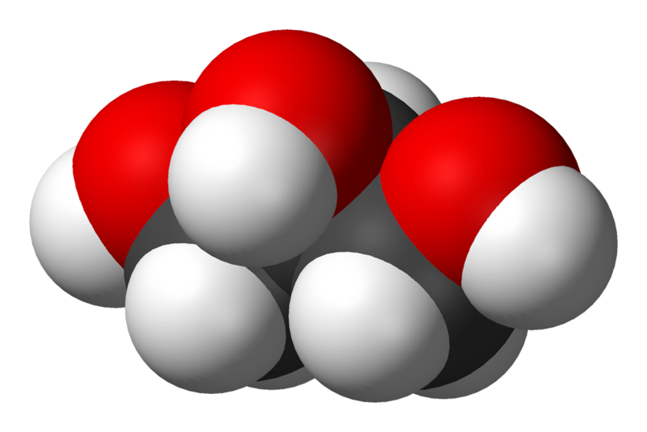
(triglyceride)

Slide 24
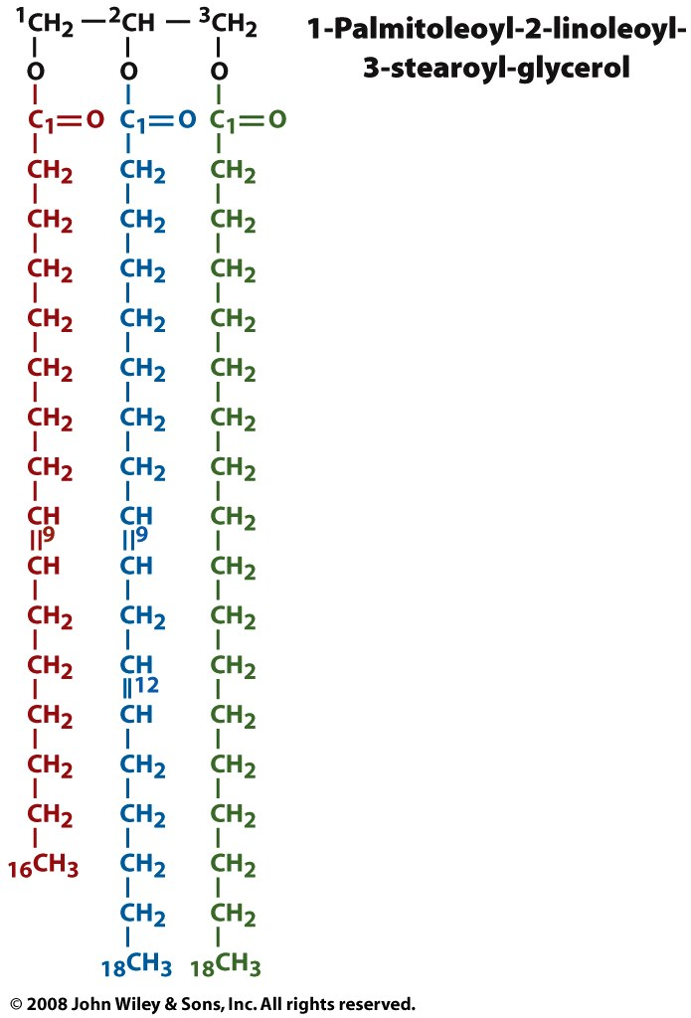
A triglyceride is glycerol linked to three fatty acids, via ester linkages. The three hydroxyl groups of the glycerol form esters with the carboxyl groups of the fatty acids. A given triglyceride generally contains different types of fatty acids.
Fatty acids can be unsaturated, with C=C bonds, and polyunsaturated, with multiple C=C bonds. C=C bonds. Double bonds lower the melting temp of the membrane.
Plant triglycerides are lower melting than animal triglycerides because they are less saturated (with more C=C bonds).
Fatty acids in biological triglycerides generally contain 16 - 20 carbon atoms. Fatty acids in eukaryotes contain even numbers of carbon atoms.
A high level of triglycerides in blood is linked with risk of heart disease. Triglycerides are not soluble in aqueous media, and are carried by proteins (lipoproteins)
A triglyceride
ester of
palmitoleic acid
ester of
linoleic acid
ester of
steric acid

Slide 25
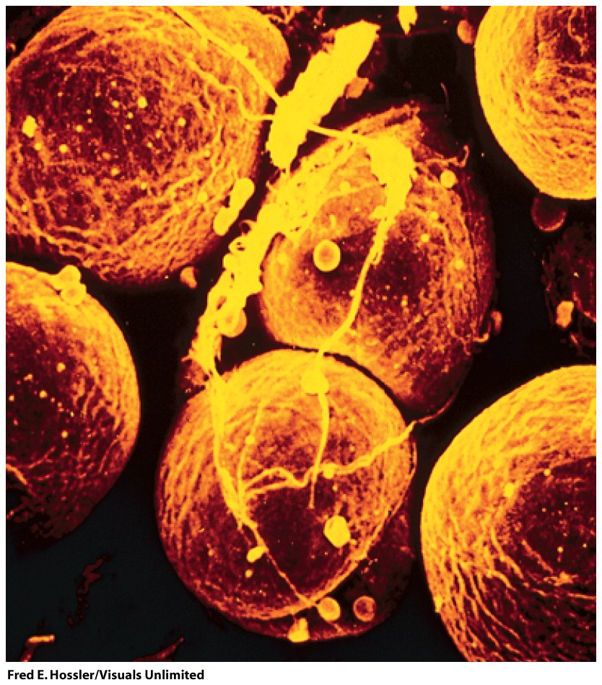
Adipocytes (fat cells, monovacuolar cells) contain lipid surrounded by cytoplasm. The nucleus is on the periphery. Fat is stored mostly as triglycerides and cholesteryl esters.
This is the densest form of stored energy in a biological system. The energy can be released slowly over long periods of time (as during starvation). By contrast glycogen (polysachharide) stores can be released and used quickly.
Figure 9-2

Slide 26
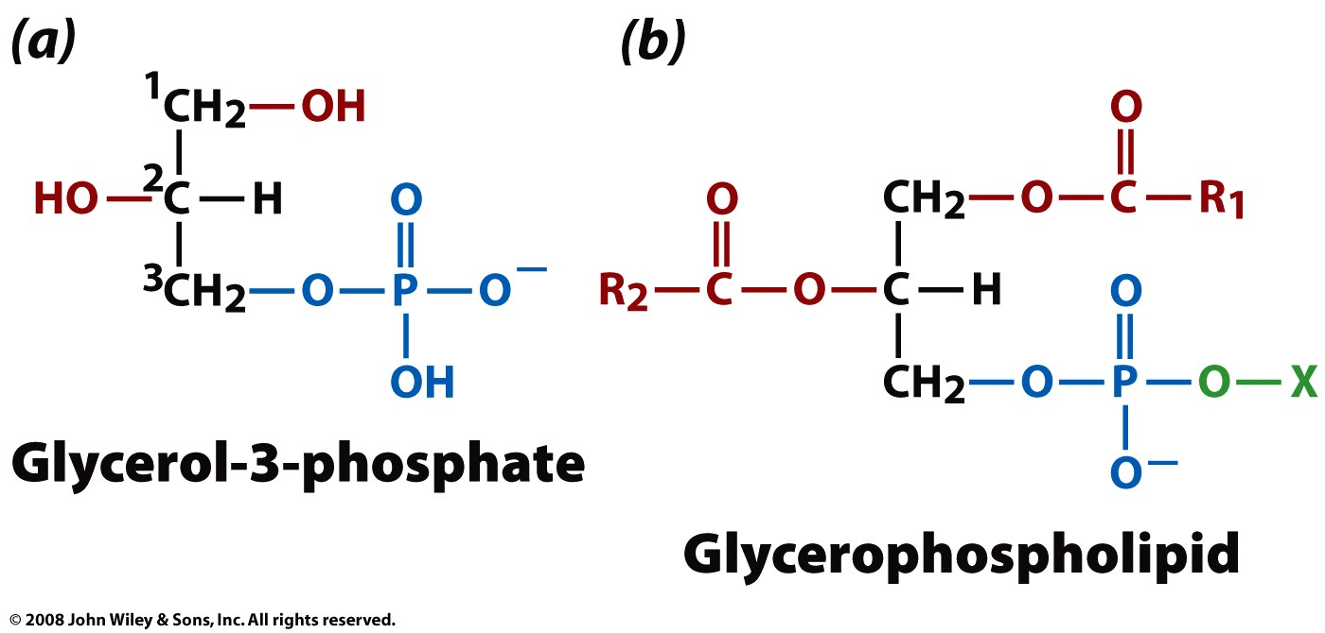
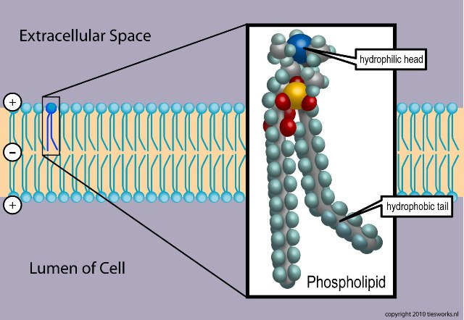
Phospholipids
A phospholipid is an amphipath, formed by a diglyceride, linked to a phosphate group, linked to a simple organic moiety like choline or ethanol amine (X, above). Phospholipids are the major components of cell membranes.

Slide 27
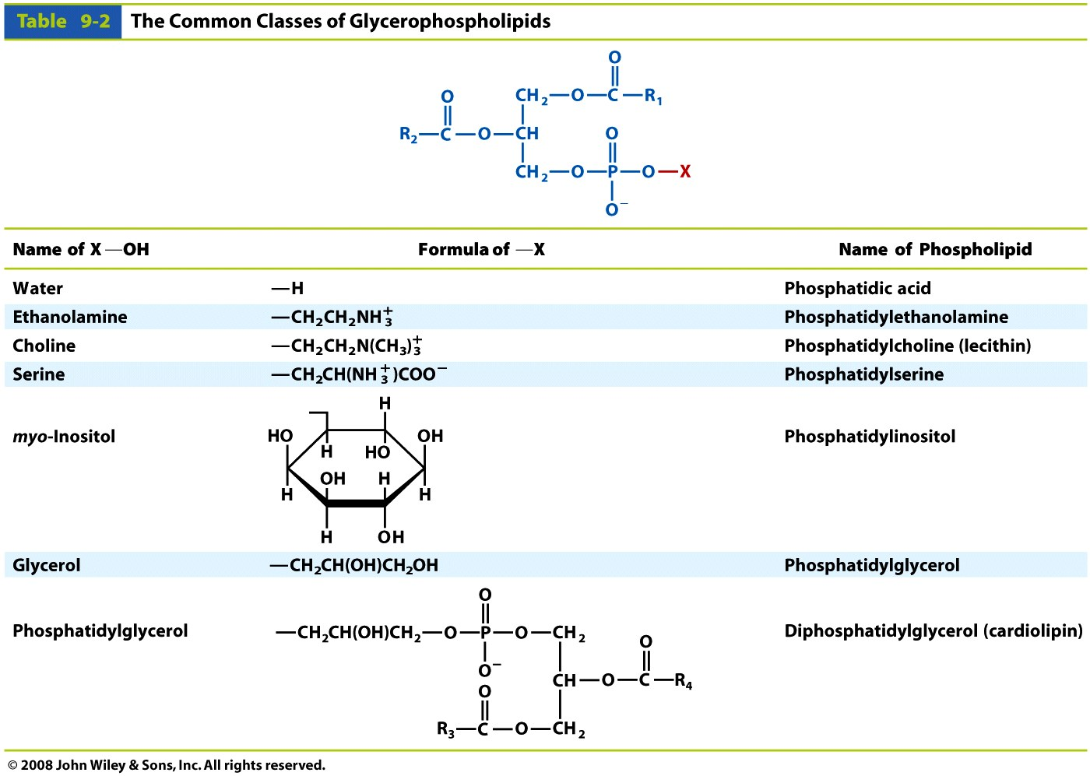
Table 9-2

Slide 28
Phosphatidylcholines are the primary components of biological membranes in eukaryotes.
Phosphatidylethanolamine is found predominantly in nervous tissue such as brain and neural tissue and is the principal phospholipid in bacteria.
Phosphatidylethanolamine membranes are more viscous than phosphatidylcholine membranes.
Phosphatidylserine is found on the cytosolic side of membranes.

Slide 29
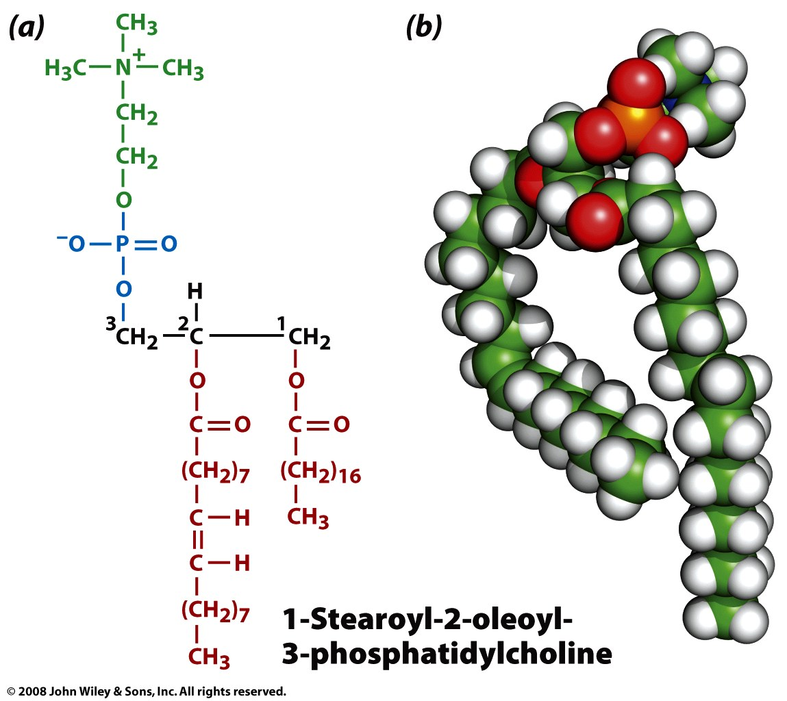
Figure 9-4

Slide 30
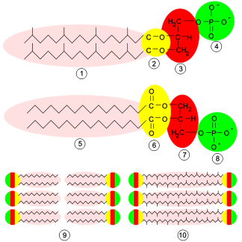
Archaea
Archaea differ from other living things in their cell membranes. Their are four fundamental differences between archaeal membranes and those of bacterial and eukaryotic cells: (1) chirality of glycerol, (2) ether versus ester linkage, (3) isoprenoid versus fatty acid chains, and (4) branching of side chains.
http://www.ucmp.berkeley.edu/archaea/archaeamm.html

Slide 31
STOP 2021

Slide 32
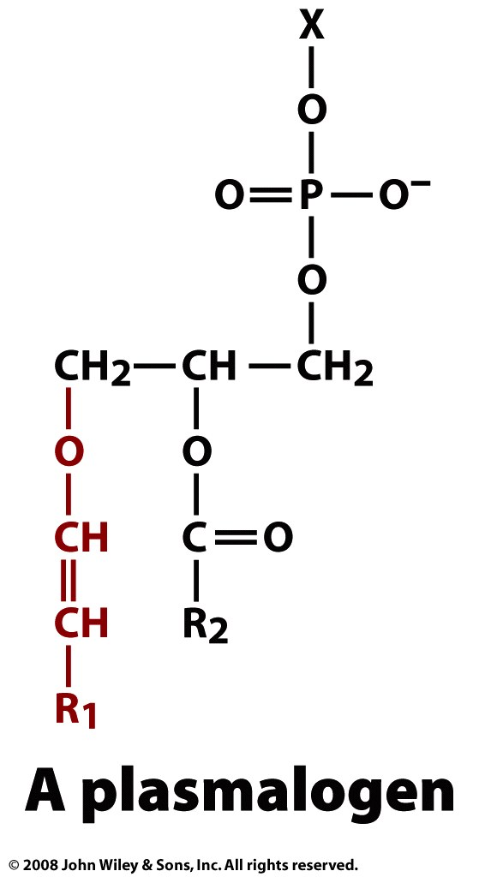
Plasmalogens are found nervous, immune, and cardiovascular tissue In human heart tissue, 30–40% of choline glycerophospholipids are plasmalogens. Almost 30% of the glycerophospholipids in the adult human brain and up to 70% of myelin sheath ethanolamine glycerophospholipids are plasmalogens
Although the functions of plasmalogens have not yet been fully elucidated, they can protect mammalian cells against the damaging effects of Reactive oxygen species.They have been implicated as being signaling molecules and modulators of membrane dynamics. (Wikipedia)
Ether-phospholipids
vinyl
ether
Page 252

Slide 33
Sphingosine
(2-amino-4-octadecene-1,3-diol) is an amino alcohol with an unsaturated (trans) 18-carbon hydrocarbon chain.
Sphingolipids are phospholipids that contain sphingosine. Sphingolipids are important components of cell membranes and are used in signal transduction and cell recognition.
Ceramide: a sphingosine plus a fatty acid.

Slide 34
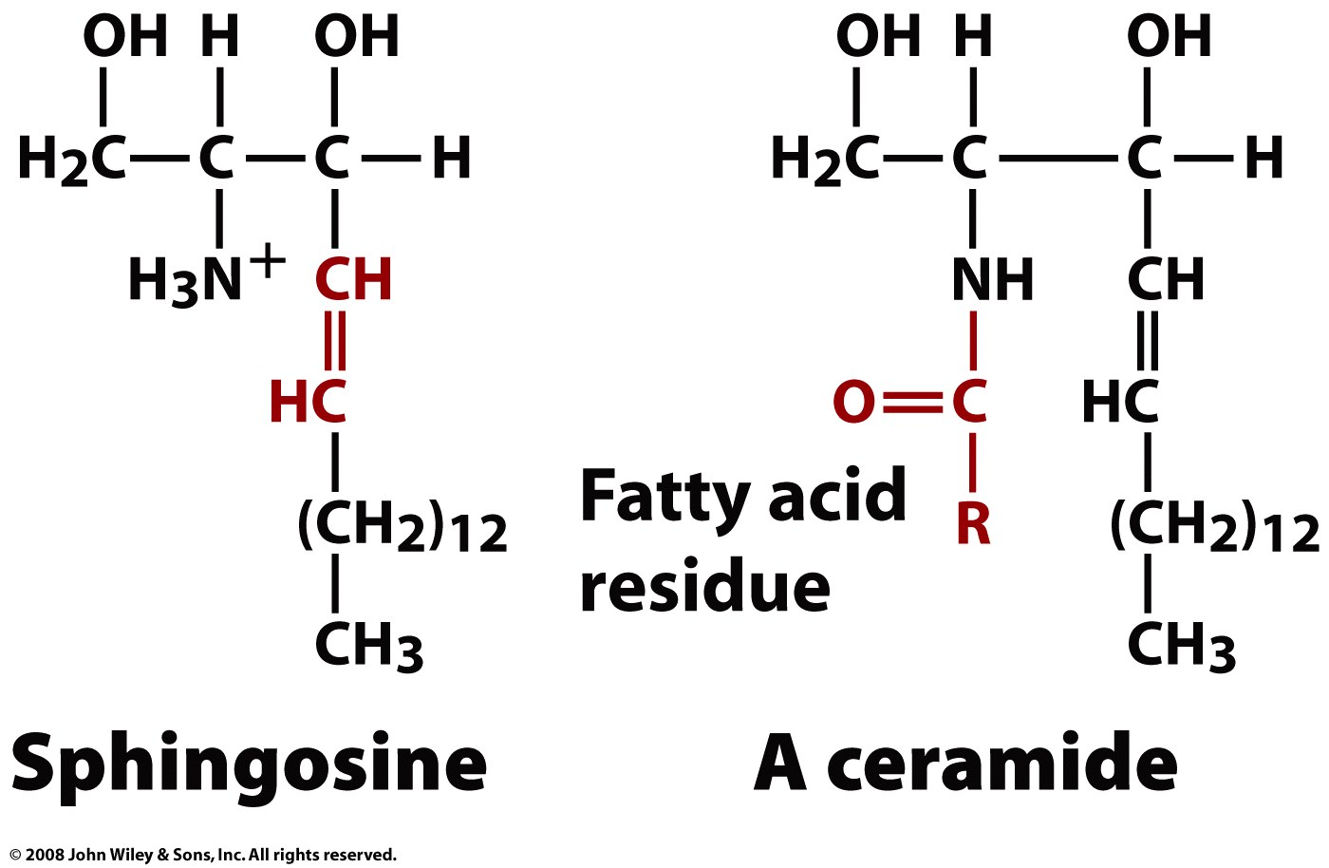
Page 252

Slide 35
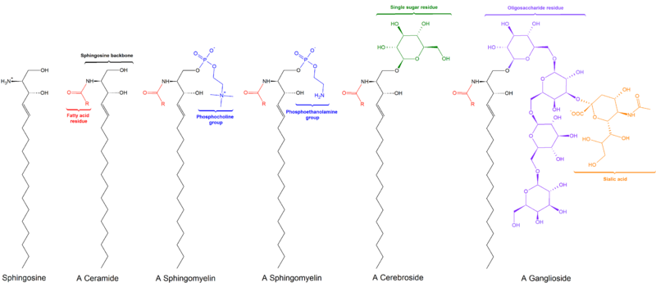

Slide 36
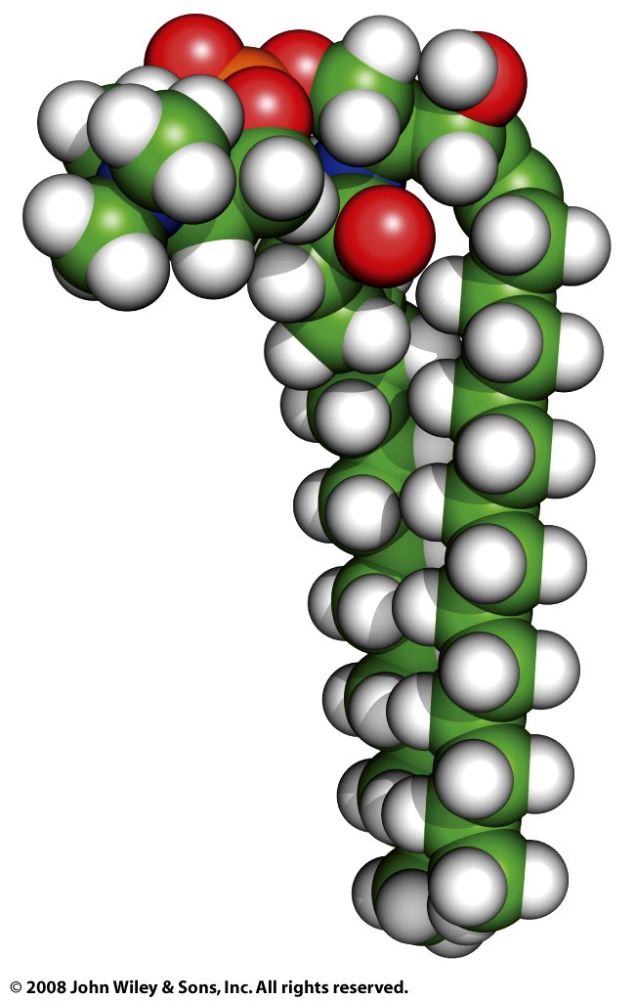
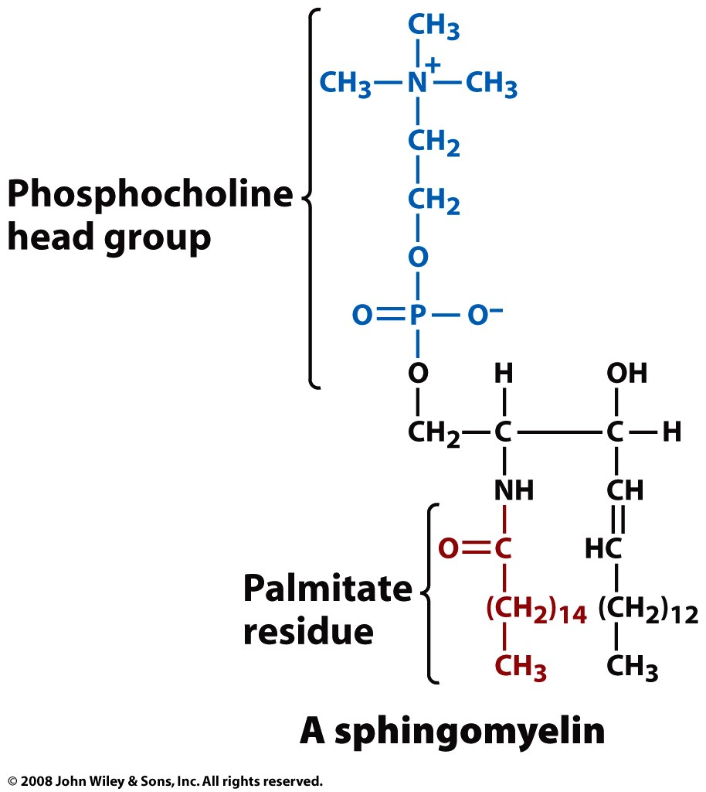
Figure 9-7a

Slide 37
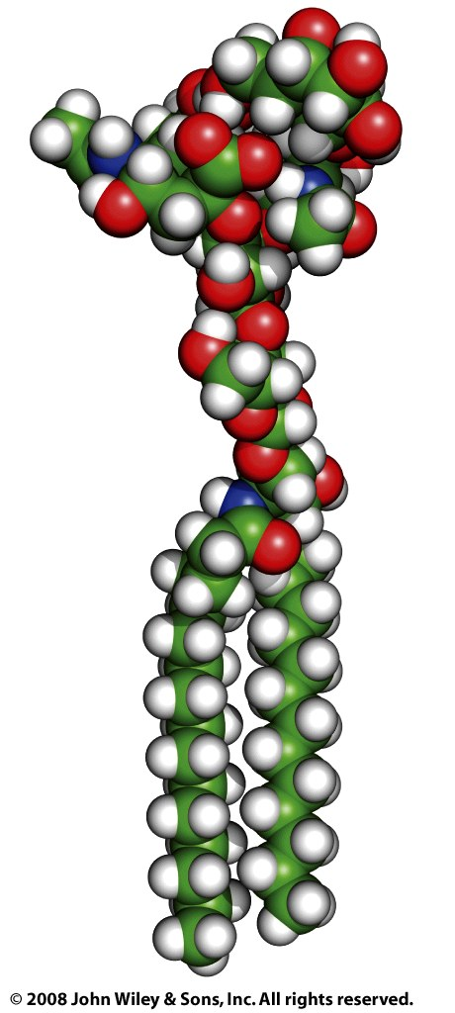
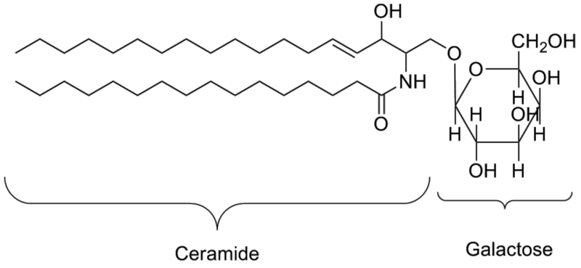
G_{M1}
Cerebroside (galactoceramide)
is a ceramide with a galactose at the 1-hydroxyl moiety.
Galactocerebrosides are found in oligodendrocytes in the brain

Slide 38
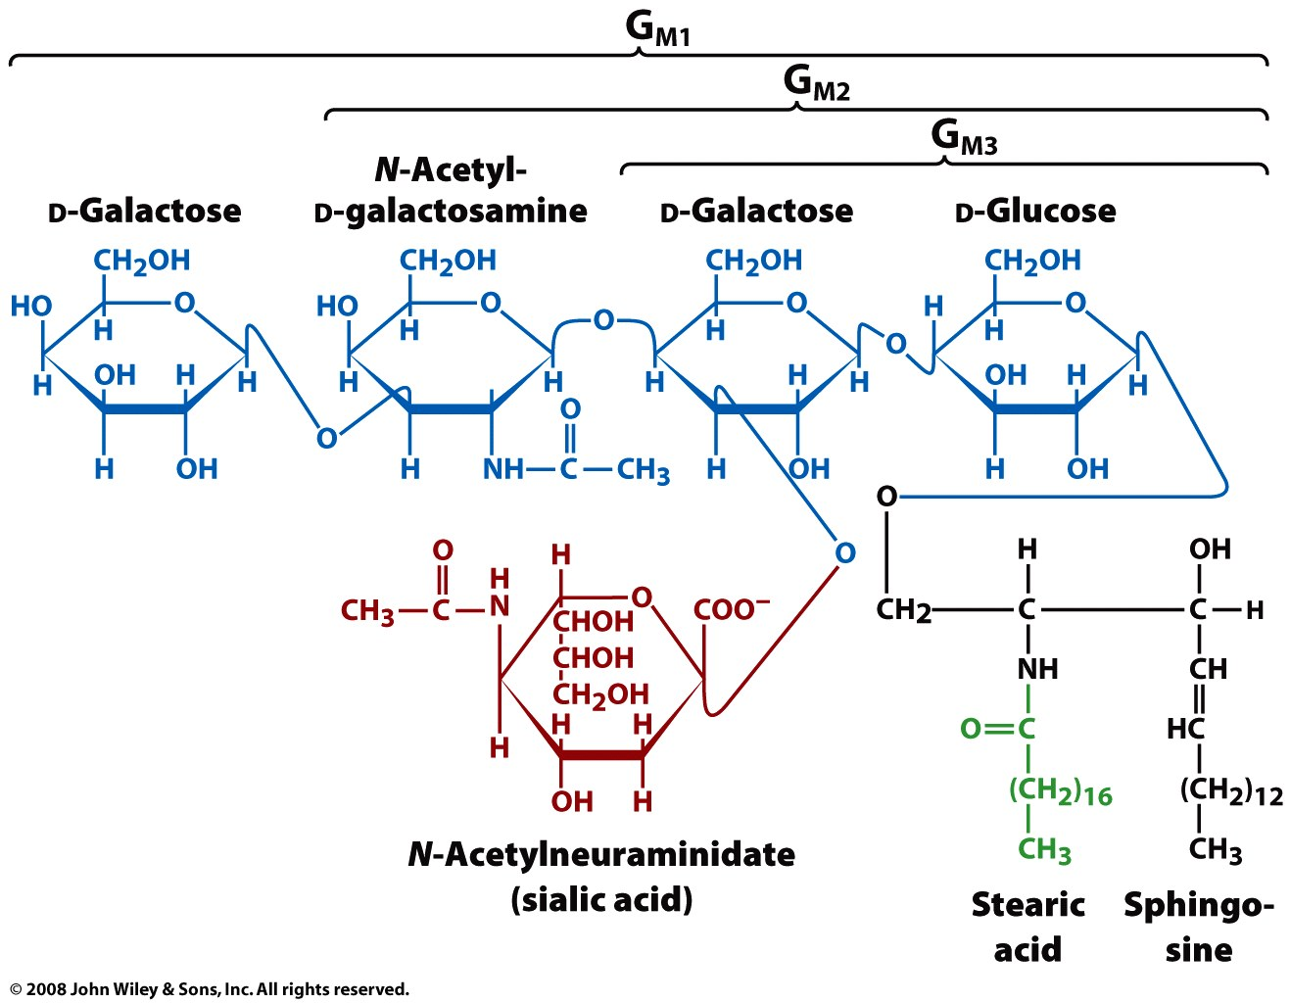
A ganglioside is a ceramide and an oligosaccharide, with one or more sialic acids (e.g. n-acetylneuraminic acid) linked to the saccharide. Gangliosides are concentrated on cell surfaces with the oligosaccharides providing recognition elements for extracellular molecules or surfaces of neighboring cells. Ganglioside are found predominantly in the nervous system where they constitute 6% of all phospholipids.

Slide 39
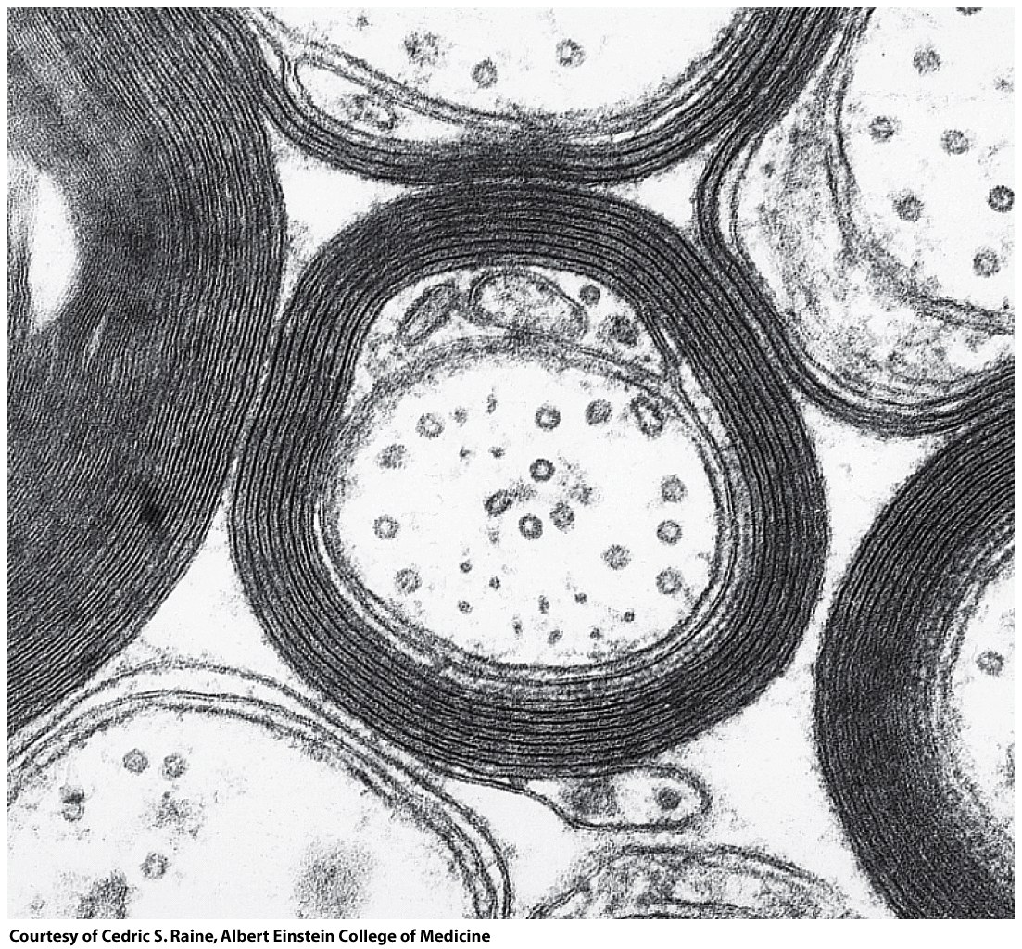
Roles of Sphingolipids.
Myelin is insulating sheath, surrounding the axons of a neurons. Myelinated axons are white ("white matter" of the brain). Myelin is made of proteins and lipids. The primary lipid is the sphingolipid cerebroside (galactocerebroside). Sphingomyelin is also abundant.
Demyelination (the loss of myelin sheath) is a defining characteristic neurodegenerative autoimmune diseases such as multiple sclerosis.
Electron micrograph of a myelinated axon.
Figure 9-8

Slide 40
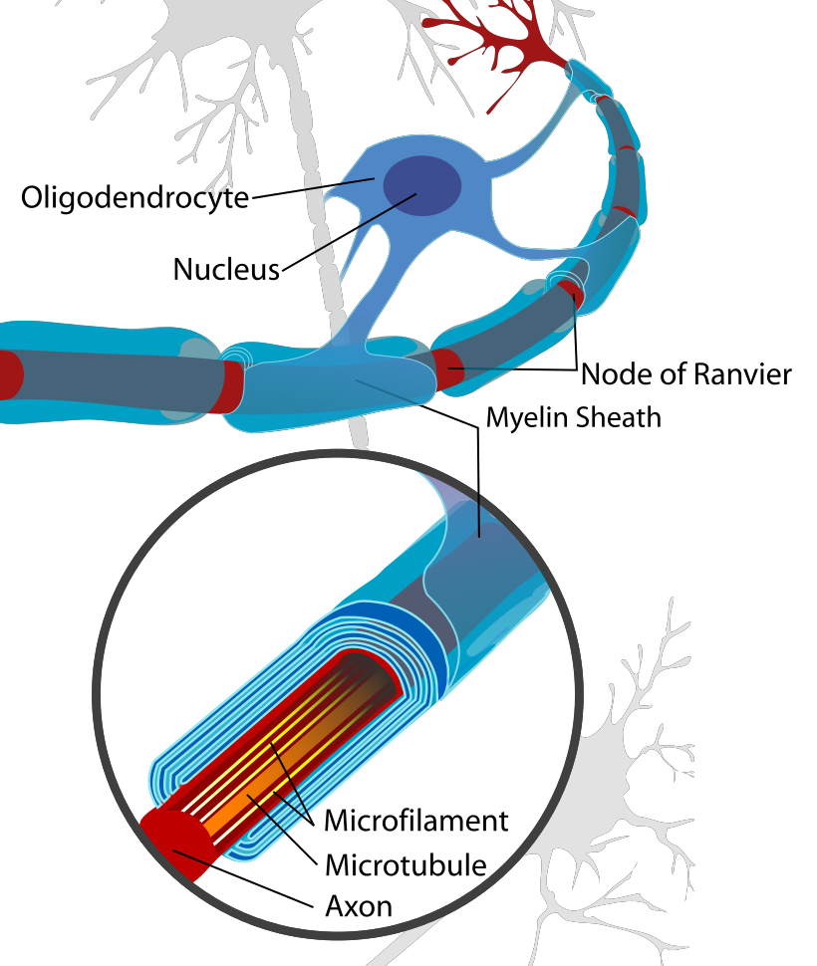
From wikipedia

Slide 41
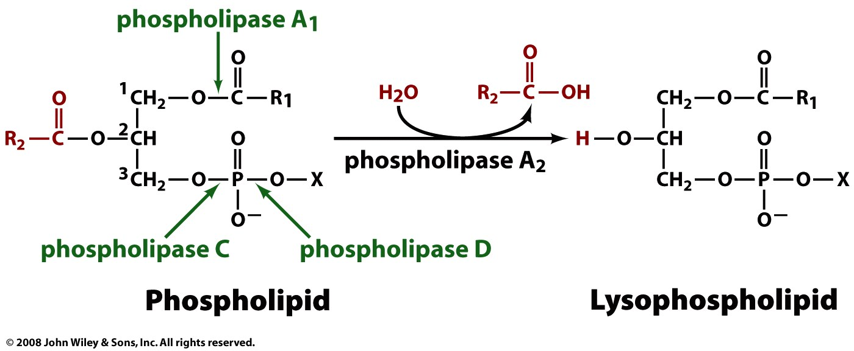
Phospholipases: Enzymes that hydrolyze phospholipids into fatty acids and modified glycerol.
Phospholipase A
o Phospholipase A1 - cleaves the SN-1 acyl chain o Phospholipase A2 - cleaves the SN-2 acyl chain
Phospholipase B (lysophospholipase) - cleaves both SN-1 and SN-2 acyl chains.
Phospholipase C - cleaves before the phosphate, releasing diacylglycerol and a phosphate-containing head group. Phospholipase Cs play a central role in signal transduction, releasing the second messenger inositol triphosphate.
Phospholipase D - cleaves after the phosphate, releasing phosphatidic acid and an alcohol.
Phospolipase A2, in the venom of the bees and viper snakes, acts on intact lecithin molecule and hydrolyses the fatty acid on 2-carbon atom. One of the products is lysophosphatidylcholine and fatty acid.

Slide 42
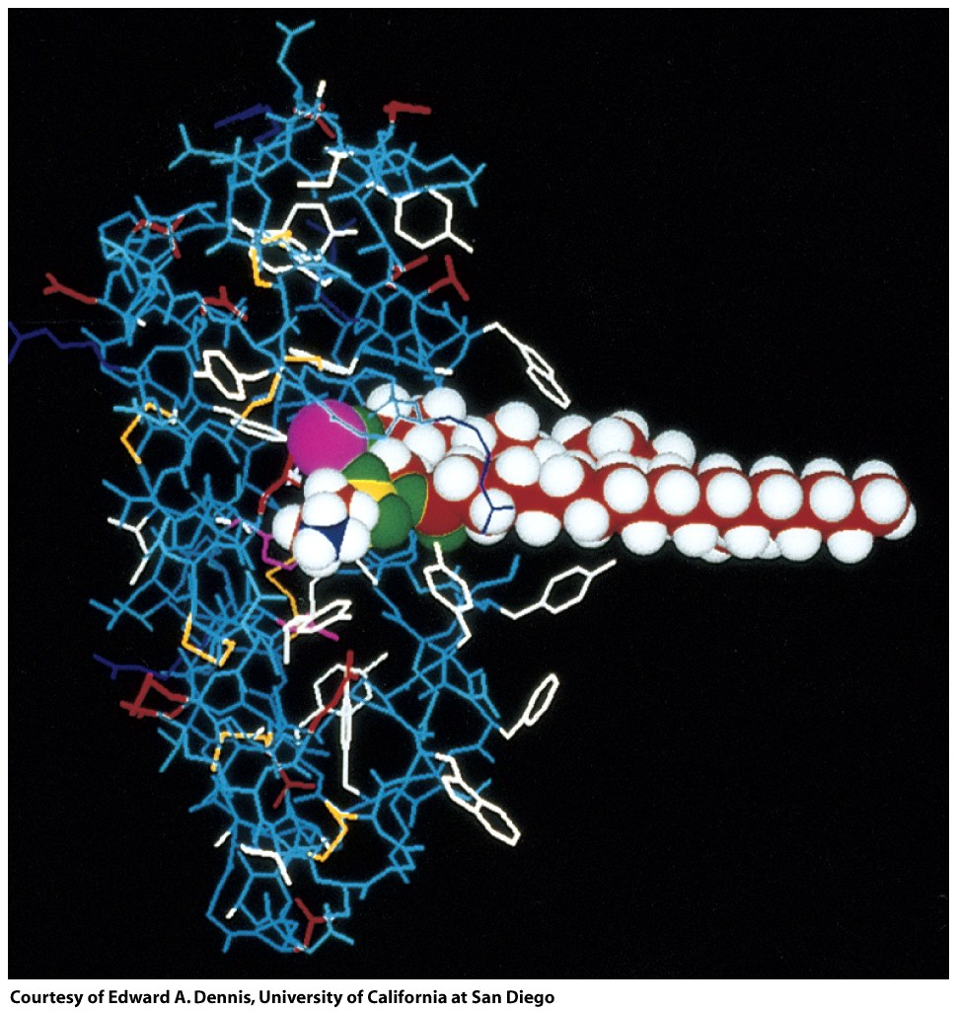
Phospolipase A2 (from venom of the bees and viper snakes) bound to a substrate molecule (a phospholipid)

Slide 43
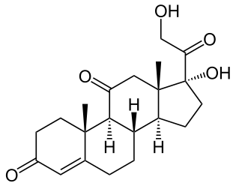
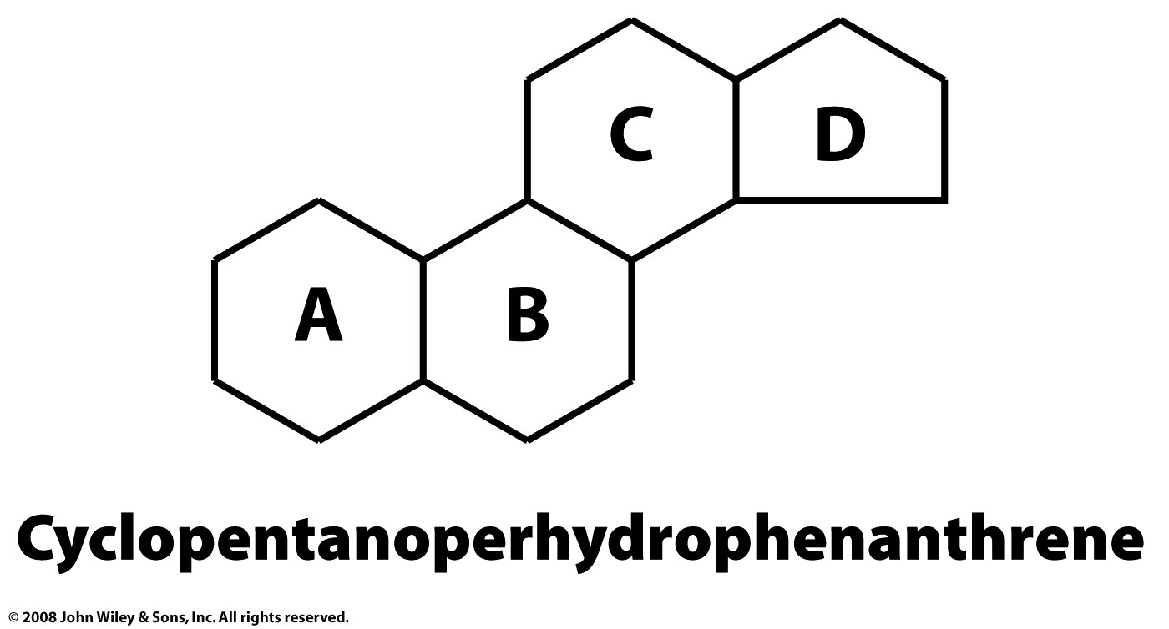
Steroids
A steroid is composed of four fused cycloalkane rings. Cholesterol, estradiol, cortisone and testosterone, dexamethasone are steroids.
The core of a steroid is formed by three cyclohexane rings (designated as rings A, B, and C) and a cyclopentane ring (the D ring). Different steroids have different functional groups attached to this four ring core and have various oxidation states of the rings.
Hundreds of different steroids are found in plants, animals, and fungi.
Cortisone

Slide 44
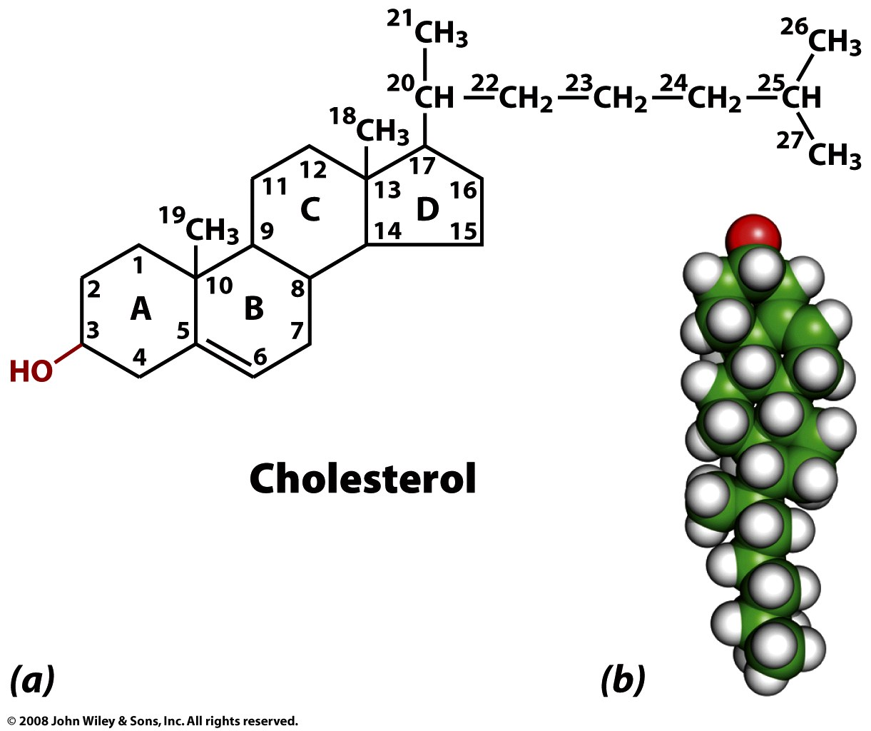
Cholesterol composes 30-40% (mol/mol) of animal membrane lipids.
Cholesterol modulates membrane permeability and fluidity.
A high level of serum cholesterol is an indicator for cardiovascular disease.
Cholesterol is a precursor of steroid hormones in mammels.
Figure 9-10

Slide 45
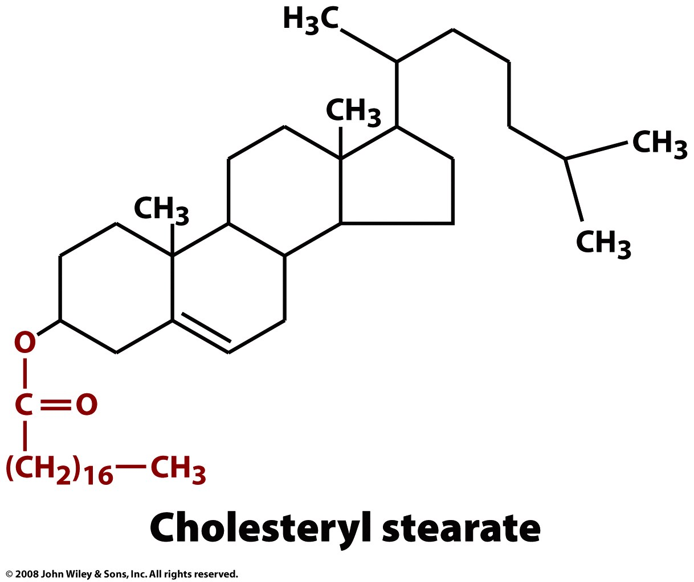
Here is gratuitous structure contained in Voet, Voet and Pratt, with no explanation of function or importance. Ignore it.
Page 254

Slide 46
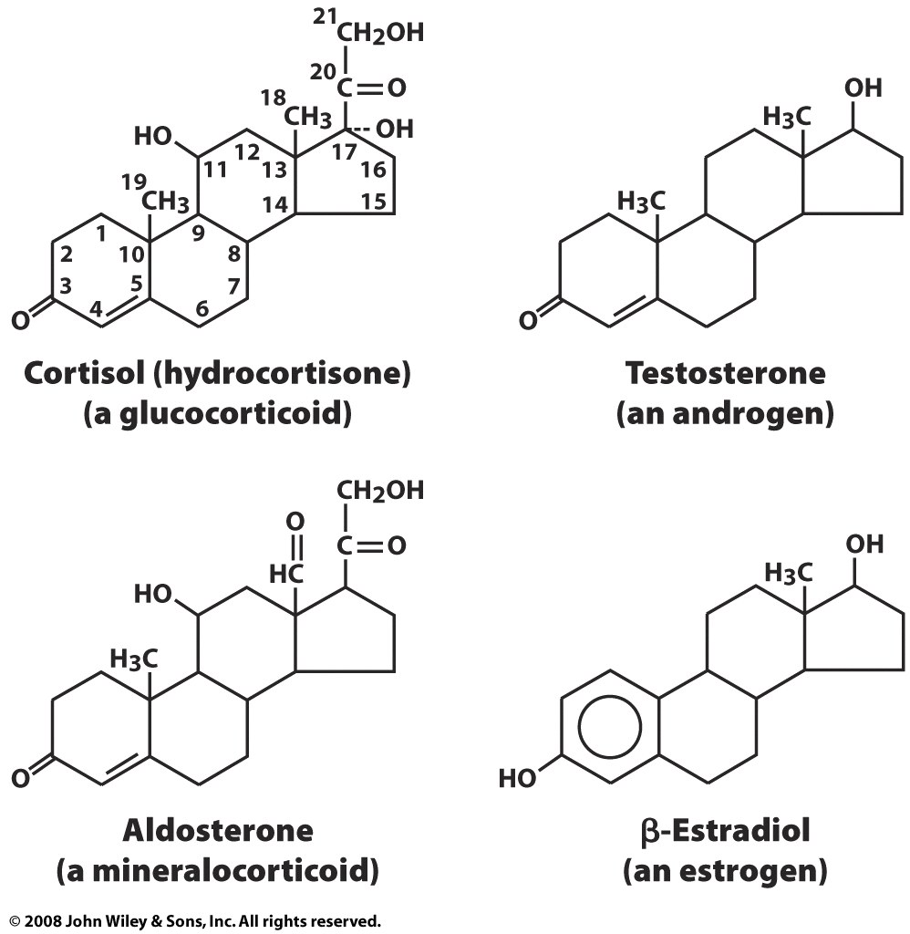
Figure 9-11

Slide 47
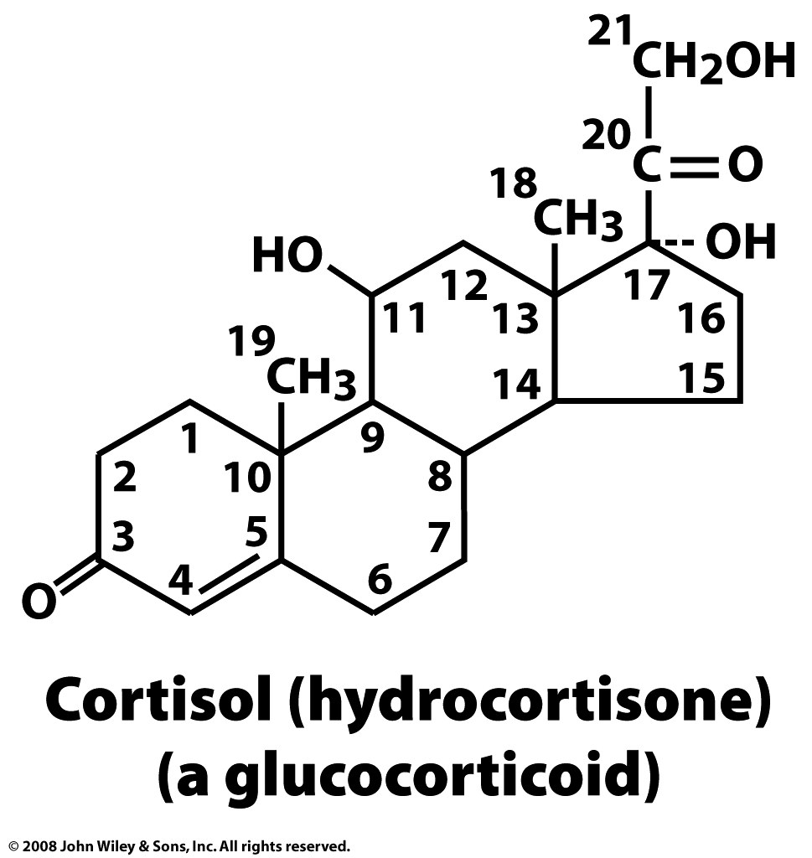
Cortisol is a steroid hormone, or a glucocorticoid, produced by the adrenal gland. It is released in response to stress, to increase blood sugar by stimulating gluconeogenesis, which is the breakdown of protein and fat to provide metabolites that can be converted to glucose.
Your brain needs glucose. If you skip breakfast (ensuring your glycogen stores are depleted) and engage in sustained exercise (1) your insulin levels will fall, (2) your body will secrete of glucagon, adrenaline, growth hormone and cortisol. You will feel bad. After a while you will pass out.
So eat breakfast.

Slide 48
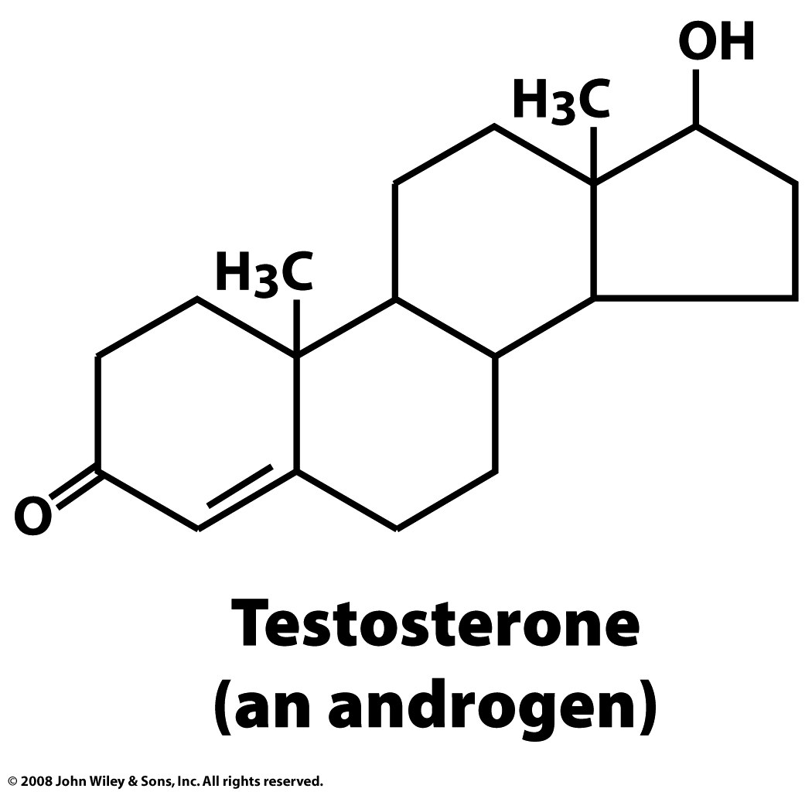
Testosterone is found in most vertebrates. In mammals, testosterone is primarily secreted in the testes of males and the ovaries of females. Testosterone is the principal male sex hormone. Testosterone plays a key role in the development of male reproductive tissues, and promotes increased muscle, bone mass and the growth of body-hair.
An androgen is a compound, usually a steroid hormone, that stimulates or controls the development and maintenance of male characteristics in vertebrates by binding to androgen receptors.
An anabolic is a compound that promotes anabolism (cell growth).
(and an anabolic)

Slide 49
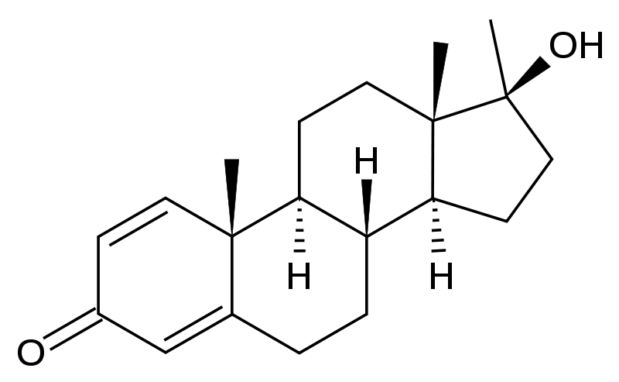
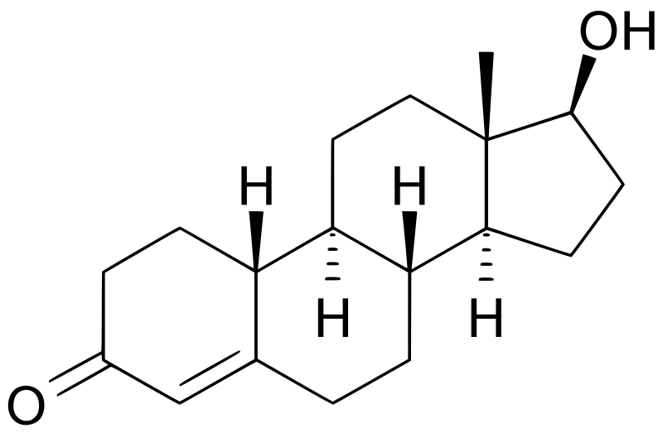
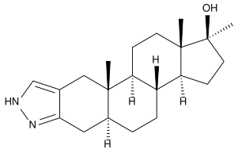
Methandrostenolone (Dianabol)
To be a professional baseball player,
take anabolic steroids.
Nandrolone
Stanozolol

Slide 50
A Small Sample of Confirmed Anabolic Steroid Users
Mark McGwire (Oakland Athletics, St. Louis Cardinals)
Roger Clemens (New York Yankees)
Barry Bonds (Giants/Pirates)
Jose Canseco (Oakland A's, Texas Rangers, etc)
Alex Rodriguez (Seattle Mariners, Texas Rangers, etc.)
Arnold Schwarzenegger (Body builder)
Marion Jones (America Sprinter, 2000 Olympic 3 gold, 2 bronze)
Maurice Greene (America Sprinter, 2000 Olympic 2 gold, 2004 Olympic silver and bronze)
Ben Johnson (Canadian sprinter, 1988 Olympic gold)
Linford Christie, (British sprinter, 1992 Olympic gold)
Royce Gracie (mixed martial arts)
Shoaib Akhtar (a Pakistani cricketer)
Mohammed Asif (another Pakistani cricketer)
Sean Sherk (Lightweight Champion)
Petr Korda (tennis)

Slide 51
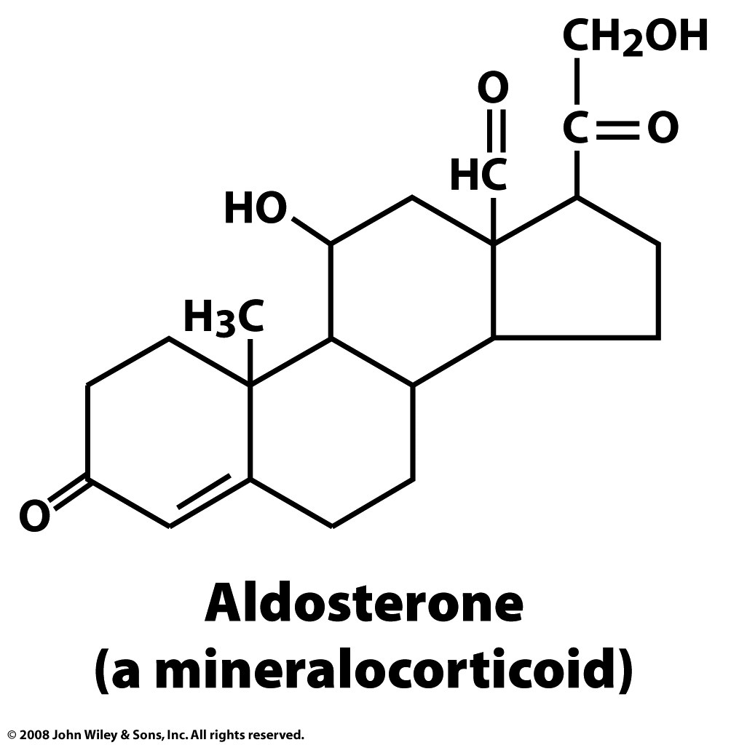
Aldosterone increases the absorption of sodium ions and water, and the secretion potassium ions from the kidneys, therefore increasing blood volume and pressure. Drugs that interfere with the secretion or action are antihypertensives.

Slide 52
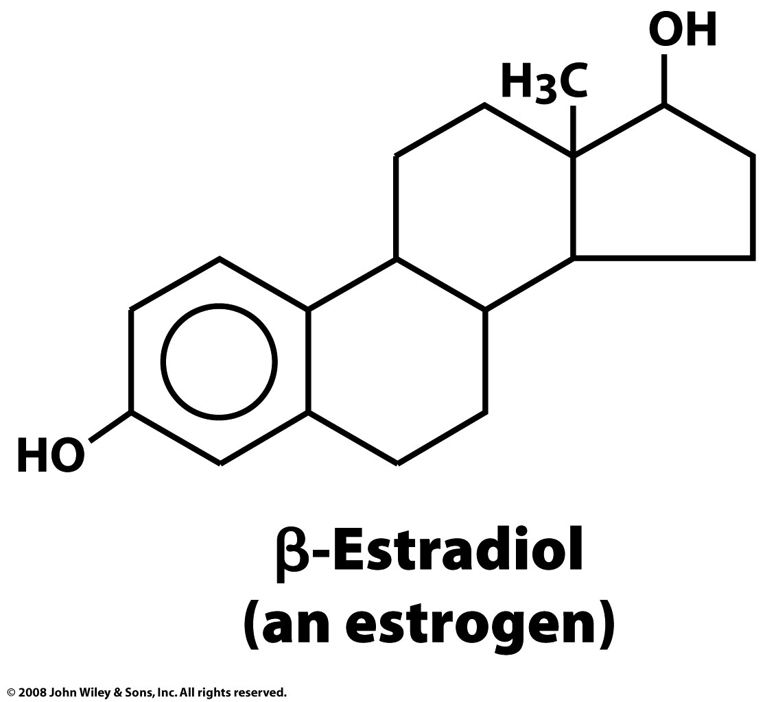
Estradiol is the predominant female sex hormone driving development of secondary sex characteristics. During pregnancy, estradiol is supplemented by placental production. Post menopausal women lose bone mass due to low estradiol.

Slide 53
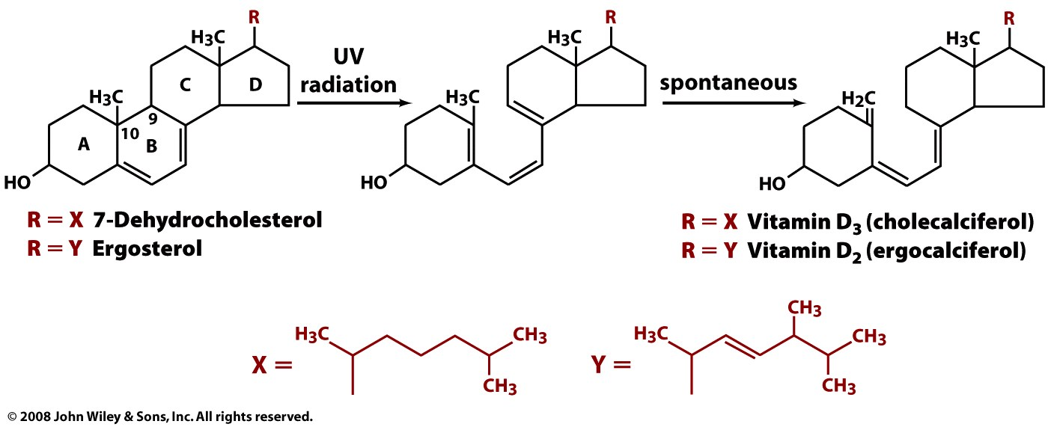
Vitamin D
7-Dehydrocholesterol is photo-synthetically (270–290 nm) converted (breaking the B-ring) to vitamin D3 (cholecalciferol) in the epidermis (skin). This is a non-enzymatic reaction.
Ergosterol is photo-synthetically converted to vitamin D2 (ergocalciferol).
These steroid-like molecules are precursors to hydroxylated compounds (dihydroxycolecalciferol) that regulate mineralization (Calcium-absorption), growth and remodeling of bone.
Ergosterol is found in fungal cell membranes, but not animal cell membranes.
Milk is supplemented with vitamin D (Vitamin D refers to either ergocalciferol or cholecalciferol or both).

Slide 54
Vitamin D
Active, produced in the liver
Cholecalciferol (vitamin D3)
Page 256

Slide 56
Other lipids
Isoprenoids
CoQ (is oxidized/reduced) during oxidative phosphorylation i.e., it is an electron acceptor/donor.
Page 257

Slide 57
Other lipids
Retinal: Photo receptor
photons cause isomerization
Retinal is contained in Rhodopsin, found in photoreceptor cells of the retina. Rhodopsin is involved in the initial processes the perception of light.
Page 257

Slide 58
Other lipids
Vitamin K is involved in carboxylation of Glutamic acids during blood clotting.
carboxyglutamic acid
Page 258

Slide 59
Other lipids
Antioxidant in cell membranes
Page 258

Slide 60
Prostaglandins
Figure 9-12

Slide 61
Structures & compartments

Slide 62
Sodium laureth sulfate =
sodium lauryl ether sulfate (SLES)
Sodium dodecyl sulfate (SDS or NaDS) =
sodium laurilsulfate =
sodium lauryl sulfate (SLS)

Slide 63
Glycerol distearate

Slide 64
from wikipedia

Slide 65
Membrane Proteins
Membrane proteins are attached to, or are associated with membranes.
The plasma membrane is around 50% protein by volume.
Membrane proteins:
(A) integral membrane proteins (transmembrane proteins)
(B) lipid anchored proteins
(C) peripheral membrane proteins

Slide 67
Glycophorin A
Integral membrane proteins span the membrane.
Integral membrane proteins have
(i) a cytosolic domain (hydrophilic surface) that can interact with internal molecules,
(ii) a membrane-spanning domain (hydrophobic surface) that anchors the protein within the membrane,
(iii) an extracellular domain (hydrophilic surface) that interacts with external molecules.
Glycophorin A/B are major sialoglycoproteins of the human erythrocyte membrane. There are about one million copies of this protein per erythrocyte. These proteins comprise about 10% of the total protein of human erythrocyte membrane.

Slide 68
Glycophorin A
Glycophorin A acts as a receptor for encephalomyocarditis virus, influenza virus, 24 Sendai virus, M pneumoniae 25 and for Portuguese man-of-war toxin.
Glycophorin A has been studied by a variety of biochemical and biophysical techniques and it is a model for how analogous systems might behave.

Slide 69
Bacteriorhodopsin
These salt flats are colored purple from the bacteriorhodopsin in the outer membrane of the microbe Halobacterium salinarum

Slide 70
Bacteriorhodopsin is an integral membrane protein with seven transmembrane α-helices that bury a retinal molecule.
Bacteriorhodopsin is a proton pump from Halobacteria (an archaea). Bacteriorhodopsin captures light and uses the energy to pump protons across a membrane and out of the cell.
Bacteriorhodopsin

Slide 71
Bacteriorhodopsin
Bacteriorhodopsin is a trimer (blue monomer, pink monomer, yellow monomer). The red line indicates the bound of extracellular side of the membrane. The blue line indicates the boundary for the intracellular side of the boundary. The area between the lines is within the membrane.

Slide 72
Bacteriorhodopsin

Slide 73
Bacteriorhodopsin

Slide 74
Porins
Porins
antiparallel β-sheet proteins that span cellular membranes.
make pores in membranes that are specific to various types of molecules.
found in the outer membrane of Gram-negative bacteria and some Gram-positive bacteria of the group Mycolata (mycolic acid-containing actinomycetes), the mitochondria, and the chloroplast.

Slide 75
Porins
Figure 9-23c

Slide 76
Porins
Figure 9-23b

Slide 77
Porins
Omp32, a strong anion-selective porin from Comamonas acidovorans
Crystal structure of Omp32
K Zeth, K Diederichs, W Welte, & H Engelhardt.

Slide 78
Porins
Omp32

Slide 79
Porins
Omp32

Slide 80
Lipid Anchored Proteins
Prenylation (isoprenylation, lipidation) is the catalytic addition of lipophilic tags to proteins or species. Prenylation is transfer of either a farnesyl or a geranylgeranyl group to a protein with a CaaX motif: a four-amino acid sequence at the carboxyl terminus of a protein.
The farnesyl group is a 15-carbon lipophilic isoprenoid.
Farnesylated proteins include members of the Ras superfamily. Several FTase inhibitors (farnesyl transferase inhibitors) are undergoing testing as anti-cancer agents.
The geranylgeranyl group is a 20-carbon lipophilic isoprenoid.

Slide 81
Page 268

Slide 82
After processing…

Slide 83
Glycosylphosphatidylinositol (GPI)
attached to the C-terminus of a protein.
a phosphatidylinositol group linked through a carbohydrate-containing linker (glucosamine and mannose glycosidically bound to the inositol residue) and via an ethanolamine phosphate (EtNP) bridge to the C-terminal amino acid of a mature protein.
two fatty acids within anchor the protein to the cell membrane.

Slide 84
Peripheral membrane proteins
generally found in the water-soluble fraction of cell extracts (are not intriniscally hydrophobic)
adhere transiently to biological membranes
sometimes associate with integral membrane proteins rather than the membrane itself,
sometimes penetrate the peripheral regions of the lipid bilayer
are regulatory subunits of many ion channels and transmembrane receptors,
sometimes bring an enzyme into close proximity with it's lipid substrate(s)
sometimes undergo rearrangement, dissociation, or conformational changes
can promote assembly of multi-protein complexes.

Slide 85
Omit this slide
Figure 9-26

Slide 86
Omit this slide
Figure 9-26 part 1

Slide 87
Omit this slide
Figure 9-26 part 2

Slide 88
Omit this slide
Figure 9-27

Slide 89
Omit this slide
Figure 9-27a

Slide 90
Omit this slide
Figure 9-27b

Slide 91
Membrane Structure
membranes are two-dimensional liquids.
lipids and proteins diffuse in the 2D matrix (laterally).
proteins, cholesterol, etc., provide structure.
pickets (anchored & transmembrane proteins)
a TM protein increases the viscosity of the 2D fluid around it
a collection of TM proteins can form a picket
fences (actin-based membrane skeleton)
compartmentalize the membrane
lipid rafts (glycosphingolipid and protein microdomains).
float freely in the membrane bilayer and are more ordered and are less dynamic than the surrounding bilayer,

Slide 92
Molecular Membrane Biology, 2003, 20, 13/18

Slide 93
Carlos Vera, Robert Skelton, Frederic Bossens, and Lanping Amy Sung, "3-D Nano-mechanics of an Erythrocyte Junctional Complex in Equibiaxial and Anisotropic Deformations" (2005). Annals of Biomedical Engineering. 33 (10), pp 1387–1404.

Slide 94
spectrin

Slide 95
Spectrin
Figure 9-28b

Slide 96
Spectrin is the major component of the protein network that covers the interior (cytoplasmic) surface of erythrocyte membranes. The network provides mechanical support for the membrane bilayer.
Spectrin is long and flexible (200-260 nm long) with α and β subunits, which are both related to α-actinin. The α and β subunits form antiparallel heterodimers that assemble head-head to form heterotetramers. The network is linked to the membrane bilayer by association with ankyrin, which is bound to the cytoplasmic domain of the anion channel.

Slide 97
Figure 9-29a

Slide 99
Ankyrin Proteins
are adaptors that target diverse proteins to specialized membrane domains in both the plasma membrane (intracellular) and the ER. Ankyrins mediate the attachment of integral membrane proteins to the spectrin-actin based membrane skeleton. Ankyrins have binding sites for the beta subunit of spectrin and many many integral membrane proteins. Ankyrins help maintain the integrity of the plasma membranes and anchor ion channels, ion exchangers and ion transporters in the plasma membrane.
They anchor membrane-spanning proteins that float in the fluid phospholipid bilayer with the spectrin skeleton on the inner surface of the membrane - like an anchor immobilize a boat floating in water.
Ankryin membrane-binding domain

Slide 100
An ankyrin has four domains: an N-terminal domain that contains 24 tandem ankyrin repeats and binds to the membrane, a central spectrin binding domain, a death domain that binds to proteins involved in apoptosis, and a C-terminal domain that is highly variable between different types of ankyrin proteins.
http://www.mc.vanderbilt.edu/root/vumc.phpsite=hustedtlab&doc=42159

Slide 101
.
Mohler P J et al. J Cell Sci 2002;115:1565-1566
©2002 by The Company of Biologists Ltd

Slide 102
Differential mobility, gates, etc

Slide 103
The inner (cytoplasmic) leaflet is composed largely of hosphatidylethanolamine, phosphatidylserine and phosphatidylinositol and its phosphorylated derivatives.
The outer (extracellular) leaflet is composed largely of phosphatidylcholine, sphingomyelin and various glycolipids,
Flippases: enzymes that transport inner leaflet phospholipids to the outer leaflet.
Floppases: enzymes that transport outer leaflet phospholipids to the inner leaflet.

Slide 104
Omit this slide
Figure 9-33

Slide 105
Omit this slide
Figure 9-34

Slide 106
The Secretory Pathway:
All eukaryotic proteins are synthesized in the cytosol.
Signal sequences target some proteins for co-translational insertion into the ER.
Those destined for non-cytosolic locations cross the ER membrane in an unfolded state and then fold and assemble.
Only single membrane translocation is required: across the ER membrane, after which proteins do not have to cross any further membrane to reach other locations.
The ER folds and assembles not only of its own proteins but also of proteins destined for other locations.

Slide 108
Figure 9-38

Slide 109
Ribosomes synthesizing certain proteins (containing a signal sequence) bind to the SRP then the ER. The polypeptide chains are extruded through the ER membrane in the ER lumen.
Some proteins (e.g., rough ER enzymes or structural proteins) remain in the ER.
Other proteins move into transport vesicles that fuse together to form new cis-Golgi vesicles. Each cis-Golgi cisterna, with its protein content, physically moves from the cis to the trans face of the Golgi stack.
During this process proteins are modified, primarily by attachment of oligosaccharides.
Some proteins remain in the trans-Golgi cisternae, while others move via small vesicles to the cell surface or to lysosomes.
Some proteins move to the cell surface in transport vesicles and are secreted continuously (constitutive secretion).
Integral membrane proteins move via transport vesicles from the rough ER to the cis-Golgi and then on to their final destinations (plasma membrane, etc).
Retrograde movement via small transport vesicles retrieves ER proteins that migrate to the cis-Golgi and returns them to the ER. Cis- or medial-Golgi proteins that migrate to a later compartment are retrieved by small retrograde transport vesicles.

Slide 110
Omit this slide
Figure 9-37

Slide 111
Omit this slide
Figure 9-37a

Slide 112
Omit this slide
Figure 9-37b

Slide 113
Omit this slide
Figure 9-37c

Slide 114
Omit this slide
Figure 9-39a

Slide 115
Omit this slide
Figure 9-39b

Slide 116
Omit this slide
Figure 9-39c

Slide 117
Fusion
Two lipid bilayers merge to give one interconnected structure.

Slide 118
Vesicle and Vesicle Fusion
Vacuoles
Primarily contain water. Plant cells use a large central vacuole for osmotic control and nutrient storage.
Lysosomes
Involved in cellular digestion. Material is taken from outside to inside in endocytosis.
Transport vesicles
Move between sites inside the cell, from the rough ER to Golgi.
Secretory vesicles
contain material to be excreted from the cell.
Figure 9-40

Slide 119
Figure 9-40 part 1

Slide 120
Figure 9-40 part 2

Slide 121
Figure 9-40 part 3

Slide 122
Omit this slide
Figure 9-41

Slide 123
Omit this slide
Figure 9-42a

Slide 124
Omit this slide
Figure 9-42b

Slide 125
Omit this slide
Figure 9-43a

Slide 126
Omit this slide
Figure 9-43b

Slide 127
Omit this slide
Figure 9-44

Slide 128
Omit this slide
Figure 9-45

Slide 129
Omit this slide
Figure 9-45 part 1

Slide 130
Omit this slide
Figure 9-45 part 2

Slide 131
Omit this slide
Figure 9-45 part 3

Slide 132
Omit this slide
Figure 9-45 part 4

Slide 133
Omit this slide
Figure 9-45 part 5

Slide 134
Omit this slide
Figure 9-46

Slide 135
Omit this slide
Figure 9-47

