Slide 1
RNA Structure

Slide 2
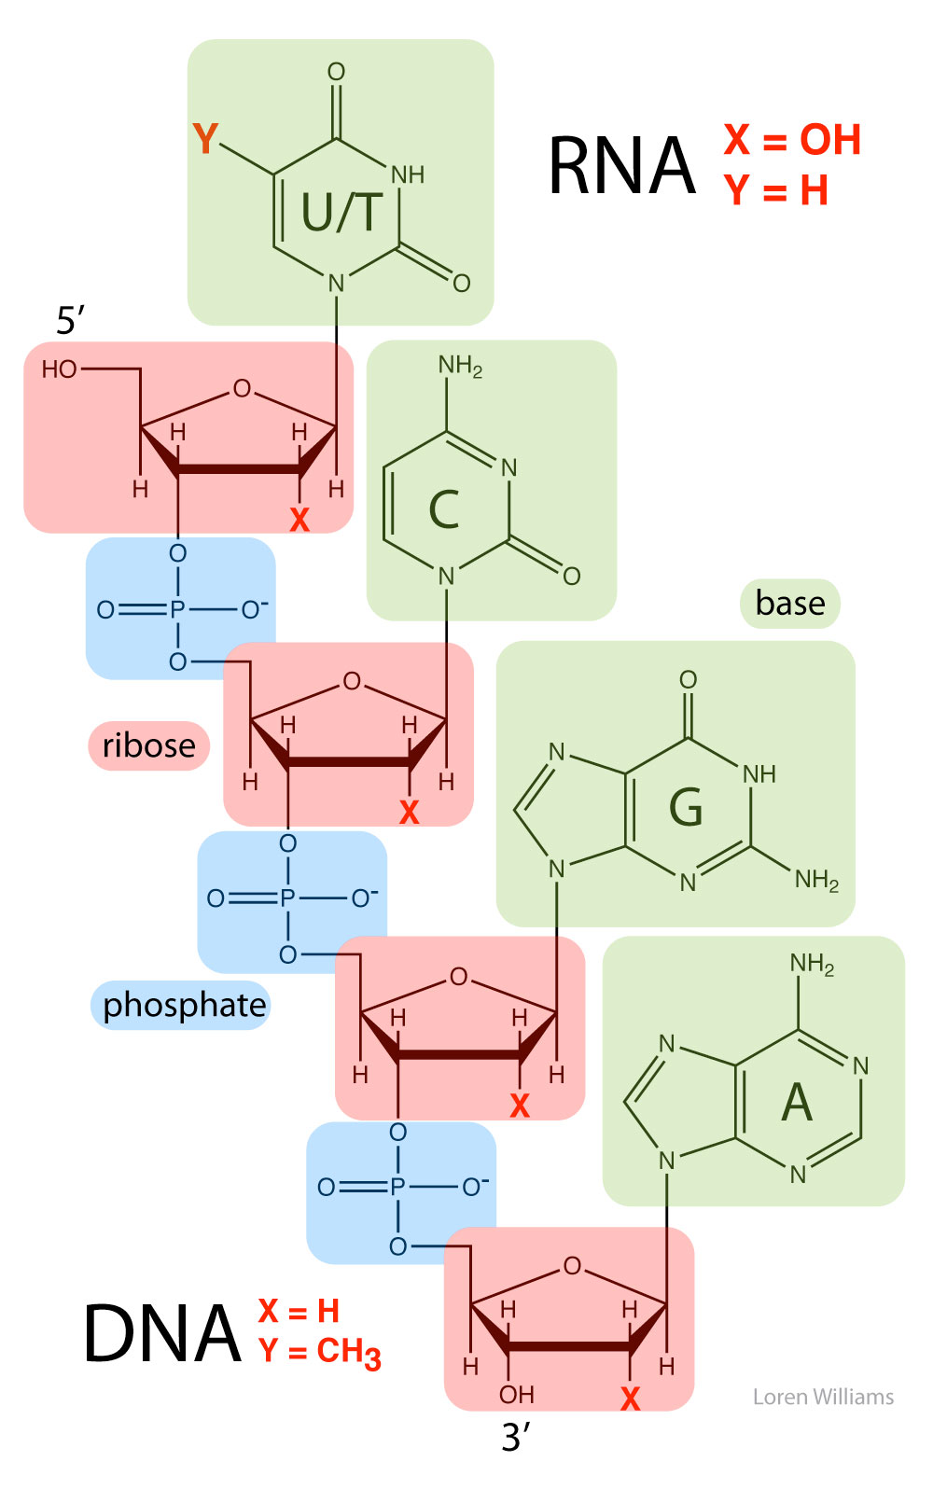
DNA has no HB donors on the backbone. It has many HB acceptors. The DNA backbone cannot self-assemble.
(compare to protein: which has equal number of acceptors and donors)

Slide 3
The hydroxyl group on the 2’ position of RNA can act as a HB donor. It is a HB donor in a sea of HB acceptors.
The 2’ OH acts like sticky tape.

Slide 4
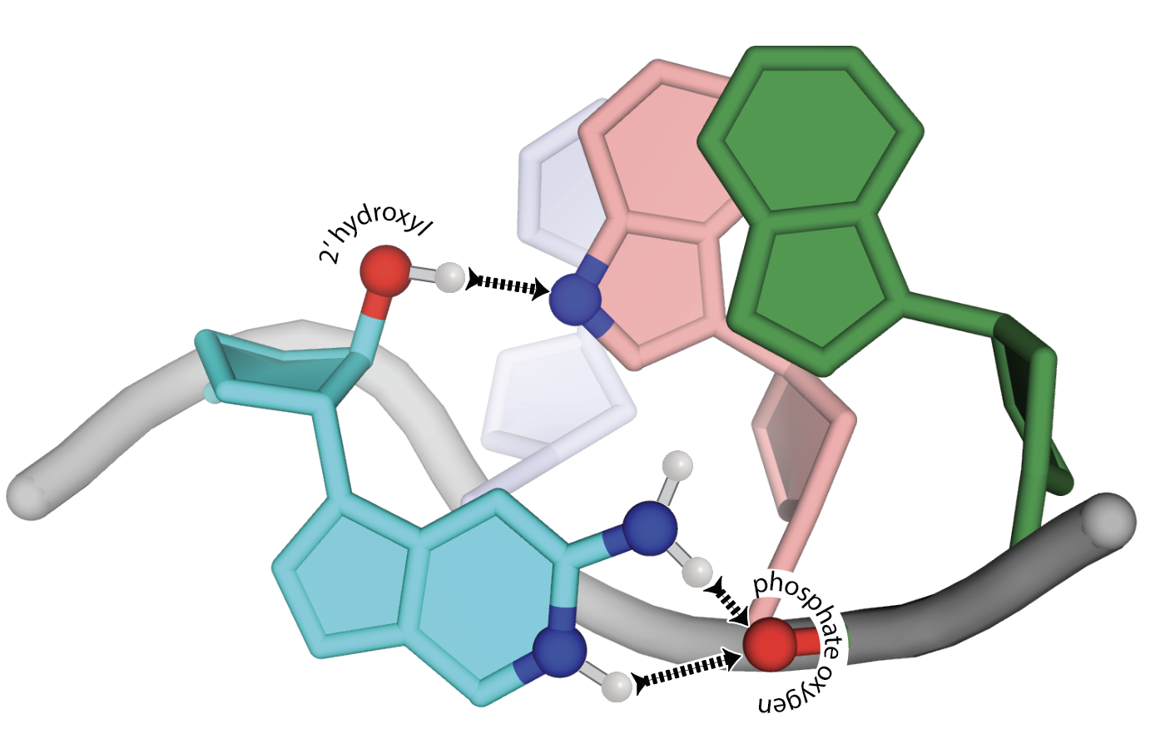

Slide 5
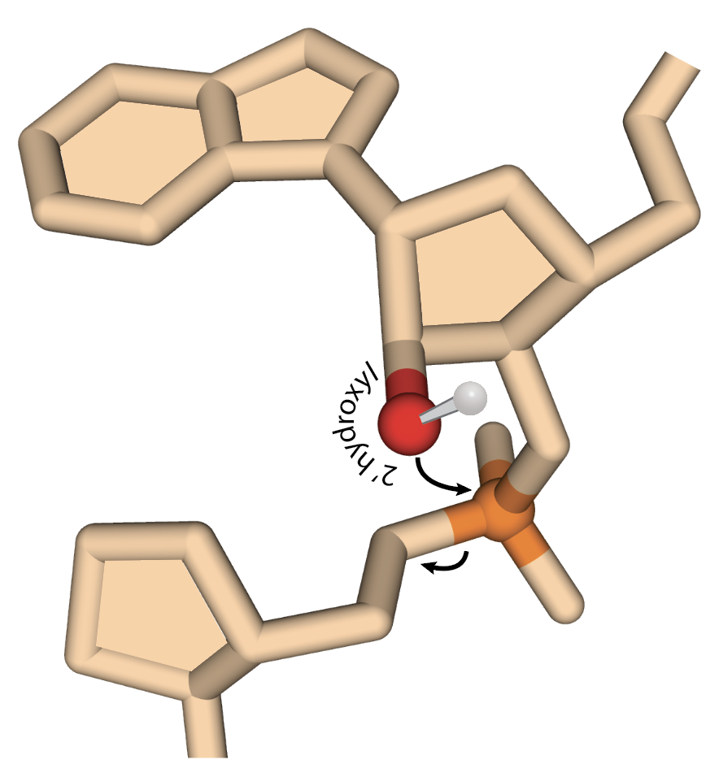
“RNA aims a gun at its own head”
Professor Nick Hud

Slide 6
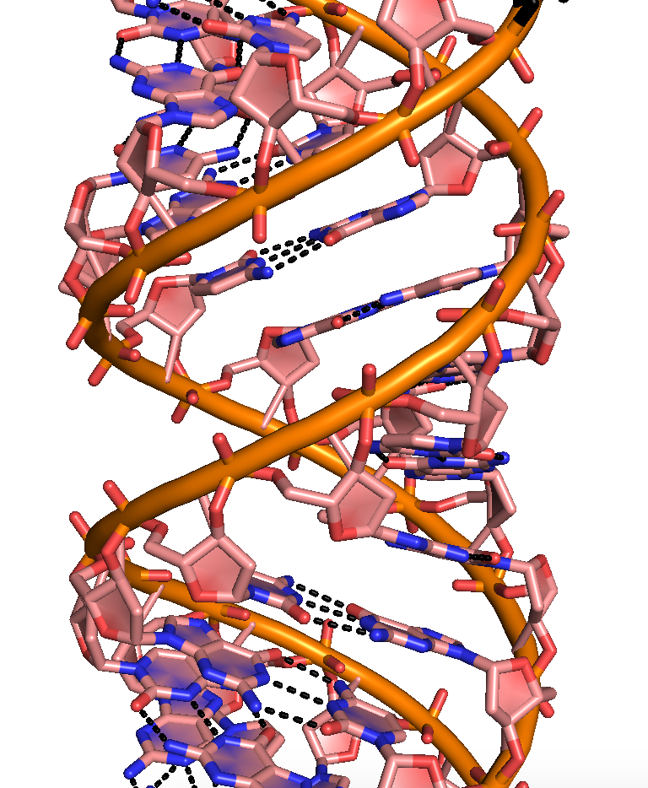
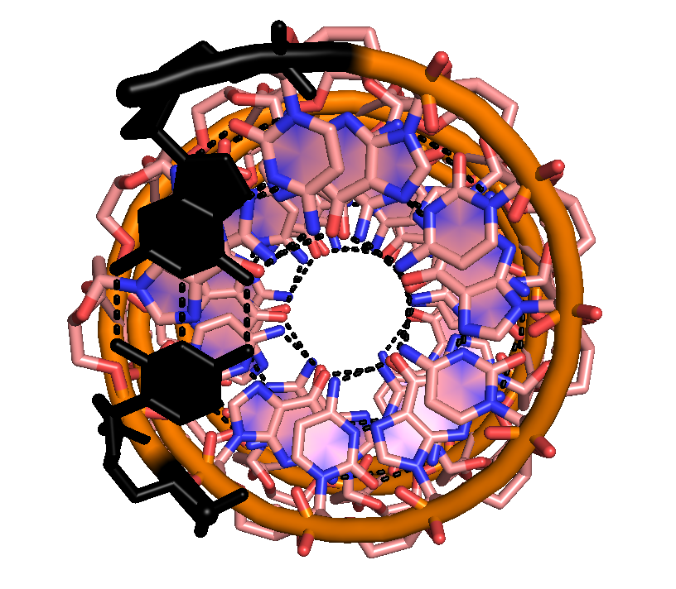
Double-Stranded RNA A-form helix

Slide 7
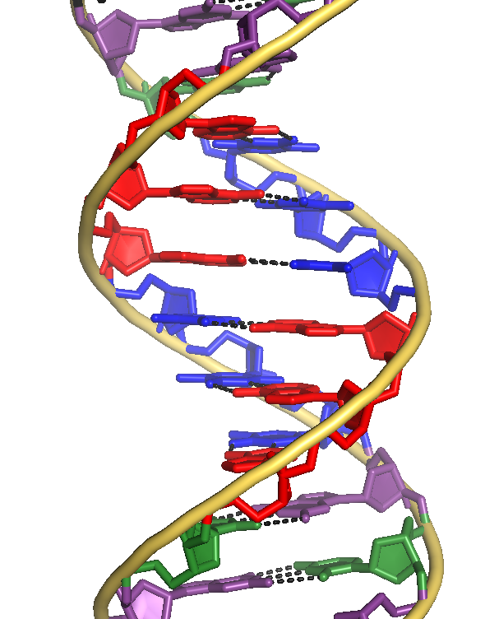
DNA (almost always B-form)
RNA (A-form + other structures)
11
base pairs/turn
10
base pairs/turn

Slide 8
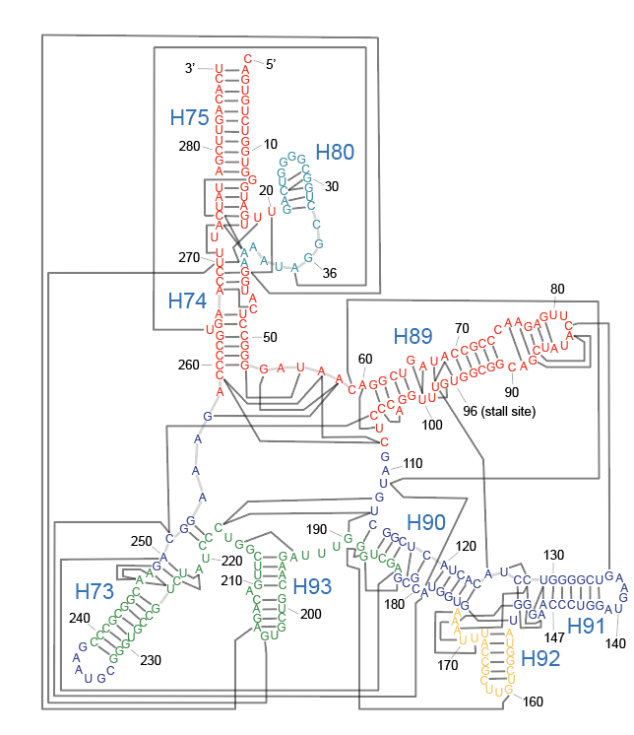
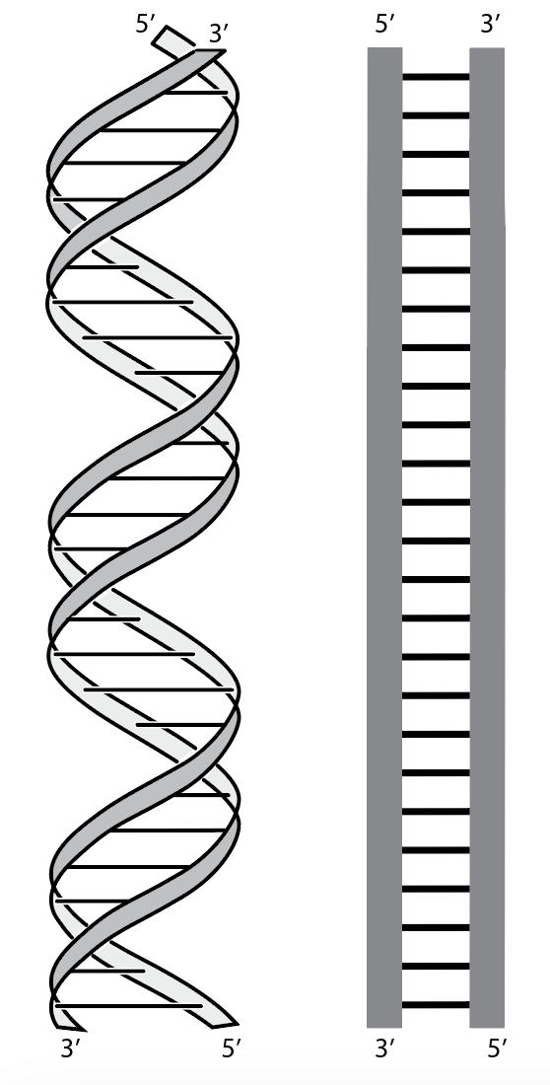
DNA tends not to assemble
(except for base-base interactions)
The backbone is self-repulsive
RNA Assembles into globular structures

Slide 9
DNA RNA
Primary structure:
sequence
Secondary structure:
local helices
Tertiary structure:
long range

Slide 10
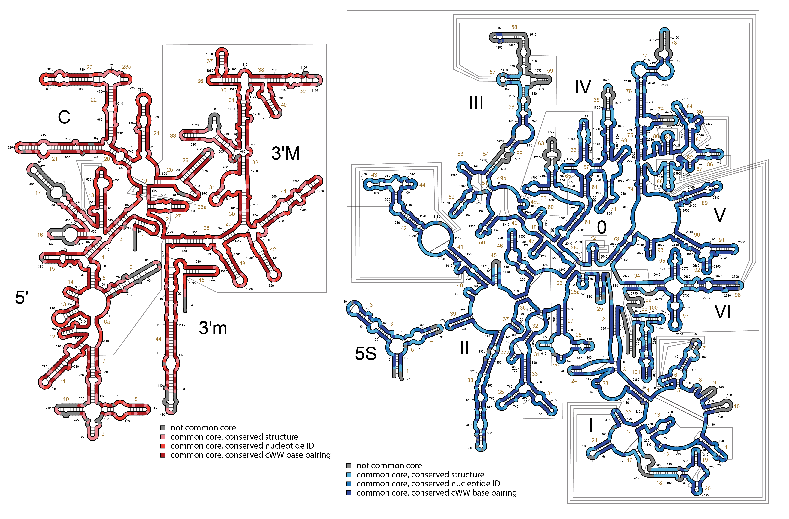
Ribosomal RNA
(rRNA)

Slide 11
DNA RNA

Slide 12
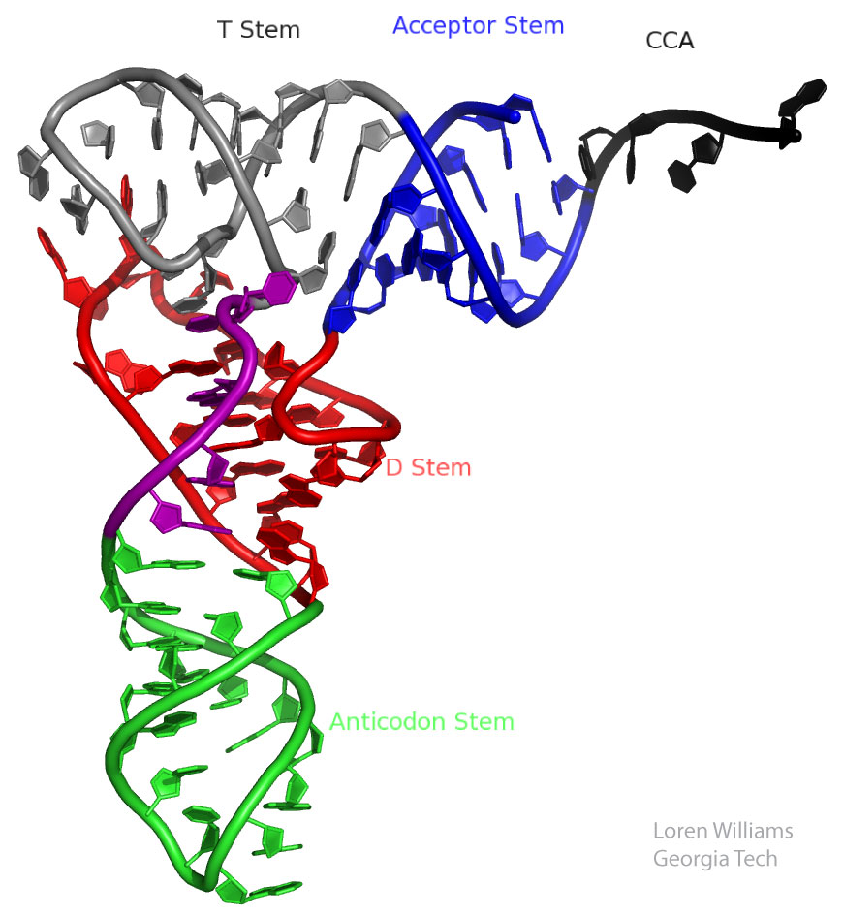
DNA likes B tRNA: RNA likes A

Slide 13
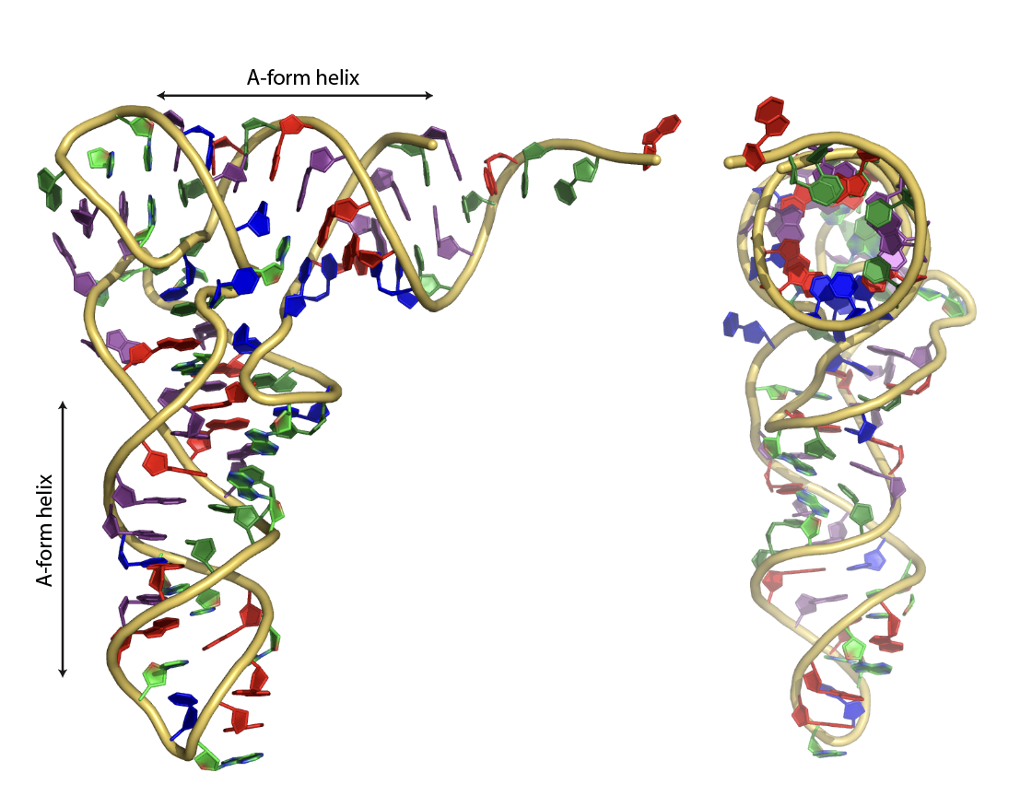
tRNA: RNA likes A

Slide 14
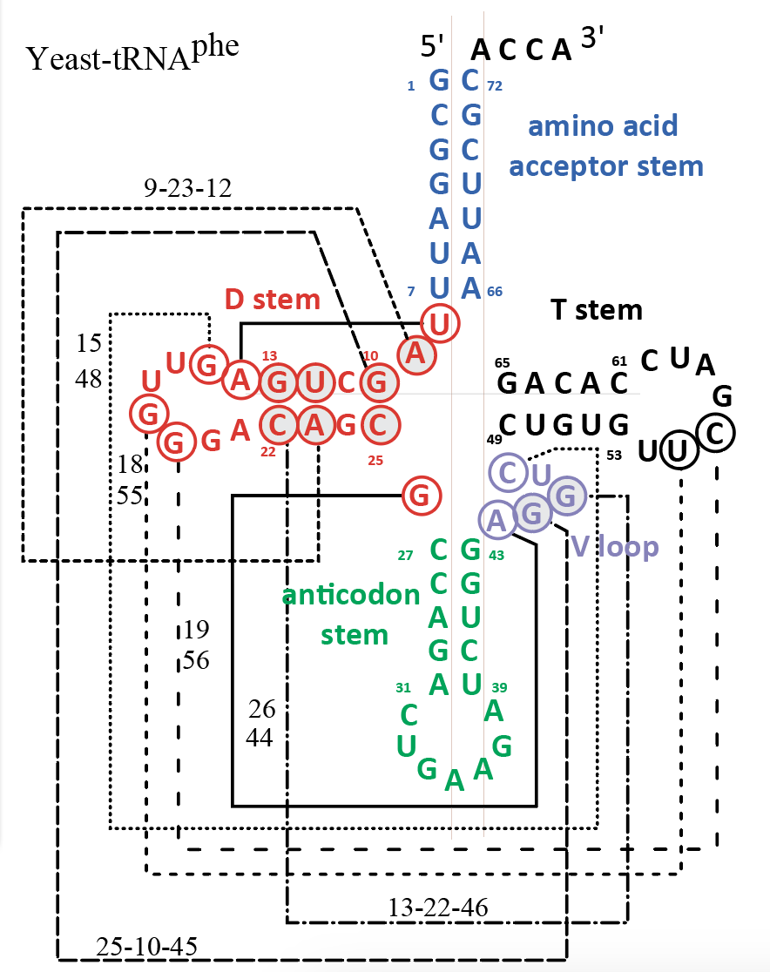
Primary structure:
sequence
Secondary structure:
local helices
Tertiary structure:
long range

Slide 15
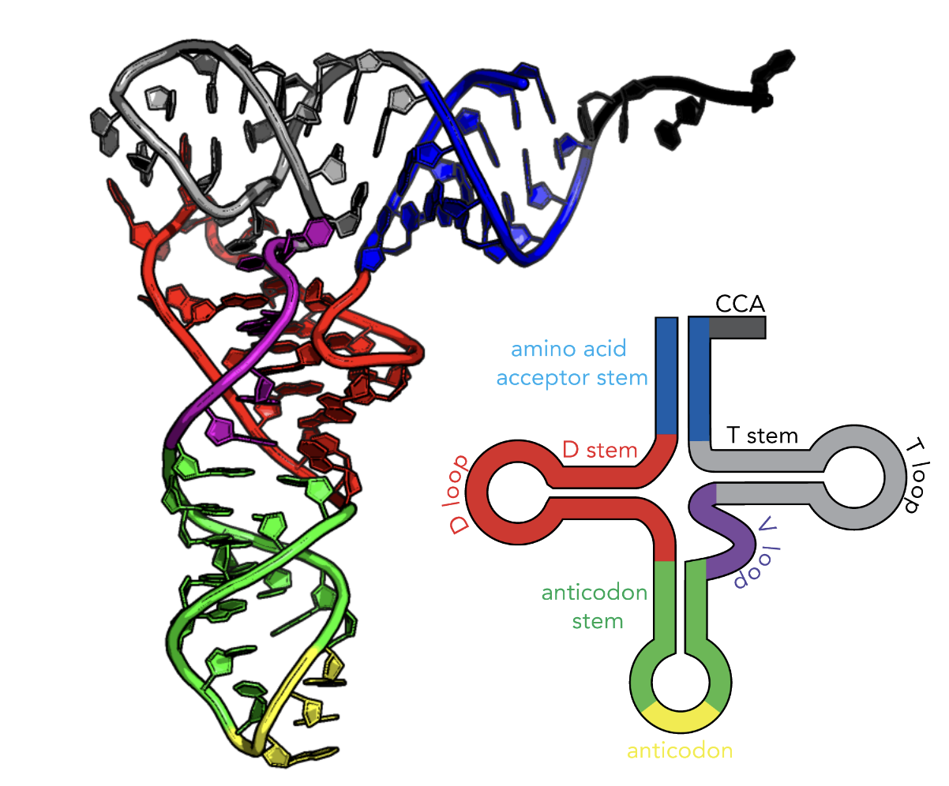

Slide 16
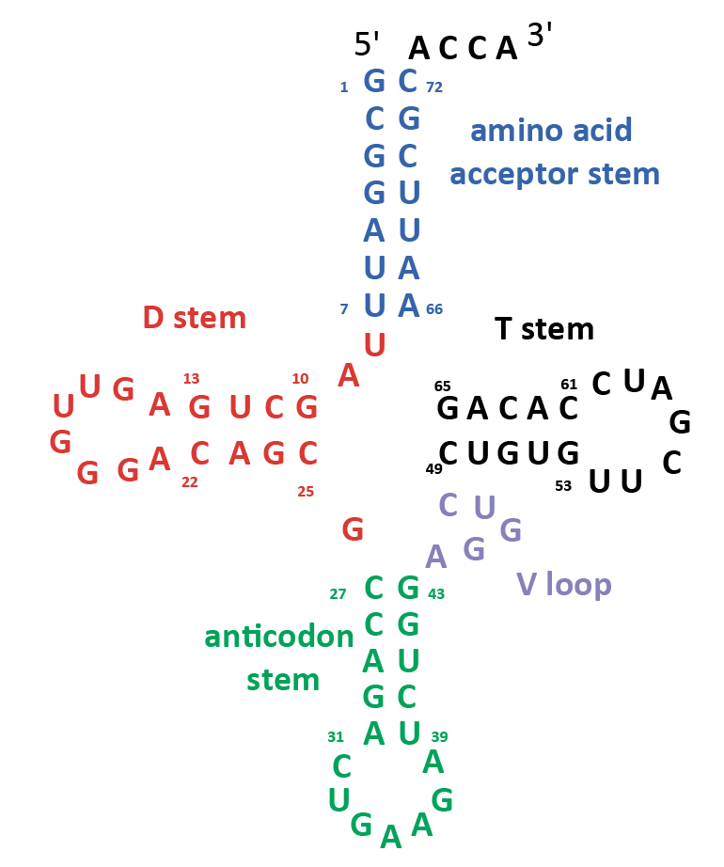

Slide 17
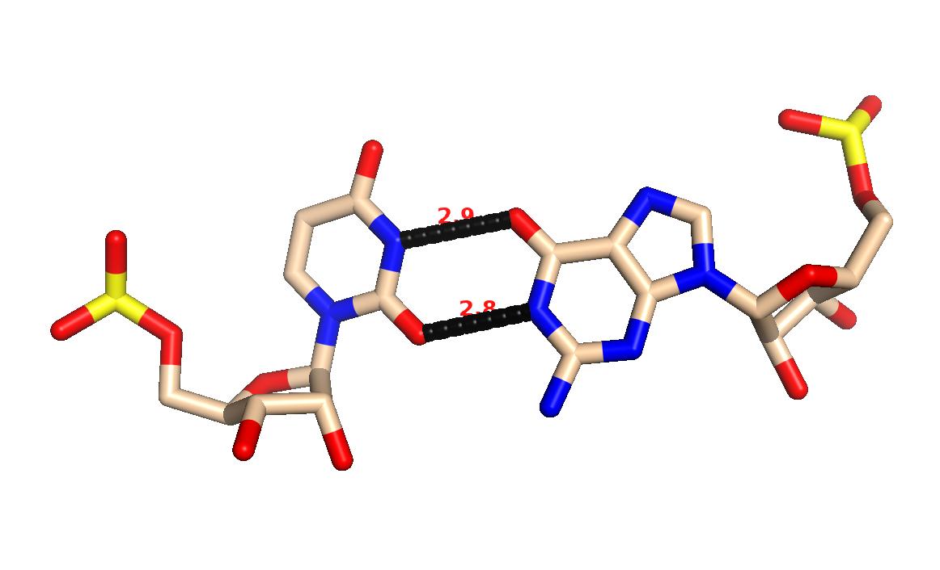
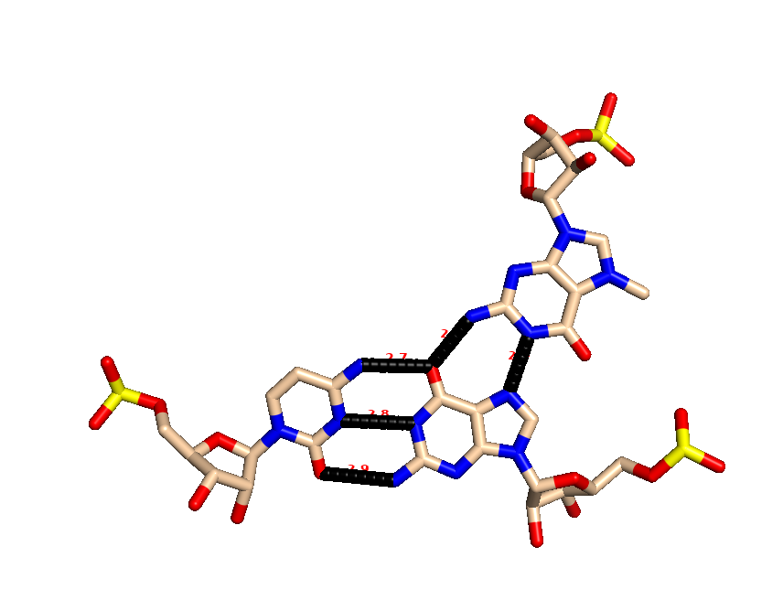
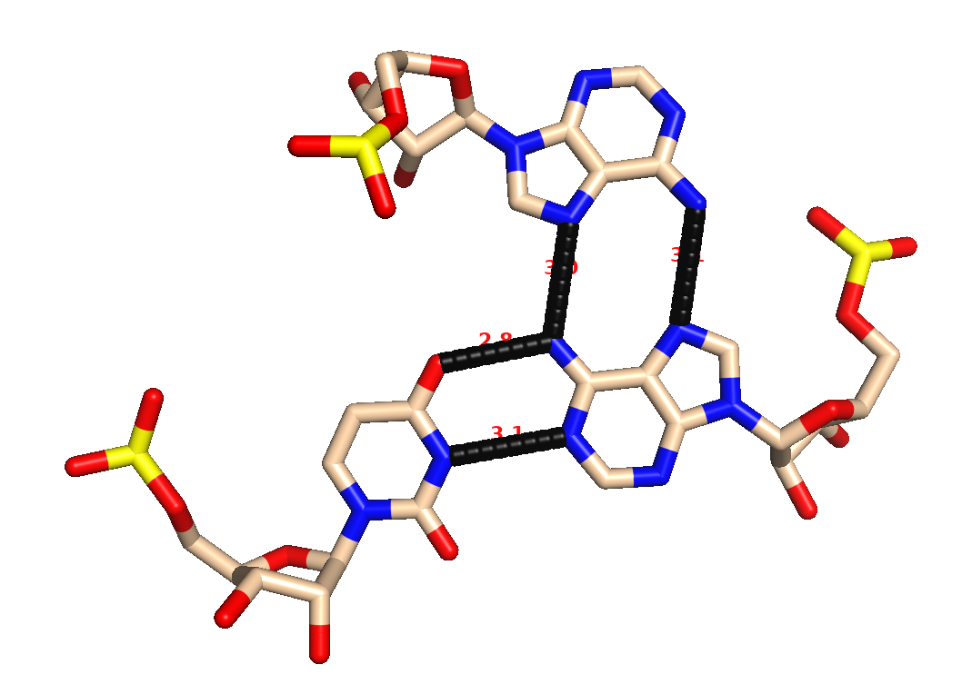
GU Wobble
Base Triples in tRNA

Slide 18
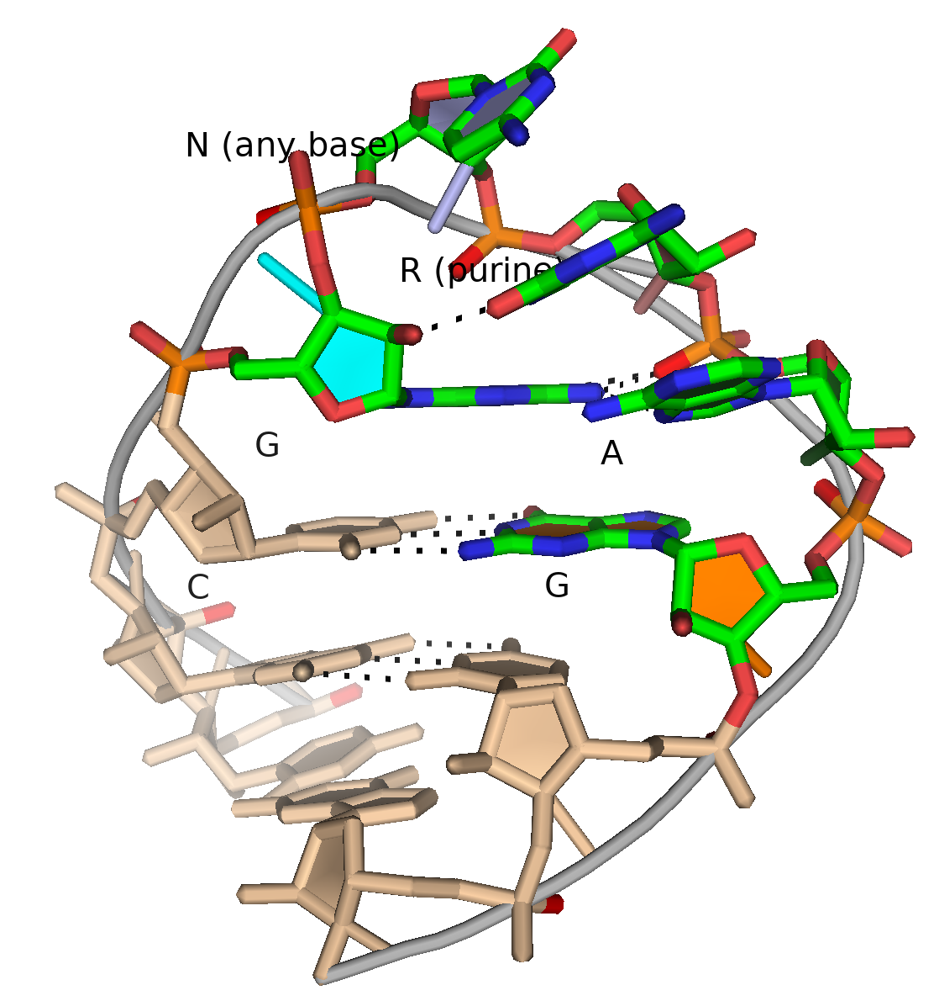
GNRA tetraloop
G
G

Slide 20
GNRA tetraloop

Slide 21
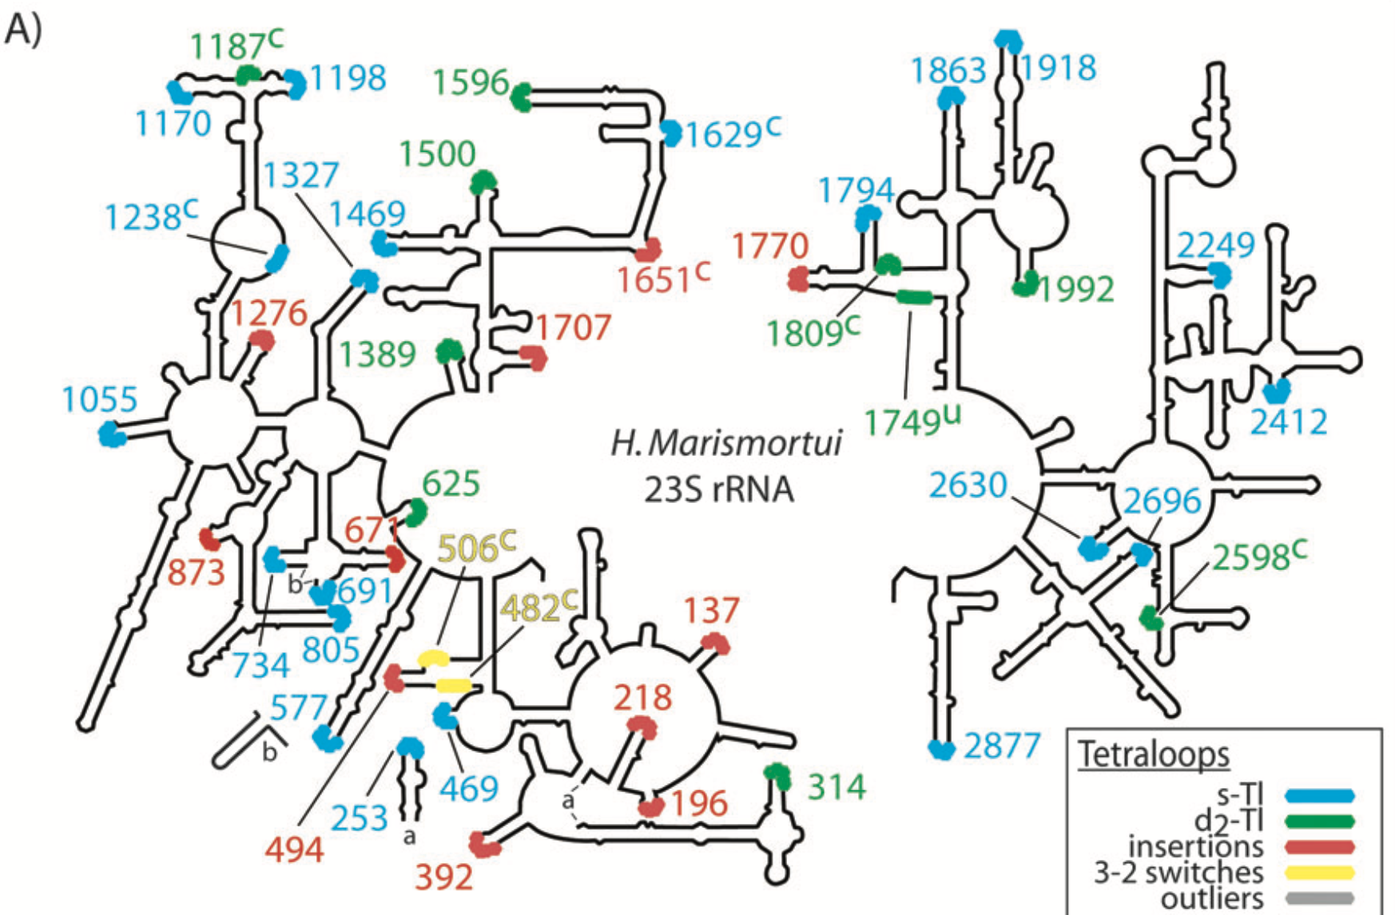

Slide 22
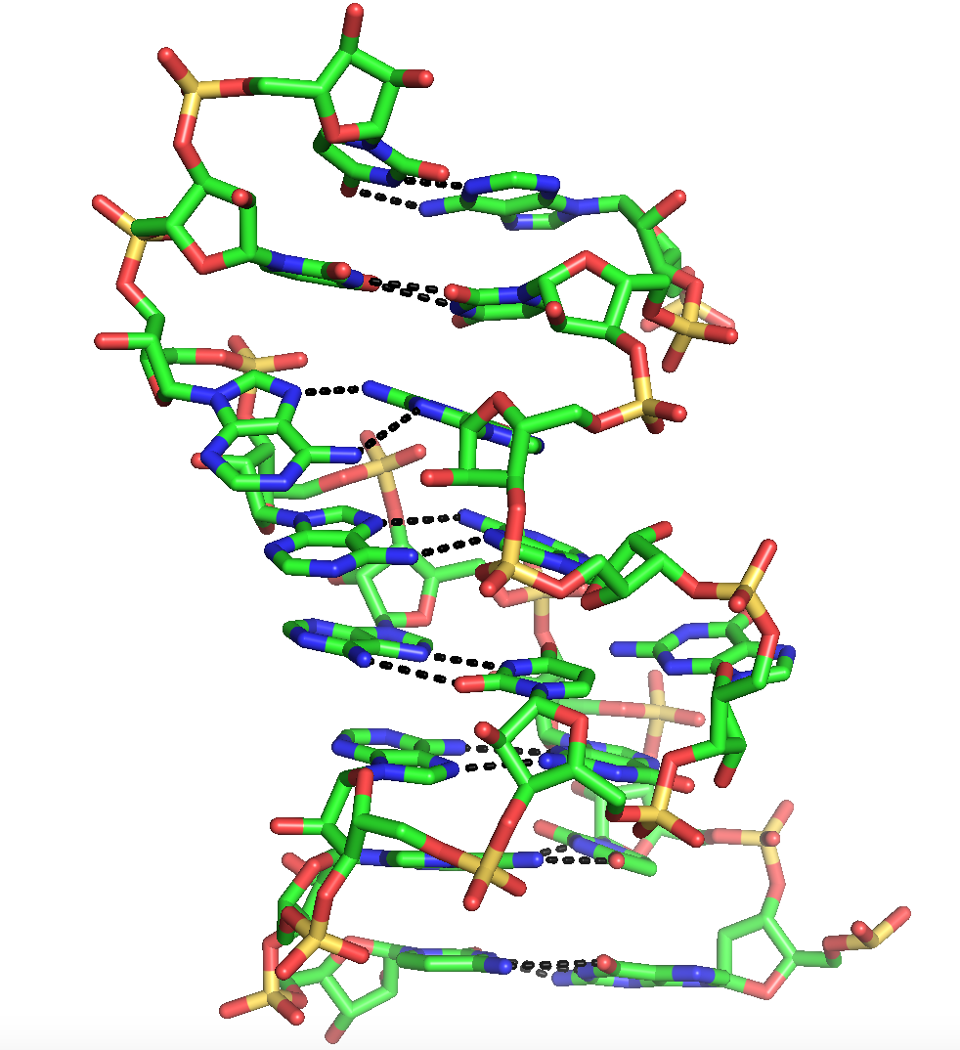
Helix 26a of the Ribosome

Slide 24
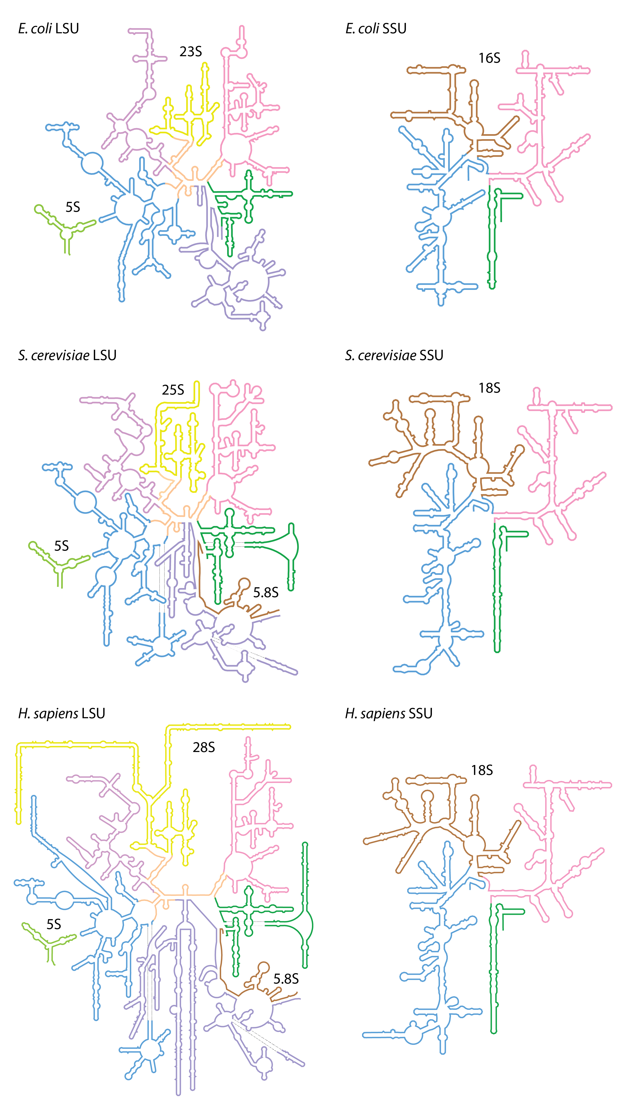

Slide 25
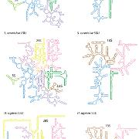
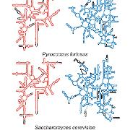
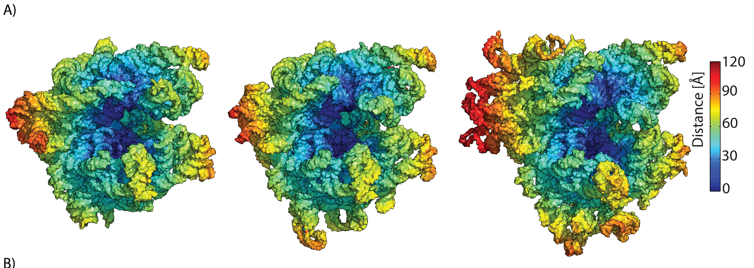
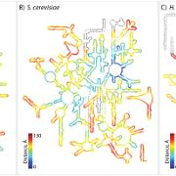
E coli P furiosus S. cerevisiae

Slide 26
Ribozymes
The vast majority of catalysis in biology is conducted by proteins (enzymes).
But some catalysis is performed by RNA (ribozymes which are actually RNPs)
two kinds of reactions:
Peptidyl transfer in the ribosome
RNA cutting and pasting in the splicosome, RNAse P, etc

Slide 27
The ribosome

Slide 28
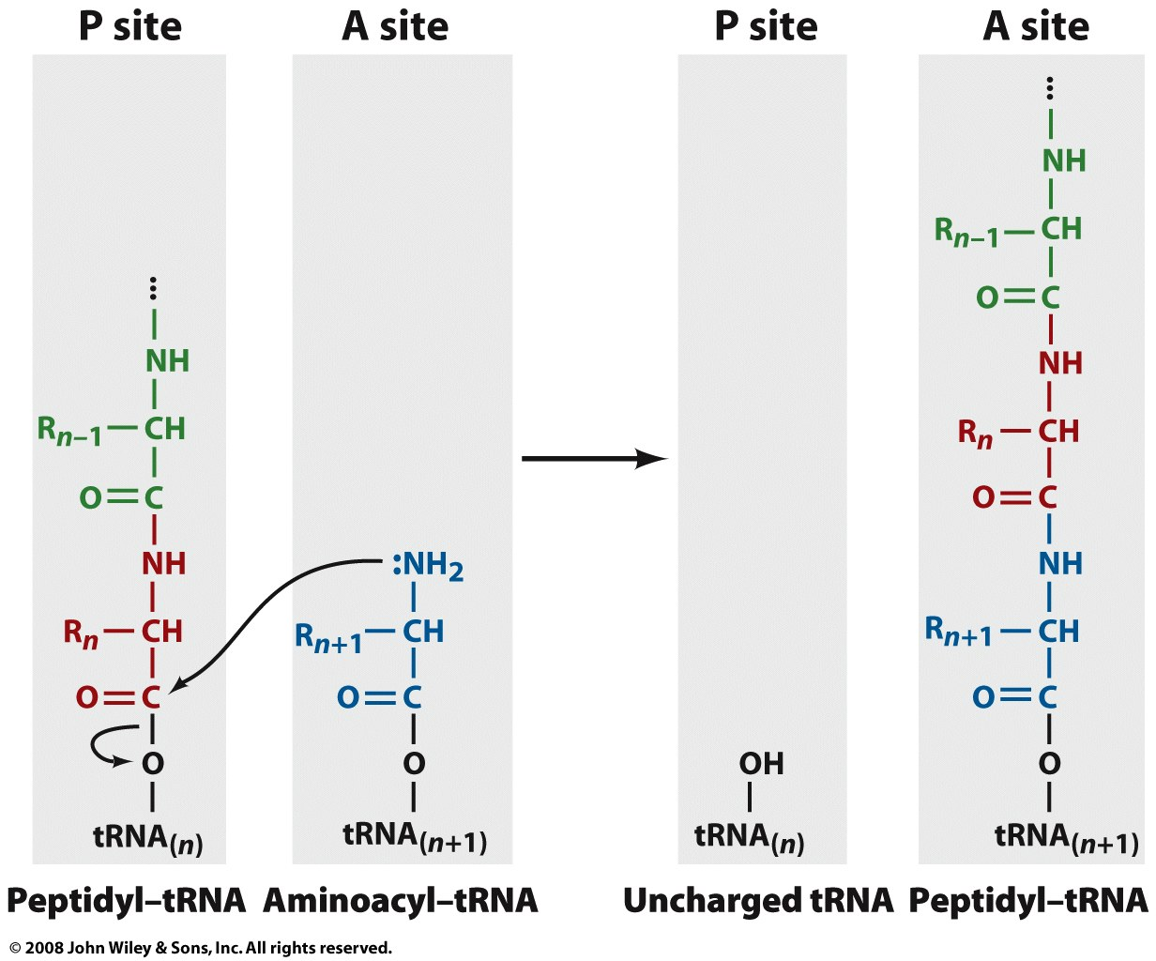
The Ribosome: The peptidyl transfer reaction

Slide 29
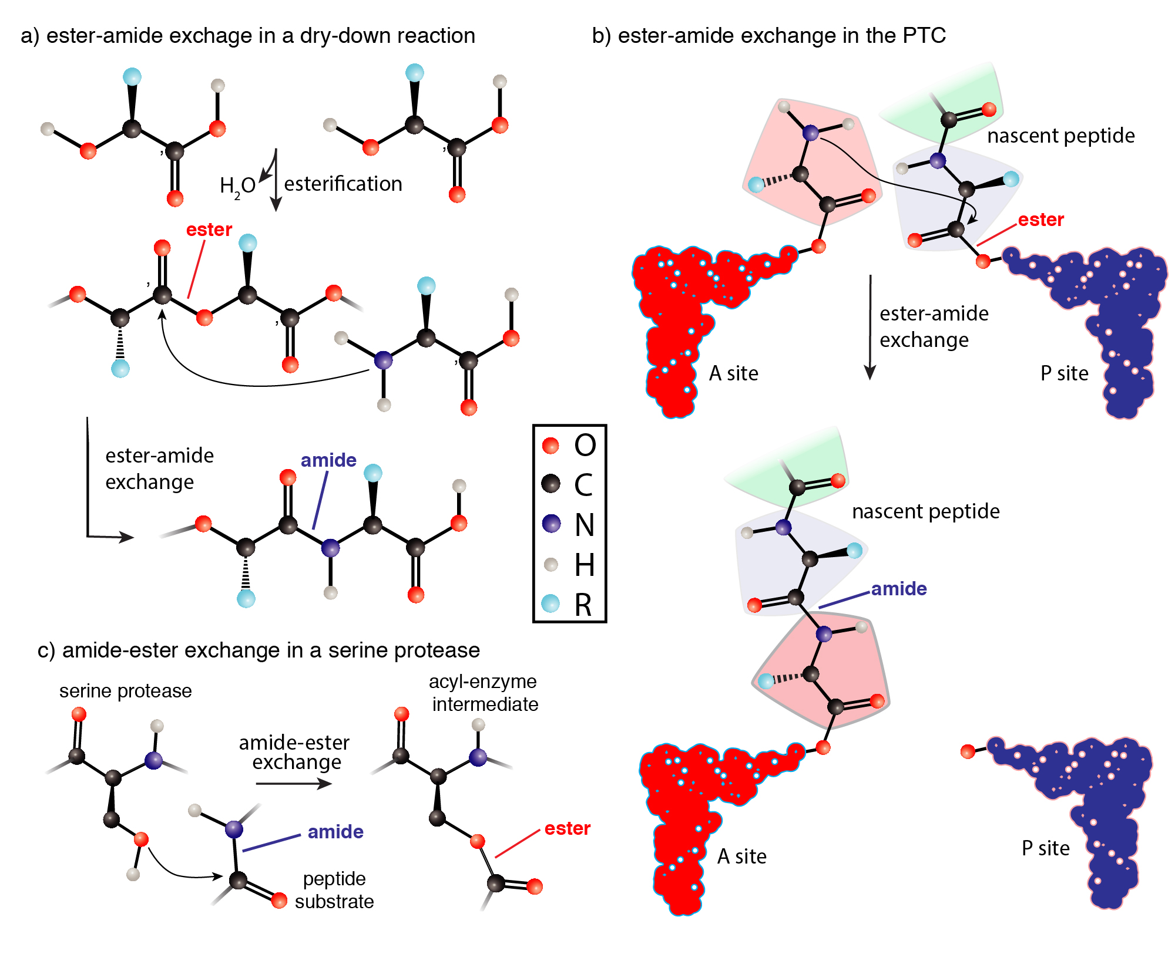
Notes:
Translation outrageously complex, produces coded protein by very simple chemistry

Slide 30
Splicing

Slide 31
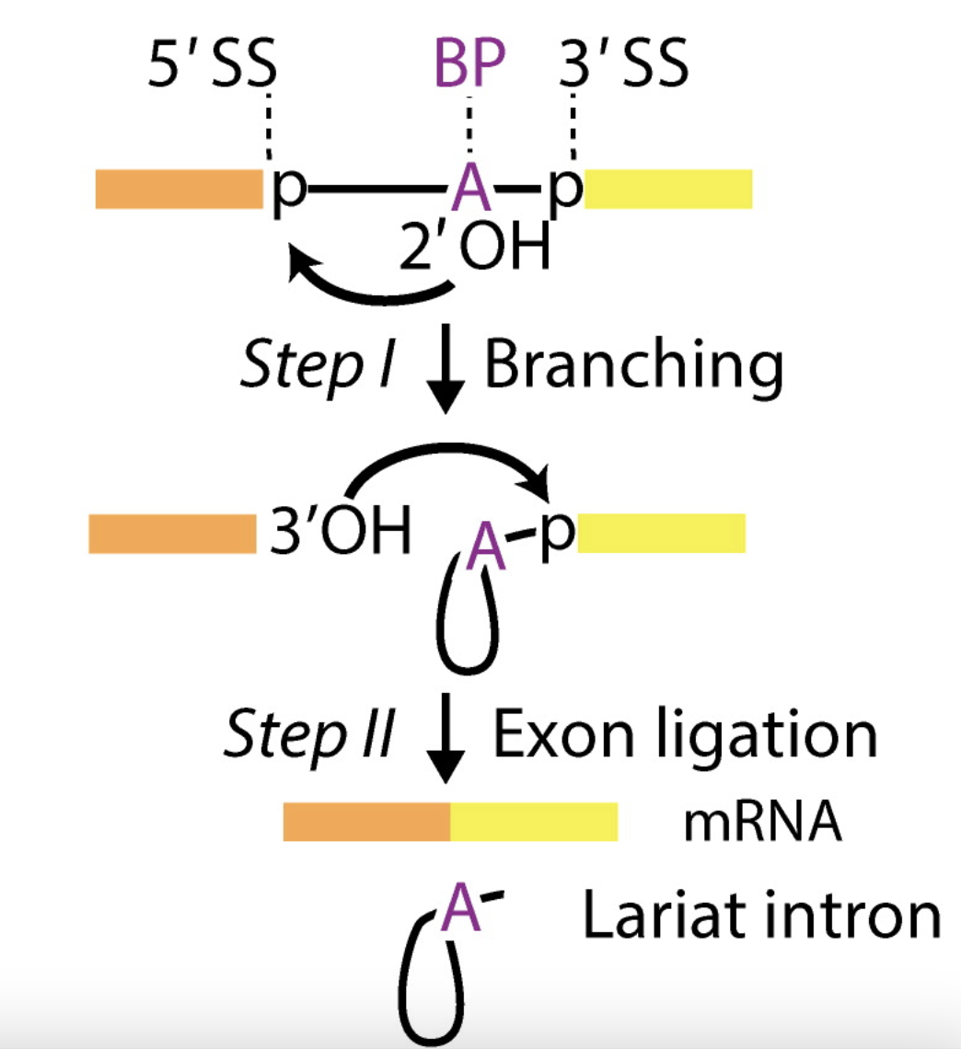
Exons of eukaryotic genes are interleaved by introns that are removed (spliced) from pre-mRNAs to form mature mRNAs.
A human has around 22,000 protein-coding genes. A gene has 8 introns on average.
The length of intron is around 1000 nucleotides on average.
exon
exon
Image from RNA Splicing by the Spliceosome, Annual Review of Biochemistry (2020)

