Slide 1
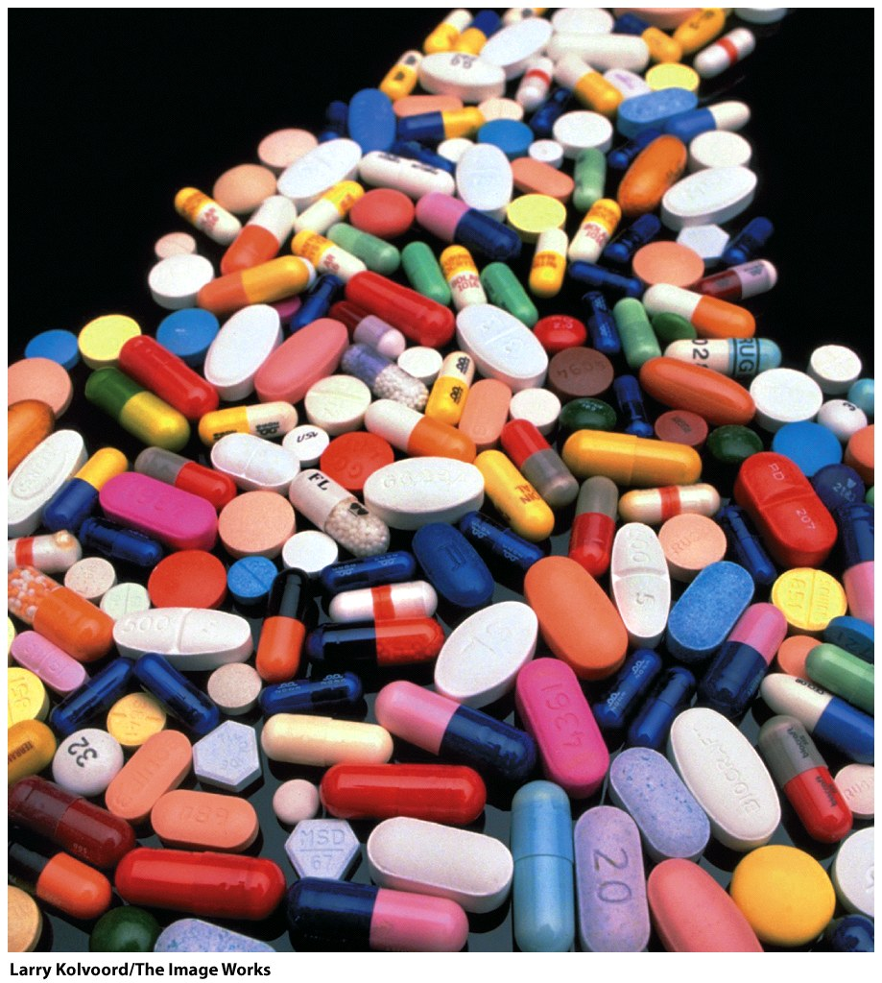
Many drugs are enzyme inhibitors.
Ibuprofin: Inhibits COX-1 and COX-2
(cyclooxygenases 1 & 2) and decreases synthesis of prostaglandins, which mediate inflammation, pain, fever, and swelling.
Aspirin is also COX-1,2 inhibitor. At low doses aspirin inhibits a COX involved in platelet formation.
Lipitor: Inhibits a liver enzyme (HMG-CoA reductase) that is important in biosynthesis of cholesterol (>$100 billion total sales since 1996).
Viread & Emtriva: reverse transcriptase inhibitors, anti-retrovirus (HIV).
Saquinavir: protease inhibitor, anti-retrovirus (HIV).

Slide 2
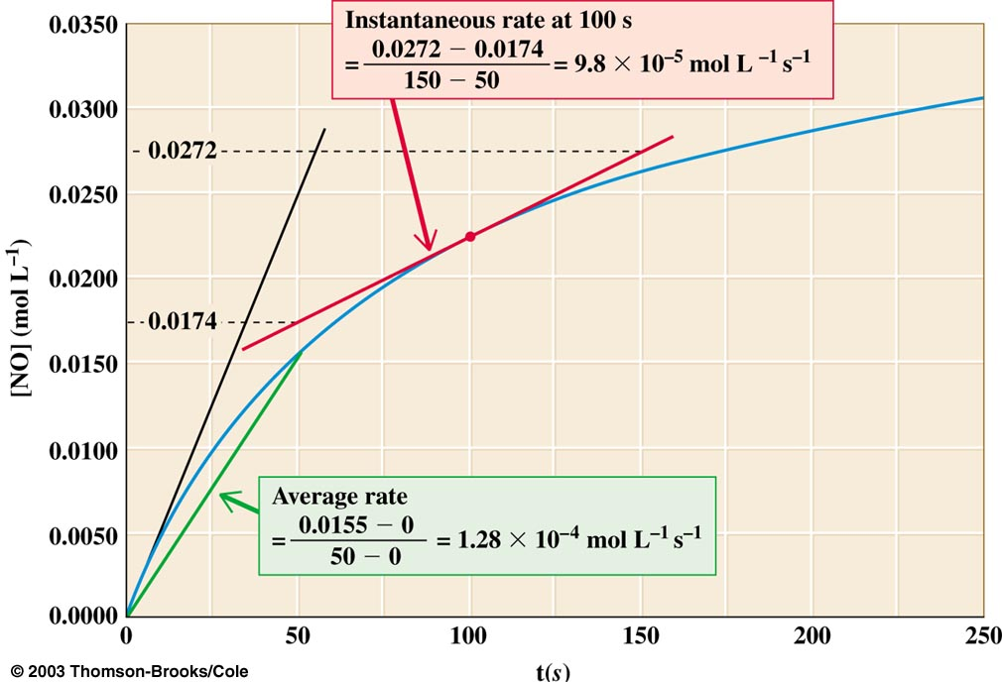
Reaction Rates (reaction velocities): To measure a reaction rate we monitor the disappearance of reactants or appearance of products.
e.g., 2NO₂ + F₂ → 2NO₂F
Measure
initial velocity =>
[product] = 0,
no back reaction

Slide 3
Reaction Order
Zero Order. The rate of a zero-order reaction is independent of the concentration of the reactant(s). Zero-order kinetics are observed when an enzyme is saturated by reactants.
First Order. The rate of a first-order reaction varies linearly on the concentration of one reactant. First-order kinetics are observed when a protein folds and RNA folds (assuming no association or aggregation), also radioactive decay.
Second Order. The rate of a second-order reaction varies linearly with the square of concentrations of one reactant (or with the product of the concentrations of two reactants). Second order kinetics are observed for formation of double-stranded DNA from two single-strands.

Slide 4
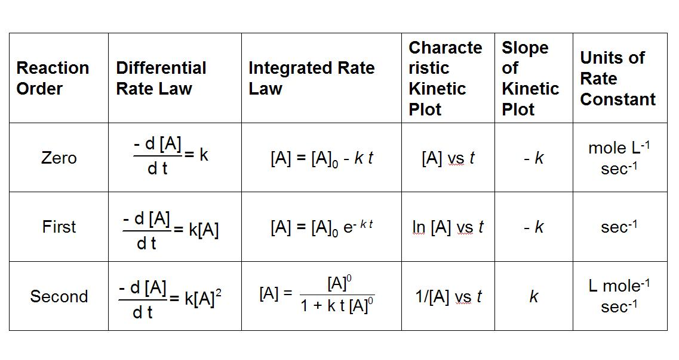

Slide 5
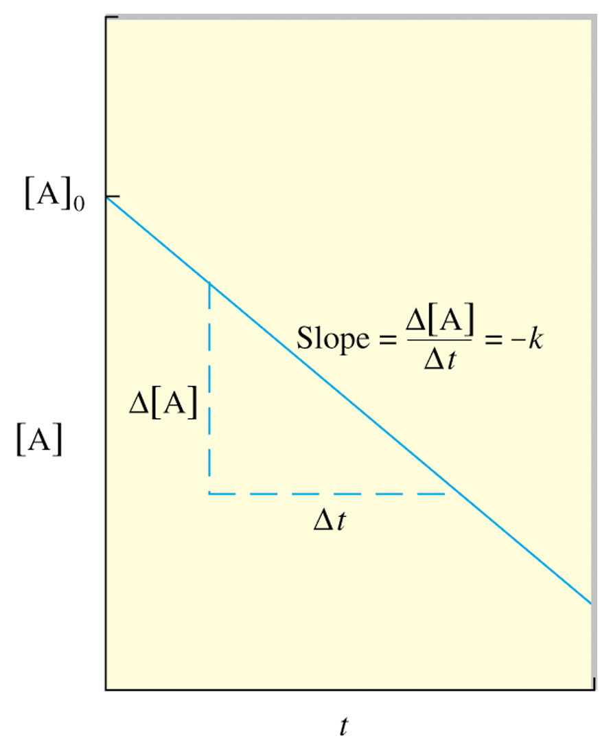
Use experimental data to determine the reaction order.
If a plot of [A] vs t is a straight line, then the reaction is zero order.
If a plot of ln[A] vs t is a straight line, then the reaction is 1st order.
If a plot of 1/ [A] vs t is a straight line, then the reaction is 2nd order.

Slide 6
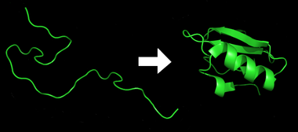
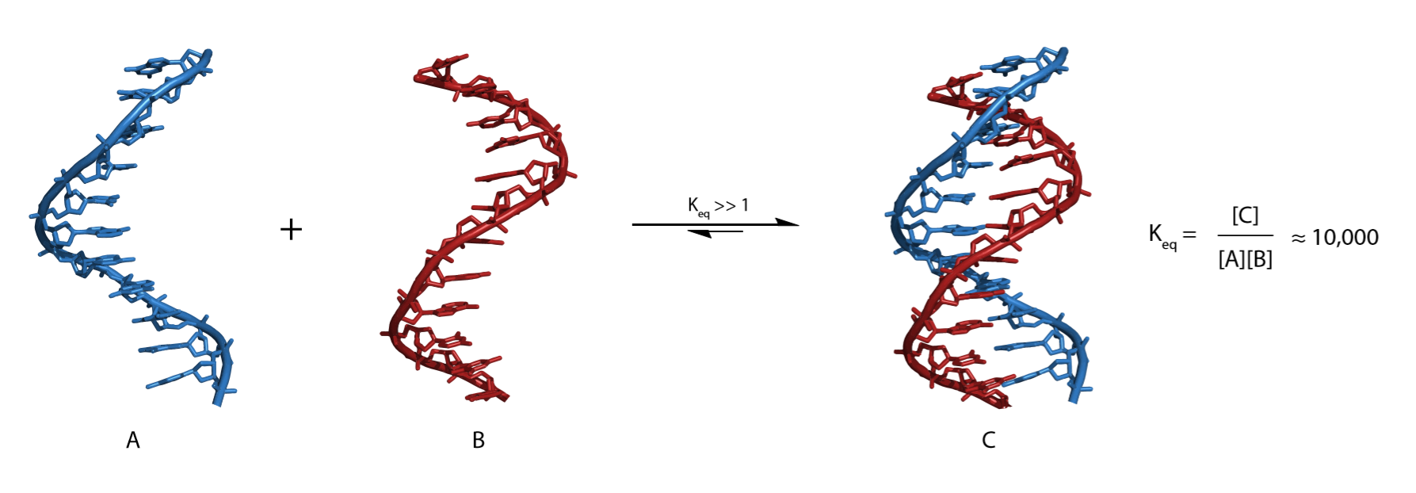
Protein Folding: 1st order process
DNA annealing: 2nd order process

Slide 7
Each elementary step has reactant(s), a transition state, and product(s). Products that are consumed in subsequent elementary reaction are called intermediates.

Slide 8
Kinetics is the study of reaction rates (time-dependent phenomena)
Rates of reactions are affected by
Enzymes/catalysts
Substrate type
Substrate concentration
Effectors & cofactors
Temperature

Slide 9
Why study enzyme kinetics?
Quantitative description of biocatalysis
Understand catalytic mechanism
Find effective inhibitors (drugs and tools)
Understand regulation of activity

Slide 10
General Observations
Enzymes exert their influence at very low concentrations [enzyme] = ~ nM.
The initial rate [initial velocity, i.e., initial d[P]/dt)] is linear with [enzyme].
The initial velocity increases with [substrate] at low [substrate].
Saturation: the initial velocity approaches a maximum at high [substrate].

Slide 11
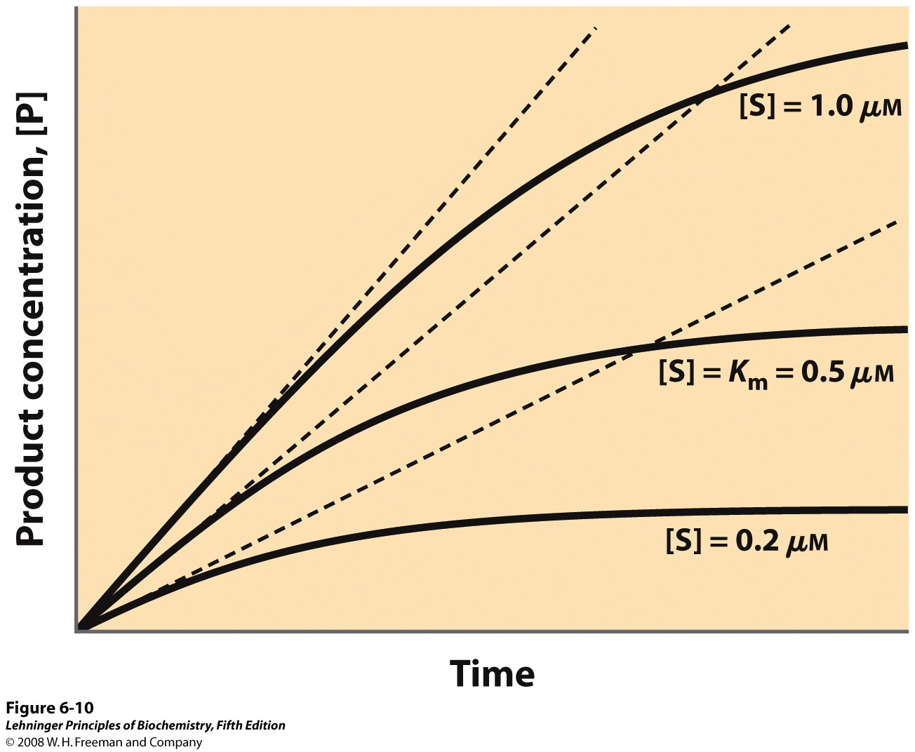
Enzyme Kinetics
The initial velocity (initial d[P]/dt)
increases with [S] at low [S].
Initial velocity
Notes:
FIGURE 6-10 Initial velocities of enzyme-catalyzed reactions. A theoretical enzyme catalyzes the reaction S ↔ P, and is present at a concentration sufficient to catalyze the reaction at a maximum velocity, V_{max}, of 1 μM/min. The Michaelis constant, K_{m} (explained in the text), is 0.5 μM. Progress curves are shown for substrate concentrations below, at, and above the K_{m}. The rate of an enzyme-catalyzed reaction declines as substrate is converted to product. A tangent to each curve taken at time = 0 defines the initial velocity, V₀, of each reaction.

Slide 12
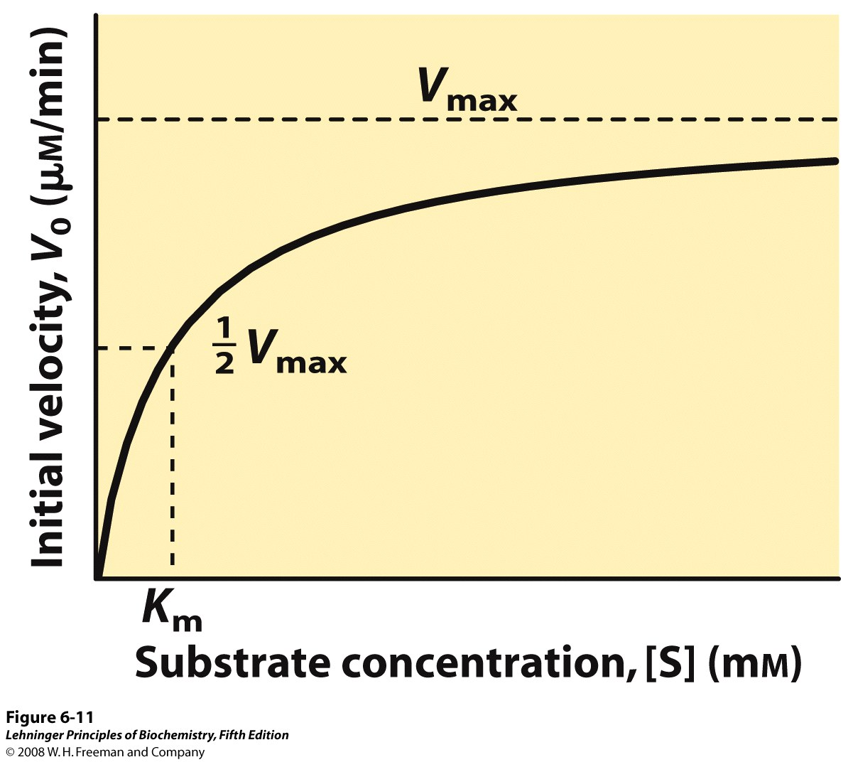
Enzyme Kinetics
The initial velocity increases with [S] at low [S].
(velocity =d[P]/dt, P=product)
Saturation: The initial reaction velocity approaches a maximum (V_{max}) at high [S]
i.e., the reaction order is zero order at high [S].
Notes:
FIGURE 6-11 Effect of substrate concentration on the initial velocity of an enzyme-catalyzed reaction. The maximum velocity, V_{max}, is extrapolated from the plot, because V₀ approaches but never quite reaches V_{max}. The substrate concentration at which V₀ is half maximal is K_{m}, the Michaelis constant. The concentration of enzyme in an experiment such as this is generally so low that [S] >> [E] even when [S] is described as low or relatively low. The units shown are typical for enzyme-catalyzed reactions and are given only to help illustrate the meaning of V₀ and [S]. (Note that the curve describes part of a rectangular hyperbola, with one asymptote at V_{max}. If the curve were continued below [S] = 0, it would approach a vertical asymptote at [S] = –K_{m}.)

Slide 13
Equations describing Enzyme Kinetics
Start with a mechanistic model
Identify constraints and assumptions
Do the algebra ...
Solve for velocity (d[P]/dt)

Slide 14
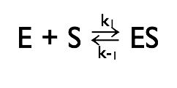
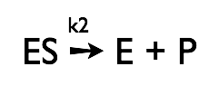
Michaelis-Menten Kinetics
Simplest enzyme mechanism
One reactant (S)
One intermediate (ES)
One product (P)

Slide 15
Michaelis-Menten Kinetics
First step: The enzyme (E) and the substrate (S) reversibly and quickly form a non-covalent ES complex (Michaelis Complex).
Second step: The ES complex undergoes a chemical transformation and dissociates to give product (P) and enzyme (E).
v=k₂[ES]
Many enzymatic reactions follow Michaelis–Menten kinetics, even though enzyme mechanisms are always more complicated than the Michaelis–Menten model.
For real enzymatic reactions use k_{cat} instead of k₂.

Slide 16
The Enzyme-Substrate Complex (ES)
Michaelis-Menten Kinetics
The enzyme binds non-covalently to the substrate to form a non-covalent ES complex
the ES complex is known as the Michaelis complex.
A Michaelis complex is stabilized by molecular interactions (non-covalent interactions).
Michaelis complexes form quickly and dissociate quickly.

Slide 17
E + S → ES → E + P
Michaelis-Menten Kinetics
k_{cat} and the reaction velocity
k₁
←
k_{cat}
k₋₁
The enzyme is either free ([E]) or bound ([ES]): [E_{o}] = [E]_{TOT}= [ES] + [E].
At high [S] all of the enzyme is tied up as ES (i.e., [E_{o}] ≈ [ES], (Le Chatelier's Principle)
At high [S] the enzyme is working at full capacity (v_{o}=v_{max}).
The maximum velocity (v_{max}) is determined only by k_{cat} and [E_{o}].
k_{cat} = turnover #: number of moles of substrate produced per time per enzyme molecule.

Slide 18
E + S → ES → E + P
Michaelis-Menten Kinetics
k₁
k_{cat}
←
k₋₁
For any enzyme it is possible (pretty easy) to determine k_{cat}.
To understand and compare enzymes we need to know how well the enzyme binds to S (i.e, what happens in the first part of the reaction.) k_{cat} does not tell us anything about how well the enzyme binds to the substrate.

Slide 19
Assumptions
Michaelis-Menten Kinetics
k₁,k₋₁>>k₂ (i.e., the first step is fast and is always at equilibrium).
d[ES]/dt ≈ 0 (i.e., the system is at steady state.)
There is a single reaction/dissociation step (i.e., k₂=k_{cat}).
E_{Tot} = [E] + [ES]
There is no back reaction of P to ES (i.e. [P] ≈ 0). This assumption allows us to ignore k₋₂. We measure initial velocities, when [P] ≈ 0.

Slide 20
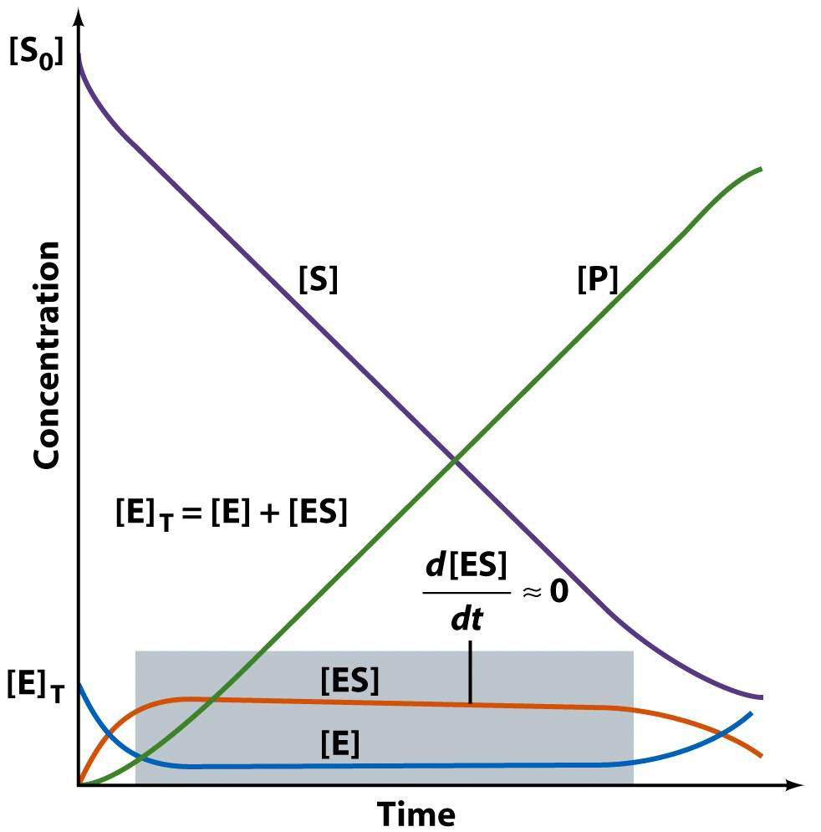
Michaelis-Menten Kinetics
Michaelis-Menten Kinetics
E + S → ES → E + P
k₁
k_{cat}
←
k₋₁
The time dependence of everything (in a Michaelis-Menten reaction)

Slide 21
Michaelis-Menten Kinetics
E + S → ES → E + P
k₁
k_{cat}
k₋₁
Now: we derive the Michaelis-Menten Equation
d[ES]/dt = k₁[E][S] –k₋₁[ES] – k₂[ES]
= 0 (steady state assumption, see previous graph)
solve for [ES] (do the algebra)
[ES] = [E][S] k₁/(k₋₁ + k₂)
Define K_{M} (Michealis Constant)
K_{M} = (k₋₁ + k₂)/k₁ => [ES] = [E][S]/K_{M}
rearrange to give K_{M} = [E][S]/[ES]

Slide 22
Michaelis-Menten Kinetics
E + S → ES → E + P
k₁
k_{cat}
k₋₁
$$v_{o}= \frac{v_{max} [S]}{K_{M}+[S]}$$
This is the Michaelis-Menton Equation (page 547 Lehninger)
When [S] = K_{M}, the velocity is half v_{max}
$$v_{o}= \frac{v_{max} [S]}{[S]+[S]}=\frac{v_{max}}{2}$$

Slide 23
Michaelis-Menten Kinetics
K_{M} is the substrate concentration required to reach half-maximal velocity (v_{max}/2).

Slide 24
Significance of K_{M}
Michaelis-Menten Kinetics
K_{M} = [E][S]/[ES] and K_{M} = (k₋₁ + k₂)/k₁.
K_{M} is the apparent dissociation constant of the ES complex. A dissociation constant (K_{d}) is the reciprocal of an equilibrium constant (K_{d}=K_{e}⁻¹). K_{M} is a measure of a substrate’s affinity for the enzyme (small K_{d} = high affinity).
If k₁,k₋₁ >> k_{cat}, the K_{M} is approximated by K_{d} (see previous slide)
K_{M} is the substrate concentration required to reach half-maximal velocity (v_{max}/2). A small K_{M} means the substrate binds tightly to the enzyme and saturates (max’s out) the enzyme.
The microscopic meaning of K_{M} depends on the details of the mechanism.

Slide 25
The Significance of the Dissociation Constant (K_{d})
The dissociation constant (K_{d}) is the reciprocal of the equilibrium constant (K_{e})
For protein binding to a ligand, we have Free protein and Bound protein (Complex)
Free + Ligand = Complex
(this reasonably describes E + S = ES if k_{cat}<< k₁,k₋₋₁)
K_{d} = [Free][Ligand]/[Complex] (the units of K_{d} are M)
At 50% binding, [Complex]/[Free] = 1, and K_{d}= [Ligand]
If K_{d}=10⁻⁹ M, then 50% of ligand is bound 10⁻⁹ M (tight binding)
If K_{d}=10⁻⁶ M, then 50% of ligand is bound 10⁻⁶ M
If K_{d}=10⁻³ M, then 50% of ligand is bound 10⁻³ M (weak binding)

Slide 26
The significance of k_{cat}
Michaelis-Menten Kinetics
v_{max} = k_{cat} [E]_{tot}
k_{cat}: For the simplest possible mechanism, where ES is the only intermediate, and dissociation of P is fast, then k_{cat}=k₂, the first order rate constant for the catalytic step.
If there are multiple catalytic steps (see trypsin) then each of those rate constants contributes to k_{cat}.
If one catalytic step is much slower than all the others (and than the dissociation of P), than the rate constant for that step is approximately equal to k_{cat}.
k_{cat} is the “turnover number”: indicates the rate at which the enzyme turns over, i.e., the number of substrate molecules converted to product per second per enzyme.
The microscopic meaning of k_{cat} depends on the details of the mechanism.
If dissociation of P is slow then the dissociation rate constant also contributes to k_{cat}.

Slide 27
Significance of k_{cat}/K_{M}
Michaelis-Menten Kinetics
k_{cat}/K_{M} is the catalytic efficiency. It is used to rank enzymes. A big k_{cat}/K_{M} means that an enzyme binds tightly to a substrate (small K_{M}), with a fast reaction of the ES complex, and it is a good enzyme.
k_{cat}/K_{M} is an apparent second order rate constant
v_{o}=(k_{cat}/K_{M} ) [E]₀[S]
k_{cat}/K_{M} can be used to estimate the reaction velocity from the total enzyme concentration ([E]₀). k_{cat}/K_{M} =10⁹ => diffusion control.
k_{cat}/K_{M} is the specificity constant. It is used to distinguish and describe various substrates for a given enzyme.

Slide 28
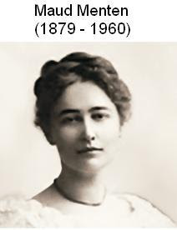
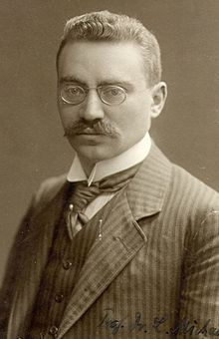
Leonor Michaelis
(1875 –1949)

Slide 29
Data analysis
Michaelis-Menten Kinetics
It would be useful to have a linear plot of the MM equation
Lineweaver and Burk (1934) proposed the following: take the reciprocal of both sides and rearrange.
Collect data at a fixed [E]₀.

Slide 30
Michaelis-Menten Kinetics
the y (1/v) intercept (1/[S] = 0) is 1/v_{max}
the x (1/[S]) intercept (1/v = 0) is -1/K_{M}
the slope is K_{M}/v_{max}

Slide 31
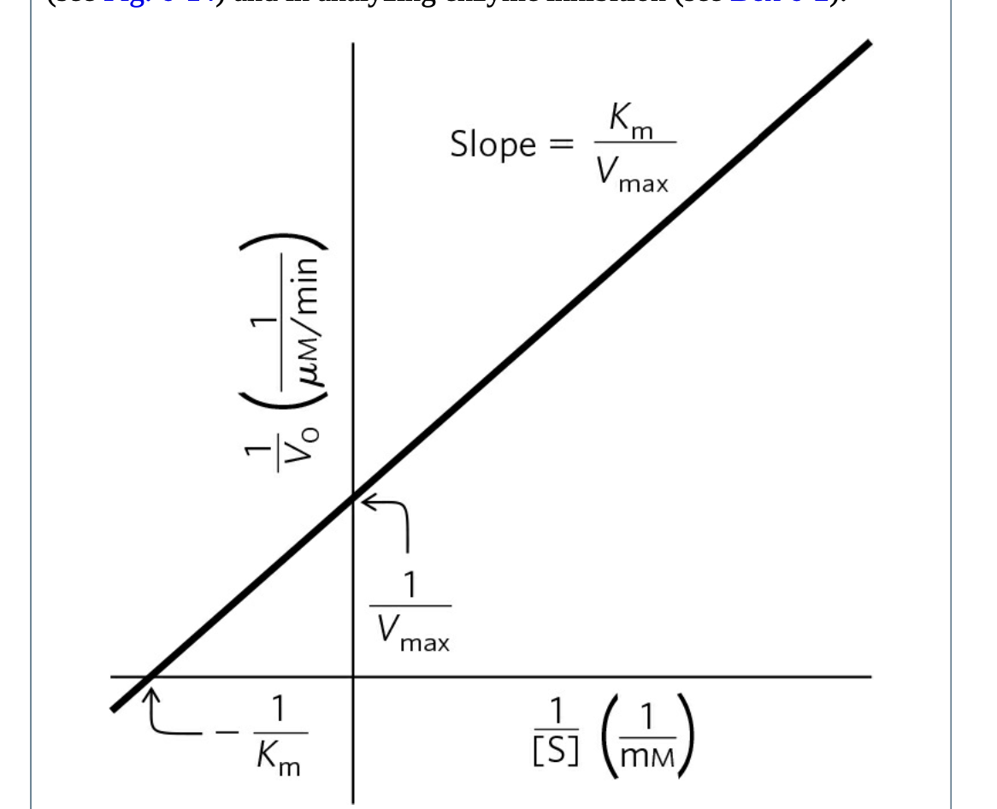
Michaelis-Menten Kinetics
Lineweaver-Burk-Plot
the y (1/v) intercept (1/[S] = 0) is 1/v_{max}
the x (1/[S]) intercept (1/v = 0) is -1/K_{M}
the slope is K_{M}/v_{max}

Slide 32
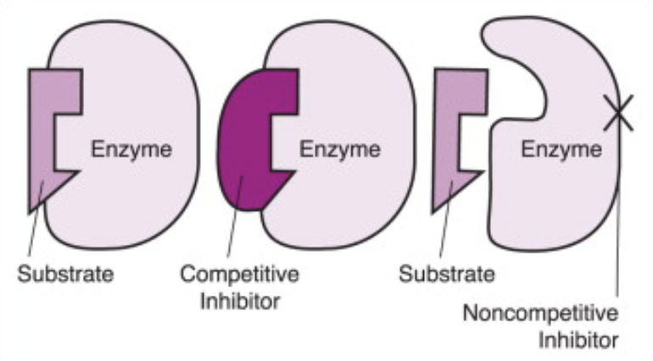
Enzyme Inhibition
Competitive inhibition,
The inhibitor binds to the active site and competes with the substrate for binding.
Noncompetitive, Uncompetitive inhibition,
The inhibitor binds to allosteric site.
Non-competitive inhibitors bind to the enzyme or enzyme–substrate complex. Uncompetitive inhibitors bind only to the enzyme–substrate complex.

Slide 33
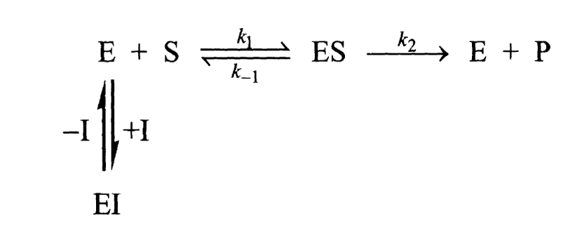
Competitive Inhibition
Page 378

Slide 34
Competitive Inhibition
Page 378

Slide 35
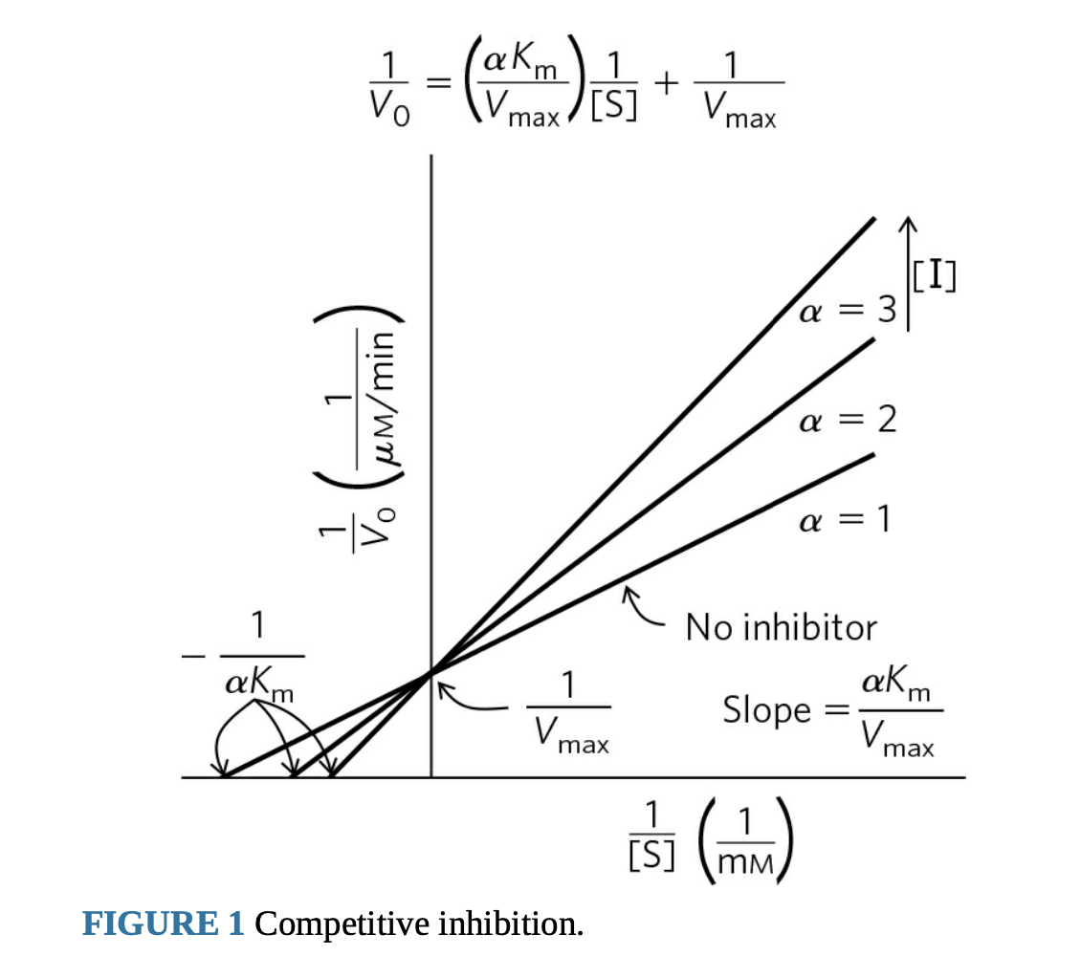
Competitive Inhibition
Page 378

Slide 36
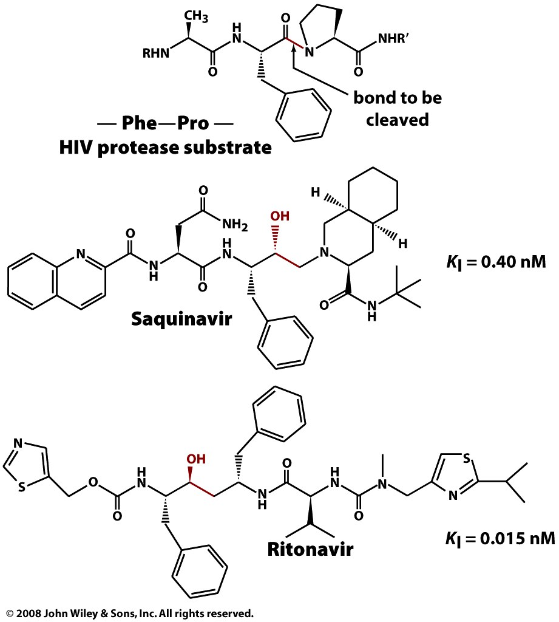
Competitive Inhibition
Box 12-4c

Slide 37
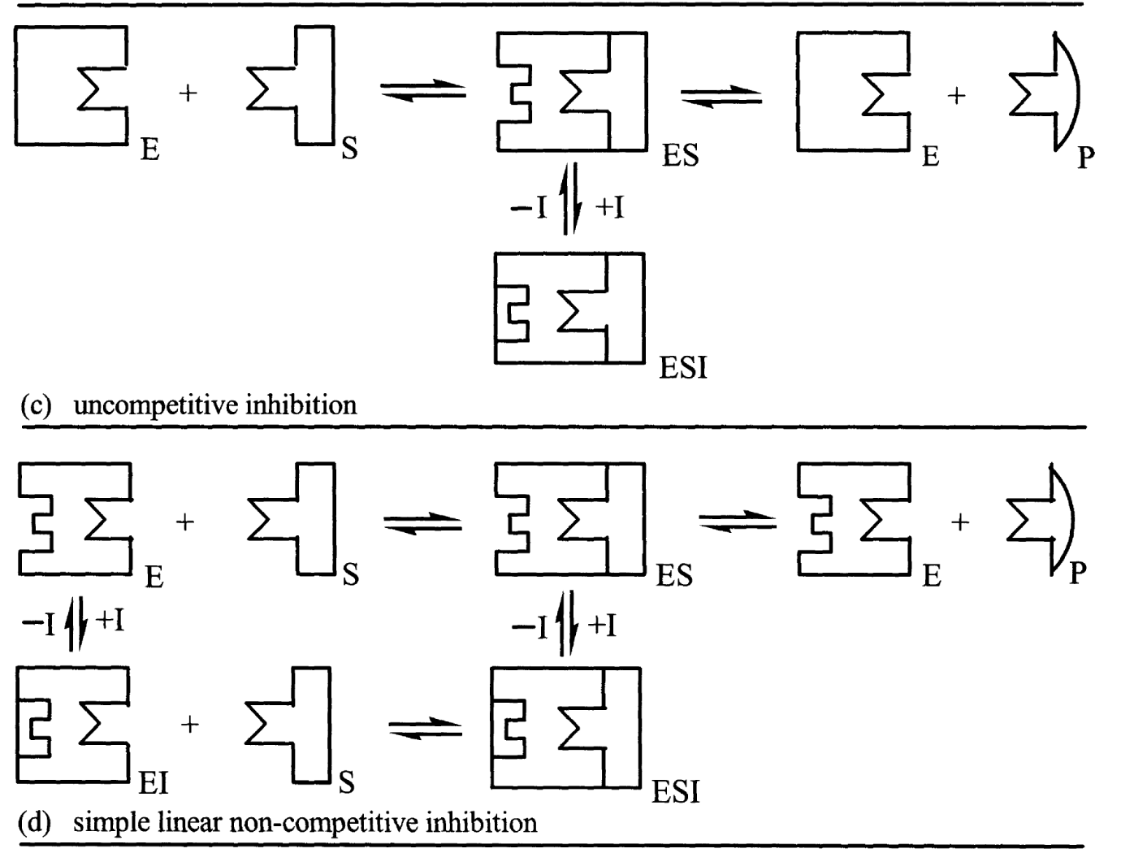

Slide 38
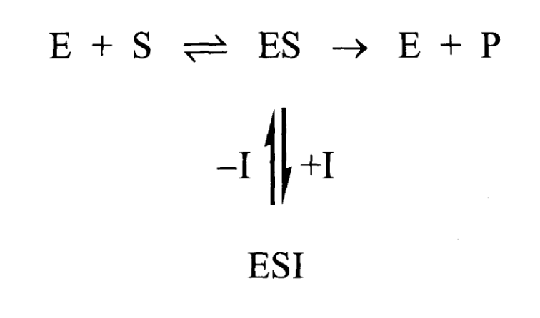
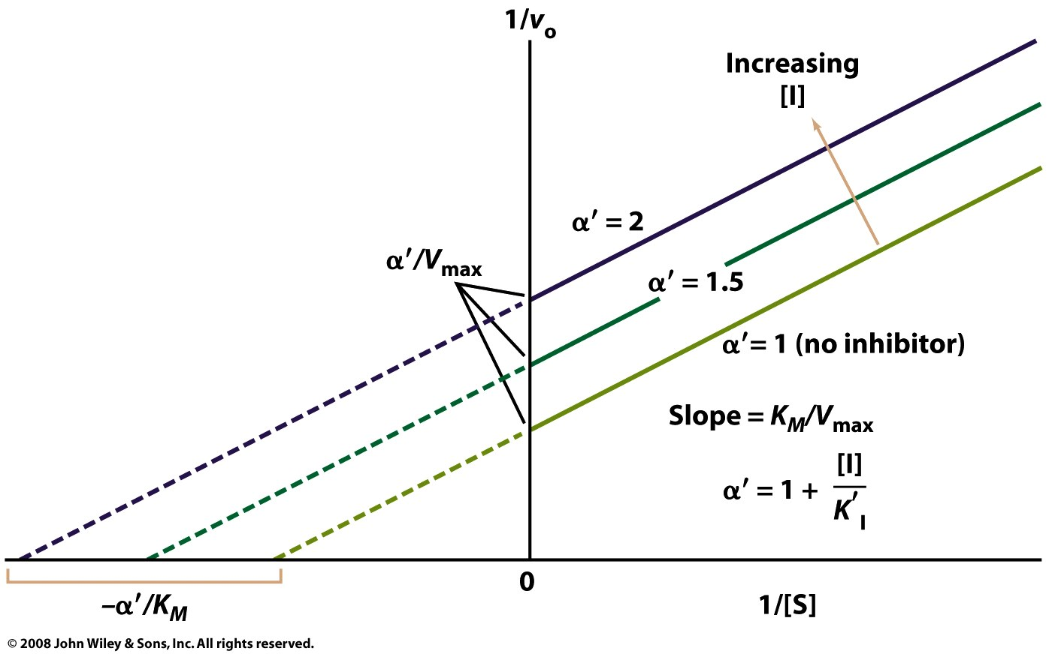
Uncompetitive Inhibition

Slide 39
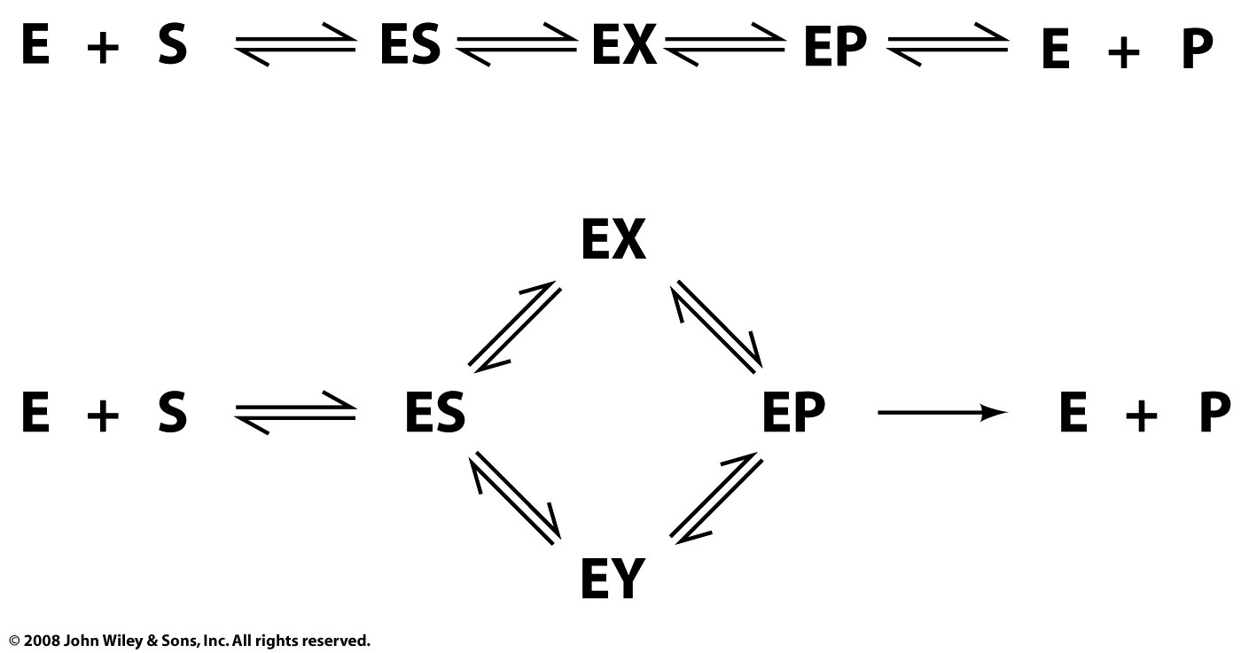
Real enzyme mechanisms
Page 374

Slide 40
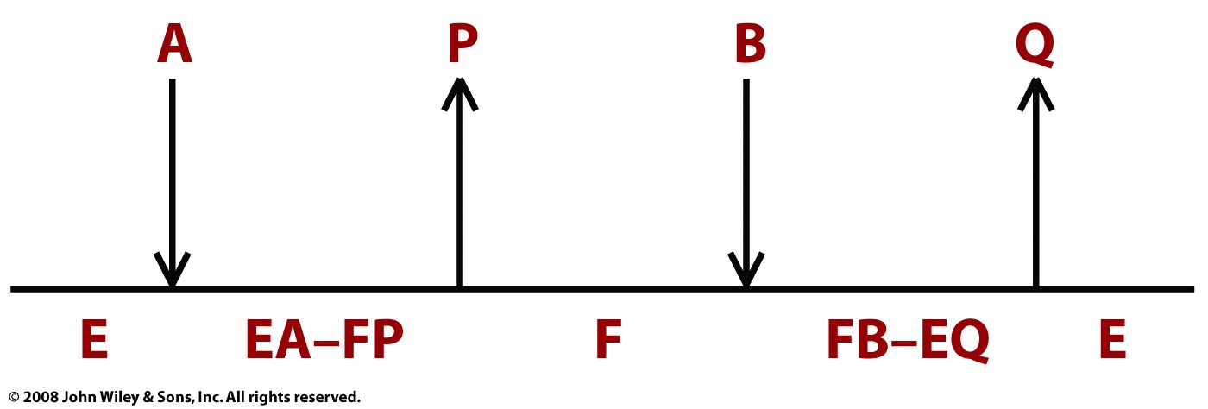
Bisubstrate Ping Pong:
Trypsin:
A = polypeptide
B = water
P = amino terminus
Q = carboxy terminus
Page 376

Slide 41
Other possibilities
Page 376

Slide 42
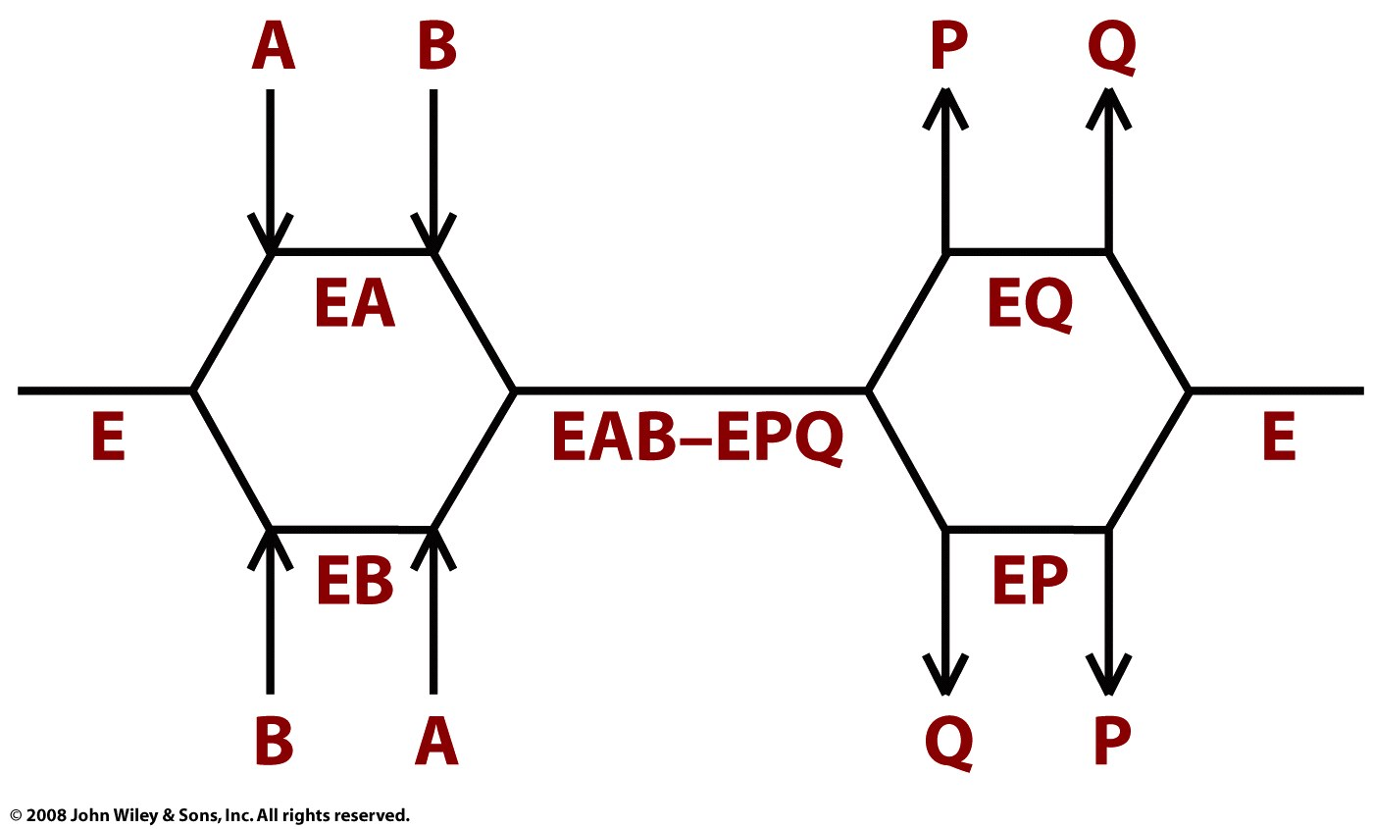
Page 376

